Slide 1
Lecture 12.
Searching Algorithms and its analysis

Slide 2



Recap
Let T(n) be a monotonically increasing function that satisfies
T(n) = a T(n/b) + f(n)
T(1) = c
where a ≥ 1, b ≥ 2, c>0. If f(n) is Θ(n^{d}) where d ≥ 0 then
 |  | if a < b^{d}
T(n) = |  | If a = b^{d}
 |  | if a > b^{d}

Slide 3
Searching Algorithms
Necessary components to search a list of data
  Array containing the list
  Length of the list
  Item for which you are searching
After search completed
  If item found, report “success,” return location in array
  If item not found, report “not found” or “failure”

Slide 4

Searching Algorithms (Cont !!!)
Suppose that you want to determine whether 27 is in the list
First compare 27 with list[0]; that is, compare 27 with 35
Because list[0] ≠ 27, you then compare 27 with list[1]
Because list[1] ≠ 27, you compare 27 with the next element in the list
Because list[2] = 27, the search stops
This search is successful!

Slide 5
Searching Algorithms (Cont’d)
Let’s now search for 10
The search starts at the first element in the list;
that is, at list[0]
Proceeding as before, we see that this time the
search item, which is 10, is compared with every
item in the list
Eventually, no more data is left in the list to
compare with the search item; this is an unsuccessful search

Slide 6
Linear Search Algorithm
public static int linSearch(int[] list, int listLength, int key) {
int loc;
boolean found = false;
for(int loc = 0; loc < listLength; loc++) {
if(list[loc] == key) {
found = true;
break;
}
}
if(found)
return loc;
else
return -1;
}

Slide 7
Linear Search Algorithm (Cont !!!)
public static int linSearch(int[] list, int listLength, int key) {
int loc;
for(int loc = 0; loc < listLength; loc++) {
if(list[loc] == key)
return loc;
}
return -1;
}

Slide 8
Linear Search Algorithm (Cont !!!)
Using a while (or a for) loop, the definition of the method seqSearch
can also be written without the break statement as:
public static int linSearch(int[] list, int listLength, int key) {
int loc = 0;
boolean found = false;
while(loc < listLength && !found) {
if(list[loc] == key)
found = true;
else
loc++ }
if(found)
return loc;
else
return -1;
}

Slide 9
Performance of the Linear Search
Suppose that the first element in the array list contains the variable key,
then we have performed one comparison to find the key.
Suppose that the second element in the array list contains the variable key,
then we have performed two comparisons to find the key.
Carry on the same analysis till the key is contained in the last element of the
array list. In this case, we have performed N comparisons (N is the size of the
array list) to find the key.
Finally if the key is NOT in the array list, then we would have performed N comparisons and the key is NOT found and we would return -1.

Slide 10
Performance of the Linear Search (Cont’d)
Therefore, the best case is: 1
And, the worst case is: N
The average case is:
Worst case and key found at the end of
the array list!
Best case
1 + 2 + 3 + …..+ N + N
Average Number of
Comparisons
=
N+1
Worst case and key is NOT found!
Number of possible cases

Slide 11
Binary Search Algorithm
Can only be performed on a sorted list !!!
Uses divide and conquer technique to search list

Slide 12
Binary Search Algorithm (Cont’d)
Search item is compared with middle element of list
If search item < middle element of list, search is restricted to first
half of the list
If search item > middle element of list, search second half of the list
If search item = middle element, search is complete

Slide 13

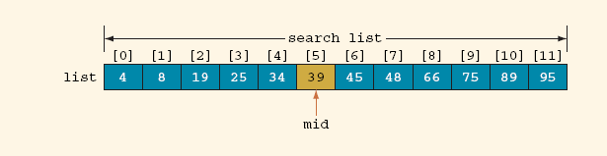
Binary Search Algorithm (Cont !!!)
Determine whether 75 is in the list

Slide 14
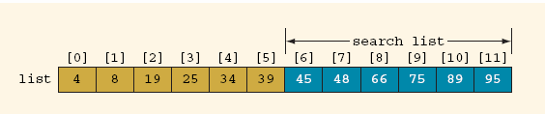
Binary Search Algorithm (Cont !!!)

Slide 15
Binary Search Algorithm (Cont’d)
public static int binarySearch(int[] list, int listLength, int key) {
int first = 0, last = listLength - 1;
int mid;
boolean found = false;
while (first <= last && !found) {
mid = (first + last) / 2;
if (list[mid] == key)
found = true;
else
if(list[mid] > key)
last = mid - 1;
else
first = mid + 1; }
if (found)
return mid;
else
return –1;
} //end binarySearch

Slide 16

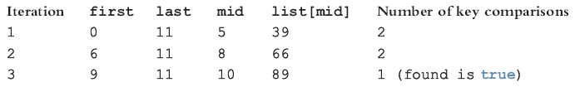
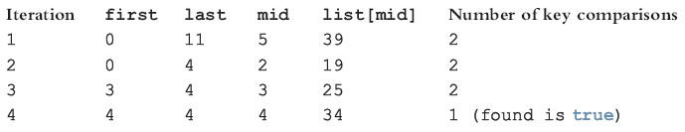
Binary Search Algorithm (Cont !!!)
key = 89
key = 34

Slide 17

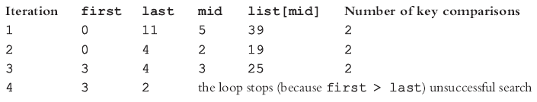
Binary Search Algorithm (Cont’d)
key = 22

Slide 18

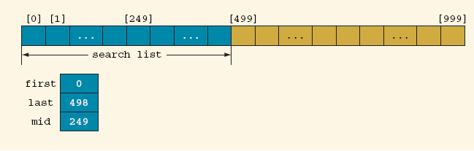
Performance of Binary Search Algorithm
key ≠ List[499]
key < List[499]

Slide 19
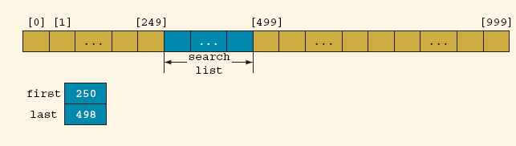
Performance of Binary Search Algorithm (Cont !!!)
key > List[249]

Slide 20
Performance of Binary Search Algorithm (Cont !!!)
Suppose that L is a list of size 1000000
Since 1000000 ≈ 1048576 = 220, it follows that the while
loop in binary search will have at most 21 iterations to
determine whether an element is in L
Every iteration of the while loop makes two key
(that is, item) comparisons

Slide 21
Performance of Binary Search Algorithm (Cont !!!)
To determine whether an element is in L, binary search makes at most 42 item comparisons
  On the other hand, on average, a linear search will make 500,000 key (item) comparisons to determine whether an element is in L
In general, if L is a sorted list of size N, to determine whether an element is in L, the binary search makes at most 2log2N + 2 key (item) comparisons

Slide 22
Summary
In Linear searching, you have to scan an array from first location to Nth location till your required element found. You have three cases
  Required element is at first location (Best Case)
  Required element is at Last location (Worst Case)
  Required element is at other than first and last location (Best Case)
For binary search you will have sorted array and apply divide and conquer approach to find the location of required element
For sorting you can use any one of following teachnique
  Bubble
  Selection
  insertion

Slide 23
In Next Lecturer
In next lecture, we will discuss about sorting techniques.

