Slide 1
Lecture 13.
Sorting Types and insertion sort

Slide 2
Recap
In Linear searching, you have to scan an array from first location to Nth location till your required element found. You have three cases
  Required element is at first location (Best Case)
  Required element is at Last location (Worst Case)
  Required element is at other than first and last location (Best Case)
For binary search you will have sorted array and apply divide and conquer approach to find the location of required element
For sorting you can use any one of following teachnique
  Bubble
  Selection
  insertion

Slide 3
The Sorting Problem
Input:
  A sequence of n numbers a₁, a₂, . . . , a_{n}
Output:
  A permutation (reordering) a₁’, a₂’, . . . , a_{n}’ of the input sequence such that a₁’ ≤ a₂’ ≤ · · · ≤ a_{n}’

Slide 4
Examples
Sorting Books in Library (Dewey system)
Sorting Individuals by Height (Feet and Inches)
Sorting Movies in Blockbuster (Alphabetical)
Sorting Numbers (Sequential)

Slide 5
Why Study Sorting Algorithms?
There are a variety of situations that we can encounter
  Do we have randomly ordered keys?
  Are all keys distinct?
  How large is the set of keys to be ordered?
  Need guaranteed performance?
Various algorithms are better suited to some of these situations

Slide 6
Types of Sorting Algorithms
There are many, many different types of sorting algorithms, but the primary ones are:
Bubble Sort
Selection Sort
Insertion Sort
Merge Sort
Shell Sort
Heap Sort
Quick Sort
Radix Sort
Swap Sort

Slide 7
Some Definitions
Internal Sort
  The data to be sorted is all stored in the computer’s main memory.
External Sort
  Some of the data to be sorted might be stored in some external, slower, device.
In Place Sort
  The amount of extra space required to sort the data is constant with the input size.

Slide 8
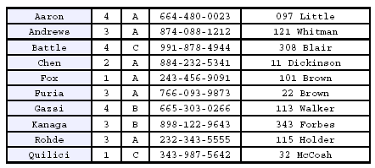
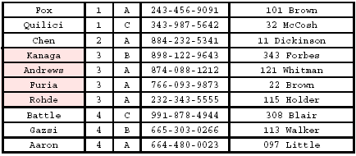
Stability
A STABLE sort preserves relative order of records with equal keys
Sorted on first key:
Sort file on second key:
Records with key value 3 are not in order on first key!!

Slide 9
Stable sort algorithms
Ann
98
Ann
98
A stable sort keeps equal elements in the same order
This may matter when you are sorting data according to some characteristic
Example: sorting students by test scores
Bob
90
Joe
98
Dan
75
Bob
90
Joe
98
Sam
90
Pat
86
Pat
86
Sam
90
Zöe
86
Zöe
86
Dan
75
original array
stably sorted

Slide 10
Unstable sort algorithms
An unstable sort may or may not keep equal elements in the same order
Stability is usually not important, but sometimes it is important
Ann
98
Joe
98
Bob
90
Ann
98
Dan
75
Bob
90
Joe
98
Sam
90
Pat
86
Zöe
86
Sam
90
Pat
86
Zöe
86
Dan
75
original array
unstably sorted

Slide 11
Time Efficiency Improvements
Possibilities (some better than others!)
Move code out of loops that does not belong there
(just good programming!)
Remove any unnecessary I/O operations (I/O operations
are expensive time-wise)
Code so that the compiled code is more efficient
Moral - Choose the most appropriate algorithm(s) BEFORE
program implementation

Slide 12
Insertion Sort
Idea: like sorting a hand of playing cards
  Start with an empty left hand and the cards facing down on the table.
  Remove one card at a time from the table, and insert it into the correct position in the left hand
    compare it with each of the cards already in the hand, from right to left
  The cards held in the left hand are sorted
    these cards were originally the top cards of the pile on the table

Slide 13
Insertion Sort
To insert 12, we need to make room for it by moving first 36 and then 24.
6
10
24
36
12

Slide 14
Insertion Sort
6
10
24
36
12

Slide 15
Insertion Sort
6
10
24
36
12

Slide 16

Insertion Sort
input array
5 2 4 6 1 3
at each iteration, the array is divided in two sub-arrays:
left sub-array
right sub-array
sorted
unsorted

Slide 17





Insertion Sort

Slide 18
INSERTION-SORT
Alg.: INSERTION-SORT(A)
for j ← 2 to n
do key ← A[ j ]
Insert A[ j ] into the sorted sequence A[1 . . j -1]
i ← j - 1
while i > 0 and A[i] > key
do A[i + 1] ← A[i]
i ← i – 1
A[i + 1] ← key
Insertion sort – sorts the elements in place
1
2
3
4
5
6
7
8
a₁
a₂
a₃
a₄
a₅
a₆
a₇
a₈
key

Slide 19
Loop Invariant for Insertion Sort
Alg.: INSERTION-SORT(A)
for j ← 2 to n
do key ← A[ j ]
Insert A[ j ] into the sorted sequence A[1 . . j -1]
i ← j - 1
while i > 0 and A[i] > key
do A[i + 1] ← A[i]
i ← i – 1
A[i + 1] ← key
Note: invariant of a loop is a property that holds before each repetition.
Invariant: at the start of the for loop the elements in A[1 . . j-1] are in sorted order

Slide 20
Proving Loop Invariants
Proving loop invariants works like induction
Initialization (base case):
  It is true prior to the first iteration of the loop
Maintenance (inductive step):
  If it is true before an iteration of the loop, it remains true before the next iteration
Termination:
  When the loop terminates, the invariant gives us a useful property that helps show that the algorithm is correct
  Stop the induction when the loop terminates

Slide 21
Loop Invariant for Insertion Sort
Initialization:
  Just before the first iteration, j = 2:
  the subarray A[1 . . j-1] = A[1], (the element originally in A[1]) – is sorted

Slide 22
Loop Invariant for Insertion Sort
Maintenance:
  the while inner loop moves A[j -1], A[j -2], A[j -3], and so on, by one position to the right until the proper position for key (which has the value that started out in A[j]) is found
  At that point, the value of key is placed into this position.

Slide 23

Loop Invariant for Insertion Sort
Termination:
  The outer for loop ends when j = n + 1 ⇒ j-1 = n
  Replace n with j-1 in the loop invariant:
    the subarray A[1 . . n] consists of the elements originally in A[1 . . n], but in sorted order
The entire array is sorted!
j - 1
j
Invariant: at the start of the for loop the elements in A[1 . . j-1] are in sorted order

Slide 24


Analysis of Insertion Sort
cost times
c₁ n
c₂ n-1
0 n-1
c₄ n-1
c₅
c₆
c₇
c₈ n-1
INSERTION-SORT(A)
for j ← 2 to n
do key ← A[ j ]
Insert A[ j ] into the sorted sequence A[1 . . j -1]
i ← j - 1
while i > 0 and A[i] > key
do A[i + 1] ← A[i]
i ← i – 1
A[i + 1] ← key
t_{j}: # of times the while statement is executed at iteration j
Notes:
₇

Slide 25
Best Case Analysis
The array is already sorted
  A[i] ≤ key upon the first time the while loop test is run (when i = j -1)
  t_{j} = 1
T(n) = c₁n + c₂(n -1) + c₄(n -1) + c₅(n -1) + c₈(n-1) = (c₁ + c₂ + c₄ + c₅ + c₈)n + (c₂ + c₄ + c₅ + c₈)
= an + b = Θ(n)
“while i > 0 and A[i] > key”

Slide 26
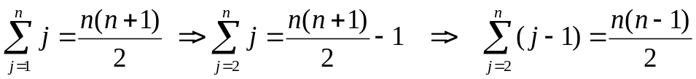

Worst Case Analysis
The array is in reverse sorted order
  Always A[i] > key in while loop test
  Have to compare key with all elements to the left of the j-th position ⇒ compare with j-1 elements ⇒ t_{j} = j
  a quadratic function of n
T(n) = Θ(n²) order of growth in n²
“while i > 0 and A[i] > key”
using
we have:

Slide 27
Insertion Sort - Summary
Advantages
  Good running time for “almost sorted” arrays Θ(n)
Disadvantages
  Θ(n²) running time in worst and average case
  ≈ n²/2 comparisons and exchanges

Slide 28
Summary
If sorting algorithm using main memory only , it is called internal sorting technique.
If sorting algorithm using main memory as well virtual memory , it is called external sorting technique.
If sorting technique using either main or virtual and its demand for extra space remain constant i.e. demand for space not change with increase or decrease in input size.
There are several sorting techniques such as insertion, bubble, selection and quick sort etc.

Slide 29
In Next Lecturer
In next lecture, we will discuss about bubble and selection sorting techniques and its analysis

