Slide 1
Lecture 15.
Analysis of Quick and Merge Sort

Slide 2
Recap
In bubble sort, N-1 Phases and N-Phase_No comparisions are performed to order data either in ascending or descending order.
Flag (Boolean variable can be used to reduce or trim the unwanted comparisons.
In Selection sort, for each phase you will take a min number and then perform comparison to check or find other smallest value.

Slide 3
Divide-and-Conquer
Divide the problem into a number of sub-problems
  Similar sub-problems of smaller size
Conquer the sub-problems
  Solve the sub-problems recursively
  Sub-problem size small enough ⇒ solve the problems in straightforward manner
Combine the solutions of the sub-problems
  Obtain the solution for the original problem

Slide 4
Merge Sort Approach
To sort an array A[p . . r]:
Divide
  Divide the n-element sequence to be sorted into two subsequences of n/2 elements each
Conquer
  Sort the subsequences recursively using merge sort
  When the size of the sequences is 1 there is nothing more to do
Combine
  Merge the two sorted subsequences

Slide 5
Merge Sort
p
q
r
1
2
3
4
5
6
7
8
Alg.: MERGE-SORT(A, p, r)
if p < r Check for base case
then q ← ⎣(p + r)/2⎦ Divide
MERGE-SORT(A, p, q) Conquer
MERGE-SORT(A, q + 1, r) Conquer
MERGE(A, p, q, r) Combine
Initial call: MERGE-SORT(A, 1, n)
5
2
4
7
1
3
2
6

Slide 6
Example – n Power of 2
Divide
1
2
3
4
5
6
7
8
5
2
4
7
1
3
2
6
q = 4
1
2
3
4
5
6
7
8
5
2
4
7
1
3
2
6
1
2
3
4
5
6
7
8
5
2
4
7
1
3
2
6
1
2
3
4
5
6
7
8
5
2
4
7
1
3
2
6

Slide 7
Example – n Power of 2
Conquer
and
Merge
1
2
3
4
5
6
7
8
1
2
2
3
4
5
6
7
1
2
3
4
5
6
7
8
2
4
5
7
1
2
3
6
1
2
3
4
5
6
7
8
2
5
4
7
1
3
2
6
1
2
3
4
5
6
7
8
5
2
4
7
1
3
2
6

Slide 8
Example – n Not a Power of 2
Divide
1
2
3
4
5
6
7
8
9
10
11
4
7
2
6
1
4
7
3
5
2
6
q = 6
1
2
3
4
5
6
7
8
9
10
11
q = 3
4
7
2
6
1
4
7
3
5
2
6
q = 9
1
2
3
4
5
6
7
8
9
10
11
4
7
2
6
1
4
7
3
5
2
6
1
2
3
4
5
6
7
8
9
10
11
4
7
2
6
1
4
7
3
5
2
6
1
2
4
5
7
8
4
7
6
1
7
3

Slide 9
Example – n Not a Power of 2
1
2
3
4
5
6
7
8
9
10
11
Conquer
and
Merge
1
2
2
3
4
4
5
6
6
7
7
1
2
3
4
5
6
7
8
9
10
11
1
2
4
4
6
7
2
3
5
6
7
1
2
3
4
5
6
7
8
9
10
11
2
4
7
1
4
6
3
5
7
2
6
1
2
3
4
5
6
7
8
9
10
11
4
7
2
1
6
4
3
7
5
2
6
1
2
4
5
7
8
4
7
6
1
7
3

Slide 10
Merging
p
q
r
1
2
3
4
5
6
7
8
2
4
5
7
1
2
3
6
Input: Array A and indices p, q, r such that p ≤ q < r
  Subarrays A[p . . q] and A[q + 1 . . r] are sorted
Output: One single sorted subarray A[p . . r]

Slide 11
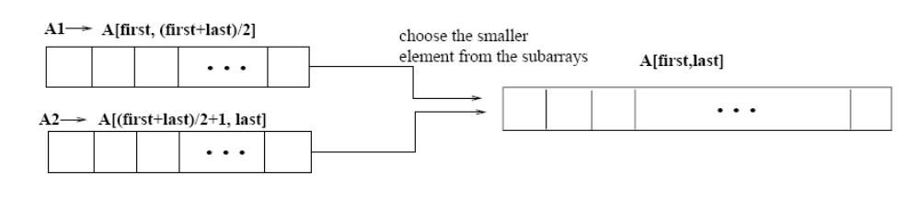
Merging
Idea for merging:
  Two piles of sorted cards
    Choose the smaller of the two top cards
    Remove it and place it in the output pile
  Repeat the process until one pile is empty
  Take the remaining input pile and place it face-down onto the output pile
p
q
r
1
2
3
4
5
6
7
8
2
4
5
7
1
2
3
6
A1← A[p, q]
A[p, r]
A2← A[q+1, r]

Slide 12
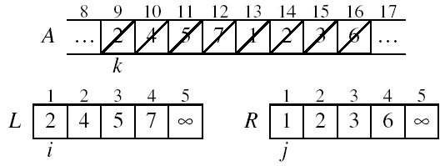
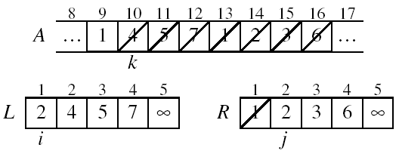
Example: MERGE(A, 9, 12, 16)
p
q
r

Slide 13
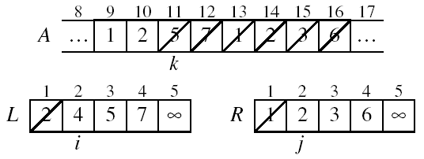
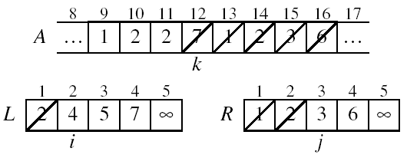
Example: MERGE(A, 9, 12, 16)

Slide 14
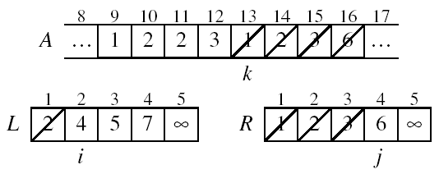
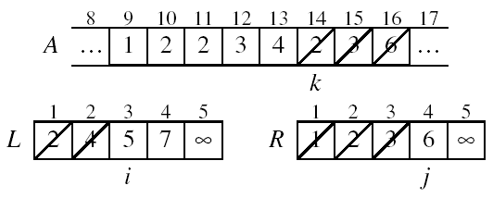
Example (Cont !!!)

Slide 15
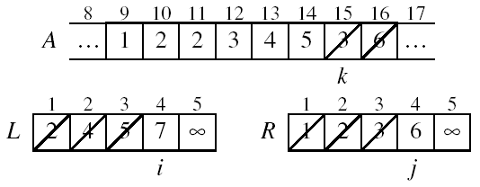
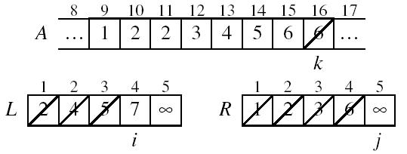
Example (Cont !!!)

Slide 16
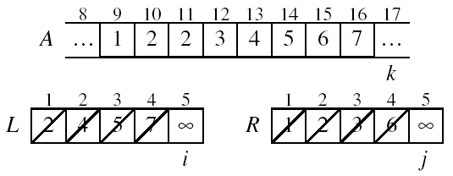
Example (Cont !!!)
Done!

Slide 17
Merge - Pseudo code
Alg.: MERGE(A, p, q, r)
Compute n₁ and n₂
Copy the first n₁ elements into L[1 . . n₁ + 1]
and the next n₂ elements into R[1 . . n₂ + 1]
L[n₁ + 1] ← ∞; R[n₂ + 1] ← ∞
i ← 1; j ← 1
for k ← p to r
do if L[ i ] ≤ R[ j ]
then A[k] ← L[ i ]
i ←i + 1
else A[k] ← R[ j ]
j ← j + 1
p
q
r
1
2
3
4
5
6
7
8
2
4
5
7
1
2
3
6
n₁
n₂
p
q
L
2
4
5
7
∞
q + 1
r
R
1
2
3
6
∞

Slide 18
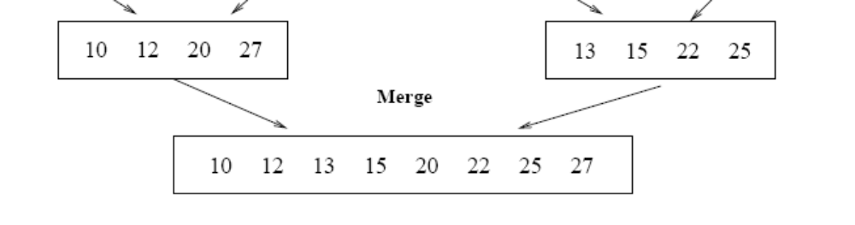
Running Time of Merge
Initialization (copying into temporary arrays):
  Θ(n₁ + n₂) = Θ(n)
Adding the elements to the final array:
  - n iterations, each taking constant time ⇒ Θ(n)
Total time for Merge:
  Θ(n)

Slide 19
Analyzing Divide-and Conquer Algorithms
The recurrence is based on the three steps of the paradigm:
  T(n) – running time on a problem of size n
  Divide the problem into a subproblems, each of size n/b: takes D(n)
  Conquer (solve) the subproblems aT(n/b)
  Combine the solutions C(n)
Θ(1) if n ≤ c
T(n) = aT(n/b) + D(n) + C(n) otherwise

Slide 20
MERGE-SORT Running Time
Divide:
  compute q as the average of p and r: D(n) = Θ(1)
Conquer:
  recursively solve 2 subproblems, each of size n/2 ⇒ 2T (n/2)
Combine:
  MERGE on an n-element subarray takes Θ(n) time ⇒ C(n) = Θ(n)
Θ(1) if n =1
T(n) = 2T(n/2) + Θ(n) if n > 1

Slide 21
Solve the Recurrence
T(n) = c if n = 1
2T(n/2) + cn if n > 1
Use Master’s Theorem:
Compare n with f(n) = cn
Case 2: T(n) = Θ(nlgn)

Slide 22
Merge Sort - Discussion
Running time insensitive of the input
Advantages:
  Guaranteed to run in Θ(nlgn)
Disadvantage
  Requires extra space ≈N

Slide 23
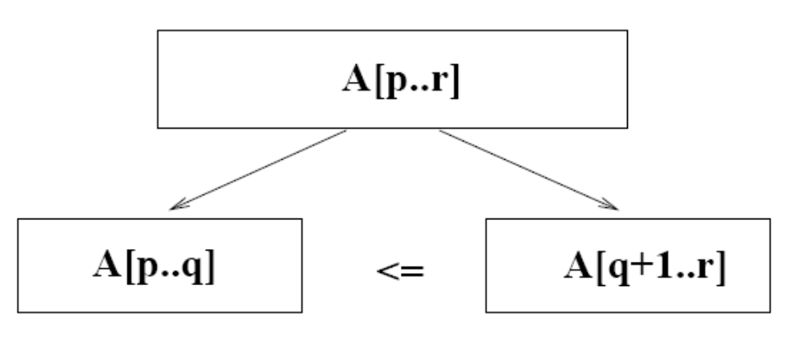
Quick sort
A[p…q]
A[q+1…r]
Sort an array A[p…r]
Divide
  Partition the array A into 2 subarrays A[p..q] and A[q+1..r], such that each element of A[p..q] is smaller than or equal to each element in A[q+1..r]
  Need to find index q to partition the array
≤

Slide 24
Quick sort
Conquer
  Recursively sort A[p..q] and A[q+1..r] using Quicksort
Combine
  Trivial: the arrays are sorted in place
  No additional work is required to combine them
  The entire array is now sorted
A[p…q]
A[q+1…r]
≤

Slide 25
QUICKSORT
Alg.: QUICKSORT(A, p, r)
if p < r
then q ← PARTITION(A, p, r)
QUICKSORT (A, p, q)
QUICKSORT (A, q+1, r)
Initially: p=1, r=n
PARTITION())
Recurrence:
T(n) = T(q) + T(n – q) + f(n)

Slide 26
Partitioning the Array
Choosing PARTITION()
  There are different ways to do this
  Each has its own advantages/disadvantages
Hoare partition
  Select a pivot element x around which to partition
  Grows two regions
A[p…i] ≤ x
x ≤ A[j…r]
A[p…i] ≤ x
x ≤ A[j…r]
i
j

Slide 27
Example
pivot x=5
A[p…r]
5
3
2
6
4
1
3
7
5
3
2
6
4
1
3
7
i
j
i
j
3
3
2
6
4
1
5
7
3
3
2
6
4
1
5
7
i
j
i
j
A[p…q]
A[q+1…r]
3
3
2
5
4
1
6
7
3
3
2
1
4
5
6
7
i
j
j
i

Slide 28
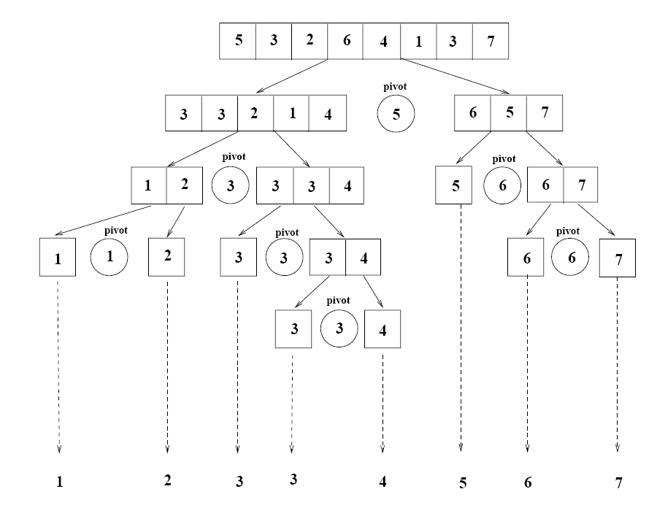
Example

Slide 29
Partitioning the Array
Alg. PARTITION (A, p, r)
x ← A[p]
i ← p – 1
j ← r + 1
while TRUE
do repeat j ← j – 1
until A[j] ≤ x
do repeat i ← i + 1
until A[i] ≥ x
if i < j
then exchange A[i] ↔ A[j]
else return j
A:
p
r
5
3
2
6
4
1
3
7
i
j
A[p…q]
≤
A[q+1…r]
A:
a_{p}
a_{r}
j=q
i
Each element is
visited once!
Running time: Θ(n)
n = r – p + 1

Slide 30
Recurrence
Initially: p=1, r=n
Alg.: QUICKSORT(A, p, r)
if p < r
then q ← PARTITION(A, p, r)
QUICKSORT (A, p, q)
QUICKSORT (A, q+1, r)
Recurrence:
T(n) = T(q) + T(n – q) + n

Slide 31
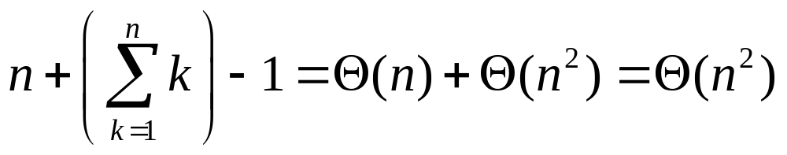
Worst Case Partitioning
Worst-case partitioning
  One region has one element and the other has n – 1 elements
  Maximally unbalanced
Recurrence: q=1
  T(n) = T(1) + T(n – 1) + n,
  T(1) = Θ(1)
  T(n) = T(n – 1) + n
  =
n
n
1
n - 1
n
1
n - 2
n - 1
n
1
n - 3
n - 2
1
2
3
1
1
2
Θ(n²)
When does the worst case happen?

Slide 32
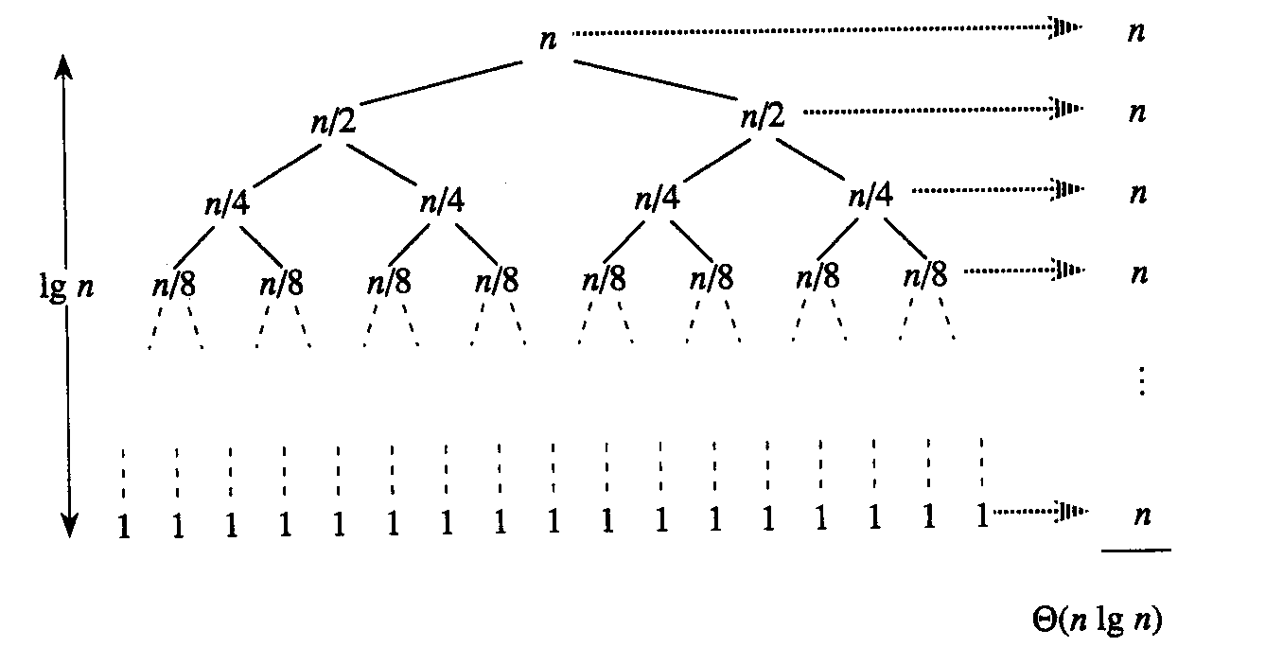
Best Case Partitioning
Best-case partitioning
  Partitioning produces two regions of size n/2
Recurrence: q=n/2
  T(n) = 2T(n/2) + Θ(n)
  T(n) = Θ(nlgn) (Master theorem)

Slide 33
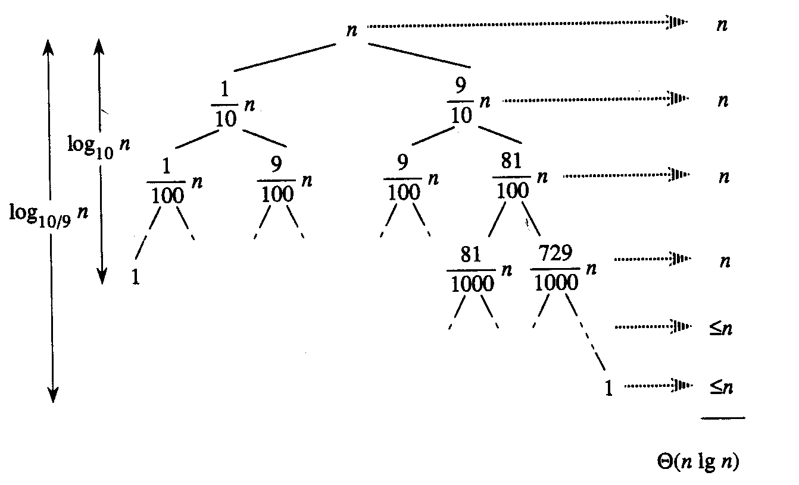
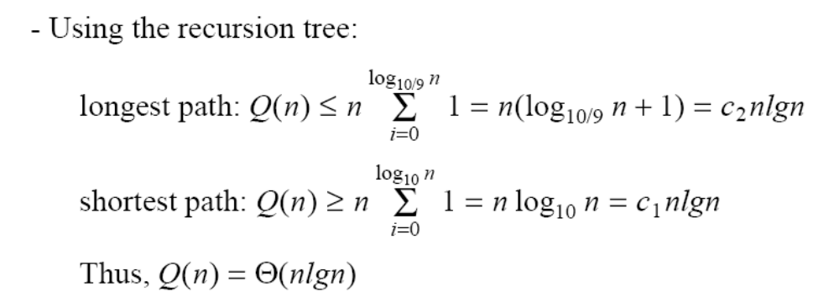
Case Between Worst and Best
9-to-1 proportional split
Q(n) = Q(9n/10) + Q(n/10) + n

Slide 34
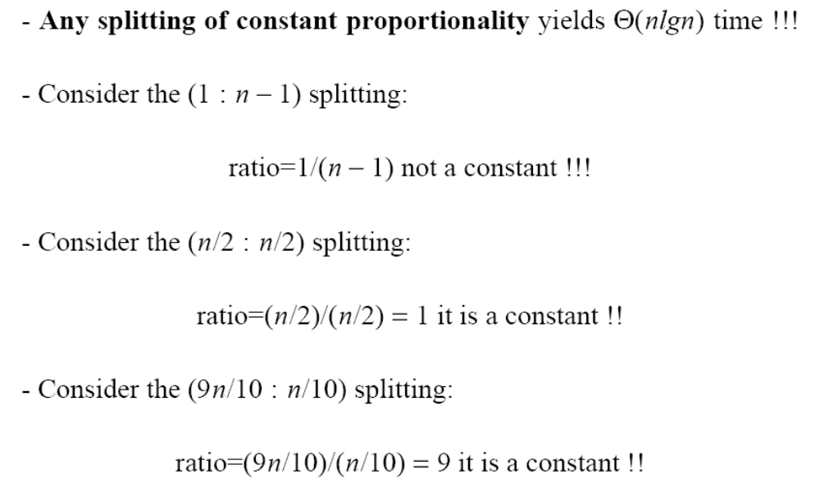
How does partition affect performance?

Slide 35
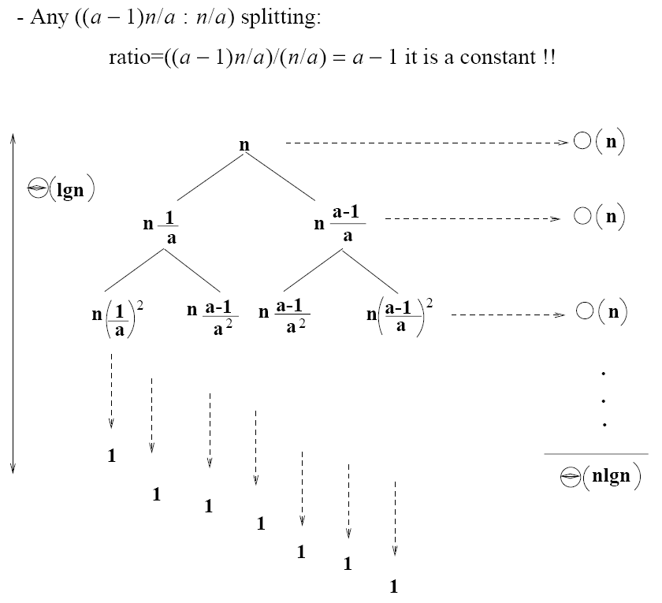
How does partition affect performance?

Slide 36
Performance of Quick sort
Average case
  All permutations of the input numbers are equally likely
  On a random input array, we will have a mix of well balanced and unbalanced splits
  Good and bad splits are randomly distributed across throughout the tree
partitioning cost:
n = Θ(n)
n
combined partitioning cost:
2n-1 = Θ(n)
n
1
n - 1
(n – 1)/2 + 1
(n – 1)/2
(n – 1)/2
(n – 1)/2
Alternate of a good
and a bad split
Nearly well
balanced split
Running time of Quicksort when levels alternate between good and bad splits is O(nlgn)

Slide 37
Summary
Merge and quick sort are both divide and conquer based sorting technique.
  Partitioning of array (Problem divid into sub problems)
  recursive calling for each sub problems.
  Combining result of each sub problem
Merge sort is not in place sort because t need extra space to combine or merge values
In quick sort focus is on pivot element which help to divide the array/problem into sub problems.
Complexity of quick sort vary because it depends on good selection of pivot element.

Slide 38
In Next Lecturer
In next lecture, we will discuss about linear sorting techniques.

