Slide 1
Lecture 16.
Analysis of Linear Sorting techniques

Slide 2
Recap
Merge and quick sort are both divide and conquer based sorting technique.
  Partitioning of array (Problem divided into sub problems)
  recursive calling for each sub problems.
  Combining result of each sub problem
Merge sort is not in place sort because t need extra space to combine or merge values
In quick sort focus is on pivot element which help to divide the array/problem into sub problems.
Complexity of quick sort vary because it depends on good selection of pivot element.

Slide 3
How Fast Can We Sort?
Selection Sort, Bubble Sort, Insertion Sort:
Merge sort:
Quick sort:
What is common to all these algorithms?
  Make comparisons between input elements
  a_{i} < a_{j}, a_{i} ≤ a_{j}, a_{i} = a_{j}, a_{i} ≥ a_{j}, or a_{i} > a_{j}
O(n²)
O(nlgn)
O(nlgn) - average

Slide 4
Can we do better?
Linear sorting algorithms
  Counting Sort
  Radix Sort
  Bucket sort
Make certain assumptions about the data
Linear sorts are NOT “comparison sorts”

Slide 5

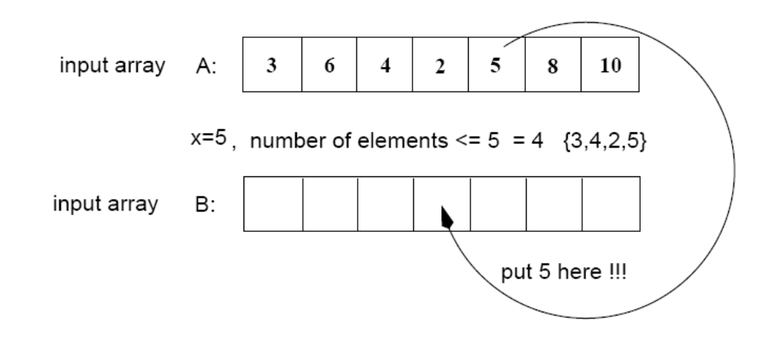
Counting Sort
Assumptions:
  n integers which are in the range [0 ... r]
  r is in the order of n, that is, r=O(n)
Idea:
  For each element x, find the number of elements x
  Place x into its correct position in the output array
output array

Slide 6


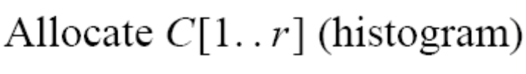




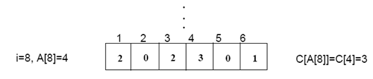
Step 1
(i.e., frequencies)
(r=6)

Slide 7
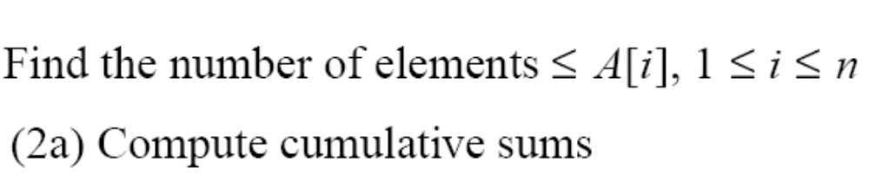
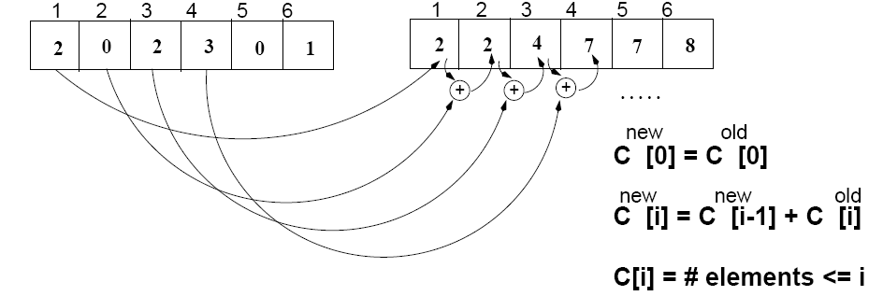
Step 2
C
(frequencies)
C^{new}
(cumulative sums)

Slide 8
Algorithm
Start from the last element of A
Place A[i] at its correct place in the output array
Decrease C[A[i]] by one
1
2
3
4
5
6
7
8
A
2
5
3
0
2
3
0
3
0
1
2
3
4
5
C^{new}
2
2
4
7
7
8

Slide 9
Example
1
2
3
4
5
6
7
8
0
1
2
3
4
5
A
2
5
3
0
2
3
0
3
C^{new}
2
2
4
7
7
8
1
2
3
4
5
6
7
8
1
2
3
4
5
6
7
8
B
3
B
0
3
0
1
2
3
4
5
0
1
2
3
4
5
C^{new}
C^{new}
1
2
4
6
7
8
2
2
4
6
7
8
1
2
3
4
5
6
7
8
1
2
3
4
5
6
7
8
B
0
3
3
B
0
2
3
3
0
1
2
3
4
5
0
1
2
3
4
5
C^{new}
C^{new}
1
2
3
5
7
8
1
2
4
5
7
8

Slide 10
Example (Cont !!!)
1
2
3
4
5
6
7
8
A
2
5
3
0
2
3
0
3
1
2
3
4
5
6
7
8
1
2
3
4
5
6
7
8
B
0
0
2
3
3
B
0
0
2
3
3
3
5
0
1
2
3
4
5
0
1
2
3
4
5
C
0
2
3
5
7
8
C
0
2
3
4
7
7
1
2
3
4
5
6
7
8
1
2
3
4
5
6
7
8
B
0
0
2
3
3
3
B
0
0
2
2
3
3
3
5
0
1
2
3
4
5
C
0
2
3
4
7
8

Slide 11
COUNTING-SORT
  Alg.: COUNTING-SORT(A, B, n, k)
  for i ← 0 to r
  do C[ i ] ← 0
  for j ← 1 to n
  do C[A[ j ]] ← C[A[ j ]] + 1
  C[i] contains the number of elements equal to i
  for i ← 1 to r
  do C[ i ] ← C[ i ] + C[i -1]
  C[i] contains the number of elements ≤ i
  for j ← n downto 1
  do B[C[A[ j ]]] ← A[ j ]
  C[A[ j ]] ← C[A[ j ]] - 1
1
j
n
A
0
k
C
1
n
B

Slide 12
Analysis of Counting Sort
  Alg.: COUNTING-SORT(A, B, n, k)
  for i ← 0 to r
  do C[ i ] ← 0
  for j ← 1 to n
  do C[A[ j ]] ← C[A[ j ]] + 1
  C[i] contains the number of elements equal to i
  for i ← 1 to r
  do C[ i ] ← C[ i ] + C[i -1]
  C[i] contains the number of elements ≤ i
  for j ← n downto 1
  do B[C[A[ j ]]] ← A[ j ]
  C[A[ j ]] ← C[A[ j ]] - 1
O(r)
O(n)
O(r)
O(n)
Overall time: O(n + r)

Slide 13
Analysis of Counting Sort
Overall time: O(n + r)
In practice we use COUNTING sort when r = O(n)
⇒ running time is O(n)

Slide 14
Radix Sort
Represents keys as d-digit numbers in some base-k
key = x₁x₂...x_{d} where 0≤x_{i}≤k-1
Example: key=15
key₁₀ = 15, d=2, k=10 where 0≤x_{i}≤9
key₂ = 1111, d=4, k=2 where 0≤x_{i}≤1

Slide 15

Radix Sort
Assumptions
  d=O(1) and k =O(n)
Sorting looks at one column at a time
  For a d digit number, sort the least significant digit first
  Continue sorting on the next least significant digit,
    until all digits have been sorted
  Requires only d passes through the list

Slide 16

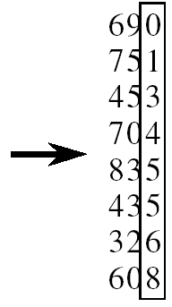
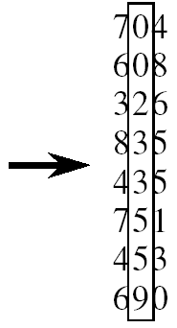
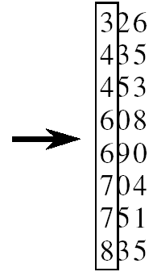
RADIX-SORT
Alg.: RADIX-SORT(A, d)
for i ← 1 to d
do use a stable sort to sort array A on digit i
(stable sort: preserves order of identical elements)

Slide 17
Analysis of Radix Sort
Given n numbers of d digits each, where each digit may take up to k possible values, RADIX-SORT correctly sorts the numbers in O(d(n+k))
  One pass of sorting per digit takes O(n+k) assuming that we use counting sort
  There are d passes (for each digit)

Slide 18
Analysis of Radix Sort
Given n numbers of d digits each, where each digit may take up to k possible values, RADIX-SORT correctly sorts the numbers in O(d(n+k))
  Assuming d=O(1) and k=O(n), running time is O(n)

Slide 19
Bucket Sort
Assumption:
  the input is generated by a random process that distributes elements uniformly over [0, 1)
Idea:
  Divide [0, 1) into k equal-sized buckets (k=Θ(n))
  Distribute the n input values into the buckets
  Sort each bucket (e.g., using quicksort)
  Go through the buckets in order, listing elements in each one
Input: A[1 . . n], where 0 ≤ A[i] < 1 for all i
Output: elements A[i] sorted

Slide 20
Example - Bucket Sort
A
1
.78
.17
.39
.26
.72
.94
.21
.12
.23
.68
B
0
/
2
1
.17
.12 /
3
2
.26
.21
.23 /
4
3
.39 /
5
4
/
Distribute
Into buckets
6
5
/
7
6
.68 /
8
7
.78
.72 /
9
8
/
10
9
.94 /

Slide 21
Example - Bucket Sort
0
/
1
.12
.17 /
2
.21
.23
.26 /
3
.39 /
Sort within each
bucket
4
/
5
/
6
.68 /
7
.72
.78 /
8
/
9
.94 /

Slide 22
Example - Bucket Sort
.12
.17
.21
.23
.26
.39
.68
.72
.78
.94 /
0
/
1
.12
.17 /
2
.21
.23
.26 /
3
.39 /
4
/
5
/
Concatenate the lists from
0 to n – 1 together, in order
6
.68 /
7
.72
.78 /
8
.94 /
9
/

Slide 23
Analysis of Bucket Sort
Alg.: BUCKET-SORT(A, n)
for i ← 1 to n
do insert A[i] into list B[⎣nA[i]⎦]
for i ← 0 to k - 1
do sort list B[i] with quicksort sort
concatenate lists B[0], B[1], . . . , B[n -1] together in order
return the concatenated lists
O(n)
k O(n/k log(n/k))
=O(nlog(n/k)
O(k)
O(n) (if k=Θ(n))

Slide 24
Radix Sort as a Bucket Sort
Radix sort
Is not a comparison sort
Uses a radix-length array of queues of
records
Makes use of the values in digit positions in
the keys to select the queue into which a
record must be enqueued

Slide 25
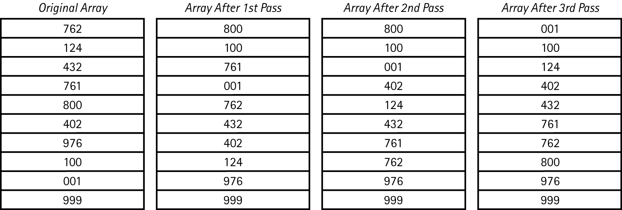
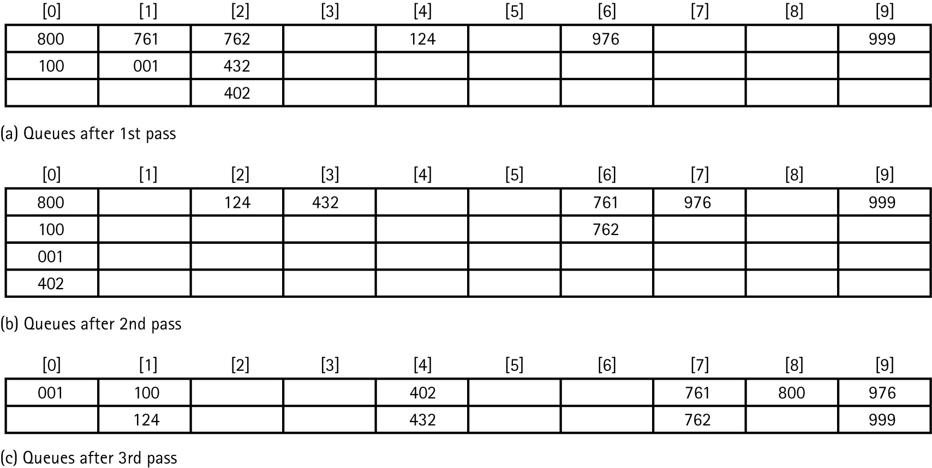
Original Array
Queues After First Pass

Slide 26
Array After First Pass
Queues After Second Pass

Slide 27
Array After Second Pass
Queues After Third Pass

Slide 28
Array After Third Pass

Slide 29
Summary
Counting, radix and bucket sort are linear sorting techniques.
No comparisons are performed as in quick, merge, bubble, insertion and selection sort.
Run time complexity of linear sorting algorithm is O(n).

Slide 30
In Next Lecturer
In next lecture, we will discuss about hashing techniques

