Slide 1
Lecture 17.
Hashing Techniques

Slide 2
Recap
Counting, radix and bucket sort are linear sorting techniques.
No comparisons are performed as in quick, merge, bubble, insertion and selection sort.
Run time complexity of linear sorting algorithm is O(n).

Slide 3
Overview
Hash Table Data Structure : Purpose
  To support insertion, deletion and search in average-case constant time
    Assumption: Order of elements irrelevant
    ==> data structure *not* useful for if you want to maintain and retrieve some kind of an order of the elements
Hash function
  Hash[ “string key”] ==> integer value
Hash table ADT
  Implementations, Analysis, Applications
Notes:
Cpt S 223
Washington State University

Slide 4
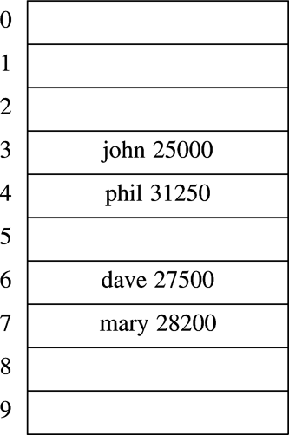
Hash table: Main components
key
value
Hash index
h(“john”)
“john”
TableSize
key
Hash
function
Hash table
(implemented as a vector)
How to determine … ?
Notes:
Cpt S 223
Washington State University

Slide 5
Hash Table
Hash table is an array of fixed size TableSize
Array elements indexed by a key, which is mapped to an array index (0…TableSize-1)
Mapping (hash function) h from key to index
  E.g., h(“john”) = 3
key
Element value
Notes:
Cpt S 223
Washington State University

Slide 6
Hash Table Operations
Hash function
Hash key
Insert
  T [h(“john”)] = <“john”,25000>
Delete
  T [h(“john”)] = NULL
Search
  T [h(“john”)] returns the element hashed for “john”
Data record
What happens if h(“john”) == h(“joe”) ?
  “collision”
Notes:
Cpt S 223
Washington State University

Slide 7
Factors affecting Hash Table Design
Hash function
Table size
  Usually fixed at the start
Collision handling scheme
Notes:
Cpt S 223
Washington State University

Slide 8
Hash Function
A hash function is one which maps an element’s key into a valid hash table index
  h(key) => hash table index
  Note that this is (slightly) different from saying: h(string) => int
  Because the key can be of any type
    E.g., “h(int) => int” is also a hash function!
  But also note that any type can be converted into an equivalent string form

Slide 9
h(key) ==> hash table index
Hash Function Properties
A hash function maps key to integer
  Constraint: Integer should be between
  [0, TableSize-1]
A hash function can result in a many-to-one mapping (causing collision)
  Collision occurs when hash function maps two or more keys to same array index
Collisions cannot be avoided but its chances can be reduced using a “good” hash function
Notes:
Cpt S 223
Washington State University

Slide 10
h(key) ==> hash table index
Hash Function Properties
A “good” hash function should have the properties:
  Reduced chance of collision
    Different keys should ideally map to different indices
    Distribute keys uniformly over table
  Should be fast to compute
Notes:
Cpt S 223
Washington State University

Slide 11
Hash Function - Effective use of table size
Simple hash function (assume integer keys)
  h(Key) = Key mod TableSize
For random keys, h() distributes keys evenly over table
  What if TableSize = 100 and keys are ALL multiples of 10?
  Better if TableSize is a prime number
Notes:
Cpt S 223
Washington State University

Slide 12
Different Ways to Design a Hash Function for String Keys
A very simple function to map strings to integers:
Add up character ASCII values (0-255) to produce integer keys
    E.g., “abcd” = 97+98+99+100 = 394
    ==> h(“abcd”) = 394 % TableSize
Potential problems:
Anagrams will map to the same index
    h(“abcd”) == h(“dbac”)
Small strings may not use all of table
    Strlen(S) * 255 < TableSize
Time proportional to length of the string
Notes:
Cpt S 223
Washington State University

Slide 13
Different Ways to Design a Hash Function for String Keys
Approach 2
  Treat first 3 characters of string as base-27 integer (26 letters plus space)
    Key = S[0] + (27 * S[1]) + (27² * S[2])
  Better than approach 1 because … ?
  Potential problems:
  Assumes first 3 characters randomly distributed
    Not true of English
Apple
Apply
Appointment
Apricot
collision
Notes:
Cpt S 223
Washington State University

Slide 14
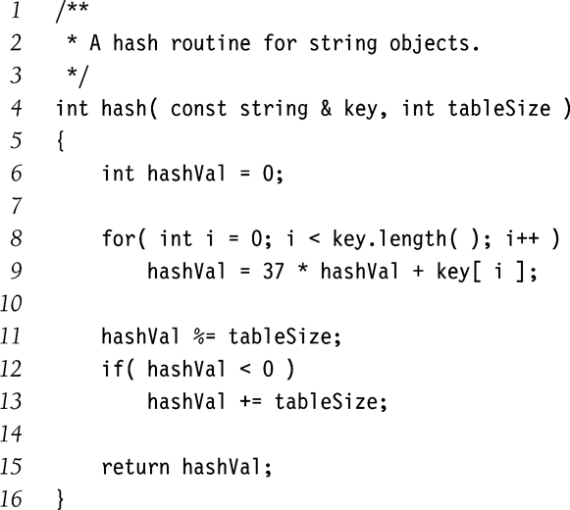
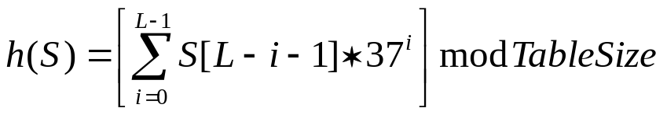
Different Ways to Design a Hash Function for String Keys
Approach 3
  Use all N characters of string as an N-digit base-K number
  Choose K to be prime number larger than number of different digits (characters)
    I.e., K = 29, 31, 37
  If L = length of string S, then
  Use Horner’s rule to compute h(S)
  Limit L for long strings
Problems:
potential overflow larger runtime
Notes:
Cpt S 223
Washington State University

Slide 15
Collision and Resolving technique
What happens when h(k₁) = h(k₂)?
  ==> collision !
Collision resolution strategies
  Chaining
    Store colliding keys in a linked list at the same hash table index
  Open addressing
    Store colliding keys elsewhere in the table
Notes:
Cpt S 223
Washington State University

Slide 16
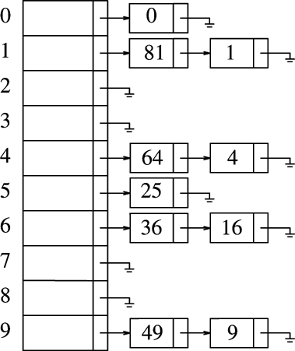
Chaining strategy: maintains a linked list at every hash index for collided elements
Insertion sequence: { 0 1 4 9 16 25 36 49 64 81 }
Hash table T is a vector of linked lists
  Insert element at the head (as shown here) or at the tail
Key k is stored in list at T[h(k)]
E.g., TableSize = 10
  h(k) = k mod 10
  Insert first 10 perfect squares
Notes:
Cpt S 223
Washington State University

Slide 17
Collision Resolution by Chaining: Analysis
Load factor λ of a hash table T is defined as follows:
  N = number of elements in T (“current size”)
  M = size of T (“table size”)
  λ = N/M (“ load factor”)
    i.e., λ is the average length of a chain
Unsuccessful search time: O(λ)
  Same for insert time
Successful search time: O(λ/2)
Ideally, want λ ≤ 1 (not a function of N)
Notes:
Cpt S 223
Washington State University

Slide 18
Potential disadvantages of Chaining
Linked lists could get long
  Especially when N approaches M
  Longer linked lists could negatively impact performance
More memory because of pointers
Absolute worst-case (even if N << M):
  All N elements in one linked list!
  Typically the result of a bad hash function

Slide 19
Collision Resolution by Open Addressing
An “inplace” approach
When a collision occurs, look elsewhere in the table for an empty slot
Advantages over chaining
  No need for list structures
  No need to allocate/deallocate memory during insertion/deletion (slow)
Disadvantages
  Slower insertion – May need several attempts to find an empty slot
  Table needs to be bigger (than chaining-based table) to achieve average-case constant-time performance
    Load factor λ ≈ 0.5
Notes:
Cpt S 223
Washington State University

Slide 20
Collision Resolution by Open Addressing
A “Probe sequence” is a sequence of slots in hash table while searching for an element x
  h₀(x), h₁(x), h₂(x), …
  Needs to visit each slot exactly once
  Needs to be repeatable (so we can find/delete what we’ve inserted)
Hash function
  h_{i}(x) = (h(x) + f(i)) mod TableSize
  f(0) = 0 ==> position for the 0th probe
  f(i) is “the distance to be traveled relative to the 0th probe position, during the i^{th} probe”.
Notes:
Cpt S 223
Washington State University

Slide 21
Linear Probing
i^{th} probe index =
0th probe index
+ i
f(i) = is a linear function of i,
E.g., f(i) = i
  h_{i}(x) = (h(x) + i) mod TableSize
Linear probing:
0th probe
i
occupied
1st probe
occupied
2nd probe
occupied
3rd probe
…
  Probe sequence: +0, +1, +2, +3, +4, …
unoccupied
Populate x here
Continue until an empty slot is found
#failed probes is a measure of performance
Notes:
Cpt S 223
Washington State University

Slide 22
i^{th} probe index =
0th probe index
Linear Probing
+ i
f(i) = is a linear function of i, e.g., f(i) = i
  h_{i}(x) = (h(x) + i) mod TableSize
  Probe sequence: +0, +1, +2, +3, +4, …
Example: h(x) = x mod TableSize
  h₀(89) = (h(89)+f(0)) mod 10 = 9
  h₀(18) = (h(18)+f(0)) mod 10 = 8
  h₀(49) = (h(49)+f(0)) mod 10 = 9 (X)
  h₁(49) = (h(49)+f(1)) mod 10
  = (h(49)+ 1 ) mod 10 = 0
Notes:
Cpt S 223
Washington State University

Slide 23
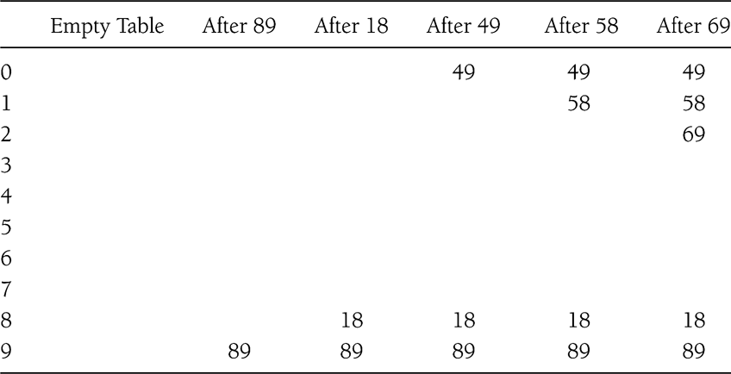
Linear Probing Example
Insert sequence: 89, 18, 49, 58, 69
time
#unsuccessful
probes:
0
0
1
3
3
7
total
Notes:
Cpt S 223
Washington State University

Slide 24
Quadratic Probing
Avoids primary clustering
f(i) is quadratic in i
e.g., f(i) = i²
  h_{i}(x) = (h(x) + i²) mod TableSize
  Probe sequence:
  +0, +1, +4, +9, +16, …
Quadratic probing:
0th probe
i
occupied
1st probe
occupied
2nd probe
occupied
3rd probe
…
occupied
Continue until an empty slot is found
#failed probes is a measure of performance
Notes:
Cpt S 223
Washington State University

Slide 25
Quadratic Probing
Avoids primary clustering
f(i) is quadratic in I, e.g., f(i) = i²
  h_{i}(x) = (h(x) + i²) mod TableSize
  Probe sequence: +0, +1, +4, +9, +16, …
Example:
  h₀(58) = (h(58)+f(0)) mod 10 = 8 (X)
  h₁(58) = (h(58)+f(1)) mod 10 = 9 (X)
  h₂(58) = (h(58)+f(2)) mod 10 = 2
Notes:
Cpt S 223
Washington State University

Slide 26
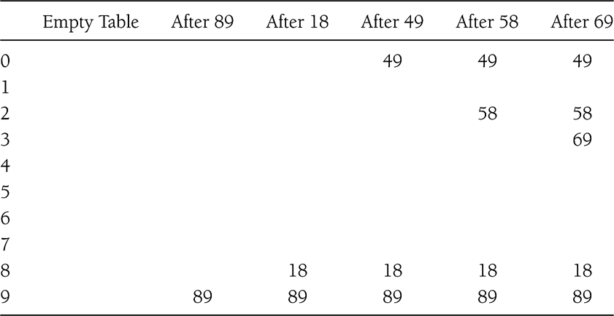
Q) Delete(49), Find(69) - is there a problem?
Quadratic Probing Example
Insert sequence: 89, 18, 49, 58, 69
+1²
+1²
+2²
+2²
+0²
+0²
+0²
+0²
+1²
+0²
#unsuccessful
probes:
0
0
1
2
2
5
total
Notes:
Cpt S 223
Washington State University

Slide 27
Quadratic Probing: Analysis
Difficult to analyze
Theorem 5.1
  New element can always be inserted into a table that is at least half empty and TableSize is prime
Otherwise, may never find an empty slot, even is one exists
Ensure table never gets half full
  If close, then expand it
Notes:
Cpt S 223
Washington State University

Slide 28
Quadratic Probing
May cause “secondary clustering”
Deletion
  Emptying slots can break probe sequence and could cause find stop prematurely
  Lazy deletion
    Differentiate between empty and deleted slot
    When finding skip and continue beyond deleted slots
      If you hit a non-deleted empty slot, then stop find procedure returning “not found”
  May need compaction at some time
Notes:
Cpt S 223
Washington State University

Slide 29
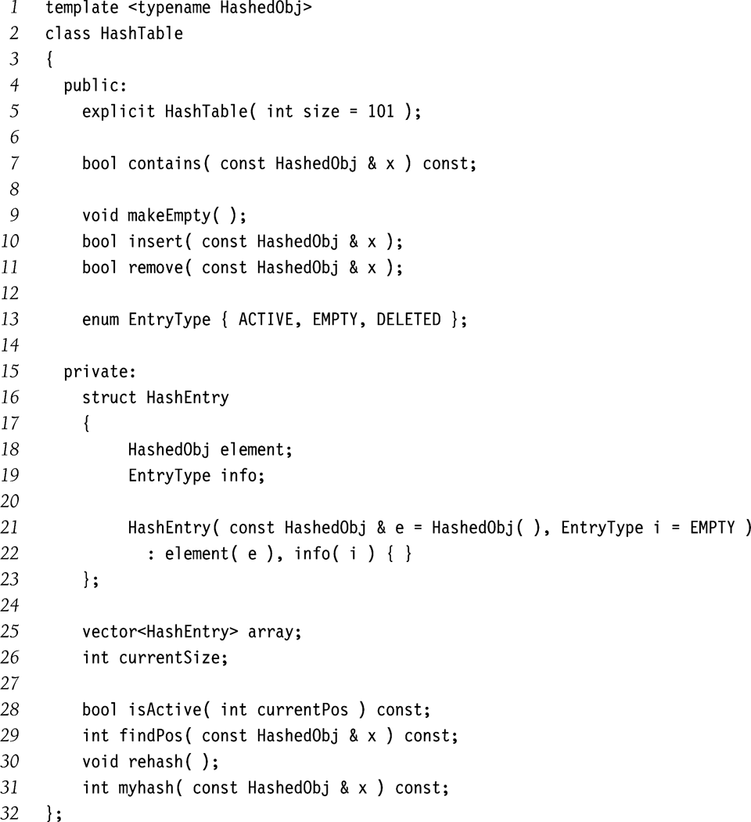
Quadratic Probing: Implementation
Notes:
Cpt S 223
Washington State University

Slide 30
Quadratic Probing: Implementation
Lazy deletion
Notes:
Cpt S 223
Washington State University

Slide 31
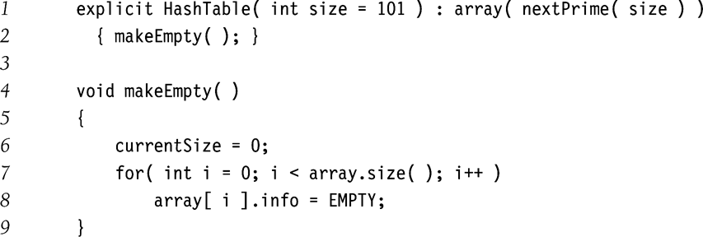
Quadratic Probing: Implementation
Ensure table size is prime
Notes:
Cpt S 223
Washington State University

Slide 32
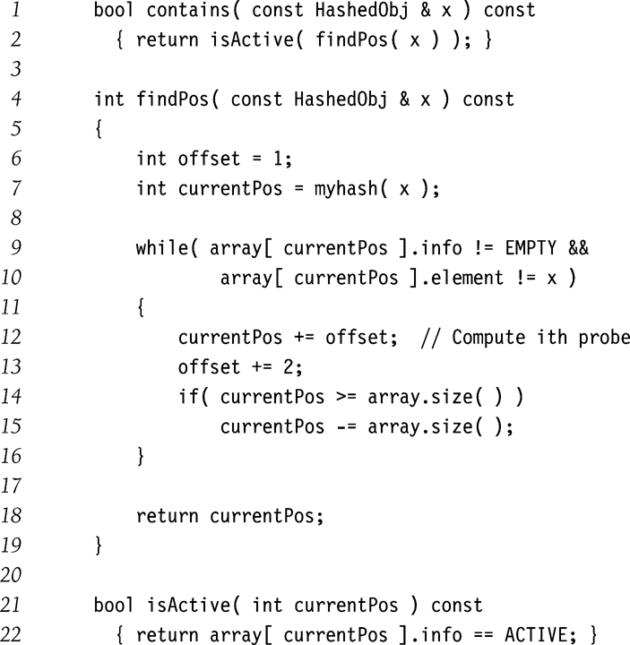
Quadratic Probing: Implementation
Find
Skip DELETED;
No duplicates
Quadratic probe sequence (really)
Notes:
Cpt S 223
Washington State University

Slide 33
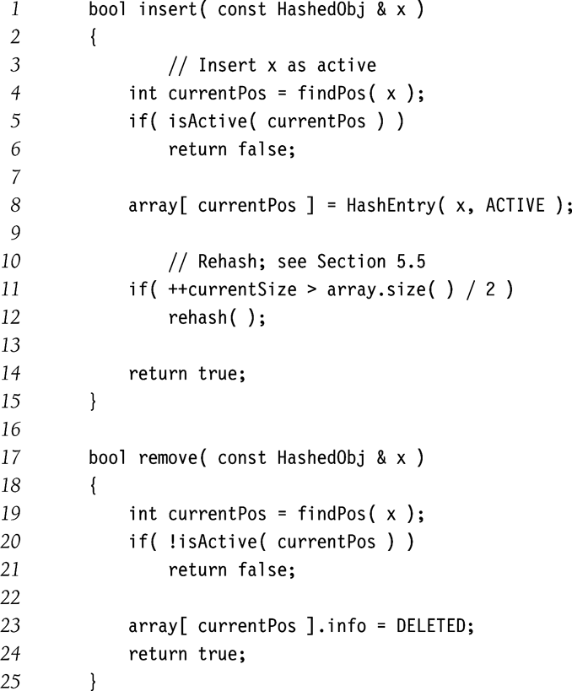
Quadratic Probing: Implementation
Insert
No duplicates
Remove
No deallocation needed
Notes:
Cpt S 223
Washington State University

Slide 34
Double Hashing: keep two hash functions h₁ and h₂
Use a second hash function for all tries I other than 0: f(i) = i * h₂(x)
Good choices for h₂(x) ?
  Should never evaluate to 0
  h₂(x) = R – (x mod R)
    R is prime number less than TableSize
Previous example with R=7
  h₀(49) = (h(49)+f(0)) mod 10 = 9 (X)
  h₁(49) = (h(49)+1*(7 – 49 mod 7)) mod 10 = 6
f(1)
Notes:
Cpt S 223
Washington State University

Slide 35
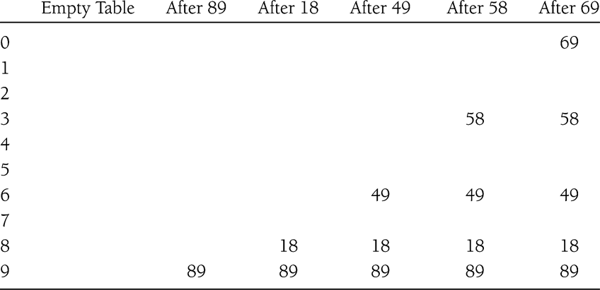
Double Hashing Example
Notes:
Cpt S 223
Washington State University

Slide 36
Double Hashing: Analysis
Imperative that TableSize is prime
  E.g., insert 23 into previous table
Empirical tests show double hashing close to random hashing
Extra hash function takes extra time to compute
Notes:
Cpt S 223
Washington State University

Slide 37
Probing Techniques - review
Linear probing:
Quadratic probing:
Double hashing*:
0th try
0th try
0th try
i
i
1st try
i
1st try
2nd try
2nd try
2nd try
3rd try
…
3rd try
1st try
3rd try
…
…
*(determined by a second
hash function)
Notes:
Cpt S 223
Washington State University

Slide 38
Rehashing
Increases the size of the hash table when load factor becomes “too high” (defined by a cutoff)
  Anticipating that prob(collisions) would become higher
Typically expand the table to twice its size (but still prime)
Need to reinsert all existing elements into new hash table
Notes:
Cpt S 223
Washington State University

Slide 39
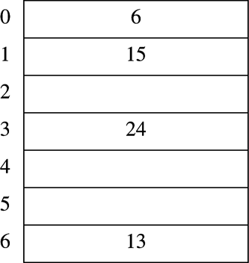
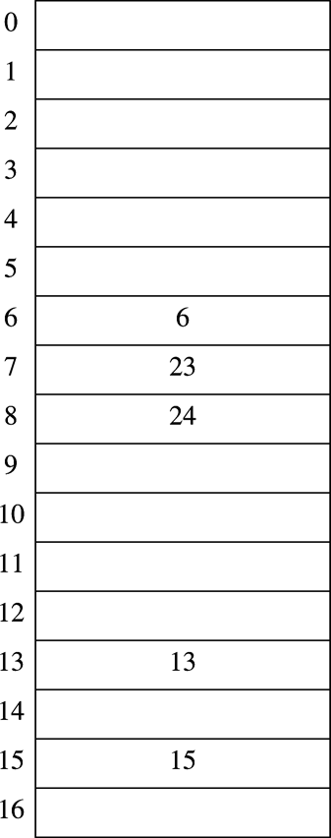
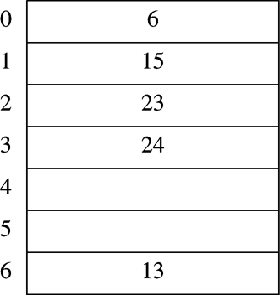
Rehashing Example
h(x) = x mod 7
λ = 0.57
h(x) = x mod 17
λ = 0.29
Rehashing
Insert 23
λ = 0.71
Notes:
Cpt S 223
Washington State University

Slide 40
Rehashing Analysis
Rehashing takes time to do N insertions
Therefore should do it infrequently
Specifically
  Must have been N/2 insertions since last rehash
  Amortizing the O(N) cost over the N/2 prior insertions yields only constant additional time per insertion
Notes:
Cpt S 223
Washington State University

Slide 41
Rehashing Implementation
When to rehash
  When load factor reaches some threshold (e.g,. λ ≥0.5), OR
  When an insertion fails
Applies across collision handling schemes
Notes:
Cpt S 223
Washington State University

Slide 42
Problem with Large Tables
What if hash table is too large to store in main memory?
Solution: Store hash table on disk
  Minimize disk accesses
But…
  Collisions require disk accesses
  Rehashing requires a lot of disk accesses
Solution: Extendible Hashing
Notes:
Cpt S 223
Washington State University

Slide 43
Hash Table Applications
Symbol table in compilers
Accessing tree or graph nodes by name
  E.g., city names in Google maps
Maintaining a transposition table in games
  Remember previous game situations and the move taken (avoid re-computation)
Dictionary lookups
  Spelling checkers
  Natural language understanding (word sense)
Heavily used in text processing languages
  E.g., Perl, Python, etc.
Notes:
Cpt S 223
Washington State University

Slide 44
Points to remember - Hash tables
Table size prime
Table size much larger than number of inputs (to maintain λ closer to 0 or < 0.5)
Tradeoffs between chaining vs. probing
Collision chances decrease in this order: linear probing => quadratic probing => {random probing, double hashing}
Rehashing required to resize hash table at a time when λ exceeds 0.5
Good for searching. Not good if there is some order implied by data.
Notes:
Cpt S 223
Washington State University

Slide 45
Summary
  The function of hashing is to map a key into an index To support insertion, deletion and search in average-case constant time.
  The performance of hashing technique depends on the designing of hash function.
  Hash function can map integer or string key into integer address.
  When more than one key map into single index then collision occur.
  Linear probing, quadratic probing, chaining and rehashing are techniques to reduce collision.

Slide 46
In Next Lecturer
In next lecture, we will discuss the basics and types of trees.

