Slide 1
Lecture 18.
Basics and types of Trees

Slide 2
Recap
  The function of hashing is to map a key into an index To support insertion, deletion and search in average-case constant time.
  The performance of hashing technique depends on the designing of hash function.
  Hash function can map integer or string key into integer address.
  When more than one key map into single index then collision occur.
  Linear probing, quadratic probing, chaining and rehashing are techniques to reduce collision.

Slide 3
Basic Tree Concepts
A tree consists of finite set of elements, called nodes, and a finite set of directed lines called branches, that connect the nodes.
The number of branches associated with a node is the degree of the node.

Slide 4
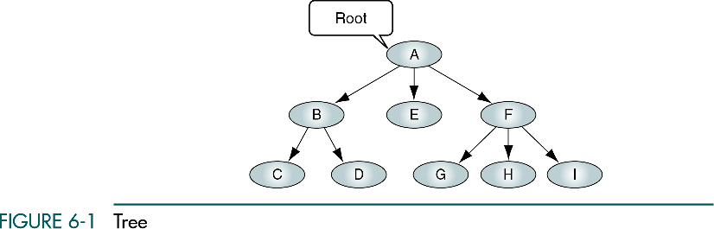

Slide 5
Basic Tree Concepts
When the branch is directed toward the node, it is indegree branch.
When the branch is directed away from the node, it is an outdegree branch.
The sum of the indegree and outdegree branches is the degree of the node.
If the tree is not empty, the first node is called the root.

Slide 6
Basic Tree Concepts
The indegree of the root is, by definition, zero.
With the exception of the root, all of the nodes in a tree must have an indegree of exactly one; that is, they may have only one predecessor.
All nodes in the tree can have zero, one, or more branches leaving them; that is, they may have outdegree of zero, one, or more.

Slide 8
Basic Tree Concepts
A leaf is any node with an outdegree of zero, that is, a node with no successors.
A node that is not a root or a leaf is known as an internal node.
A node is a parent if it has successor nodes; that is, if it has outdegree greater than zero.
A node with a predecessor is called a child.

Slide 9
Basic Tree Concepts
Two or more nodes with the same parents are called siblings.
An ancestor is any node in the path from the root to the node.
A descendant is any node in the path below the parent node; that is, all nodes in the paths from a given node to a leaf are descendants of that node.

Slide 10
Basic Tree Concepts
A path is a sequence of nodes in which each node is adjacent to the next node.
The level of a node is its distance from the root. The root is at level 0, its children are at level 1, etc. …

Slide 11
Basic Tree Concepts
The height of the tree is the level of the leaf in the longest path from the root plus 1. By definition the height of any empty tree is -1.
A subtree is any connected structure below the root. The first node in the subtree is known is the root of the subtree.

Slide 12
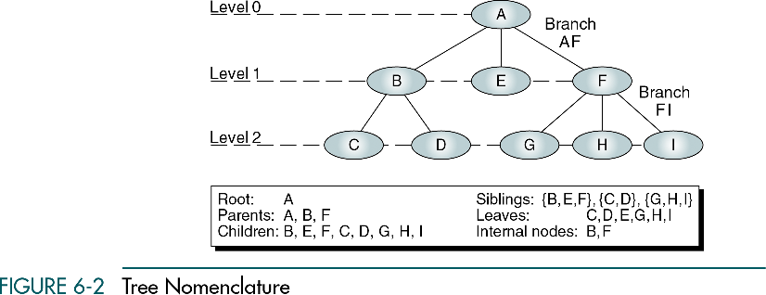

Slide 13
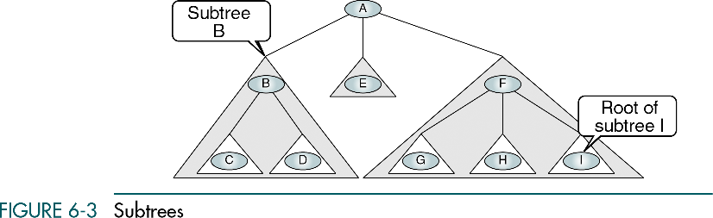

Slide 14
Recursive definition of a tree
A tree is a set of nodes that either:
is empty or
has a designated node, called the root, from which hierarchically descend zero or more subtrees, which are also trees.

Slide 15
Tree Representation
General Tree – organization chart format
Indented list – bill-of-materials system in which a parts list represents the assembly structure of an item

Slide 16
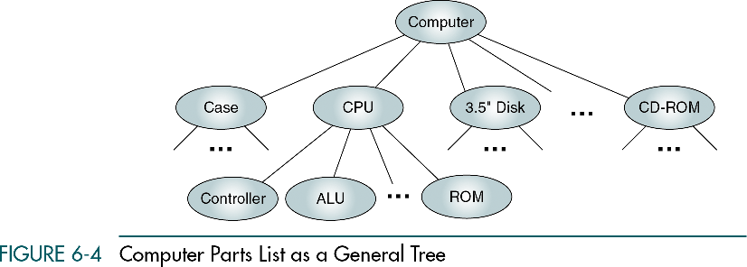

Slide 17
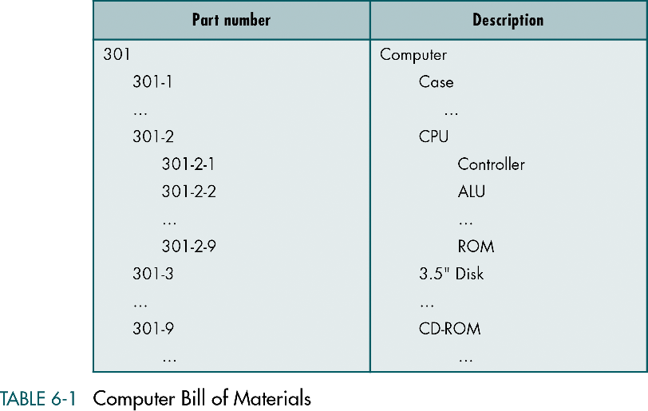

Slide 18
Parenthetical Listing
Parenthetical Listing – the algebraic expression, where each open parenthesis indicates the start of a new level and each closing parenthesis completes the current level and moves up one level in the tree.

Slide 19
Parenthetical Listing
A (B (C D) E F (G H I) )

Slide 20
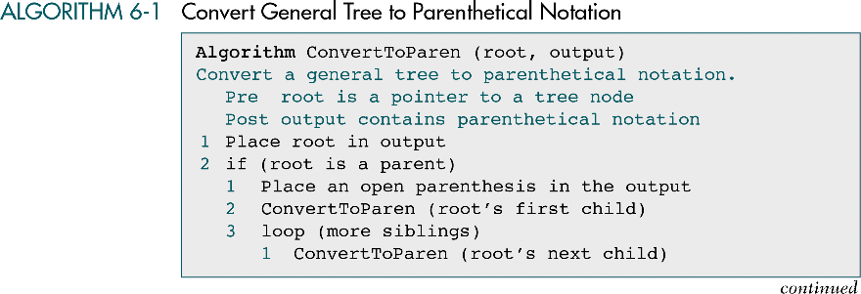

Slide 21
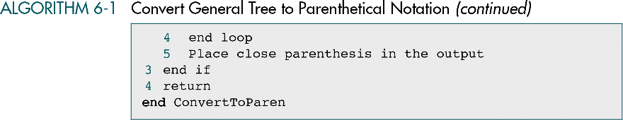

Slide 22
Binary Trees
A binary tree can have no more than two descendents. In this section we discuss the properties of binary trees, four different binary tree traversals
Properties
Binary Tree Traversals
Expression Trees
Huffman Code

Slide 23
Binary Trees
A binary tree is a tree in which no node can have more than two subtrees; the maximum outdegree for a node is two.
In other words, a node can have zero, one, or two subtrees.
These subtrees are designated as the left subtree and the right subtree.

Slide 24
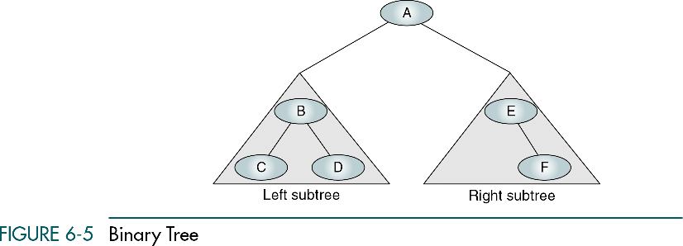

Slide 25
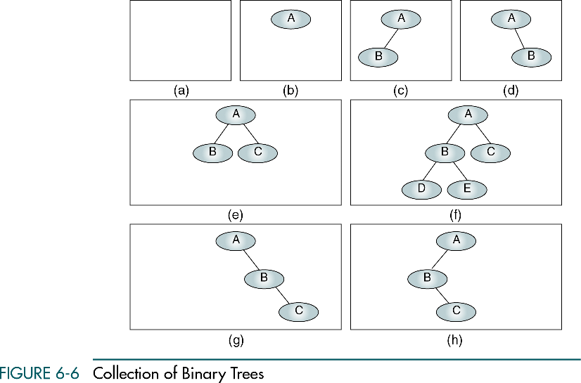
A null tree is a tree with no nodes

Slide 26
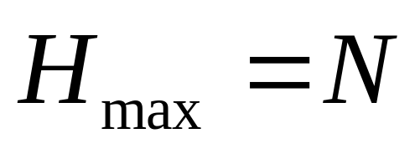
Some Properties of Binary Trees
The height of binary trees can be mathematically predicted
Given that we need to store N nodes in a binary tree, the maximum height is
A tree with a maximum height is rare. It occurs when all of the nodes in the entire tree have only one successor.

Slide 27
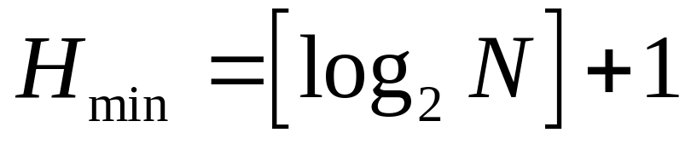
Some Properties of Binary Trees
The minimum height of a binary tree is determined as follows:
For instance, if there are three nodes to be stored in the binary tree (N=3) then H_{min}=2.

Slide 28
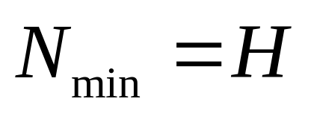
Some Properties of Binary Trees
Given a height of the binary tree, H, the minimum number of nodes in the tree is given as follows:

Slide 29
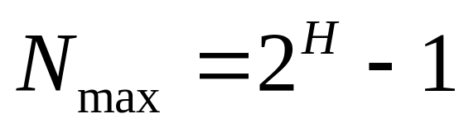
Some Properties of Binary Trees
The formula for the maximum number of nodes is derived from the fact that each node can have only two descendents. Given a height of the binary tree, H, the maximum number of nodes in the tree is given as follows:

Slide 30
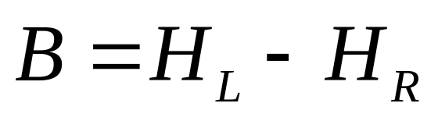
Some Properties of Binary Trees
The children of any node in a tree can be accessed by following only one branch path, the one that leads to the desired node.
The nodes at level 1, which are children of the root, can be accessed by following only one branch; the nodes of level 2 of a tree can be accessed by following only two branches from the root, etc.
The balance factor of a binary tree is the difference in height between its left and right subtrees:

Slide 31
Balance of the tree
B=0
B=0
B=1
B=-1
B=1
B=0
B=-2
B=2

Slide 32
Some Properties of Binary Trees
In the balanced binary tree (definition of Russian mathematicians Adelson-Velskii and Landis) the height of its subtrees differs by no more than one (its balance factor is -1, 0, or 1), and its subtrees are also balanced.

Slide 33
Complete and nearly complete binary trees
A complete tree has the maximum number of entries for its height. The maximum number is reached when the last level is full.
A tree is considered nearly complete if it has the minimum height for its nodes and all nodes in the last level are found on the left

Slide 34
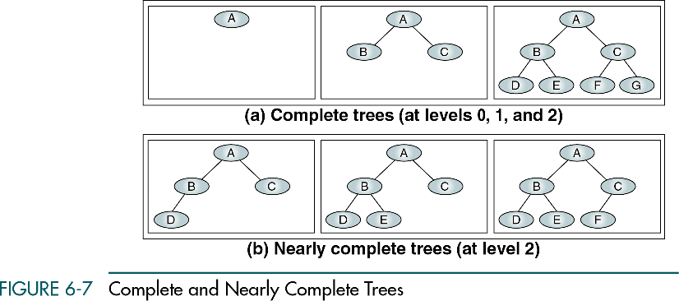

Slide 35
Binary Tree Traversal
A binary tree traversal requires that each node of the tree be processed once and only once in a predetermined sequence.
In the depth-first traversal processing process along a path from the root through one child to the most distant descendant of that first child before processing a second child.

Slide 36
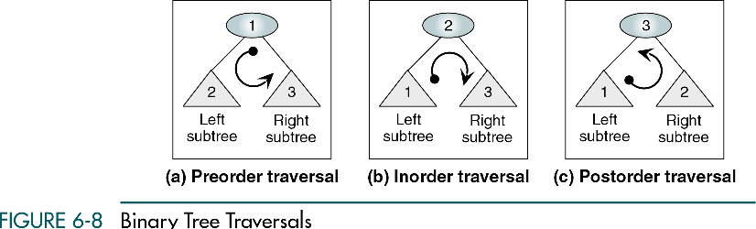

Slide 37
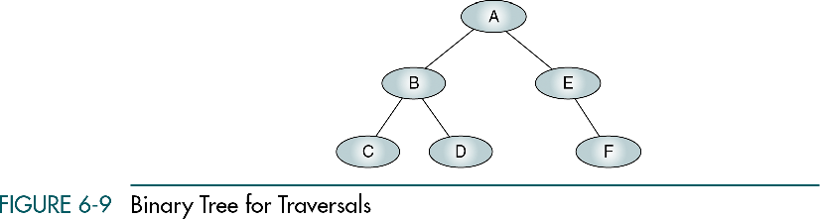

Slide 38
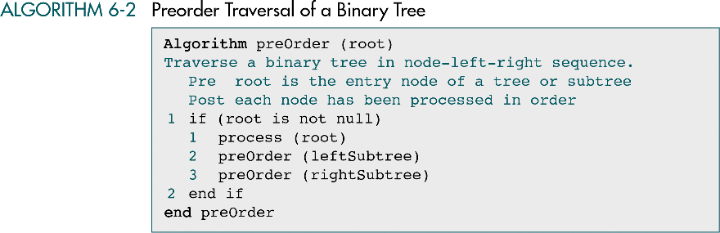

Slide 39
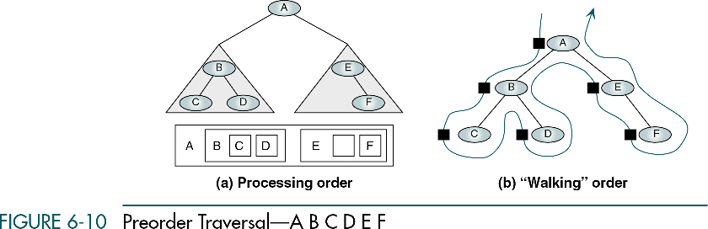

Slide 40
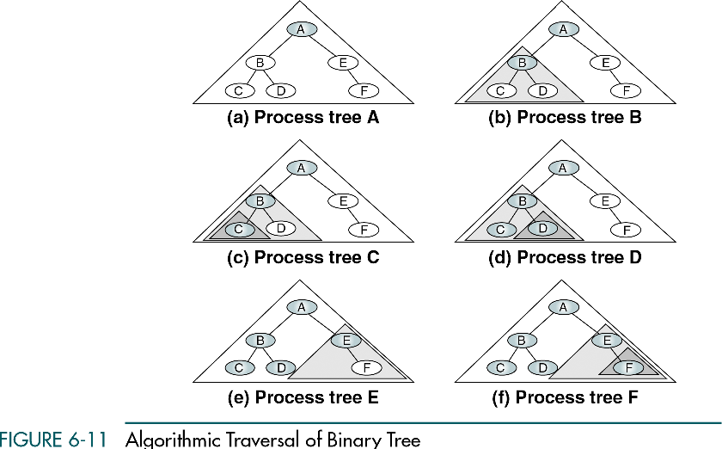

Slide 41
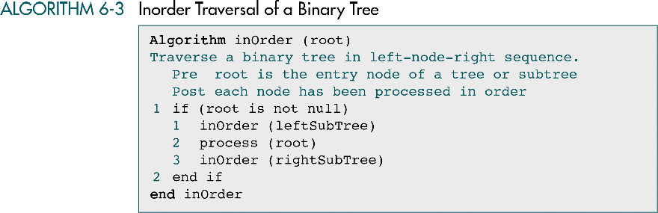

Slide 42
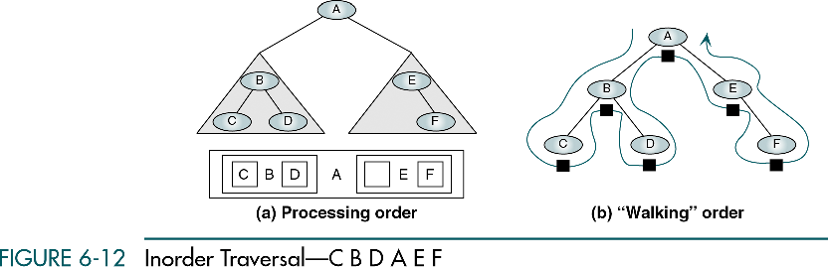

Slide 43
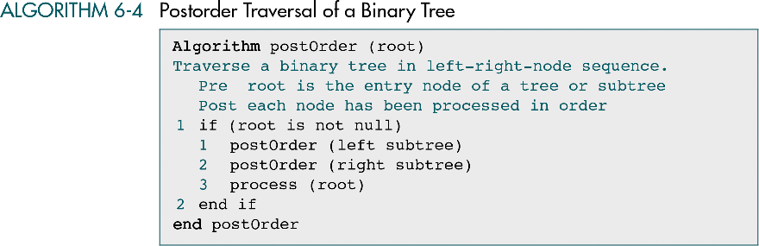

Slide 44
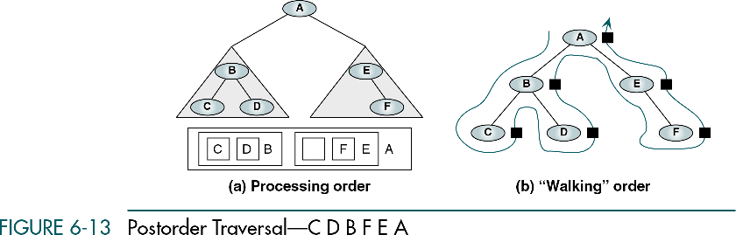

Slide 45
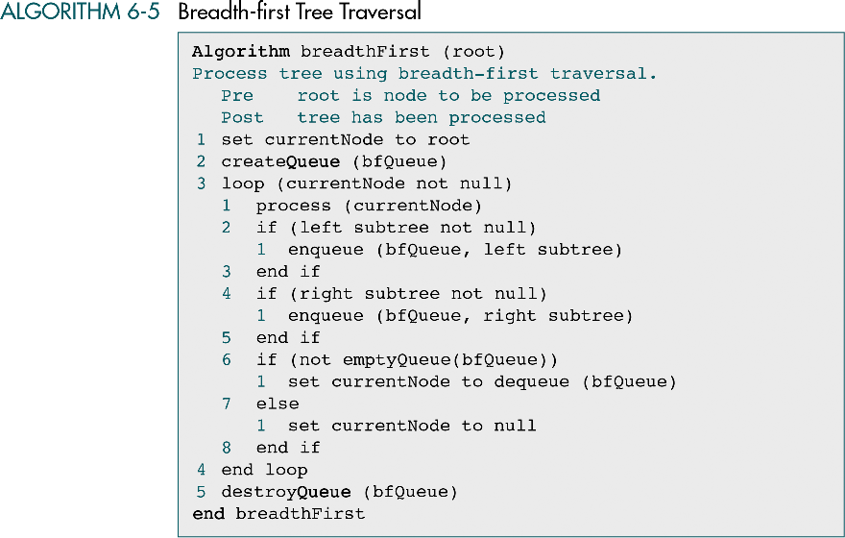

Slide 46
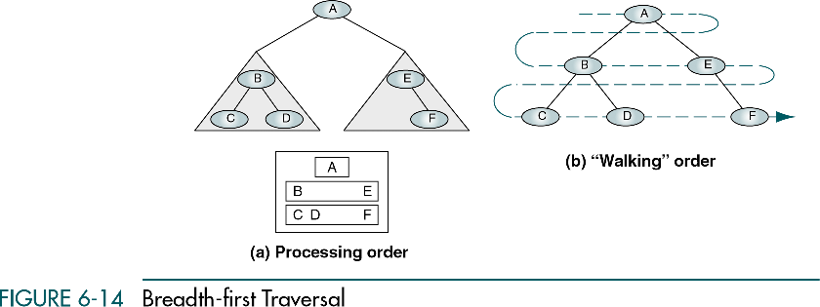

Slide 47
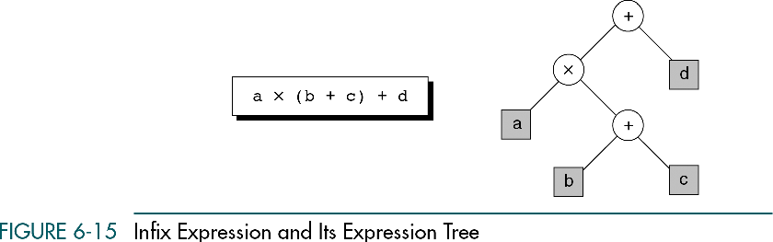

Slide 48
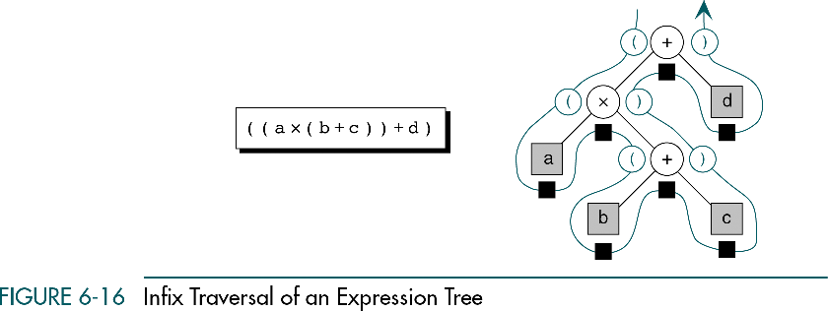

Slide 49
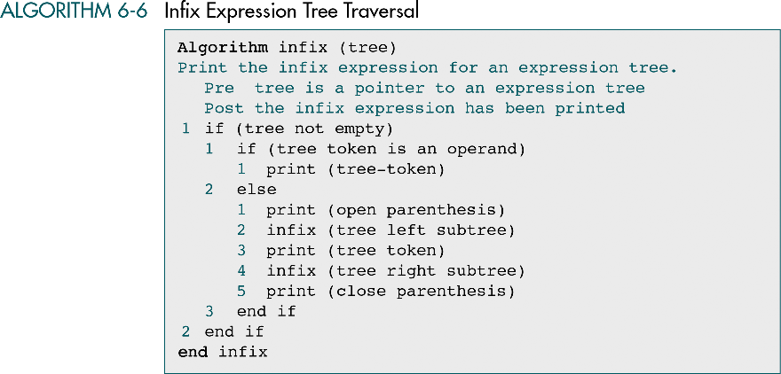

Slide 50
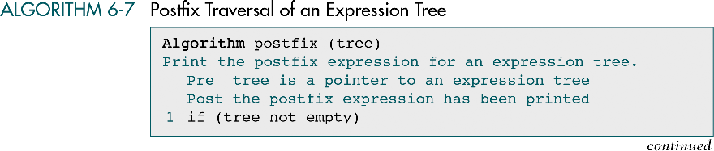

Slide 51


Slide 52
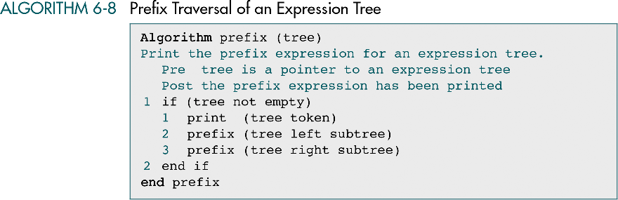

Slide 53
Summary
  Tree is a non linear data structure to present data in hierarchical form.
  It is also called acyclic data structure.
  The main component of a tree are node , branches, level, family (subtree) and path.
  A node may be used as root, parent, left, brother, predecessor , successor and leaf node.
  If every node of a tree have 0, 1 or 2 child it is called binary tree.
  There ar different traversing method of tree such as inorder, pre order and post order.

Slide 54
In Next Lecturer
In next lecture, we will discuss about binary search tree and its algorithms

