Slide 1
Lecture 19.
Binary Search Tree

Slide 2
Recap
  Tree is a non linear data structure to present data in hierarchical form.
  It is also called acyclic data structure.
  The main component of a tree are node , branches, level, family (subtree) and path.
  A node may be used as root, parent, left, brother, predecessor , successor and leaf node.
  If every node of a tree have 0, 1 or 2 child it is called binary tree.
  There ar different traversing method of tree such as inorder, pre order and post order.

Slide 3
Binary Search Trees
Tree representation:
  A linked data structure in which each node is an object
Node representation:
  Key field
  Satellite data
  Left: pointer to left child
  Right: pointer to right child
  p: pointer to parent (p [root [T]] = NIL)
Satisfies the binary-search-tree property !!
parent
L
R
key
data
Left child
Right child

Slide 4
Binary Search Tree Property
Binary search tree property:
  If y is in left subtree of x,
    then key [y] ≤ key [x]
  If y is in right subtree of x,
    then key [y] ≥ key [x]
5
3
7
2
5
9

Slide 5
Binary Search Trees
Support many dynamic set operations
  SEARCH, MINIMUM, MAXIMUM, PREDECESSOR, SUCCESSOR, INSERT, DELETE
Running time of basic operations on binary search trees
  On average: Θ(lgn)
    The expected height of the tree is lgn
  In the worst case: Θ(n)
    The tree is a linear chain of n nodes

Slide 6
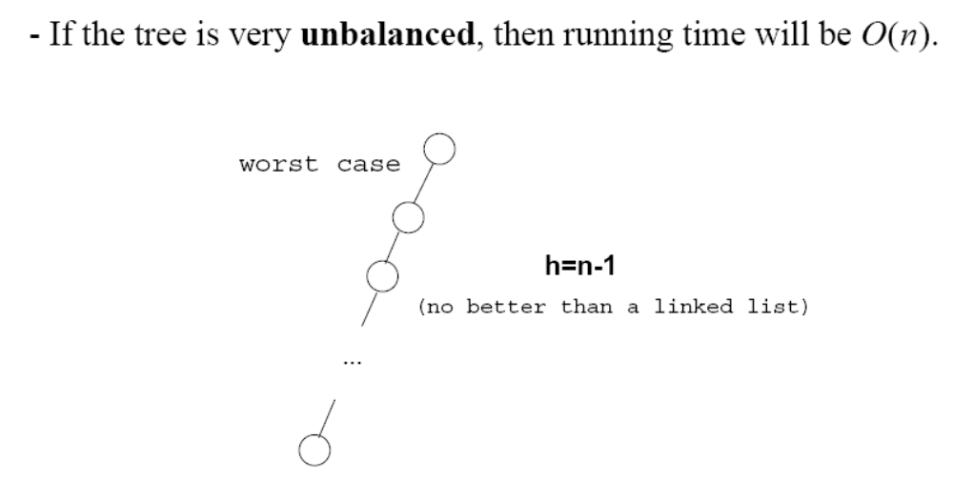
Worst Case
Θ(n)

Slide 7
Traversing a Binary Search Tree
Inorder tree walk:
  Root is printed between the values of its left and right subtrees: left, root, right
  Keys are printed in sorted order
Preorder tree walk:
  root printed first: root, left, right
Postorder tree walk:
  root printed last: left, right, root
Inorder: 2 3 5 5 7 9
5
Preorder: 5 3 2 5 7 9
3
7
Postorder: 2 5 3 9 7 5
2
5
9

Slide 8
Traversing a Binary Search Tree
Alg: INORDER-TREE-WALK(x)
if x ≠ NIL
then INORDER-TREE-WALK ( left [x] )
print key [x]
INORDER-TREE-WALK ( right [x] )
E.g.:
Running time:
  Θ(n), where n is the size of the tree rooted at x
5
Output: 2 3 5 5 7 9
3
7
2
5
9

Slide 9
Searching for a Key
Given a pointer to the root of a tree and a key k:
  Return a pointer to a node with key k
  if one exists
  Otherwise return NIL
Idea
  Starting at the root: trace down a path by comparing k with the key of the current node:
    If the keys are equal: we have found the key
    If k < key[x] search in the left subtree of x
    If k > key[x] search in the right subtree of x
5
3
7
2
4
9

Slide 10
Example: TREE-SEARCH
15
Search for key 13:
  15 → 6 → 7 → 13
6
18
3
7
17
20
2
4
13
9

Slide 11
Searching for a Key
Alg: TREE-SEARCH(x, k)
if x = NIL or k = key [x]
then return x
if k < key [x]
then return TREE-SEARCH(left [x], k )
else return TREE-SEARCH(right [x], k )
5
3
7
2
4
9
Running Time: O (h),
h – the height of the tree

Slide 12
Finding the Minimum in a Binary Search Tree
Goal: find the minimum value in a BST
  Following left child pointers from the root, until a NIL is encountered
Alg: TREE-MINIMUM(x)
while left [x] ≠ NIL
do x ← left [x]
return x
Running time: O(h), h – height of tree
15
6
18
3
7
17
20
2
4
13
9
Minimum = 2

Slide 13
Finding the Maximum in a Binary Search Tree
Goal: find the maximum value in a BST
  Following right child pointers from the root, until a NIL is encountered
Alg: TREE-MAXIMUM(x)
while right [x] ≠ NIL
do x ← right [x]
return x
Running time: O(h), h – height of tree
15
6
18
3
7
17
20
2
4
13
9
Maximum = 20

Slide 14
Successor
Def: successor (x ) = y, such that key [y] is the smallest key > key [x]
E.g.: successor (15) =
successor (13) =
successor (9) =
Case 1: right (x) is non empty
  successor (x ) = the minimum in right (x)
Case 2: right (x) is empty
  go up the tree until the current node is a left child: successor (x ) is the parent of the current node
  if you cannot go further (and you reached the root): x is the largest element
15
17
6
18
15
3
7
17
y
20
13
x
2
4
13
9

Slide 15
Finding the Successor
Alg: TREE-SUCCESSOR(x)
if right [x] ≠ NIL
then return TREE-MINIMUM(right [x])
y ← p[x]
while y ≠ NIL and x = right [y]
do x ← y
y ← p[y]
return y
Running time: O (h), h – height of the tree
15
y
6
18
3
7
17
20
x
2
4
13
9

Slide 16
Predecessor
Def: predecessor (x ) = y, such that key [y] is the biggest key < key [x]
E.g.: predecessor (15) =
predecessor (9) =
predecessor (7) =
Case 1: left (x) is non empty
  predecessor (x ) = the maximum in left (x)
Case 2: left (x) is empty
  go up the tree until the current node is a right child: predecessor (x ) is the parent of the current node
  if you cannot go further (and you reached the root): x is the smallest element
15
y
13
x
6
18
7
3
7
17
20
6
2
4
13
9

Slide 17
Insertion
Goal:
  Insert value v into a binary search tree
Idea:
  If key [x] < v move to the right child of x,
  else move to the left child of x
  When x is NIL, we found the correct position
  If v < key [y] insert the new node as y’s left child
else insert it as y’s right child
  Begining at the root, go down the tree and maintain:
    Pointer x : traces the downward path (current node)
    Pointer y : parent of x (“trailing pointer” )
Insert value 13
12
5
18
2
9
15
19
1
3
13
17

Slide 18
Example: TREE-INSERT
x=root[T], y=NIL
y
Insert 13:
12
12
x
5
18
5
18
2
9
15
19
2
9
15
19
1
3
17
1
3
17
12
12
x
y
5
18
5
18
2
9
15
19
2
9
15
19
1
3
17
1
3
13
17
x = NIL
y = 15

Slide 19
Alg: TREE-INSERT(T, z)
y ← NIL
x ← root [T]
while x ≠ NIL
do y ← x
if key [z] < key [x]
then x ← left [x]
else x ← right [x]
p[z] ← y
if y = NIL
then root [T] ← z Tree T was empty
else if key [z] < key [y]
then left [y] ← z
else right [y] ← z
12
5
18
2
9
15
19
1
3
13
17
Running time: O(h)

Slide 20
Deletion
Goal:
  Delete a given node z from a binary search tree
Idea:
  Case 1: z has no children
    Delete z by making the parent of z point to NIL
15
15
5
16
5
16
3
12
20
3
12
z
20
10
18
23
10
13
18
23
6
6
delete
7
7

Slide 21
Deletion
Case 2: z has one child
  Delete z by making the parent of z point to z’s child, instead of to z
15
delete
15
z
5
16
5
20
3
12
20
3
12
18
23
10
13
18
23
10
6
6
7
7

Slide 22
Deletion
Case 3: z has two children
  z’s successor (y) is the minimum node in z’s right subtree
  y has either no children or one right child (but no left child)
  Delete y from the tree (via Case 1 or 2)
  Replace z’s key and satellite data with y’s.
6
15
15
delete
z
5
16
6
16
3
12
20
3
12
20
10
13
18
23
10
13
18
23
y
6
7
7

Slide 23
TREE-DELETE(T, z)
if left[z] = NIL or right[z] = NIL
then y ← z
else y ← TREE-SUCCESSOR(z)
if left[y] ≠ NIL
then x ← left[y]
else x ← right[y]
if x ≠ NIL
then p[x] ← p[y]
z has one child
z has 2 children
15
y
5
16
x
3
12
20
10
13
18
23
6
7

Slide 24
TREE-DELETE(T, z) – cont.
15
y
if p[y] = NIL
then root[T] ← x
else if y = left[p[y]]
then left[p[y]] ← x
else right[p[y]] ← x
if y ≠ z
then key[z] ← key[y]
copy y’s satellite data into z
return y
5
16
x
3
12
20
10
13
18
23
6
7
Running time: O(h)

Slide 25
Binary Search Trees - Summary
Operations on binary search trees:
  SEARCH O(h)
  PREDECESSOR O(h)
  SUCCESOR O(h)
  MINIMUM O(h)
  MAXIMUM O(h)
  INSERT O(h)
  DELETE O(h)
These operations are fast if the height of the tree is small – otherwise their performance is similar to that of a linked list

Slide 26
Summary
Binary search tree is a special binary tree which is designed to make the search of elements or keys in constant times.
For each current parent node key, the values of all nodes of left sub tree are less and of right sub tree are greater than from current parent.
You can use different operations in constant times such as search, max, min, successor, insert and delete.

Slide 27
In Next Lecturer
In next lecture, we will discuss graphs and network models

