Slide 1
Lecture 20.
Graphs and network models

Slide 2
Recap
Binary search tree is a special binary tree which is designed to make the search of elements or keys in linear times.
For each current parent node key, the values of all nodes of left sub tree are less and of right sub tree are greater than from current parent.
You can use different operations in constant times such as search, max, min, successor, insert and delete.

Slide 3
Graphs
Definition = a set of nodes (vertices) with edges (links) between them.
G = (V, E) - graph
V = set of vertices ⎜V ⎜= n
E = set of edges ⎜E ⎜= m
  Binary relation on V
  Subset of V x V ={(u,v): u ∈V, v ∈V}
1
2
3
4

Slide 4

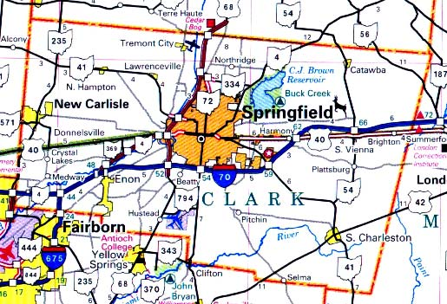


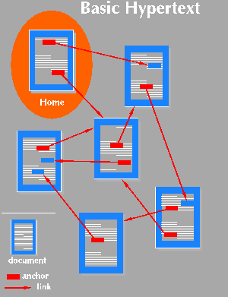
Applications
Applications that involve not only a set of items, but also the connections between them
Maps
Computer networks
Schedules
Hypertext
Circuits

Slide 5
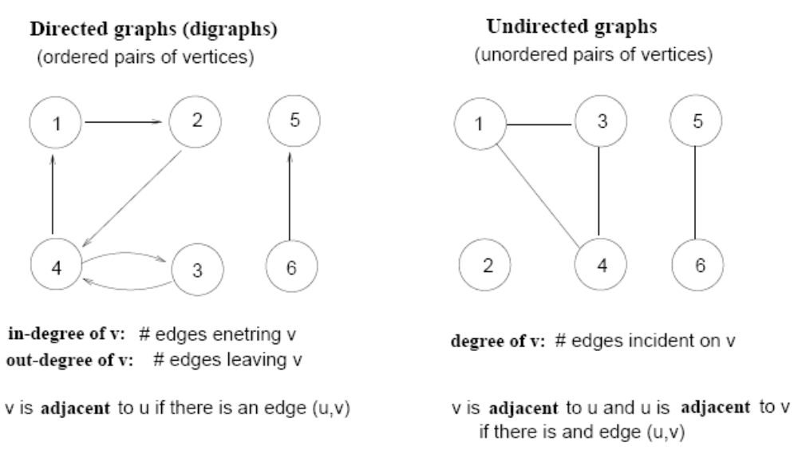
Terminology
Directed vs Undirected graphs

Slide 6
Terminology (Cont !!!)
Complete graph
  A graph with an edge between each pair of vertices
Subgraph
  A graph (V’, E’) such that V’⊆V and E’⊆E
Path from v to w
  A sequence of vertices <v₀, v₁, …, v_{k}> such that v₀=v and v_{k}=w
Length of a path
  Number of edges in the path
1
2
3
4
path from v₁ to v₄
<v₁, v₂, v₄>

Slide 7
Terminology (Cont !!!)
w is reachable from v
  If there is a path from v to w
Simple path
  All the vertices in the path are distinct
Cycles
  A path <v₀, v₁, …, v_{k}> forms a cycle if v₀=v_{k} and k≥2
Acyclic graph
  A graph without any cycles
1
2
3
4
cycle from v₁ to v₁
<v₁, v₂, v₃,v₁>

Slide 8
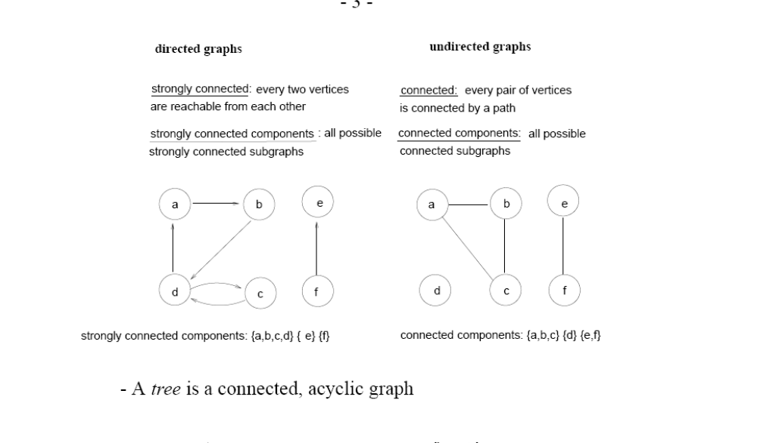
Terminology (Cont !!!)
Connected and Strongly Connected

Slide 9
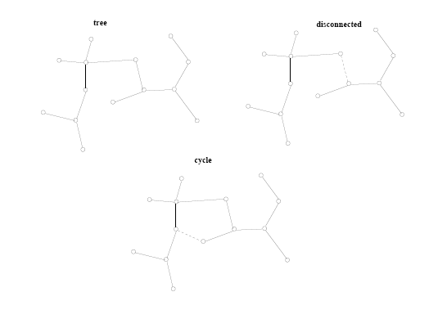
Terminology (Cont !!!)
A tree is a connected, acyclic undirected graph

Slide 10
Graph Representation
Adjacency list representation of G = (V, E)
  An array of ⎜V ⎜lists, one for each vertex in V
  Each list Adj[u] contains all the vertices v that are adjacent to u (i.e., there is an edge from u to v)
  Can be used for both directed and undirected graphs
1
2
5 | /
1
2
2
1
5
3
4 | /
3
3
2
4
5
4
4
2
5
3 | /
5
4
1
2
Undirected graph

Slide 11
Properties of Adjacency-List Representation
Sum of “lengths” of all adjacency lists
  Directed graph:
    edge (u, v) appears only once (i.e., in the
    list of u)
  Undirected graph:
    edge (u, v) appears twice (i.e., in the lists of
    both u and v)
1
2
⎜E ⎜
3
4
Directed graph
1
2
2 ⎜E ⎜
3
5
4
Undirected graph

Slide 12
Properties of Adjacency-List Representation
1
2
Memory required
  Θ(V + E)
Preferred when
  The graph is sparse: ⎜E ⎜ << ⎜V ⎜²
  We need to quickly determine the nodes adjacent to a given node.
Disadvantage
  No quick way to determine whether there is an edge between node u and v
Time to determine if (u, v) ∈ E:
  O(degree(u))
Time to list all vertices adjacent to u:
  Θ(degree(u))
3
5
4
Undirected graph
1
2
3
4
Directed graph

Slide 13
Graph Representation
Adjacency matrix representation of G = (V, E)
  Assume vertices are numbered 1, 2, … ⎜V ⎜
  The representation consists of a matrix A _{⎜V ⎜x ⎜V ⎜}:
  a_{ij} = 1 if (i, j) ∈ E
  0 otherwise
1
2
3
4
5
1
0
1
0
0
1
For undirected graphs, matrix A is symmetric:
a_{ij} = a_{ji}
A = A^{T}
1
2
3
2
1
0
1
1
1
5
4
3
0
1
0
1
0
4
0
1
1
0
1
Undirected graph
5
1
1
0
1
0

Slide 14
Properties of Adjacency Matrix Representation
1
2
Memory required
  Θ(V²), independent on the number of edges in G
Preferred when
  The graph is dense: ⎜E ⎜is close to ⎜V ⎜²
  We need to quickly determine if there is
  an edge between two vertices
Time to determine if (u, v) ∈ E:
  Θ(1)
Disadvantage
  No quick way to determine the vertices
  adjacent to another vertex
Time to list all vertices adjacent to u:
  Θ(V)
3
5
4
Undirected graph
1
2
3
4
Directed graph

Slide 15
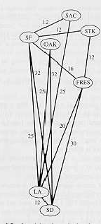
Weighted Graphs
Graphs for which each edge has an associated weight w(u, v)
w: E → R, weight function
Storing the weights of a graph
  Adjacency list:
    Store w(u,v) along with vertex v in
    u’s adjacency list
  Adjacency matrix:
    Store w(u, v) at location (u, v) in the matrix

Slide 16
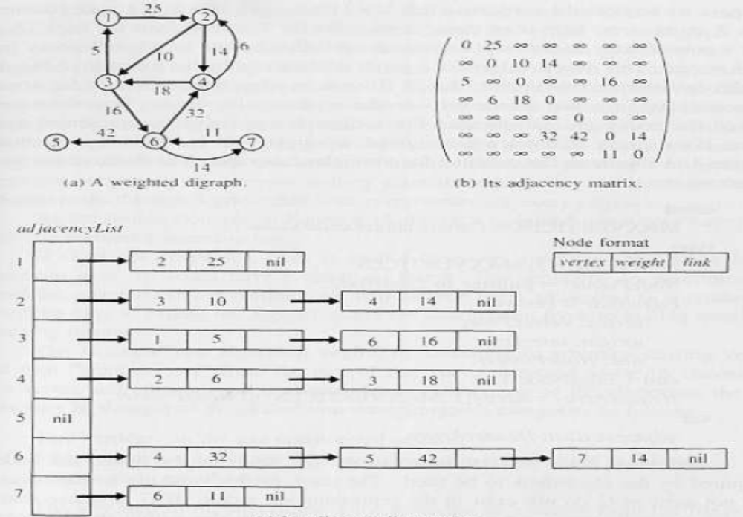
Weighted Graphs

Slide 17
Problem 1
Given an adjacency-list representation, how long does it take to compute the out-degree of every vertex?
  For each vertex u, search Adj[u] → Θ(E)
1
2
5 | /
2
1
5
3
4 | /
3
2
4
4
2
5
3 | /
5
4
1
2

Slide 18
Problem 2
How long does it take to compute the in-degree of every vertex?
  For each vertex u,
  search entire list of edges → Θ(VE)
1
2
5 | /
2
1
5
3
4 | /
3
2
4
4
2
5
3 | /
5
4
1
2

Slide 19
Network Models
Network models are used to solve a variety of problems:
the minimal-spanning tree technique,
the maximal-flow technique, and
the shortest-route technique.

Slide 20
Minimal-Spanning Tree Technique
Definition:
The minimal-spanning tree technique determines the path through the network that connects all the points while minimizing total distance.
For example:
If the points represent houses in a subdivision, the minimal spanning tree technique can be used to determine the best way to connect all of the houses to electrical power, water systems, etc.
in a way that minimizes the total distance or length of power lines or water pipes.

Slide 21
Minimal-Spanning Tree Steps
Selecting any node in the network.
Connecting this node to the nearest node minimizing the total distance.
Finding and connecting the nearest unconnected node.
  If there is a tie for the nearest node, one can be selected arbitrarily.
  A tie suggests that there may be more than one optimal solution.
Repeating the third step until all nodes are connected.

Slide 22
Minimal-Spanning Tree Technique
Solving the network for Melvin Lauderdale construction
Start by arbitrarily selecting node 1.
Since the nearest node is the third node at a distance of 2 (200 feet), connect node 1 to node 3.
Considering nodes 1 and 3, look for the next-nearest node.
  This is node 4, which is the closest to node 3 with a distance of 2 (200 feet).
Once again, connect these nodes

Slide 23
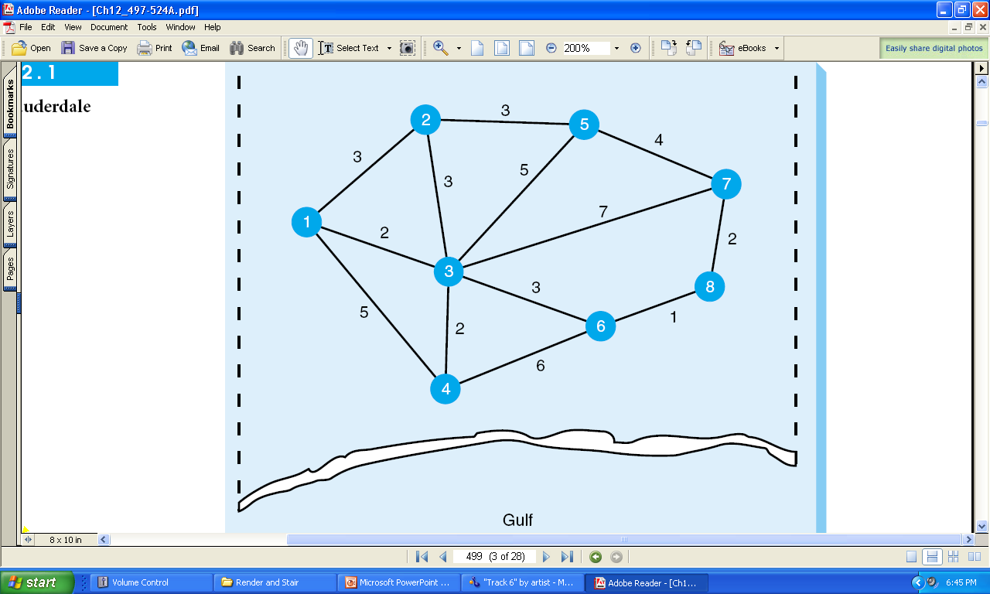
Network for Lauderdale Construction

Slide 24
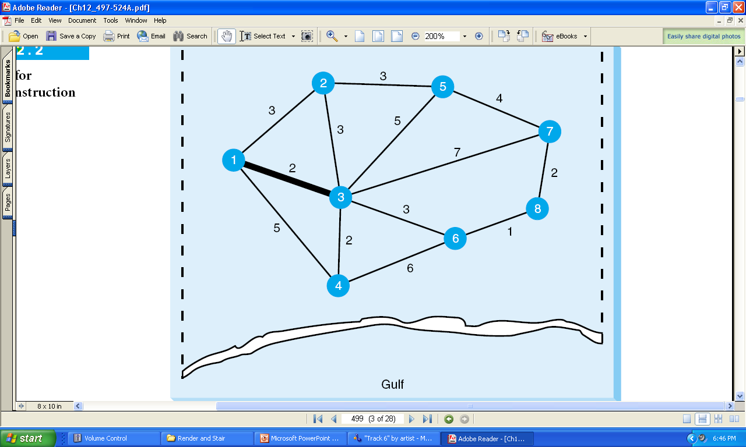
First Iteration

Slide 25
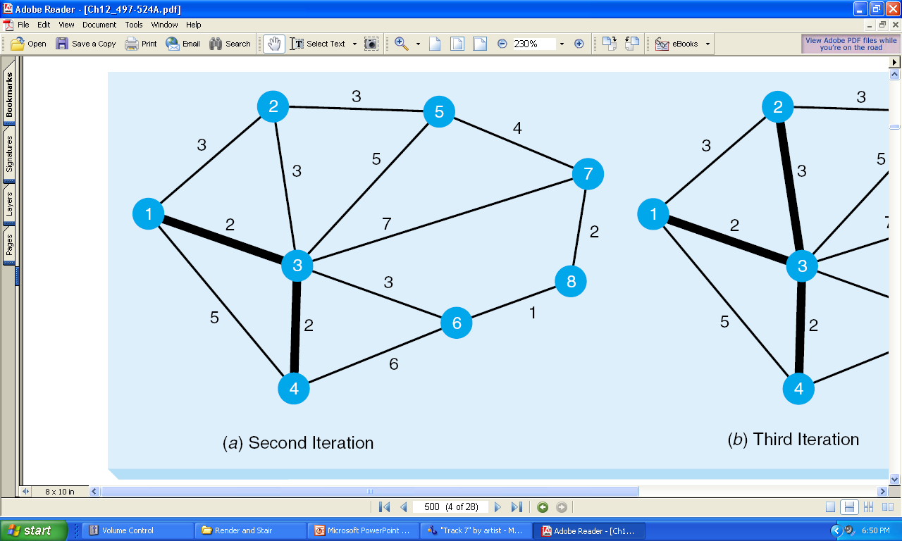
Second Iteration

Slide 26
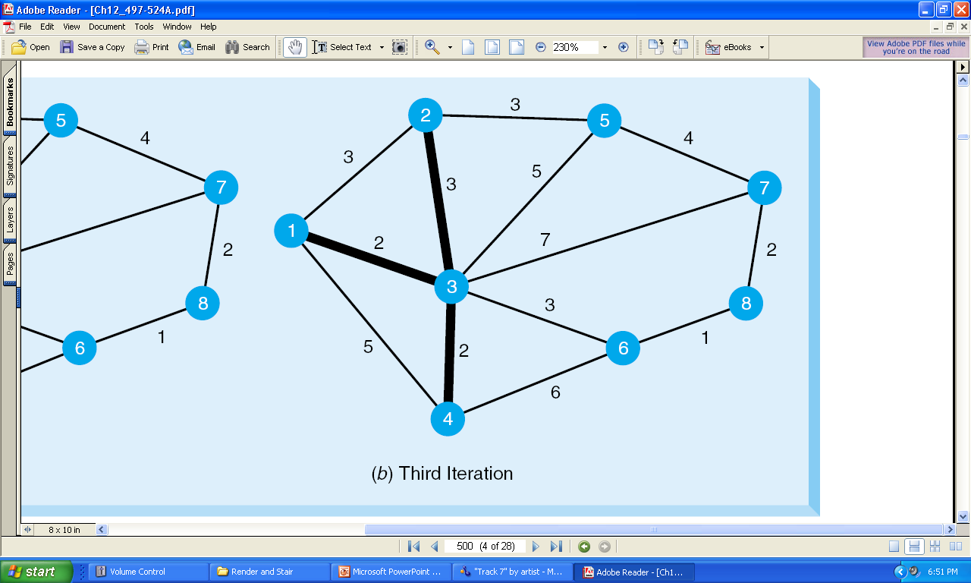
Third Iteration

Slide 27
Summarize: Minimal-Spanning Tree Technique
Step 1: Select node 1
Step 2: Connect node 1 to node 3
Step 3: Connect the next nearest node
Step 4: Repeat the process
The total number of iterations to solve this example is 7.
This final solution is on next slide

Slide 28
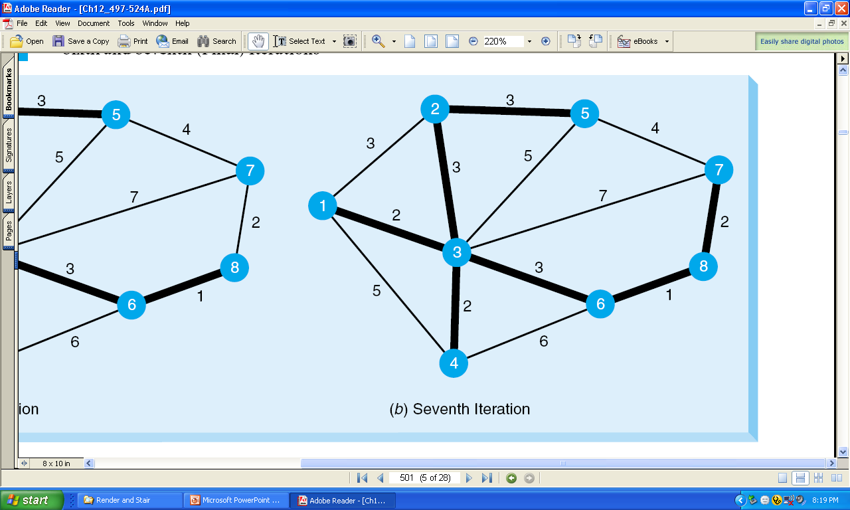
Third Iteration

Slide 29
Final Solution to the Minimal-Spanning Tree Example
Nodes 1, 2, 4, and 6 are all connected to node 3. Node 2 is connected to
node 5.
Node 6 is connected to node 8, and node 8 is connected to node 7.
All of the nodes are now connected.
The total distance is found by adding the distances for the arcs used in the spanning tree.
In this example, the distance is:
2 + 2 + 3 + 3 + 3 + 1 + 2 = 16 (or 1,600 feet).

Slide 30
Summary
Graphs and network models are used to solved certain real life problems.
Graph is a cyclic and non linear data structure.
Vertices V and Edges E are main components of graph
Main types of graphs are directed, un directed and weighted graphs.
Minimum spanning tree is an application of network model to solve the problems where you have to find shortest path over a network.

Slide 31
In Next Lecturer
In next lecture, we will discuss other network and graph models.

