Slide 1
Lecture 21.
Graphs and network models (Cont!!!)

Slide 2
Recap
Graphs are non linear and acyclic data structure and different network models use it.
The main components of graphs are nodes/vertices and edges/arcs.
Main types of graphs are directed, undirected and weighted graphs.
Graphs are represented through adjacency list and adjacency matrix.
Network models are graphs are traversed through using different techniques such as Minimal Spanning tree, Maximal Flow technique and shortest route technique

Slide 3
Maximal-Flow Technique
The maximal-flow technique allows the maximum amount of a material that can flow through a network to be determined.
For example:
  It has been used to find the maximum number of automobiles that can flow through a state highway system.
An example:
  Waukesha is in the process of developing a road system for down town.
  City planners would like to determine the maximum number of cars that can flow through the town from west to east.

Slide 4
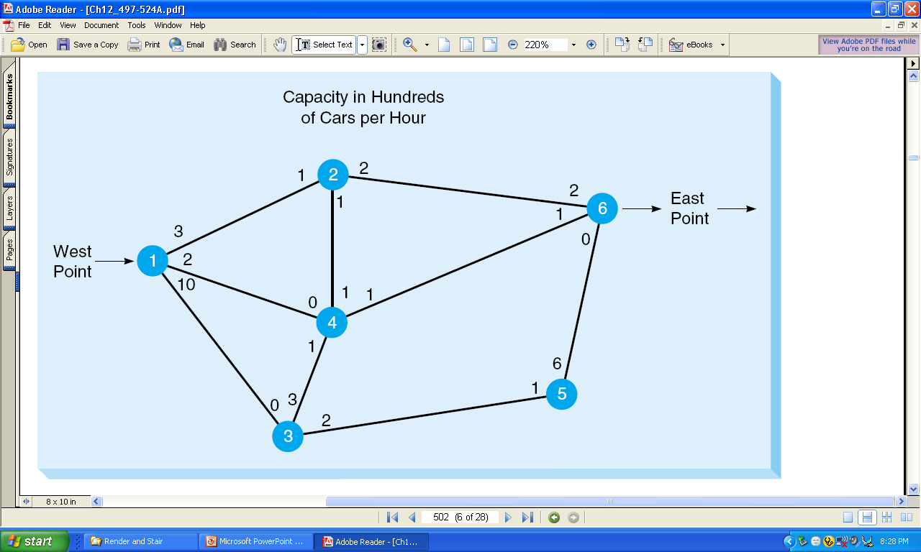
Road Network forWaukesha
Traffic can flow in both directions.

Slide 5
Maximal-Flow Technique (Cont!!!)
The Four Maximal-Flow Technique Steps:
Pick any path from the start (source) to the finish (sink) with some flow.
  If no path with flow exists, then the optimal solution has been found.
Find the arc on this path with the smallest flow capacity available.
  Call this capacity C.
  This represents the maximum additional capacity that can be allocated to this route.
For each node on this path, decrease the flow capacity in the direction of flow by the amount C.
  For each node on this path, increase the flow capacity in the reverse direction by the amount C.
Repeat these steps until an increase in flow is no longer possible.

Slide 6
Solving the Waukesha Example
Start by arbitrarily picking the path 1–2–6, at the top of the network.
What is the maximum flow from west to east? It is 2 because only 2 units (200 cars) can flow from node 2 to node 6.
Now we adjust the flow capacities . As you can see, we subtracted the maximum flow of 2 along the path 1–2–6 in the direction of the flow (west to east) and added 2 to the path in the direction against the flow (east to west).

Slide 7
Capacity Adjustment
Iteration 1
Add 2
1
2
2
2
Subtract 2
6
East
Point
3
West
Point
1
3
0
2
4
East
Point
6
1
New path
West
Point
1
© 2006 by Prentice Hall, Inc.
Upper Saddle River, NJ 07458

Slide 8
Solving the Waukesha Example
The New Path reflects the new relative capacity at this stage.
The flow number by any node represents two factors.
  One factor is the flow that can come from that node.
  The second factor is flow that can be reduced coming into the node.
The number 1 by node 1 indicates that 100 cars can flow from node 1 to node 2.
3
0
2
4
East
Point
6
1
New path
West
Point
1

Slide 9
Solving the Waukesha Example
The number 0 by node 2 on the path from node 2 to node 6 indicates that 0 cars can flow from node 2 to node 6.
3
0
2
4
East
Point
6
1
West
Point
1
New path
The number 4 by node 6, on the path from node 6 to node 2, indicates that
we can reduce the flow into node 6 by 2 (or 200 cars) and that there is
a capacity of 2 (or 200 cars) that can come from node 6.
These two factors total 4.

Slide 10
Solving the Waukesha Example
On the path from node 2 to node 1, the number 3 by node 2 shows that we can reduce the flow into node 2 by 2 (or 200 cars) and that there is a capacity of 1 (or 100 cars) from node 2 to node 1
3
0
2
4
East
Point
6
1
New path
West
Point
1
At this stage, there is a flow of 200 cars through the network from node 1
to node 2 to node 6.
The new relative capacity reflects this.

Slide 11
Repeat the Process
Now, repeat the process by picking another path with existing capacity.
Can arbitrarily pick path 1–2–4–6.
  The maximum capacity along this path is 1.
  In fact, the capacity at every node along this path (1–2–4–6) going from west to east is 1.
Remember, the capacity of branch 1–2 is now 1 because 2 units (200 cars per hour) are now flowing through the network.
So, need to increase the flow along path 1–2–4–6 by 1 and adjust the capacity flow

Slide 12
Second Iteration for Waukesha
2
Add 1
3
1
1
6
1
1
1
1
4
Subtract 1
Old Path

Slide 13
3
2
Add 1
1
1
6
Second Iteration for Waukesha
1
1
1
1
4
0
Subtract 1
4
2
Old Path
0
4
6
East
Point
2
0
West
Point
0
1
2
0
2
0
10
4
1
6
5
0
3
1
3
2
New Network

Slide 14
Continuing the Process
Now, there is a flow of 3 units (300 cars):
  200 cars per hour along path 1–2–6 plus
  100 cars per hour along path 1–2–4–6
Can the flow be further increased?
  Yes, along path 1–3–5–6.
  This is the bottom path.
  The maximum flow is 2 because this is the maximum from node 3 to node 5.

Slide 15
Third Iteration
0
4
2
0
4
6
East
Point
2
0
West
Point
0
1
2
0
2
0
10
4
1
Subtract 2
6
5
0
3
1
3
2
Add 2
© 2006 by Prentice Hall, Inc.
Upper Saddle River, NJ 07458

Slide 16
Continuing the Process
Again, repeat the process.
Try to find a path with any unused capacity through the network.
Carefully checking the third iteration in the last slide reveals that there are no more paths from node 1 to node 6 with unused capacity,
  even though several other branches in the network do have unused capacity.
The final network appears on the next slide.

Slide 17
Final Iteration
New Path
0
4
2
0
4
6
East
Point
2
0
West
Point
2
1
2
0
2
0
10
4
1
4
5
0
3
3
3
0
Path = 1, 3, 5, 6
© 2006 by Prentice Hall, Inc.
Upper Saddle River, NJ 07458

Slide 18
Final Network Flow
The maximum flow of 500 cars per hour is summarized in the following table:
(Cars per Hour)
PATH FLOW
0
1-2-6 200
1-2-4-6 100
1-3-5-6 200
Total =500
4
2
0
4
2
6
East
Point
0
2
West
Point
1
2
2
0
0
10
4
1
4
5
0
3
3
3
0

Slide 19
The Shortest-Route Technique
The shortest-route technique minimizes the distance through a network.
The shortest-route technique finds how a person or item can travel from one location to another while minimizing the total distance traveled.
The shortest-route technique finds the shortest route to a series of destinations.

Slide 20
Example: From Ray’s Plant to Warehouse
For example,
Every day, Ray Design, Inc., must transport beds, chairs, and other furniture items from the factory to the warehouse.
This involves going through several cities.
Ray would like to find the route with the shortest distance.

Slide 21
Shortest-Route Technique (continued)
Roads from Ray’s Plant to Warehouse:
Plant
200
2
4
100
100
100
1
50
150
6
200
100
3
5
40
Warehouse
© 2006 by Prentice Hall, Inc.
Upper Saddle River, NJ 07458

Slide 22
Steps of the Shortest-Route Technique
Find the nearest node to the origin (plant). Put the distance in a box by the node.
Find the next-nearest node to the origin (plant), and put the distance in a box by the node. In some cases, several paths will have to be checked to find the nearest node.
Repeat this process until you have gone through the entire network.
The last distance at the ending node will be the distance of the shortest route.
© 2006 by Prentice Hall, Inc.
Upper Saddle River, NJ 07458

Slide 23
Shortest-Route Technique (Cont!!!)
Ray Design: 1st Iteration
100
Plant
200
2
4
100
100
100
1
50
150
6
200
100
3
5
40
Warehouse
The nearest node to the plant is node 2, with a distance of 100 miles.
Thus, connect these two nodes.
© 2006 by Prentice Hall, Inc.
Upper Saddle River, NJ 07458

Slide 24
Shortest Route Technique (Cont!!!)
Ray Design: 2nd Iteration
100
200
2
4
100
100
100
1
50
150
6
200
100
3
5
40
150
The nearest node to the plant is node 3, with a distance of 50 miles.
Thus, connect these two nodes.
© 2006 by Prentice Hall, Inc.
Upper Saddle River, NJ 07458

Slide 25
Shortest-Route Technique (Cont!!!)
Ray Design: 3rd Iteration
100
200
2
4
100
100
100
1
50
150
6
200
100
3
5
40
150
190
The nearest node to the plant is node 5, with a distance of 40 miles.
Thus, connect these two nodes.
© 2006 by Prentice Hall, Inc.
Upper Saddle River, NJ 07458

Slide 26
Shortest Route Technique (Cont!!!)
4th and Final Iteration
290
100
200
2
4
100
100
100
1
50
150
6
200
100
3
5
40
150
190
Total Shortest Route =
100 + 50 + 40 + 100 = 290 miles.
© 2006 by Prentice Hall, Inc.
Upper Saddle River, NJ 07458

Slide 27
Minimum Connector Algorithms(Prim’s algorithm)
)
Select any vertex
Select the shortest edge connected to that vertex
Select the shortest edge connected to any vertex already connected
Repeat step 3 until all vertices have been connected

Slide 28
Example
A cable company want to connect five villages to their network which currently extends to the market town of Avonford. What is the minimum length of cable needed?
Brinleigh
5
Cornwell
3
4
8
6
8
Avonford
Fingley
Donster
7
5
4
2
Edan

Slide 29
We model the situation as a network, then the problem is to find the minimum connector for the network
B
5
C
3
4
8
6
8
A
F
D
7
5
4
2
E

Slide 30
Prim’s Algorithm
B
5
C
Select any vertex
A
Select the shortest edge connected to that vertex
AB 3
3
4
8
6
8
A
D
7
F
5
4
2
E

Slide 31
Prim’s Algorithm
B
5
C
Select the shortest
edge connected to
any vertex already
connected.
AE 4
3
4
8
6
8
A
D
7
F
5
4
2
E

Slide 32
Prim’s Algorithm
B
5
C
3
4
8
6
Select the shortest
edge connected to
any vertex already
connected.
ED 2
8
A
D
7
F
5
4
2
E

Slide 33
Prim’s Algorithm
B
5
C
Select the shortest
edge connected to
any vertex already
connected.
DC 4
3
4
8
6
8
A
D
7
F
5
4
2
E

Slide 34
Prim’s Algorithm
B
5
C
3
Select the shortest
edge connected to
any vertex already
connected.
EF 5
4
8
6
8
A
D
7
F
5
4
2
E

Slide 35
Prim’s Algorithm
B
5
C
All vertices have been
connected.
The solution is
AB 3
AE 4
ED 2
DC 4
EF 5
Total weight of tree: 18
3
4
8
6
8
A
D
7
F
5
4
2
E

Slide 36
Prim’s algorithm for finding MST
Step 1: x ∈ V, Let A = {x}, B = V - {x}.
Step 2: Select (u, v) ∈ E, u ∈ A, v ∈ B such that (u, v) has the smallest weight between A and B.
Step 3: Put (u, v) in the tree. A = A ∪ {v}, B = B - {v}
Step 4: If B = ∅, stop; otherwise, go to Step 2.

Slide 37
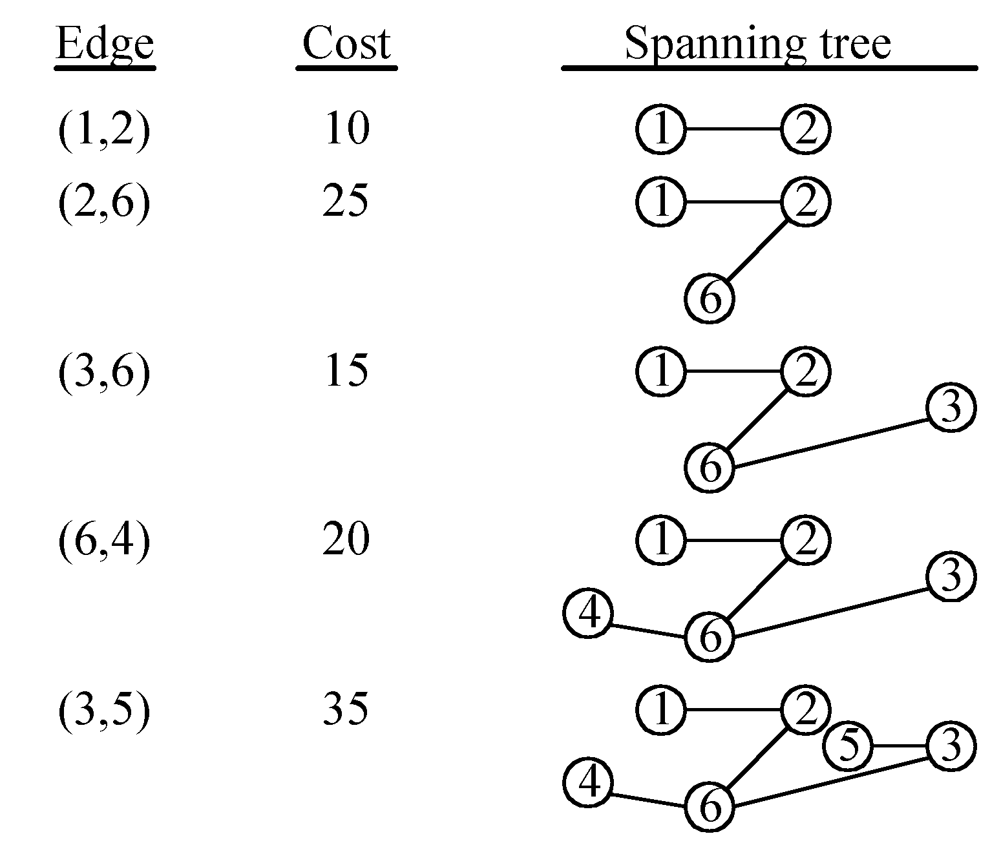
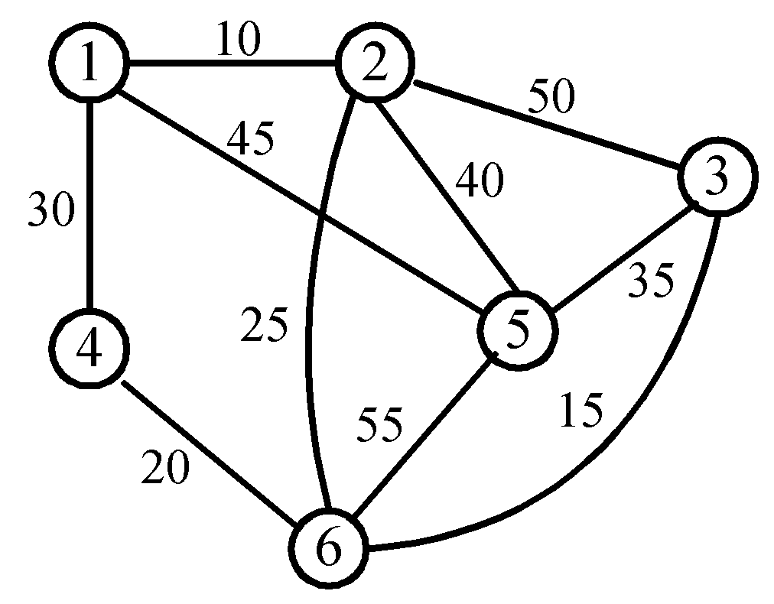
An example for Prim’s algorithm
4 -<number>

Slide 38
Analysis of Prim's Algorithm
Running Time = O(m + n log n) (m = edges, n = nodes)
Time complexity : O(n²), n = |V|.
If a heap is not used, the run time will be O(n^2) instead of O(m + n log n).
However, using a heap complicates the code since you’re complicating the data structure.
A Fibonacci heap is the best kind of heap to use, but again, it complicates the code.

Slide 39
Summary
Maximal Flow technique and shortest route technique are other two techniques of network model.
In Maximal Flow technique , maximum flow capacity of different problems is solved and in shortest route technique you have to solve the problems where you need to find distance.
Prim’s algorithm is also example graph or network and solve for making Minimal spanning tree with time complexity O(n²)

Slide 40
In next Lecturer
In next lecturer, we will discuss about the Kruskal and Dijkstra algorithm of network models or graphs.

