Slide 1
Lecture 22.
Kruskal and Dijkstra Algorithms

Slide 2
Recap
Maximal Flow technique and shortest route technique are other two techniques of network model.
In Maximal Flow technique , maximum flow capacity of different problems is solved and in shortest route technique you have to solve the problems where you need to find distance.
Prim’s algorithm is also example graph or network and solve for making Minimal spanning tree with time complexity O(n²)

Slide 3
Kruskal’s algorithm for finding MST
Step 1: Sort all edges into nondecreasing order.
Step 2: Add the next smallest weight edge to the forest if it will not cause a cycle.
Step 3: Stop if n-1 edges. Otherwise, go to Step2.

Slide 4
Example:
A cable company want to connect five villages to their network which currently extends to the market town of Avonford. What is the minimum length of cable needed?
Brinleigh
5
Cornwell
3
4
8
6
8
Avonford
Fingley
Donster
7
5
4
2
Edan

Slide 5
Example: (Kruskal Algorithm)
We model the situation as a network, then the problem is to find the minimum connector for the network
B
5
C
3
4
8
6
8
A
F
D
7
5
4
2
E

Slide 6
Example: (Kruskal Algorithm)
B
5
C
List the edges in order of size:
ED 2
AB 3
AE 4
CD 4
BC 5
EF 5
CF 6
AF 7
BF 8
CF 8
3
4
8
6
8
A
D
7
F
5
4
2
E

Slide 7
Example: (Kruskal Algorithm)
B
5
C
3
Select the shortest
edge in the network
ED 2
4
8
6
ED 2
AB 3
AE 4
CD 4
BC 5
EF 5
CF 6
AF 7
BF 8
CF 8
8
A
D
7
F
5
4
2
E

Slide 8
Example: (Kruskal Algorithm)
B
5
C
Select the next shortest
edge which does not
create a cycle
ED 2
AB 3
3
4
8
6
ED 2
AB 3
AE 4
CD 4
BC 5
EF 5
CF 6
AF 7
BF 8
CF 8
8
A
D
7
F
5
4
2
E

Slide 9
Example: (Kruskal Algorithm)
B
5
C
Select the next shortest
edge which does not
create a cycle
ED 2
AB 3
CD 4 (or AE 4)
3
4
8
6
ED 2
AB 3
AE 4
CD 4
BC 5
EF 5
CF 6
AF 7
BF 8
CF 8
8
A
D
7
F
5
4
2
E

Slide 10
Example: (Kruskal Algorithm)
B
5
C
Select the next shortest
edge which does not
create a cycle
ED 2
AB 3
CD 4
AE 4
3
4
8
6
ED 2
AB 3
AE 4
CD 4
BC 5
EF 5
CF 6
AF 7
BF 8
CF 8
8
A
D
7
F
5
4
2
E

Slide 11
Example: (Kruskal Algorithm)
B
5
C
Select the next shortest
edge which does not
create a cycle
ED 2
AB 3
CD 4
AE 4
BC 5 – forms a cycle
EF 5
3
4
8
6
ED 2
AB 3
AE 4
CD 4
BC 5
EF 5
CF 6
AF 7
BF 8
CF 8
8
A
D
7
F
5
4
2
E

Slide 12
Example: (Kruskal Algorithm)
B
5
C
All vertices have been
connected.
The solution is
ED 2
AB 3
CD 4
AE 4
EF 5
Total weight of tree: 18
3
ED 2
AB 3
AE 4
CD 4
BC 5
EF 5
CF 6
AF 7
BF 8
CF 8
4
8
6
8
A
D
7
F
5
4
2
E

Slide 13
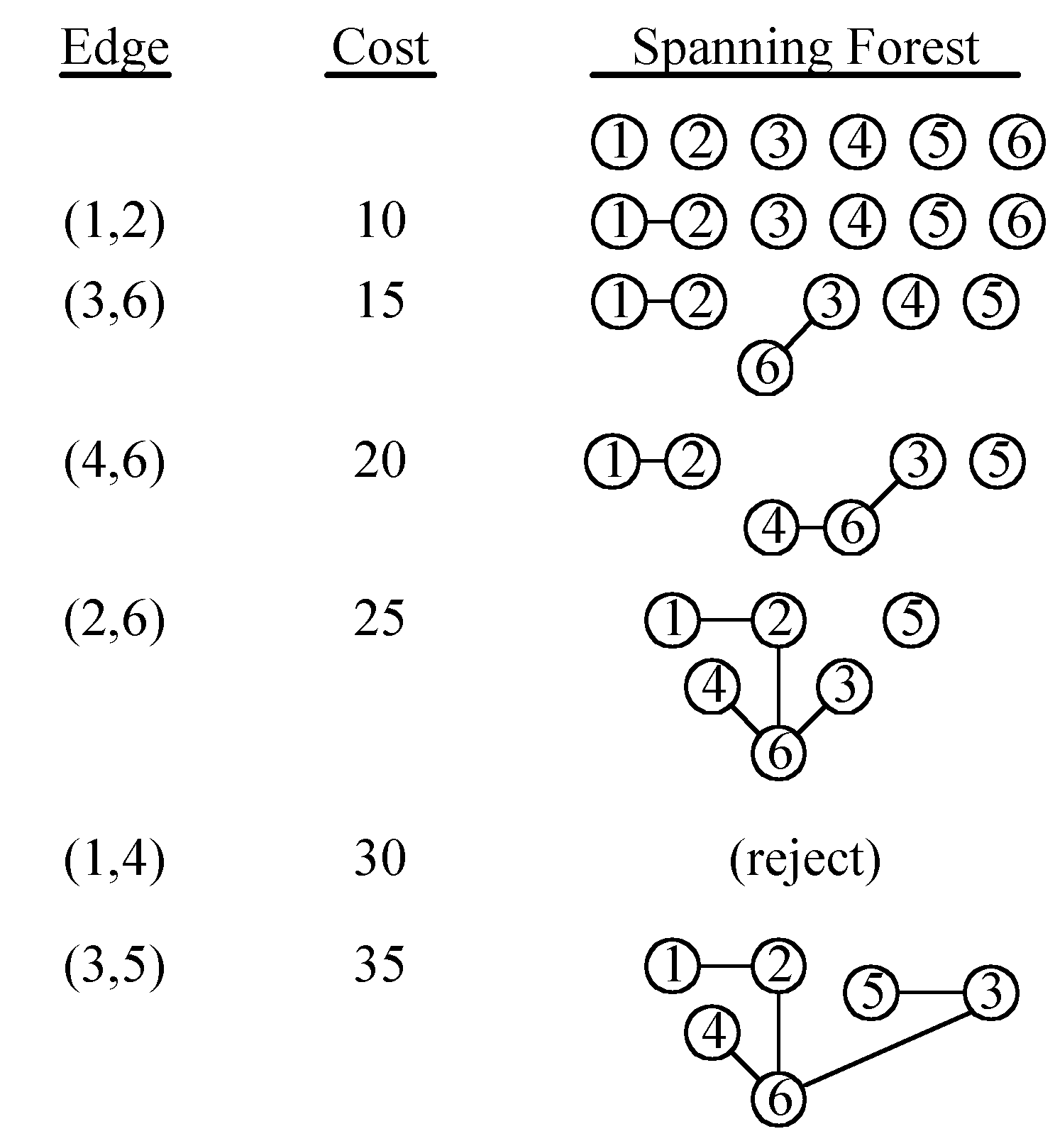
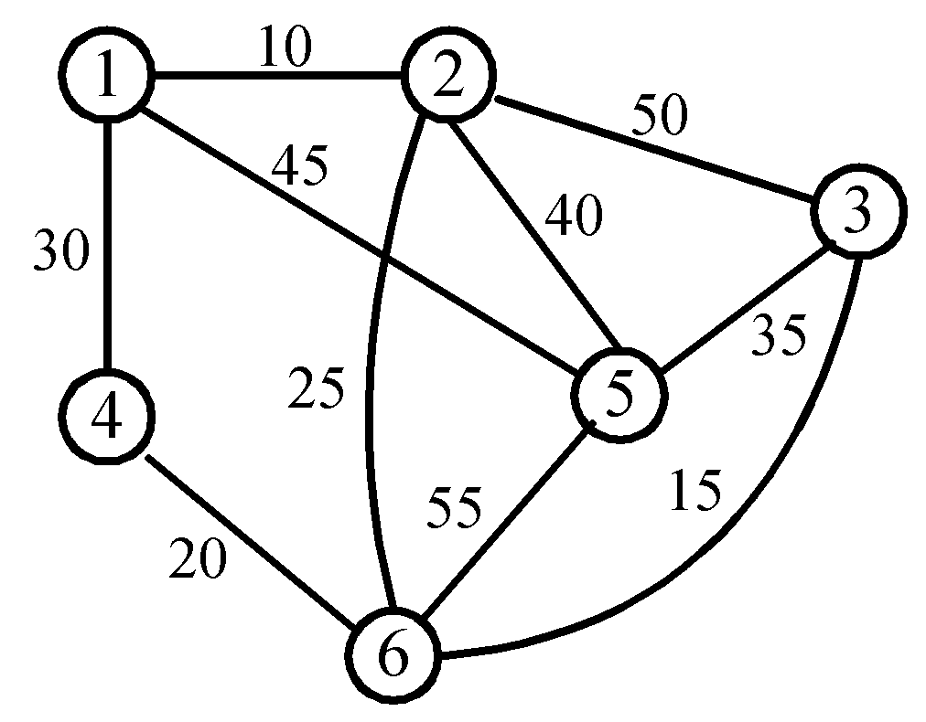
An example of Kruskal’s algorithm

Slide 14
The details for constructing MST
How do we check if a cycle is formed when a new edge is added?
  By the SET and UNION method.
A tree in the forest is used to represent a SET.
If (u, v) ∈ E and u, v are in the same set, then the addition of (u, v) will form a cycle.
If (u, v) ∈ E and u∈S₁ , v∈S₂ , then perform UNION of S₁ and S₂ .

Slide 15

Time complexity
Time complexity: O(|E| log|E|)
  Step 1: O(|E| log|E|)
  Step 2 & Step 3:
  Where α is the inverse of Ackermann’s function.

Slide 16
Dijkstra Algorithm
Works with directed and undirected graphs
Works with weighted and unweighted graphs
Rare type of algorithm ➔
A greedy algorithm that produces an optimal solution

Slide 17
Walk-Through
2
Initialize array
F
3
5
C
 | K | d_{v} | p_{v}
A | F | ∞ | −
B | F | ∞ | −
C | F | ∞ | −
D | F | ∞ | −
E | F | ∞ | −
F | F | ∞ | −
G | F | ∞ | −
H | F | ∞ | −
A
10
7
3
8
4
4
B
18
D
9
10
H
2
9
25
3
G
E
7

Slide 18
Example:
2
F
3
5
C
Start with G
A
10
7
3
8
4
B
18
4
D
 | K | d_{v} | p_{v}
A
B
C
D
E
F
G | T | 0 | −
H
9
10
H
9
2
25
3
G
E
7

Slide 19
Example:
2
F
3
5
C
A
10
Update unselected nodes
7
3
8
4
4
B
18
D
 | K | d_{v} | p_{v}
A
B
C
D |  | 2 | G
E
F
G | T | 0 | −
H |  | 3 | G
9
10
H
2
9
25
3
G
E
7

Slide 20
Example:
2
F
3
5
C
A
10
Select minimum distance
7
3
8
4
4
B
18
D
9
10
H
 | K | d_{v} | p_{v}
A
B
C
D | T | 2 | G
E
F
G | T | 0 | −
H |  | 3 | G
2
9
25
3
G
E
7

Slide 21
Example:
2
F
3
5
C
A
10
7
3
Update unselected nodes
8
4
4
B
18
D
 | K | d_{v} | p_{v}
A
B
C
D | T | 2 | G
E |  | 27 | D
F |  | 20 | D
G | T | 0 | −
H |  | 3 | G
9
10
H
2
9
25
3
G
E
7

Slide 22
Example:
2
F
3
5
C
A
10
7
3
4
Select minimum distance
8
18
4
B
D
9
 | K | d_{v} | p_{v}
A
B
C
D | T | 2 | G
E |  | 27 | D
F |  | 20 | D
G | T | 0 | −
H | T | 3 | G
H
10
2
9
25
3
G
E
7

Slide 23
2
F
3
5
C
Update unselected nodes
A
10
7
3
8
4
 | K | d_{v} | p_{v}
A |  | 7 | H
B |  | 12 | H
C
D | T | 2 | G
E |  | 27 | D
F |  | 20 | D
G | T | 0 | −
H | T | 3 | G
4
B
18
D
9
10
H
2
9
25
3
G
E
7

Slide 24
Example:
2
F
3
5
C
Select minimum distance
A
10
7
3
8
4
4
B
18
D
9
10
 | K | d_{v} | p_{v}
A | T | 7 | H
B |  | 12 | H
C
D | T | 2 | G
E |  | 27 | D
F |  | 20 | D
G | T | 0 | −
H | T | 3 | G
H
2
9
25
3
G
E
7

Slide 25
Example:
2
Update unselected nodes
F
3
5
C
A
10
 | K | d_{v} | p_{v}
A | T | 7 | H
B |  | 12 | H
C
D | T | 2 | G
E |  | 27 | D
F |  | 17 | A
G | T | 0 | −
H | T | 3 | G
7
3
8
4
4
B
18
D
9
10
H
2
9
25
3
G
E
7

Slide 26
Example:
2
F
3
5
C
Select minimum distance
A
10
7
3
8
4
 | K | d_{v} | p_{v}
A | T | 7 | H
B | T | 12 | H
C
D | T | 2 | G
E |  | 27 | D
F |  | 17 | A
G | T | 0 | −
H | T | 3 | G
4
B
18
D
9
10
H
2
9
25
3
G
E
7

Slide 27
Example:
Update unselected nodes
2
F
3
5
C
 | K | d_{v} | p_{v}
A | T | 7 | H
B | T | 12 | H
C |  | 16 | B
D | T | 2 | G
E |  | 22 | B
F |  | 17 | A
G | T | 0 | −
H | T | 3 | G
A
10
7
3
8
4
4
B
18
D
9
10
H
2
9
25
3
G
E
7

Slide 28
Example:
Select minimum distance
2
F
3
 | K | d_{v} | p_{v}
A | T | 7 | H
B | T | 12 | H
C | T | 16 | B
D | T | 2 | G
E |  | 22 | B
F |  | 17 | A
G | T | 0 | −
H | T | 3 | G
5
C
A
10
7
3
8
4
4
B
18
D
9
10
H
2
9
25
3
G
E
7

Slide 29
Example:
Update unselected nodes
2
 | K | d_{v} | p_{v}
A | T | 7 | H
B | T | 12 | H
C | T | 16 | B
D | T | 2 | G
E |  | 22 | B
F |  | 17 | A
G | T | 0 | −
H | T | 3 | G
F
3
5
C
A
10
7
3
8
4
4
B
18
D
9
10
H
2
9
25
3
G
E
7

Slide 30
Example:
Select minimum distance
2
F
3
 | K | d_{v} | p_{v}
A | T | 7 | H
B | T | 12 | H
C | T | 16 | B
D | T | 2 | G
E |  | 22 | B
F | T | 17 | A
G | T | 0 | −
H | T | 3 | G
5
C
A
10
7
3
8
4
4
B
18
D
9
10
H
2
9
25
3
G
E
7

Slide 31
Example:
Update unselected nodes
2
F
3
 | K | d_{v} | p_{v}
A | T | 7 | H
B | T | 12 | H
C | T | 16 | B
D | T | 2 | G
E |  | 19 | F
F | T | 17 | A
G | T | 0 | −
H | T | 3 | G
5
C
A
10
7
8
4
4
B
18
H
D
9
10
2
9
25
3
G
E
7

Slide 32
Example:
Select minimum distance
2
 | K | d_{v} | p_{v}
A | T | 7 | H
B | T | 12 | H
C | T | 16 | B
D | T | 2 | G
E | T | 19 | F
F | T | 17 | A
G | T | 0 | −
H | T | 3 | G
F
3
5
C
A
10
7
8
4
4
B
18
D
9
10
H
2
9
25
3
G
E
7
Done

Slide 33
Order of Complexity
Analysis
  findMin() takes O(V) time
  outer loop iterates (V-1) times
  ➔ O(V²) time
Optimal for dense graphs, i.e., |E| = O(V²)
Suboptimal for sparse graphs, i.e., |E| = O(V)

Slide 34
Order of Complexity
If the graph is sparse, i.e., |E| = O(V)
  maintain distances in a priority queue
  ➔ O(|E| log |V|) complexity

Slide 35
Summary
In Kruskal algoritm, MST is form by taking small value edge which are already in sorted order.
Its complexity is O(|E| log|E|)
Dijkstra algorithm will work especially for directed graphs.
In Dijkstra algorithm, each node is visit and its neighbour nodes are expanded and then same process remain continue until all nodes visited.

Slide 36
In Next Lecture
In next lecture, we will discuss about greedy algorithms and its types.

