Slide 1
Lecture 24.
Dynamic programming

Slide 2
Recap
Greedy approach algorithms are used tofind the optimal solution among all possible solution.
Huffman coding and other real world problem uses greedy approach to find optimal solution.
Some graphs algorithms like prims, Kruskal and Dijkstra also uses greedy approach to find MST.
Notes:
11

Slide 3
Dynamic Programming
Dynamic Programming is a general algorithm design technique
for solving problems defined by or formulated as recurrences with overlapping sub instances
Invented by American mathematician Richard Bellman in the 1950s to solve optimization problems and later assimilated by CS
“Programming” here means “planning”
Main idea:
    set up a recurrence relating a solution to a larger instance to solutions of some smaller instances
    - solve smaller instances once
    record solutions in a table
    extract solution to the initial instance from that table

Slide 4
Dynamic programming
Dynamic programming is typically applied to optimization problems. In such problem there can be many solutions. Each solution has a value, and we wish to find a solution with the optimal value.

Slide 5
The development of a dynamic programming
1. Characterize the structure of an optimal solution.
2. Recursively define the value of an optimal solution.
3. Compute the value of an optimal solution in a bottom up fashion.
4. Construct an optimal solution from computed information.

Slide 6
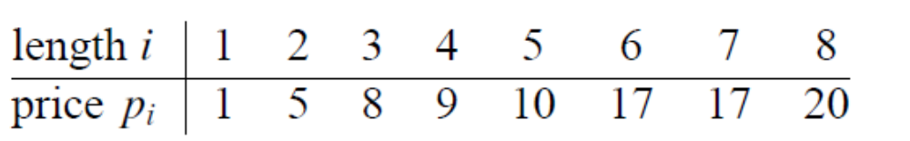
Rod cutting
Input: A length n and table of prices pi , for i = 1, 2, …, n.
Output: The maximum revenue obtainable for rods whose lengths sum to n, computed as the sum of the prices for the individual rods.

Slide 7

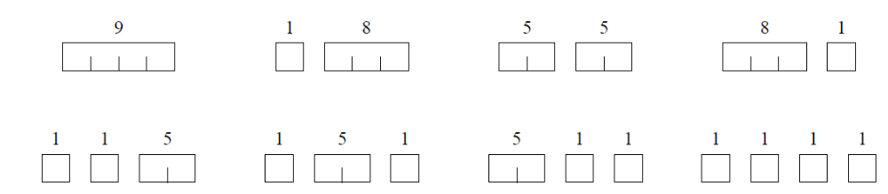
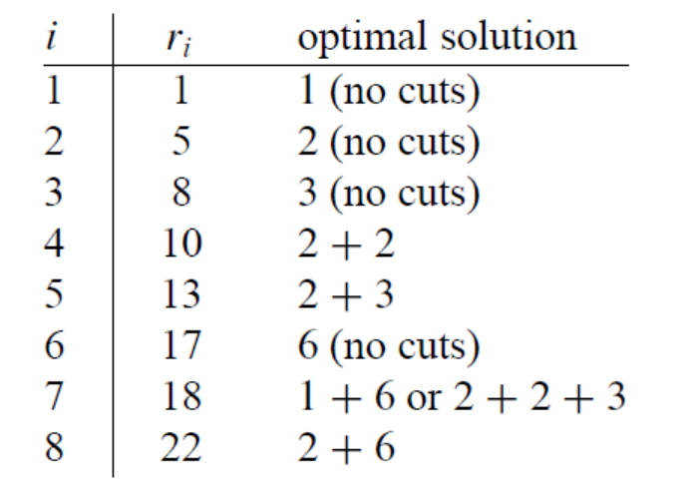
Ex: a rod of length 4

Slide 8
Example: Fibonacci numbers
Recall definition of Fibonacci numbers:
  F(n) = F(n-1) + F(n-2)
  F(0) = 0
  F(1) = 1
Computing the n^{th} Fibonacci number recursively (top-down):
F(n)
F(n-1) + F(n-2)
F(n-2) + F(n-3) F(n-3) + F(n-4)
...

Slide 9
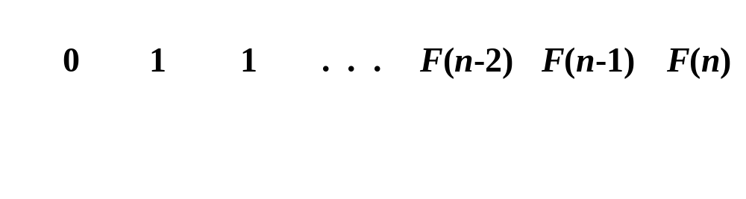
Example: Fibonacci numbers (cont.)
  Computing the n^{th} Fibonacci number using bottom-up iteration and recording results:
F(0) = 0
F(1) = 1
F(2) = 1+0 = 1
…
F(n-2) =
F(n-1) =
F(n) = F(n-1) + F(n-2)
Efficiency:
- time
- space
What if we solve it recursively?
n
n

Slide 10
Examples of DP algorithms
Computing a binomial coefficient
Longest common subsequence
Warshall’s algorithm for transitive closure
Floyd’s algorithm for all-pairs shortest paths
Constructing an optimal binary search tree
Some instances of difficult discrete optimization problems:
  - traveling salesman
  - knapsack

Slide 11
Computing a binomial coefficient by DP
  Binomial coefficients are coefficients of the binomial formula:
  (a + b)^{n} = C(n,0)a^{n}b⁰ + . . . + C(n,k)a^{n-k}b^{k} + . . . + C(n,n)a⁰b^{n}
  Recurrence: C(n,k) = C(n-1,k) + C(n-1,k-1) for n > k > 0
  C(n,0) = 1, C(n,n) = 1 for n ≥ 0
  Value of C(n,k) can be computed by filling a table:
  0 1 2 . . . k-1 k
  0 1
  1 1 1
  .
  .
  .
  n-1 C(n-1,k-1) C(n-1,k)
  n C(n,k)

Slide 12
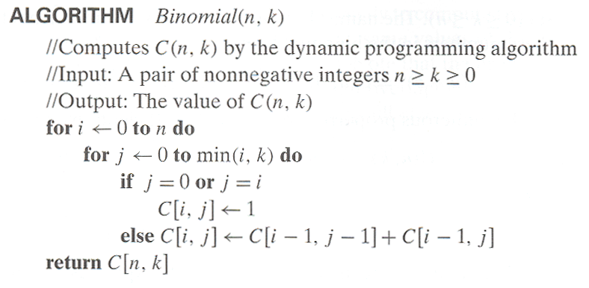
Computing C(n,k): pseudocode and analysis
Time efficiency: Θ(nk)
Space efficiency: Θ(nk)

Slide 13

Strassen's Matrix Multiplication
Suppose we want to multiply two matrices of size N x N: for example A x B = C.
C₁₁ = a₁₁b₁₁ + a₁₂b₂₁
C₁₂ = a₁₁b₁₂ + a₁₂b₂₂
C₂₁ = a₂₁b₁₁ + a₂₂b₂₁
C₂₂ = a₂₁b₁₂ + a₂₂b₂₂
2x2 matrix multiplication can be accomplished in 8 multiplication.(2^{log}₂⁸ =2³)

Slide 14
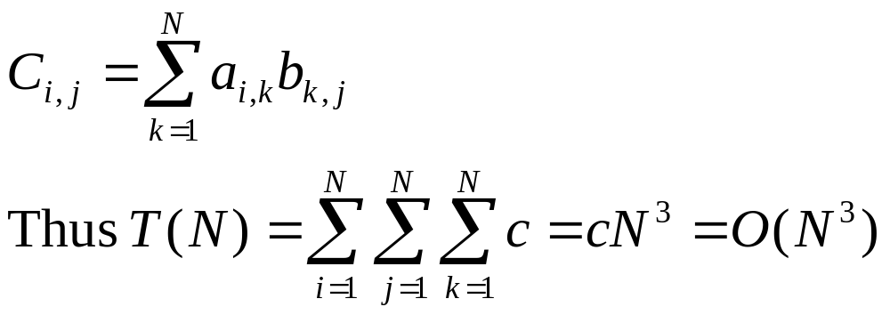
Basic Matrix Multiplication
void matrix_mult (){
for (i = 1; i <= N; i++) {
for (j = 1; j <= N; j++) { compute C_{i,j}; }
}}
algorithm
Time analysis

Slide 15
Algorithm to Multiply 2 Matrices
Input: Matrices A_{p×q} and B_{q×r} (with dimensions p×q and q×r)
Result: Matrix C_{p×r} resulting from the product A·B
MATRIX-MULTIPLY(A_{p×q} , B_{q×r})
1. for i ← 1 to p
2. for j ← 1 to r
3. C[i, j] ← 0
4. for k ← 1 to q
5. C[i, j] ← C[i, j] + A[i, k] · B[k, j]
6. return C

Slide 16
Strassens’s Matrix Multiplication
Strassen showed that 2x2 matrix multiplication can be accomplished in 7 multiplication and 18 additions or subtractions. .(2^{log}₂⁷ =2^{2.807})
This reduce can be done by Divide and Conquer Approach.

Slide 17
Divide-and-Conquer
Divide-and conquer is a general algorithm design paradigm:
  Divide: divide the input data S in two or more disjoint subsets S₁, S₂, …
  Recur: solve the subproblems recursively
  Conquer: combine the solutions for S₁, S₂, …, into a solution for S
The base case for the recursion are subproblems of constant size
Analysis can be done using recurrence equations

Slide 18
Divide and Conquer Matrix Multiply
A × B = R
A₀ | A₁
A₂ | A₃
B₀ | B₁
B₂ | B₃
A₀×B₀+A₁×B₂ | A₀×B₁+A₁×B₃
A₂×B₀+A₃×B₂ | A₂×B₁+A₃×B₃
×
=
Divide matrices into sub-matrices: A₀ , A₁, A₂ etc
Use blocked matrix multiply equations
Recursively multiply sub-matrices

Slide 19
Divide and Conquer Matrix Multiply
A × B = R
a₀
b₀
a₀ × b₀
×
=
Terminate recursion with a simple base case

Slide 20
Strassens’s Matrix Multiplication
P₁ = (A₁₁+ A₂₂)(B₁₁+B₂₂)
P₂ = (A₂₁ + A₂₂) * B₁₁
P₃ = A₁₁ * (B₁₂ - B₂₂)
P₄ = A₂₂ * (B₂₁ - B₁₁)
P₅ = (A₁₁ + A₁₂) * B₂₂
P₆ = (A₂₁ - A₁₁) * (B₁₁ + B₁₂)
P₇ = (A₁₂ - A₂₂) * (B₂₁ + B₂₂)
C₁₁ = P₁ + P₄ - P₅ + P₇
C₁₂ = P₃ + P₅
C₂₁ = P₂ + P₄
C₂₂ = P₁ + P₃ - P₂ + P₆

Slide 21
Comparison
C₁₁ = P₁ + P₄ - P₅ + P₇
= (A₁₁+ A₂₂)(B₁₁+B₂₂) + A₂₂ * (B₂₁ - B₁₁) - (A₁₁ + A₁₂) * B₂₂+
(A₁₂ - A₂₂) * (B₂₁ + B₂₂)
= A₁₁ B₁₁ + A₁₁ B₂₂ + A₂₂ B₁₁ + A₂₂ B₂₂ + A₂₂ B₂₁ – A₂₂ B₁₁ -
A₁₁ B₂₂ -A₁₂ B₂₂ + A₁₂ B₂₁ + A₁₂ B₂₂ – A₂₂ B₂₁ – A₂₂ B₂₂
= A₁₁ B₁₁ + A₁₂ B₂₁

Slide 22
Strassen Algorithm
void matmul(int *A, int *B, int *R, int n) {
if (n == 1) {
(*R) += (*A) * (*B);
} else {
matmul(A, B, R, n/4);
matmul(A, B+(n/4), R+(n/4), n/4);
matmul(A+2*(n/4), B, R+2*(n/4), n/4);
matmul(A+2*(n/4), B+(n/4), R+3*(n/4), n/4);
matmul(A+(n/4), B+2*(n/4), R, n/4);
matmul(A+(n/4), B+3*(n/4), R+(n/4), n/4);
matmul(A+3*(n/4), B+2*(n/4), R+2*(n/4), n/4);
matmul(A+3*(n/4), B+3*(n/4), R+3*(n/4), n/4);
}
Divide matrices in sub-matrices and recursively multiply sub-matrices

Slide 23
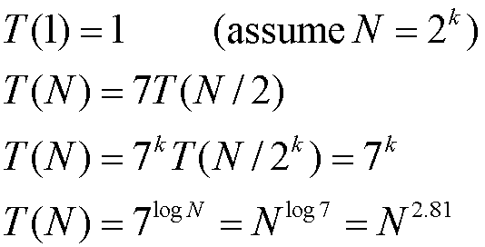
Time Analysis

Slide 24
Matrix-chain Multiplication
Suppose we have a sequence or chain A₁, A₂, …, A_{n} of n matrices to be multiplied
  That is, we want to compute the product A₁A₂…A_{n}
There are many possible ways (parenthesizations) to compute the product

Slide 25
Matrix-chain Multiplication
Example: consider the chain A₁, A₂, A₃, A₄ of 4 matrices
  Let us compute the product A₁A₂A₃A₄
There are 5 possible ways:
  (A₁(A₂(A₃A₄)))
  (A₁((A₂A₃)A₄))
  ((A₁A₂)(A₃A₄))
  ((A₁(A₂A₃))A₄)
  (((A₁A₂)A₃)A₄)

Slide 26
Matrix-chain Multiplication
To compute the number of scalar multiplications necessary, we must know:
  Algorithm to multiply two matrices
  Matrix dimensions

Slide 27
Matrix-chain Multiplication
Example: Consider three matrices A_{10×100}, B_{100×5}, and C_{5×50}
There are 2 ways to parenthesize
  ((AB)C) = D_{10×5} · C_{5×50}
    AB ⇒ 10·100·5=5,000 scalar multiplications
    DC ⇒ 10·5·50 =2,500 scalar multiplications
  (A(BC)) = A_{10×100} · E_{100×50}
    BC ⇒ 100·5·50=25,000 scalar multiplications
    AE ⇒ 10·100·50 =50,000 scalar multiplications
Total: 7,500
Total: 75,000

Slide 28
Matrix-chain Multiplication
Matrix-chain multiplication problem
  Given a chain A₁, A₂, …, A_{n} of n matrices, where for i=1, 2, …, n, matrix A_{i} has dimension p_{i-1}×p_{i}
  Parenthesize the product A₁A₂…A_{n} such that the total number of scalar multiplications is minimized
Brute force method of exhaustive search takes time exponential in n

Slide 29
Dynamic Programming Approach
The structure of an optimal solution
  Let us use the notation A_{i..j} for the matrix that results from the product A_{i} A_{i+1} … A_{j}
  An optimal parenthesization of the product A₁A₂…A_{n} splits the product between A_{k} and A_{k+1} for some integer k where1 ≤ k < n
  First compute matrices A_{1..k} and A_{k+1..n} ; then multiply them to get the final matrix A_{1..n}

Slide 30
Dynamic Programming Approach
  Key observation: parenthesizations of the subchains A₁A₂…A_{k} and A_{k+1}A_{k+2}…A_{n} must also be optimal if the parenthesization of the chain A₁A₂…A_{n} is optimal (why?)
  That is, the optimal solution to the problem contains within it the optimal solution to subproblems

Slide 31
Summary
Dynamic programming is typically applied to optimization problems. In such problem there can be many solutions.
.Each solution has a value, and we wish to find a solution with the optimal value.
There are many problem which can be solved through dynamic programming approach such as fibonacci series and binomial series.
Complexity of multiplication of two matrices is O(n³).
Complexity of multiplication of two matrices through Stressen approach is O(n^{2.78}).

Slide 32
In Next Lecture
In next Lecturer, we will discuss about the Knapsack problem using dynamic programming approach.

