Slide 1
Lecture 28.
Amortized Analysis of Algorithms

Slide 2
Recap
String is combination of characters ends with a special character known as Null(in computer languages such as C/C++)
A String comes with a prefix and suffix.
One character or a string can be match with given string.
Two important algorithm of string are Navii String matcher and Boyer Moore Algorithm which help to match a pattern of string over given string

Slide 3
Amortized Analysis
Not just consider one operation, but a sequence of operations on a given data structure.
Average cost over a sequence of operations.
Probabilistic analysis:
  Average case running time: average over all possible inputs for one algorithm (operation).
  If using probability, called expected running time.
Amortized analysis:
  No involvement of probability
  Average performance on a sequence of operations, even some operation is expensive.
  Guarantee average performance of each operation among the sequence in worst case.

Slide 4
Three Methods of Amortized Analysis
Aggregate analysis:
  Total cost of n operations/n,
Accounting method:
  Assign each type of operation an (different) amortized cost
  overcharge some operations,
  store the overcharge as credit on specific objects,
  then use the credit for compensation for some later operations.
Potential method:
  Same as accounting method
  But store the credit as “potential energy” and as a whole.

Slide 5
Example for amortized analysis
Stack operations:
  PUSH(S,x), O(1)
  POP(S), O(1)
  MULTIPOP(S,k), min(s,k)
    while not STACK-EMPTY(S) and k>0
    do POP(S)
    k=k-1
Let us consider a sequence of n PUSH, POP, MULTIPOP.
  The worst case cost for MULTIPOP in the sequence is O(n), since the stack size is at most n.
  thus the cost of the sequence is O(n²). Correct, but not tight.

Slide 6
Aggregate Analysis
In fact, a sequence of n operations on an initially empty stack cost at most O(n). Why?
Each object can be POP only once (including in MULTIPOP) for each time
it is PUSHed. #POPs is at most #PUSHs, which is at most n.
Thus the average cost of an operation is O(n)/n = O(1).
Amortized cost in aggregate analysis is defined to be average cost.

Slide 7
Another example: increasing a binary counter
Binary counter of length k, A[0..k-1] of bit array.
INCREMENT(A)
i←0
while i<k and A[i]=1
do A[i]←0 (flip, reset)
i←i+1
if i<k
then A[i]←1 (flip, set)

Slide 8
Analysis of INCREMENT(A)
Quick analysis:
  A single execution of INCREMENT takes O(k) in the worst case (when A contains all 1s)
  So a sequence of n executions takes O(nk) in worst case (suppose initial counter is 0).
  This bound is correct, but not tight.
The tight bound is O(n) for n executions.

Slide 9
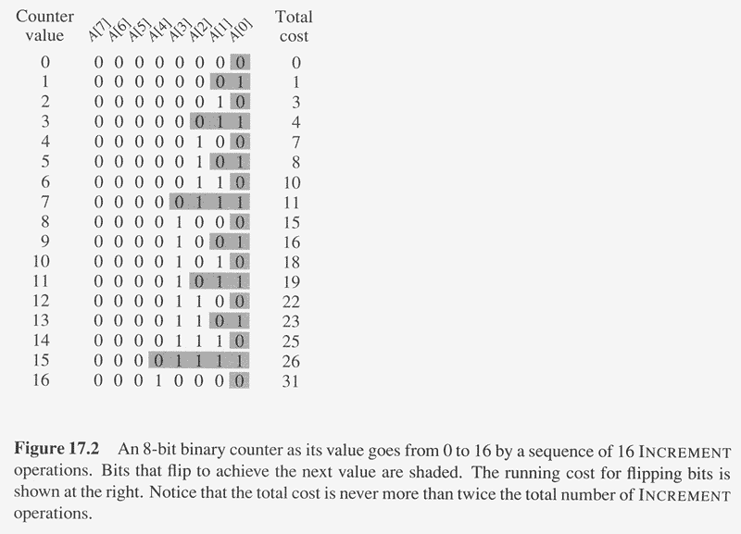
Amortized (Aggregate) Analysis of INCREMENT(A)
Observation: The running time determined by #flips
but not all bits flip each time INCREMENT is called.
A[0] flips every time, total n times.
A[1] flips every other time, ⎣n/2⎦ times.
A[2] flips every forth time, ⎣n/4⎦ times.
….
for i=0,1,…,k-1, A[i] flips ⎣n/2^{i}⎦ times.
Thus total #flips is ∑_{i=0}^{k-1} ⎣n/2^{i}⎦
< n∑_{i=0}∞ 1/2^{i}
=2n.

Slide 10
Amortized Analysis of INCREMENT(A)
Thus the worst case running time is O(n) for a sequence of n INCREMENTs.
So the amortized cost per operation is O(1).

Slide 11
Amortized Analysis: Accounting Method
Idea:
  Assign differing charges to different operations.
  The amount of the charge is called amortized cost.
  amortized cost is more or less than actual cost.
  When amortized cost > actual cost, the difference is saved in specific objects as credits.
  The credits can be used by later operations whose amortized cost < actual cost.
As a comparison, in aggregate analysis, all operations have same amortized costs.

Slide 12
Accounting Method (cont.)
Conditions:
  suppose actual cost is c_{i} for the ith operation in the sequence, and amortized cost is c_{i}',
  ∑_{i=1}^{n} c_{i}' ≥∑_{i=1}^{n} c_{i} should hold.
    since we want to show the average cost per operation is small using amortized cost, we need the total amortized cost is an upper bound of total actual cost.
    holds for all sequences of operations.
  Total credits is ∑_{i=1}^{n} c_{i}' - ∑_{i=1}^{n} c_{i} , which should be nonnegative,
    Moreover, ∑_{i=1}^{t} c_{i}' - ∑_{i=1}^{t} c_{i} ≥0 for any t>0.

Slide 13
Accounting Method: Stack Operations
Actual costs:
  PUSH :1, POP :1, MULTIPOP: min(s,k).
Let assign the following amortized costs:
  PUSH:2, POP: 0, MULTIPOP: 0.
Similar to a stack of plates in a cafeteria.
  Suppose $1 represents a unit cost.
  When pushing a plate, use one dollar to pay the actual cost of the push and leave one dollar on the plate as credit.
  Whenever POPing a plate, the one dollar on the plate is used to pay the actual cost of the POP. (same for MULTIPOP).
  By charging PUSH a little more, do not charge POP or MULTIPOP.
The total amortized cost for n PUSH, POP, MULTIPOP is O(n), thus O(1) for average amortized cost for each operation.
Conditions hold: total amortized cost ≥total actual cost, and amount of credits never becomes negative.

Slide 14
Accounting method: binary counter
Let $1 represent each unit of cost (i.e., the flip of one bit).
Charge an amortized cost of $2 to set a bit to 1.
Whenever a bit is set, use $1 to pay the actual cost, and store another $1 on
the bit as credit.
When a bit is reset, the stored $1 pays the cost.
At any point, a 1 in the counter stores $1, the number of 1’s is never negative, so is the total credits.
At most one bit is set in each operation, so the amortized cost of an operation is at most $2.
Thus, total amortized cost of n operations is O(n), and average is O(1).

Slide 15
The Potential Method
Same as accounting method: something prepaid is used later.
Different from accounting method
  The prepaid work not as credit, but as “potential energy”, or “potential”.
  The potential is associated with the data structure as a whole rather than with specific objects within the data structure.

Slide 16
The Potential Method (cont.)
Initial data structure D₀,
n operations, resulting in D₀, D₁,…, D_{n} with costs c₁, c₂,…, c_{n}.
A potential function Φ: {D_{i}} → R (real numbers)
Φ(D_{i}) is called the potential of D_{i}.
Amortized cost c_{i}' of the ith operation is:
  c_{i}' = c_{i} + Φ(D_{i}) - Φ(D_{i-1}). (actual cost + potential change)
∑_{i=1}^{n} c_{i}' = ∑_{i=1}^{n} (c_{i} + Φ(D_{i}) - Φ(D_{i-1}))
= ∑_{i=1}^{n}c_{i} + Φ(D_{n}) - Φ(D₀)

Slide 17
The Potential Method (cont.)
If Φ(D_{n}) ≥ Φ(D₀), then total amortized cost is an upper bound of total actual cost.
But we do not know how many operations, so Φ(D_{i}) ≥ Φ(D₀) is required for any i.
It is convenient to define Φ(D₀)=0,and so Φ(D_{i}) ≥0, for all i.
If the potential change is positive (i.e., Φ(D_{i}) - Φ(D_{i-1})>0), then c_{i}' is an overcharge (so store the increase as potential),
otherwise, undercharge (discharge the potential to pay the actual cost).

Slide 18
Potential method: stack operation
Potential for a stack is the number of objects in the stack.
So Φ(D₀)=0, and Φ(D_{i}) ≥0
Amortized cost of stack operations:
  PUSH:
    Potential change: Φ(D_{i})- Φ(D_{i-1}) =(s+1)-s =1.
    Amortized cost: c_{i}' = c_{i} + Φ(D_{i}) - Φ(D_{i-1})=1+1=2.
  POP:
    Potential change: Φ(D_{i})- Φ(D_{i-1}) =(s-1) –s= -1.
    Amortized cost: c_{i}' = c_{i} + Φ(D_{i}) - Φ(D_{i-1})=1+(-1)=0.
  MULTIPOP(S,k): k'=min(s,k)
    Potential change: Φ(D_{i})- Φ(D_{i-1}) = –k'.
    Amortized cost: c_{i}' = c_{i} + Φ(D_{i}) - Φ(D_{i-1})=k'+(-k')=0.
So amortized cost of each operation is O(1), and total amortized cost of n operations is O(n).
Since total amortized cost is an upper bound of actual cost, the worse case cost of n operations is O(n).

Slide 19
Potential method: binary counter
Define the potential of the counter after the ith INCREMENT is Φ(D_{i}) =b_{i}, the number of 1’s. clearly, Φ(D_{i})≥0.
Let us compute amortized cost of an operation
  Suppose the ith operation resets t_{i} bits.
  Actual cost c_{i} of the operation is at most t_{i} +1.
  If b_{i}=0, then the ith operation resets all k bits, so b_{i-1}=t_{i}=k.
  If b_{i}>0, then b_{i}=b_{i-1}-t_{i}+1
  In either case, b_{i}≤b_{i-1}-t_{i}+1.
  So potential change is Φ(D_{i}) - Φ(D_{i-1}) ≤b_{i-1}-t_{i}+1-b_{i-1}=1-t_{i.}
  So amortized cost is: c_{i}' = c_{i} + Φ(D_{i}) - Φ(D_{i-1}) ≤ t_{i} +1+1-t_{i}=2.
The total amortized cost of n operations is O(n).
Thus worst case cost is O(n).

Slide 20
Amortized analyses: dynamic table
A nice use of amortized analysis
Table-insertion, table-deletion.
Scenario:
  A table –maybe a hash table
  Do not know how large in advance
  May expend with insertion
  May contract with deletion
  Detailed implementation is not important
Goal:
  O(1) amortized cost.
  Unused space always ≤ constant fraction of allocated space.

Slide 21
Dynamic table
Load factor α = num/size, where num = # items stored, size = allocated size.
If size = 0, then num = 0. Call α = 1.
Never allow α > 1.
Keep α >a constant fraction → goal (2).

Slide 22
Dynamic table: expansion with insertion
Table expansion
Consider only insertion.
When the table becomes full, double its size and reinsert all existing items.
Guarantees that α ≥ 1/2.
Each time we actually insert an item into the table, it’s an elementary insertion.

Slide 23
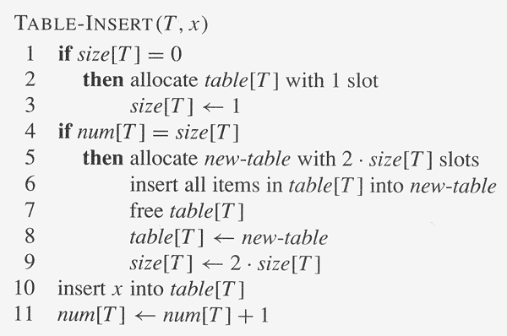
Initially, num[T ] = size[T ] = 0.

Slide 24
Aggregate analysis
Running time: Charge 1 per elementary insertion. Count only elementary insertions,
since all other costs together are constant per call.
ci = actual cost of ith operation
  If not full, ci = 1.
  If full, have i − 1 items in the table at the start of the ith operation. Have to copy all i − 1 existing items, then insert ith item, ⇒ ci = i
Cursory analysis: n operations ⇒ ci = O(n) ⇒ O(n²) time for n operations.
Of course, we don’t always expand:
  ci = i if i − 1 is exact power of 2 ,
  1 otherwise .
So total cost =∑_{i=1}^{n} ci ≤n+ ∑_{i=0}^{log(n)} 2^{i} ≤n+2n=3n
Therefore, aggregate analysis says amortized cost per operation = 3.

Slide 25
Accounting analysis
Charge $3 per insertion of x.
  $1 pays for x’s insertion.
  $1 pays for x to be moved in the future.
  $1 pays for some other item to be moved.
Suppose we’ve just expanded, size = m before next expansion, size = 2m after next expansion.
Assume that the expansion used up all the credit, so that there’s no credit stored after the expansion.
Will expand again after another m insertions.
Each insertion will put $1 on one of the m items that were in the table just after expansion and will put $1 on the item inserted.
Have $2m of credit by next expansion, when there are 2m items to move. Just enough to pay for the expansion, with no credit left over!

Slide 26
Potential method
Potential method
Φ(T ) = 2 ・ num[T ] − size[T ]
Initially, num = size = 0⇒ Φ = 0.
• Just after expansion, size = 2 ・ num ⇒ Φ = 0.
Just before expansion, size = num ⇒ Φ = num ⇒ have enough potential to pay for moving all items.
Need Φ ≥ 0, always.
Always have
  size ≥ num ≥ ½ size ⇒ 2 ・ num ≥ size ⇒ Φ ≥ 0 .

Slide 27
Potential method
Amortized cost of ith operation:
  num_{i} = num after ith operation ,
  size_{i} = size after ith operation ,
  Φ_{i} = Φ after ith operation .
If no expansion:
  size_{i} = size_{i−1} ,
  num_{i} = num_{i−1} +1 ,
  ci = 1 .
Then we have
  C_{i}’ = c_{i} + Φ_{i} − Φ_{i−1} = 1 + (2num_{i} −size_{i} ) − (2num_{i−1} −size_{i−1}) =3.
If expansion:
  size_{i} = 2size_{i−1} ,
  size_{i−1} = num_{i−1} = num_{i} −1 ,
  c_{i} = num_{i−1} +1 = num_{i}.
Then we have
C_{i}’ = c_{i} + Φ_{i} − Φ_{i−1} = num_{i} + (2num_{i} −size_{i} ) − (2num_{i−1} −size_{i−1}) = num_{i} + (2num_{i} −2(num_{i} −1)) − (2(num_{i} −1) − (num_{i} −1)) = num_{i} + 2 − (num_{i} −1) = 3

Slide 28
Summary
Amortized analysis:
  No involvement of probability
  Average performance on a sequence of operations, even some operation is expensive.
  Guarantee average performance of each operation among the sequence in worst case.
Important methods of amortized analysis are Aggregate , Potential and Accounting method.
Examples of algorithms for amortized analysis are
  Stack
  Binary increment
  Dynamic table

Slide 29
In Next Lecture
In next lecture, we will discuss about data compression algorithms.

