Slide 1
Lecture 31
Revision of Lectures (1 to 15)

Slide 2
What is an algorithm
An algorithm is a step by step procedure to solve a problem
  Plate form independent
  Can be implement in any procedural langauge
Simplest form (for experts) is Pseudo code
Pseudo code can be written in any language syntax, but here in this course we will used C/C++ syntax
Two important factors
  Space Tradeoff (Refer to less use of memory i.e. RAM)
  Time Tradeoff (Refer to less time of Micro processor for execution)

Slide 3
Features of algorithm
Complete
Finite
At least one Output
0,1 or more inputs
Correct
Clarity

Slide 4
An Algorithm (Example) and its notations
Algorithm SUM (No1, No2, Res)
{ This algorithm is used to read two numbers and print its sum }
Step-1 [ Read numbers No1 and No2]
Read(No1,No2)
Step-2 [Calculate the sum]
Res=No1+No2
Step-3 [Display the Result ]
Write(Res)
Step-4 {Finish]
Exit
C Language Program:
void main()
{
int no1, no2, res;
scanf(“%d%d”, &a, &b);
res = a+b;
printf(“Sum=%d”, res);
}

Slide 5
What is the "best" Algorithm
You can considered an algorithm best on the base of following questions.
  How fast does it run?
    Refer to processing time
  How "complicated" is the algorithm
    Time Complexity
    Space Complexity
  How well is the algorithm documented
    Written pseudo code should be clear , complete and well documented
  Can the machine used have influence on the results
    Yes
    Some good algorithms can not perform well on slow machines.

Slide 6
The RAM Model
Random Access Machine (not R.A. Memory)
An idealized notion of how the computer works
  Each "simple" operation (+, -, =, if) takes exactly 1 step.
  Each memory access takes exactly 1 step
  Loops and method calls are not simple operations, but depend upon the size of the data and the contents of the method.
Measure the run time of an algorithm by counting the number of steps.

Slide 7
Space Complexity
The amount of memory required by an algorithm to run to completion
Fixed part: The size required to store certain data/variables, that is independent of the size of the problem:
  Such as int a (2 bytes, float b (4 bytes) etc
Variable part: Space needed by variables, whose size is dependent on the size of the problem:
  Dynamic array a[]

Slide 8
Running Time of Algorithms
Running time
  depends on input size n
    size of an array
    polynomial degree
    # of elements in a matrix
    # of bits in the binary representation of the input
    vertices and edges in a graph
  number of primitive operations performed
Primitive operation
  unit of operation that can be identified in the pseudo-code

Slide 9
Steps To determine Time Complexity
Step-1. Determine how you will measure input size. Ex:
  N items in a list
  N x M table (with N rows and M columns)
  Two numbers of length N
Step-2. Choose the type of operation (or perhaps two operations)
  Comparisons
  Swaps
  Copies
  Additions
Note: Normally we don't count operations in input/output.

Slide 10
Steps To determine Time Complexity (Cont !!!)
Step-3. Decide whether you wish to count operations in the
  Best case? - the fewest possible operations
  Worst case? - the most possible operations
  Average case? This is harder as it is not always clear what is meant by an "average case". Normally calculating this case requires some higher mathematics such as probability theory.
Step-4. For the algorithm and the chosen case (best, worst, average), express the count as a function of the input size of the problem.

Slide 11
Steps To determine Time Complexity (Cont !!!)
5. Given the formula that you have determined, decide the complexity class of the algorithm.
Q. What is the complexity class of an algorithm?
A. a complexity class is a set of problems of related resource-based complexity, such as P, NP classes
Q. Is there really much difference between
3n
5n + 20
and 6n -3
A. Yes but when n is large?

Slide 12
Primitive Operations in an algorithm
Assign a value to a variable (i.e. a=5)
Call a method (i.e. method())
Arithmetic operation (i.e. a*b, a-b*c)
Comparing two numbers ( i.e. a<=b, a>b &&a>c)
Indexing into an array (i.e. a[0]=5)
Following an object reference (i.e. Test obj)
Returning from a method (i.e. return I )

Slide 13
Primitive Operations: Example -1
Count the number of primitive operations in this program :
  Int method()
  {
  i = 0;
  a = 0;
  for (i=1;i<=n;i++)
  { printf(“%d”,i);
  a=a+i; }
  return I
  }
Primitive Operations | Yes/No | Total
Assign a value to a variable
Call a method
Arithmetic operation
Comparing two numbers
Indexing into an array
Following an object reference
Returning from a method

Slide 14
Primitive Operations: Example -1 (Cont !!!)
Primitive Operations | Yes/No | Total
Assign a value to a variable | Yes | 5
Call a method | No | 0
Arithmetic operation | Yes | 2
Comparing two numbers | Yes | 1
Indexing into an array | No | 0
Following an object reference | No | 0
Returning from a method | Yes | 1

Slide 15
Run Time Analysis (Cont !!!)
int method()
{
int I, codd, ceven, a[5]={5,4,3,2,1}; --------- c1
ceven=0;codd=0; ----------- c2
for(i=0;i<=4;i++) ------ c3
if(a[i]%2==0) -------- c4
ceven++;-------- c5
else
codd++; ------- c5
printf(“Total evens %d and Total Odd %d”, ceven, codd);
Return 0; ---------- c6
}
Run Time Complexity will be = c1+c2 + n* (c3 +c4 + c5)+ c6
= c1 + c2 + n*c +c6
= n*c + c
= n

Slide 16
Run Time Analysis (Cont !!!)
int method()
{
int r,c, a[][]= { {1,2}, {1,3}}; --------- c1
for(c=0;c<=1;c++) ------ c2
for(r=0;r<=1;r++)
a[r][c]=a[r][c]+5;----------- c3+c4+c5
for(c=0;c<=1;c++)
for(r=0;r<=1;r++)
printf(“%d”, a[r][c]);
return 0; ---------- c6
}
Note:-
C3 refer to array scripts use
C4 refer to arithmetic op +
C5 refer to assignment
N * m = n ²
Run Time Complexity will be = c1 + n * m * (c2+c3+c4+c5) + n * m * c4 + c6
= c1 +c6 + n*m*c + n*m*c +
= 2*n*m*c + c
= n*m*c
= n*m = n²
N * m = n ²

Slide 17
Types of Algorithm Complexity
Worst Case Complexity:
  the function defined by the maximum number of steps taken on any instance of size n
Best Case Complexity:
  the function defined by the minimum number of steps taken on any instance of size n
Average Case Complexity:
  the function defined by the average number of steps taken on any instance of size n

Slide 18
Types of Algorithm Complexity
(Example: Linear Search)
5 | 7 | 2 | 6 | 9 | 12 | 1
Worst Case Complexity:
  You want to search 1 in above array which is at location N
  You need N steps
Best Case Complexity:
  You want to search 5 in above array which is at location 1
  You need 1 steps
Average Case Complexity:
  You want to search 2 or 9 etc in above array
  You need 3 steps for 2 and 5 steps for 9

Slide 19
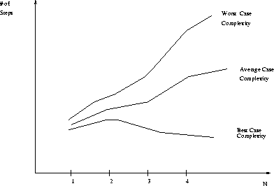
Best, Worst, and Average Case Complexity
Number of steps
Worst Case Complexity
Average Case Complexity
Best Case Complexity
N
(input size)

Slide 20
How do we analyze algorithms?
We need to define a number of objective measures.
(1) Compare execution times?
Not good: times are specific to a particular computer
(2) Count the number of statements executed?
Not good: number of statements vary with the programming
language as well as the style of the individual programmer. (see example on next slide)

Slide 21
How do we analyze algorithms Example (# of statements)
Algorithm 1 Algorithm 2
arr[0] = 0; for(i=0; i<N; i++)
arr[1] = 0; arr[i] = 0;
arr[2] = 0;
...
arr[N-1] = 0;
Notes:
Discrete Mathematics and its Applications
26年 11月 8日
(c)2001-2002, Michael P. Frank

Slide 22
How do we analyze algorithms (Cont !!!)
(3). Express running time as a function of the input size n (i.e., f(n)).
  To compare two algorithms with running times f(n) and g(n), we need a rough measure of how fast a function grows.
  Such an analysis is independent of machine time, programming style, etc.
Notes:
Discrete Mathematics and its Applications
26年 11月 8日
(c)2001-2002, Michael P. Frank

Slide 23
Example-1. (Run time Cost Analysis)
Associate a "cost" with each statement.
Find the "total cost“ by finding the total number of times each statement is executed.
Algorithm 1 Algorithm 2
Cost Cost
arr[0] = 0; c₁ for(i=0; i<N; i++) c₂
arr[1] = 0; c₁ arr[i] = 0; c₁
arr[2] = 0; c₁
... ...
arr[N-1] = 0; c₁
----------- -------------
c₁+c₁+...+c₁ = c₁ x N (N+1) x c₂ + N x c₁ =
(c₂ + c₁) x N + c₂

Slide 24
Asymptotic Analysis
To compare two algorithms with running times f(n) and g(n), we need a rough measure that characterizes how fast each function grows.
Hint: use rate of growth
Compare functions in the limit, that is, asymptotically!
  (i.e., for large values of n)

Slide 25
Rate/order of Growth
Consider the example of buying elephants and goldfish:
Cost: cost_of_elephants + cost_of_goldfish
Cost ~ cost_of_elephants (approximation)
The low order terms in a function are relatively insignificant for large n
n⁴ + 100n² + 10n + 50 ~ n⁴
i.e., we say that n⁴ + 100n² + 10n + 50 and n⁴ have the same rate of growth

Slide 26
Rate/order of Growth
Let f(n) = 3n²+5n+6
Important point to be noted when you are finding order of growth
  Remove all constants of function f(n) for an algorithm, such as
    remove 6 from above f(n)
  Remove low order terms such as
    Remove or ignore 5n from above f(n)
  Remove coefficient of high order term such
    Remove or ignore 3 from above f(n)

Slide 27
Rate of Growth ≡Asymptotic Analysis
Using rate of growth as a measure to compare different functions implies comparing them asymptotically.
If f(x) is faster growing than g(x), then f(x) always eventually becomes larger than g(x) in the limit (for large enough values of x).
Notes:
Discrete Mathematics and its Applications
26年 11月 8日
(c)2001-2002, Michael P. Frank

Slide 28
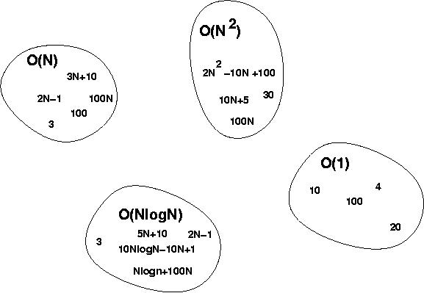
Big-O Visualization
Notes:
Discrete Mathematics and its Applications
26年 11月 8日
(c)2001-2002, Michael P. Frank

Slide 29
Asymptotic Notation
O notation: asymptotic “less than”:
  f(n)=O(g(n)) implies: f(n) “≤” g(n)
Ω notation: asymptotic “greater than”:
  f(n)= Ω (g(n)) implies: f(n) “≥” g(n)
Θ notation: asymptotic “equality”:
  f(n)= Θ (g(n)) implies: f(n) “=” g(n)
Notes:
Discrete Mathematics and its Applications
26年 11月 8日
(c)2001-2002, Michael P. Frank

Slide 30
Definition: O(g), at most order g
Let f,g are functions R→R.
We say that “f is at most order g”, if:
∃c,k: f(x) ≤ cg(x), ∀x>k
  “Beyond some point k, function f is at most a constant c times g (i.e., proportional to g).”
“f is at most order g”, or “f is O(g)”, or “f=O(g)” all just mean that f∈O(g).
Sometimes the phrase “at most” is omitted.
Notes:
Discrete Mathematics and its Applications
26年 11月 8日
(c)2001-2002, Michael P. Frank

Slide 31
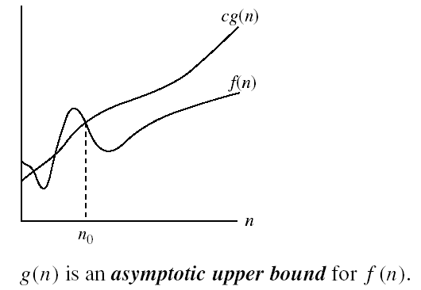
Big-O Visualization
k
Notes:
Discrete Mathematics and its Applications
26年 11月 8日
(c)2001-2002, Michael P. Frank

Slide 32
“Big-O” Proof Examples
Show that 30n+8 is O(n).
  Show ∃c,k: 30n+8 ≤ cn, ∀n>k .
    Let c=31, k=8. Assume n>k=8. Then
    cn = 31n = 30n + n > 30n+8, so 30n+8 < cn.
Show that n²+1 is O(n²).
  Show ∃c,k: n²+1 ≤ cn², ∀n>k: .
    Let c=2, k=1. Assume n>1. Then
    cn² = 2n² = n²+n² > n²+1, or n²+1< cn².
Notes:
Discrete Mathematics and its Applications
26年 11月 8日
(c)2001-2002, Michael P. Frank

Slide 33
Definition: Ω(g), at least order g
Let f,g be any function R→R.
We say that “f is at least order g”, written Ω(g), if ∃c,k: f(x) ≥ cg(x), ∀x>k
  “Beyond some point k, function f is at least a constant c times g (i.e., proportional to g).”
  Often, one deals only with positive functions and can ignore absolute value symbols.
“f is at least order g”, or “f is Ω(g)”, or “f= Ω(g)” all just mean that f∈ Ω(g).
Notes:
Discrete Mathematics and its Applications
26年 11月 8日
(c)2001-2002, Michael P. Frank

Slide 34
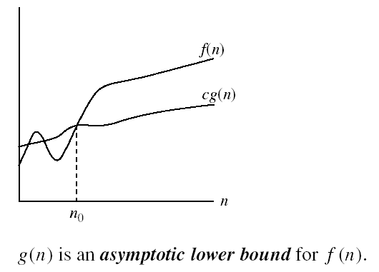
Big- Ω Visualization
Notes:
Discrete Mathematics and its Applications
26年 11月 8日
(c)2001-2002, Michael P. Frank

Slide 35
Definition: Θ(g), exactly order g
If f∈O(g) and g∈O(f) then we say “g and f are of the same order” or “f is (exactly) order g” and write f∈Θ(g).
Another equivalent definition:
∃c₁c₂,k: c₁g(x)≤f(x)≤c₂g(x), ∀x>k
“Everywhere beyond some point k, f(x) lies in between two multiples of g(x).”
Θ(g) ≡ O(g) ∩ Ω(g)
(i.e., f∈O(g) and f∈Ω(g) )
Notes:
Discrete Mathematics and its Applications
26年 11月 8日
(c)2001-2002, Michael P. Frank

Slide 36

Big- Θ Visualization
Notes:
Discrete Mathematics and its Applications
26年 11月 8日
(c)2001-2002, Michael P. Frank

Slide 37



Relations Between Q, O, W

Slide 38
Review: Orders of Growth
Definitions of order-of-growth sets, ∀g:R→R
O(g) ≡ {f | ∃ c,k: f(x) ≤ cg(x), ∀x>k }
o(g) ≡ {f | ∀c ∃k: f(x) < cg(x),∀x>k }
Ω(g) ≡ {f| | ∃c,k : f(x) ≥ cg(x),∀x>k }
ω(g) ≡ {f | ∀ c ∃k: f(x) >cg(x), ∀x>k}
Θ(g) ≡ {f | ∃c₁c₂,k: c₁g(x)≤f(x)|≤c₂g(x), ∀x>k}
Notes:
Discrete Mathematics and its Applications
26年 11月 8日
(c)2001-2002, Michael P. Frank

Slide 39
Steps to solve and analysed problem (Without using Recursive approach)
Step-1:- Take and understand problem.
  Such as find the sum of elements of an array of size N
Step-2:- Write algorithm or Pseudo code
  Use C/C++ syntax to write a pseudo code (already discused)
Step-3:- Analyse algorithm or pseudo code (Three ways)
  Consider execution time (based on computer, not preferred)
  Consider total steps (based on programmer style, not preferred)
  Make a function f(n) with respect to input size n (Preferred, for this type , follow step 4 , 5 and 6)
Step-4:- Assign run time cost to each step of algorithm/pseudo code
  c1, c2, ... Cn to all steps

Slide 40
Steps to solve and analysed problem (Without using Recursive approach)
Step-5:- Make a general function f(n) by considering input size n and run time cost of algorithm.
  Such as f(n) = c1+c2*N + c3 etc
Step-6:- Calculate rate/order of growth of f(n) (i.e. Use Big O because it refer to worst case)
  Such as O(f(n)) = O(c1 +c2*N + c3 ) = O(N)
  Apply rules of order of growth which are
    Remove constant, low order terms and coefficient with high order term)
Step-7:- if you have two algorithms or pseudo codes then use asymptotic definition O, Ω ,Θ for worst, best and average case analysis.
  Asymptotic definition will help you show the rate of growth of a function (f(n))with respect to another function g(n)

Slide 41
Recursive Algorithms
Recursive algorithms solve the problem by solving smaller versions of the problem
  If the smaller versions are only a little smaller, the algorithm can be called a reduce and conquer algorithm
  If the smaller versions are about half the size of the original, the algorithm can be called a divide and conquer algorithm

Slide 42
Analyzing Recursive Algorithms
Remember the difference between recursive algorithms and iterative algorithms
Iterative – uses a loop to do the work
Recursive – a function (method) calls itself
- usually involves a base case
- recursive call is on a “simpler” set of data

Slide 43
Analyzing Recursive Algorithms
Iterative:
Int power (int a, int p)
{result = 1;
For(i=1;i<=p;i++)
result = result * a;
Return result}

Slide 44
Analyzing Recursive Algorithms
Recursive:
int power( int a, int p) calling point:- Res=power(3,2)
{
If(p == 1)
return a
Else
return a*power(a, p-1);
}

Slide 45
Analyzing Recursive Algorithms
Check to see if the problem is small enough to solve directly
If not, then divide the data into smaller problems
Call the function on the smaller sets of data and form partial solutions
Combine the partial solutions to form the final solution

Slide 46
Analyzing Recursive Algorithms
A recursive function to find the factorial of a number
void Factorial(N) calling point:- Factorial(4)
if N == 1 then
return 1;
else
{smaller = N-1;
answer = Factorial(smaller)
return (N * answer)
}

Slide 47
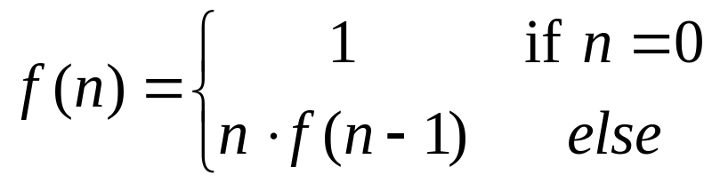
The Recursion Pattern
Recursion: when a method calls itself
Classic example--the factorial function:
  n! = 1· 2· 3· ··· · (n-1)· n
Recursive definition:
As a C/C++ method:
  // recursive factorial function
  int recursiveFactorial(int n) {
  if (n == 0) return 1; // basis case
  else return n * recursiveFactorial(n- 1); // recursive case
  }

Slide 48
Visualizing Recursion
Example recursion trace:
Recursion trace
A box for each recursive call
An arrow from each calling point to called point
An arrow from each called point to calling point showing return value
call
return
4
*
6
=
24
final answer
recursiveFactorial
(
4
)
call
return
3
*
2
=
6
recursiveFactorial
(
3
)
call
return
2
*
1
=
2
recursiveFactorial
(
2
)
call
return
1
*
1
=
1
recursiveFactorial
(
1
)
call
return
1
recursiveFactorial
(
0
)

Slide 49
Content of a Recursive function/Method
Base case(s).
  Values of the input variables for which we perform no recursive calls are called base cases (there should be at least one base case).
  Every possible chain of recursive calls must eventually reach a base case.
Recursive calls.
  Calls to the current method.
  Each recursive call should be defined so that it makes progress towards a base case.

Slide 50
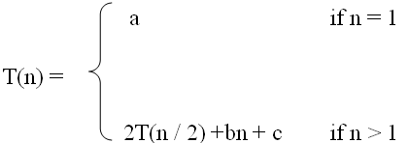
What is a recurrence relation?
A recurrence relation, T(n), is a recursive function of an
integer variable n.
Like all recursive functions, it has one or more recursive cases and one or more base cases.
Example:
The portion of the definition that does not contain T is called
the base case of the recurrence relation; the portion that
contains T is called the recurrent or recursive case.

Slide 51
Forming Recurrence Relations
For a given recursive method, the base case and the recursive case of its recurrence relation correspond directly to the base case and the recursive case of the method.
Example 1: Write the recurrence relation for the following method:
The base case is reached when n = = 0. The method performs one comparison. Thus, the number of operations when n = = 0, T(0), is some constant a.
public void f (int n) {
if (n > 0) {
cout<<n;
f(n-1);
} }

Slide 52
When n > 0, the method performs two basic operations and then calls itself, using ONE recursive call, with a parameter n – 1.
Therefore the recurrence relation is:
T(0) = a for some constant a
T(n) = b + T(n – 1) for some constant b
Forming Recurrence Relations
In General, T(n) is usually a sum of various choices of T(m ), the cost of the recursive subproblems, plus the cost of the work done outside the recursive calls:
T(n ) = aT(f(n)) + bT(g(n)) + . . . + c(n)
where a and b are the number of subproblems, f(n) and g(n) are subproblem sizes, and c(n) is the cost of the work done outside the recursive calls [Note: c(n) may be a constant]

Slide 53
Forming Recurrence Relations
For a given recursive method, the base case and the recursive case of its recurrence relation correspond directly to the base case and the recursive case of the method.
Example 1: Write the recurrence relation for the following method:
The base case is reached when n = = 0. The method performs one comparison. Thus, the number of operations when n = = 0, T(0), is some constant a.
public void f (int n) {
if (n > 0) {
cout<<n;
f(n-1);
} }

Slide 54
When n > 0, the method performs two basic operations and then calls itself, using ONE recursive call, with a parameter n – 1.
Therefore the recurrence relation is:
T(0) = a for some constant a
T(n) = b + T(n – 1) for some constant b
Forming Recurrence Relations
In General, T(n) is usually a sum of various choices of T(m ), the cost of the recursive subproblems, plus the cost of the work done outside the recursive calls:
T(n ) = aT(f(n)) + bT(g(n)) + . . . + c(n)
where a and b are the number of subproblems, f(n) and g(n) are subproblem sizes, and c(n) is the cost of the work done outside the recursive calls [Note: c(n) may be a constant]

Slide 55
Solving Recurrence Relations
To solve a recurrence relation T(n) we need to derive a form of T(n) that is not a recurrence relation. Such a form is called a closed form of the recurrence relation.
There are four methods to solve recurrence relations that represent the running time of recursive methods
  Iteration method (unrolling and summing)
  Substitution method (Guess the solution and verify by induction)
  Recursion tree method
  Master theorem (Master method)

Slide 56
The Iteration Method
Convert the recurrence into a summation and try to bound it using known series
  Iterate the recurrence until the initial condition is reached.
  Use back-substitution to express the recurrence in terms of n and the initial (boundary) condition.

Slide 57
The Iteration Method (Cont !!!)
T(n) = c + T(n/2)
T(n) = c + T(n/2)
= c + c + T(n/4)
= c + c + c + T(n/8)
Assume n = 2^{k}
T(n) = c + c + … + c + T(1)
= clgn + T(1)
= Θ(lgn)
T(n/2) = c + T(n/4)
T(n/4) = c + T(n/8)
k times

Slide 58
Substitution method
Guess a solution
Use induction to prove that the solution works

Slide 59
Substitution method (Cont !!!)
Guess a solution
  T(n) = O(g(n))
  Induction goal: apply the definition of the asymptotic notation
    T(n) ≤ d g(n), for some d > 0 and n ≥ n₀
  Induction hypothesis: T(k) ≤ d g(k) for all k < n
Prove the induction goal
  Use the induction hypothesis to find some values of the constants d and n₀ for which the induction goal holds

Slide 60
The recursion-tree method
Convert the recurrence into a tree:
  Each node represents the cost incurred at various levels of recursion
  Sum up the costs of all levels
Used to “guess” a solution for the recurrence

Slide 61
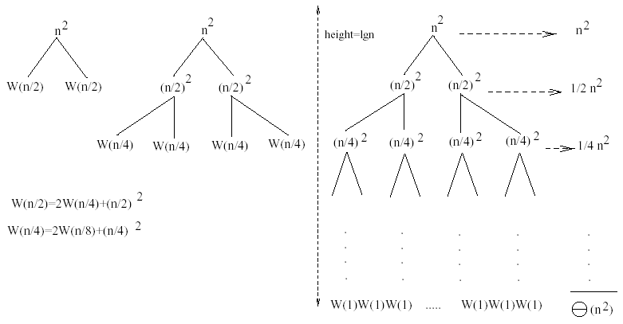
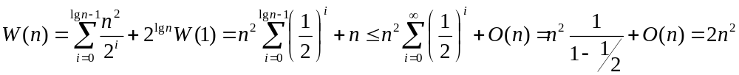
Example 1
W(n) = 2W(n/2) + n²
Subproblem size at level i is: n/2^{i}
Subproblem size hits 1 when 1 = n/2^{i} ⇒ i = lgn
Cost of the problem at level i = (n/2^{i})² No. of nodes at level i = 2^{i}
Total cost:
⇒ W(n) = O(n²)

Slide 62



Master Theorem
Let T(n) be a monotonically increasing function that satisfies
T(n) = a T(n/b) + f(n)
T(1) = c
where a ≥ 1, b ≥ 2, c>0. If f(n) is Θ(n^{d}) where d ≥ 0 then
 |  | if a < b^{d}
T(n) = |  | If a = b^{d}
 |  | if a > b^{d}

Slide 63
Master Theorem: Example 1
Let T(n) = T(n/2) + ½ n2 + n. What are the parameters?
a =
b =
d =
Therefore, which condition applies?
1
 |  | if a < b^{d}
T(n) = |  | If a = b^{d}
 |  | if a > b^{d}
2
2
1 < 2², case 1 applies
We conclude that
T(n) ∈ Θ(n^{d}) = Θ (n²)

Slide 64
Master Theorem: Example 2
Let T(n)= 2 T(n/4) + √n + 42. What are the parameters?
a =
b =
d =
Therefore, which condition applies?
2
 |  | if a < b^{d}
T(n) = |  | If a = b^{d}
 |  | if a > b^{d}
4
1/2
2 = 4^{1/2}, case 2 applies
We conclude that

Slide 65

Master Theorem: Example 3
Let T(n)= 3 T(n/2) + 3/4n + 1. What are the parameters?
a =
b =
d =
Therefore, which condition applies?
3
2
 |  | if a < b^{d}
T(n) = |  | If a = b^{d}
 |  | if a > b^{d}
1
3 > 2¹, case 3 applies
We conclude that
Note that log₂3≈1.584…, can we say that T(n) ∈ Θ (n^{1.584})
No, because log₂3≈1.5849… and n^{1.584} ∉ Θ (n^{1.5849})

Slide 66
Linear Search Algorithm (Cont !!!)
Using a while (or a for) loop, the definition of the method seqSearch
can also be written without the break statement as:
public static int linSearch(int[] list, int listLength, int key) {
int loc = 0;
boolean found = false;
while(loc < listLength && !found) {
if(list[loc] == key)
found = true;
else
loc++ }
if(found)
return loc;
else
return -1;
}

Slide 67
Performance of the Linear Search (Cont’d)
Therefore, the best case is: 1
And, the worst case is: N
The average case is:
Worst case and key found at the end of
the array list!
Best case
1 + 2 + 3 + …..+ N + N
Average Number of
Comparisons
=
N+1
Worst case and key is NOT found!
Number of possible cases

Slide 68
Binary Search Algorithm (Cont’d)
Search item is compared with middle element of list
If search item < middle element of list, search is restricted to first
half of the list
If search item > middle element of list, search second half of the list
If search item = middle element, search is complete

Slide 69
The Sorting Problem
Input:
  A sequence of n numbers a₁, a₂, . . . , a_{n}
Output:
  A permutation (reordering) a₁’, a₂’, . . . , a_{n}’ of the input sequence such that a₁’ ≤ a₂’ ≤ · · · ≤ a_{n}’

Slide 70
Types of Sorting Algorithms
There are many, many different types of sorting algorithms, but the primary ones are:
Bubble Sort
Selection Sort
Insertion Sort
Merge Sort
Shell Sort
Heap Sort
Quick Sort
Radix Sort
Swap Sort

Slide 71
Some Definitions
Internal Sort
  The data to be sorted is all stored in the computer’s main memory.
External Sort
  Some of the data to be sorted might be stored in some external, slower, device.
In Place Sort
  The amount of extra space required to sort the data is constant with the input size.

Slide 72
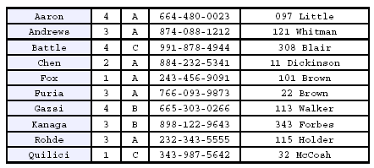
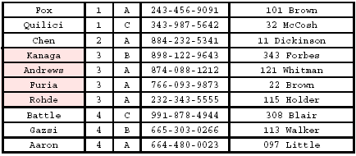
Stability
A STABLE sort preserves relative order of records with equal keys
Sorted on first key:
Sort file on second key:
Records with key value 3 are not in order on first key!!

Slide 73
Insertion Sort
Idea: like sorting a hand of playing cards
  Start with an empty left hand and the cards facing down on the table.
  Remove one card at a time from the table, and insert it into the correct position in the left hand
    compare it with each of the cards already in the hand, from right to left
  The cards held in the left hand are sorted
    these cards were originally the top cards of the pile on the table

Slide 74
"Bubbling Up" the Largest Element
Traverse a collection of elements
  Move from the front to the end
  “Bubble” the largest value to the end using pair-wise comparisons and swapping
1 2 3 4 5 6
77
42
35
12
101
5

Slide 75
“Bubbling” All the Elements
1 2 3 4 5 6
42
35
12
77
5
101
1 2 3 4 5 6
35
12
42
5
77
101
1 2 3 4 5 6
N - 1
12
35
5
42
77
101
1 2 3 4 5 6
12
5
35
42
77
101
1 2 3 4 5 6
5
12
35
42
77
101

Slide 76


Analysis of Selection Sort
cost times
c₁ 1
c₂ n
c₃ n-1
c₄
c₅
c₆ n-1
c₇
Alg.: SELECTION-SORT(A)
n ← length[A]
for j ← 1 to n - 1
do smallest ← j
for i ← j + 1 to n
do if A[i] < A[smallest]
then smallest ← i
exchange A[j] ↔ A[smallest]
n²/2
comparisons
n
exchanges

Slide 77
Divide-and-Conquer
Divide the problem into a number of sub-problems
  Similar sub-problems of smaller size
Conquer the sub-problems
  Solve the sub-problems recursively
  Sub-problem size small enough ⇒ solve the problems in straightforward manner
Combine the solutions of the sub-problems
  Obtain the solution for the original problem

Slide 78
Merge Sort Approach
To sort an array A[p . . r]:
Divide
  Divide the n-element sequence to be sorted into two subsequences of n/2 elements each
Conquer
  Sort the subsequences recursively using merge sort
  When the size of the sequences is 1 there is nothing more to do
Combine
  Merge the two sorted subsequences

Slide 79
Quick sort
Conquer
  Recursively sort A[p..q] and A[q+1..r] using Quicksort
Combine
  Trivial: the arrays are sorted in place
  No additional work is required to combine them
  The entire array is now sorted
A[p…q]
A[q+1…r]
≤

Slide 80
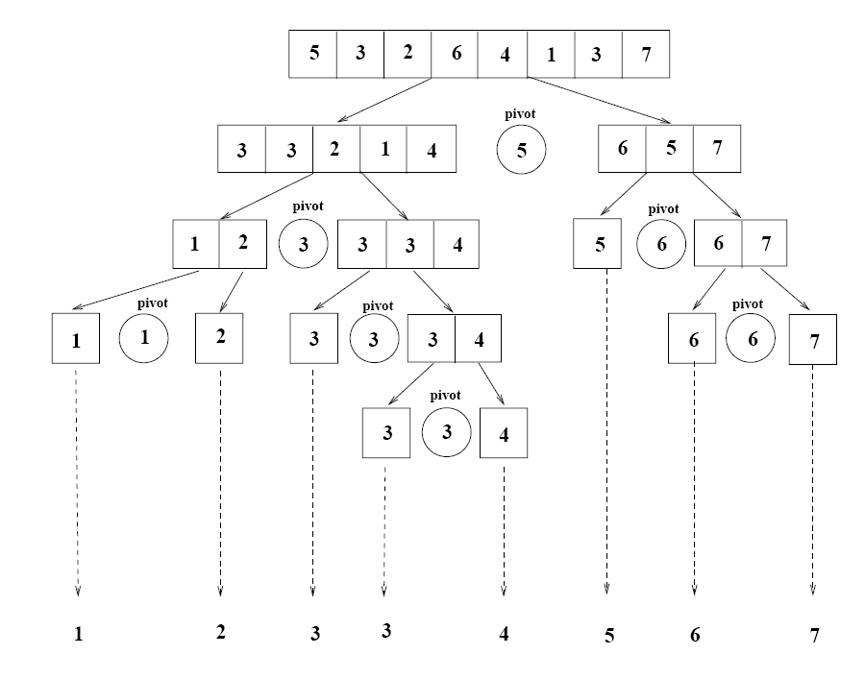
Example

