Slide 1
Lecture 32.
Revision of Lectures ( 16 to 30)

Slide 2
How Fast Can We Sort?
Selection Sort, Bubble Sort, Insertion Sort:
Merge sort:
Quick sort:
What is common to all these algorithms?
  Make comparisons between input elements
  a_{i} < a_{j}, a_{i} ≤ a_{j}, a_{i} = a_{j}, a_{i} ≥ a_{j}, or a_{i} > a_{j}
O(n²)
O(nlgn)
O(nlgn) - average

Slide 3
Can we do better?
Linear sorting algorithms
  Counting Sort
  Radix Sort
  Bucket sort
Make certain assumptions about the data
Linear sorts are NOT “comparison sorts”

Slide 4
Analysis of Counting Sort
  Alg.: COUNTING-SORT(A, B, n, k)
  for i ← 0 to r
  do C[ i ] ← 0
  for j ← 1 to n
  do C[A[ j ]] ← C[A[ j ]] + 1
  C[i] contains the number of elements equal to i
  for i ← 1 to r
  do C[ i ] ← C[ i ] + C[i -1]
  C[i] contains the number of elements ≤ i
  for j ← n downto 1
  do B[C[A[ j ]]] ← A[ j ]
  C[A[ j ]] ← C[A[ j ]] - 1
O(r)
O(n)
O(r)
O(n)
Overall time: O(n + r)

Slide 5


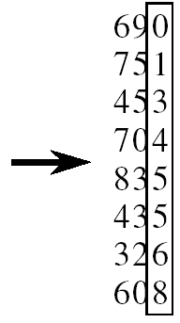
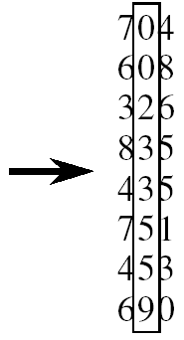
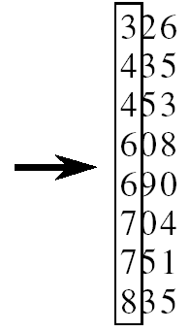
RADIX-SORT
Alg.: RADIX-SORT(A, d)
for i ← 1 to d
do use a stable sort to sort array A on digit i
(stable sort: preserves order of identical elements)

Slide 6
Bucket Sort
Assumption:
  the input is generated by a random process that distributes elements uniformly over [0, 1)
Idea:
  Divide [0, 1) into k equal-sized buckets (k=Θ(n))
  Distribute the n input values into the buckets
  Sort each bucket (e.g., using quicksort)
  Go through the buckets in order, listing elements in each one
Input: A[1 . . n], where 0 ≤ A[i] < 1 for all i
Output: elements A[i] sorted

Slide 7
Example - Bucket Sort
A
1
.78
.17
.39
.26
.72
.94
.21
.12
.23
.68
B
0
/
2
1
.17
.12 /
3
2
.26
.21
.23 /
4
3
.39 /
5
4
/
Distribute
Into buckets
6
5
/
7
6
.68 /
8
7
.78
.72 /
9
8
/
10
9
.94 /

Slide 8
Hashing Overview
Hash Table Data Structure : Purpose
  To support insertion, deletion and search in average-case constant time
    Assumption: Order of elements irrelevant
    ==> data structure *not* useful for if you want to maintain and retrieve some kind of an order of the elements
Hash function
  Hash[ “string key”] ==> integer value
Hash table ADT
  Implementations, Analysis, Applications
Notes:
Cpt S 223
Washington State University

Slide 9
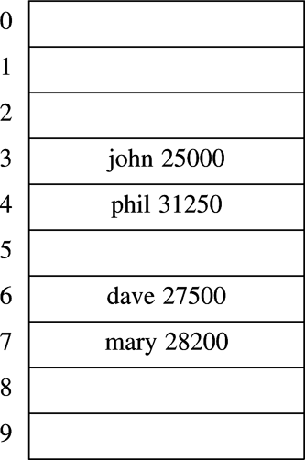
Hash Table
Hash table is an array of fixed size TableSize
Array elements indexed by a key, which is mapped to an array index (0…TableSize-1)
Mapping (hash function) h from key to index
  E.g., h(“john”) = 3
key
Element value
Notes:
Cpt S 223
Washington State University

Slide 10
Hash Table Operations
Hash function
Hash key
Insert
  T [h(“john”)] = <“john”,25000>
Delete
  T [h(“john”)] = NULL
Search
  T [h(“john”)] returns the element hashed for “john”
Data record
What happens if h(“john”) == h(“joe”) ?
  “collision”
Notes:
Cpt S 223
Washington State University

Slide 11
Collision and Resolving technique
What happens when h(k₁) = h(k₂)?
  ==> collision !
Collision resolution strategies
  Chaining
    Store colliding keys in a linked list at the same hash table index
  Open addressing
    Store colliding keys elsewhere in the table
Notes:
Cpt S 223
Washington State University

Slide 12
Basic Tree Concepts
A tree consists of finite set of elements, called nodes, and a finite set of directed lines called branches, that connect the nodes.
The number of branches associated with a node is the degree of the node.

Slide 13
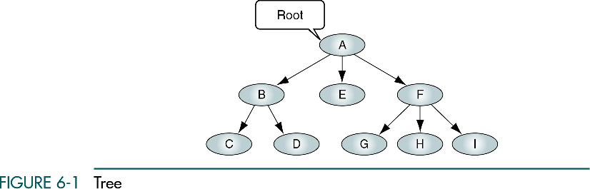

Slide 14
Basic Tree Concepts
When the branch is directed toward the node, it is indegree branch.
When the branch is directed away from the node, it is an outdegree branch.
The sum of the indegree and outdegree branches is the degree of the node.
If the tree is not empty, the first node is called the root.

Slide 15
Basic Tree Concepts
The indegree of the root is, by definition, zero.
With the exception of the root, all of the nodes in a tree must have an indegree of exactly one; that is, they may have only one predecessor.
All nodes in the tree can have zero, one, or more branches leaving them; that is, they may have outdegree of zero, one, or more.

Slide 16
Basic Tree Concepts
A leaf is any node with an outdegree of zero, that is, a node with no successors.
A node that is not a root or a leaf is known as an internal node.
A node is a parent if it has successor nodes; that is, if it has outdegree greater than zero.
A node with a predecessor is called a child.

Slide 17
Basic Tree Concepts
Two or more nodes with the same parents are called siblings.
An ancestor is any node in the path from the root to the node.
A descendant is any node in the path below the parent node; that is, all nodes in the paths from a given node to a leaf are descendants of that node.

Slide 18
Basic Tree Concepts
A path is a sequence of nodes in which each node is adjacent to the next node.
The level of a node is its distance from the root. The root is at level 0, its children are at level 1, etc. …

Slide 19
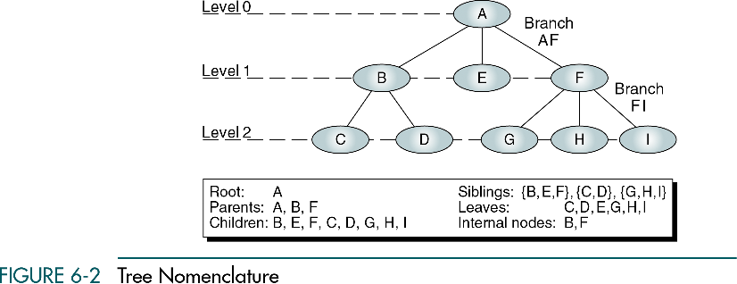

Slide 20
Binary Search Trees
Tree representation:
  A linked data structure in which each node is an object
Node representation:
  Key field
  Satellite data
  Left: pointer to left child
  Right: pointer to right child
  p: pointer to parent (p [root [T]] = NIL)
Satisfies the binary-search-tree property !!
parent
L
R
key
data
Left child
Right child

Slide 21
Binary Search Tree Property
Binary search tree property:
  If y is in left subtree of x,
    then key [y] ≤ key [x]
  If y is in right subtree of x,
    then key [y] ≥ key [x]
5
3
7
2
5
9

Slide 22
Binary Search Trees
Support many dynamic set operations
  SEARCH, MINIMUM, MAXIMUM, PREDECESSOR, SUCCESSOR, INSERT, DELETE
Running time of basic operations on binary search trees
  On average: Θ(lgn)
    The expected height of the tree is lgn
  In the worst case: Θ(n)
    The tree is a linear chain of n nodes

Slide 23
Traversing a Binary Search Tree
Inorder tree walk:
  Root is printed between the values of its left and right subtrees: left, root, right
  Keys are printed in sorted order
Preorder tree walk:
  root printed first: root, left, right
Postorder tree walk:
  root printed last: left, right, root
Inorder: 2 3 5 5 7 9
5
Preorder: 5 3 2 5 7 9
3
7
Postorder: 2 5 3 9 7 5
2
5
9

Slide 24
Graphs
Definition = a set of nodes (vertices) with edges (links) between them.
G = (V, E) - graph
V = set of vertices ⎜V ⎜= n
E = set of edges ⎜E ⎜= m
  Binary relation on V
  Subset of V x V ={(u,v): u ∈V, v ∈V}
1
2
3
4

Slide 25
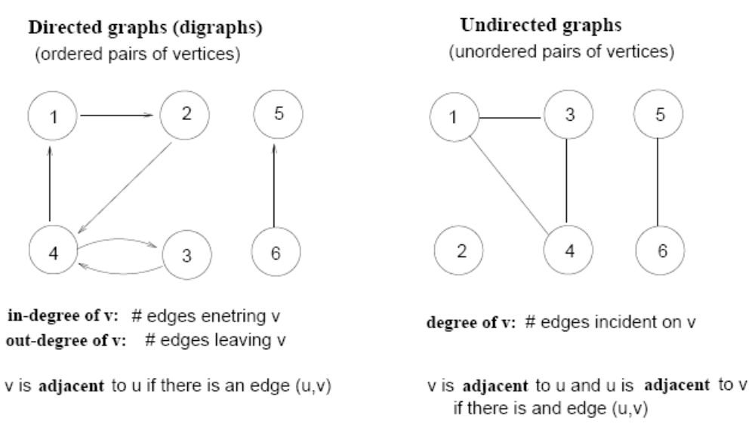
Terminology
Directed vs Undirected graphs

Slide 26
Terminology (cont!!!)
Complete graph
  A graph with an edge between each pair of vertices
Subgraph
  A graph (V’, E’) such that V’⊆V and E’⊆E
Path from v to w
  A sequence of vertices <v₀, v₁, …, v_{k}> such that v₀=v and v_{k}=w
Length of a path
  Number of edges in the path
1
2
3
4
path from v₁ to v₄
<v₁, v₂, v₄>

Slide 27
Terminology (cont!!!)
w is reachable from v
  If there is a path from v to w
Simple path
  All the vertices in the path are distinct
Cycles
  A path <v₀, v₁, …, v_{k}> forms a cycle if v₀=v_{k} and k≥2
Acyclic graph
  A graph without any cycles
1
2
3
4
cycle from v₁ to v₁
<v₁, v₂, v₃,v₁>

Slide 28
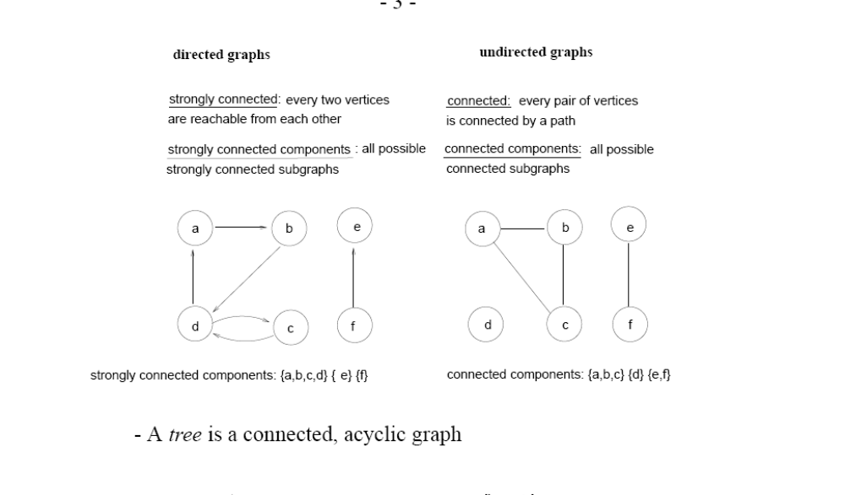
Terminology (cont!!!)
Connected and Strongly Connected

Slide 29
Graph Representation
Adjacency list representation of G = (V, E)
  An array of ⎜V ⎜lists, one for each vertex in V
  Each list Adj[u] contains all the vertices v that are adjacent to u (i.e., there is an edge from u to v)
  Can be used for both directed and undirected graphs
1
2
5 | /
1
2
2
1
5
3
4 | /
3
3
2
4
5
4
4
2
5
3 | /
5
4
1
2
Undirected graph

Slide 30
Graph Representation
Adjacency matrix representation of G = (V, E)
  Assume vertices are numbered 1, 2, … ⎜V ⎜
  The representation consists of a matrix A _{⎜V ⎜x ⎜V ⎜}:
  a_{ij} = 1 if (i, j) ∈ E
  0 otherwise
1
2
3
4
5
1
0
1
0
0
1
For undirected graphs, matrix A is symmetric:
a_{ij} = a_{ji}
A = A^{T}
1
2
3
2
1
0
1
1
1
5
4
3
0
1
0
1
0
4
0
1
1
0
1
Undirected graph
5
1
1
0
1
0

Slide 31
Network Models
The presentation will cover three network models that can be used to solve a variety of problems:
the minimal-spanning tree technique,
the maximal-flow technique, and
the shortest-route technique.

Slide 32
Minimal-Spanning Tree Technique
Definition:
The minimal-spanning tree technique
determines the path through the network
that connects all the points while
minimizing total distance.
For example:
If the points represent houses in a subdivision, the minimal spanning tree technique can be used to determine the best way to connect all of the houses to electrical power, water systems, etc.
in a way that minimizes the total distance or length of power lines or water pipes.

Slide 33
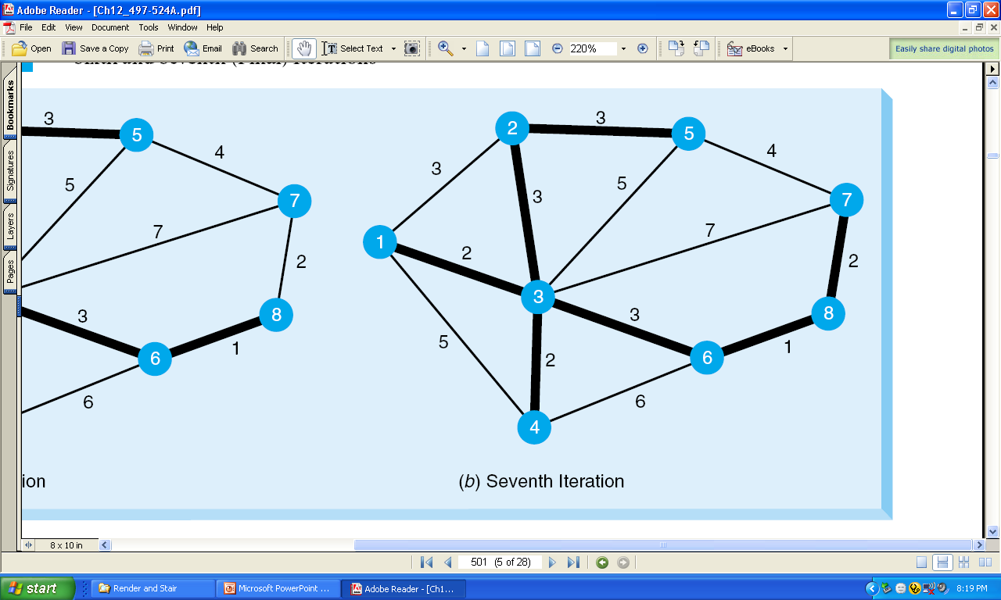
Final Solution to the Minimal-Spanning Tree Example
Nodes 1, 2, 4, and 6 are all connected to node 3. Node 2 is connected to node 5.
Node 6 is connected to node 8, and node 8 is connected to node 7.
All of the nodes are now connected.
The total distance is found by adding the distances for the arcs used in the spanning tree.
In this example, the distance is:
2 + 2 + 3 + 3 + 3 + 1 + 2 = 16 (or 1,600 feet).

Slide 34
The Maximum Flow Technique
Definition:
The maximal-flow technique finds the maximum flow of any quantity or substance through a network.
For example:
This technique can determine the maximum number of vehicles (cars, trucks, etc.) that can go through a network of roads from one location to another.

Slide 35
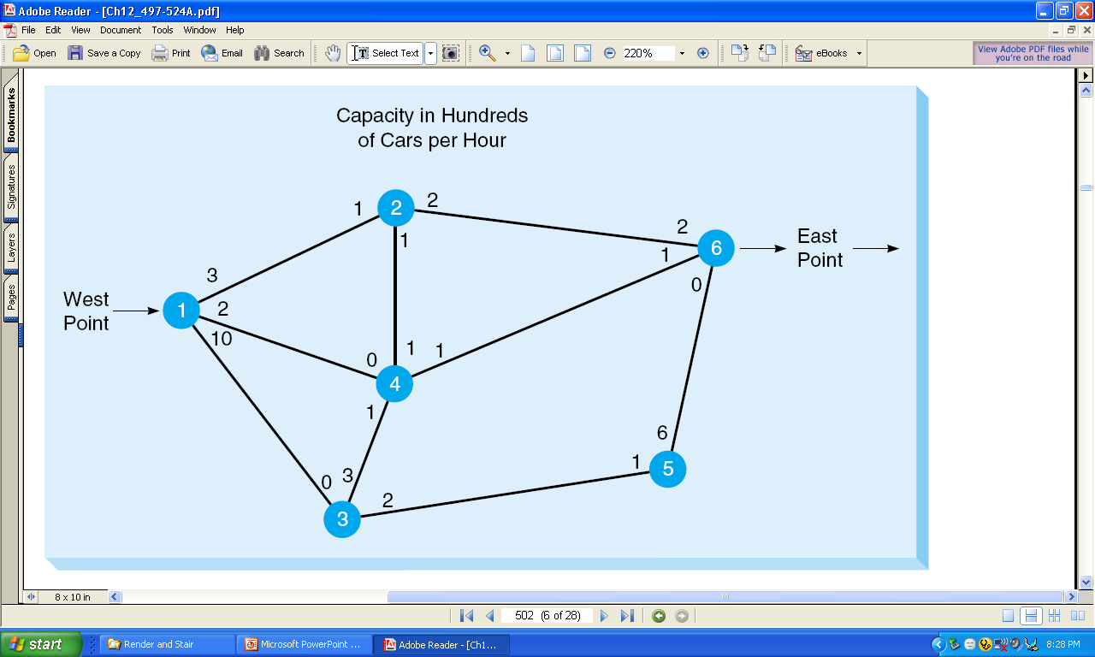
Road Network forWaukesha
Traffic can flow in both directions.

Slide 36
Shortest Route Technique
Definition:
Shortest route technique can find the shortest path through a network.
For example:
This technique can find the shortest route from one city to another through a network of roads.

Slide 37
Shortest-Route Technique (continued)
Ray Design: 1st Iteration
100
Plant
200
2
4
100
100
100
1
50
150
6
200
100
3
5
40
Warehouse
The nearest node to the plant is node 2, with a distance of 100 miles.
Thus, connect these two nodes.
© 2006 by Prentice Hall, Inc.
Upper Saddle River, NJ 07458

Slide 38
Minimum Connector Algorithms(Prim’s algorithm)
)
Select any vertex
Select the shortest edge connected to that vertex
Select the shortest edge connected to any vertex already connected
Repeat step 3 until all vertices have been connected

Slide 39
Prim’s Algorithm
B
5
C
All vertices have been
connected.
The solution is
AB 3
AE 4
ED 2
DC 4
EF 5
Total weight of tree: 18
3
4
8
6
8
A
D
7
F
5
4
2
E

Slide 40
Minimum Connector Algorithms
Kruskal’s algorithm
Select the shortest edge in a network
Select the next shortest edge which does not create a cycle
Repeat step 2 until all vertices have been connected

Slide 41
Example: (Kruskal Algorithm)
B
5
C
All vertices have been
connected.
The solution is
ED 2
AB 3
CD 4
AE 4
EF 5
Total weight of tree: 18
3
4
8
6
8
A
D
7
F
5
4
2
E

Slide 42
Dijkstra’s shortest-path algorithm
Dijkstra’s algorithm finds the shortest paths from a given node to all other nodes in a graph
  Initially,
  Mark the given node as known (path length is zero)
  For each out-edge, set the distance in each neighboring node equal to the cost (length) of the out-edge, and set its predecessor to the initially given node
  Repeatedly (until all nodes are known),
  Find an unknown node containing the smallest distance
  Mark the new node as known
  For each node adjacent to the new node, examine its neighbors to see whether their estimated distance can be reduced (distance to known node plus cost of out-edge)
  If so, also reset the predecessor of the new node

Slide 43
Optimization problems
An optimization problem is one in which you want to find, not just a solution, but the best solution
A “greedy algorithm” sometimes works well for optimization problems
A greedy algorithm works in phases. At each phase:
  You take the best you can get right now, without regard for future consequences
  You hope that by choosing a local optimum at each step, you will end up at a global optimum
Notes:
2

Slide 44
Example: Counting money
Suppose you want to count out a certain amount of money, using the fewest possible bills and coins
A greedy algorithm would do this would be:
At each step, take the largest possible bill or coin that does not overshoot
  Example: To make $6.39, you can choose:
    a $5 bill
    a $1 bill, to make $6
    a 25¢ coin, to make $6.25
    A 10¢ coin, to make $6.35
    four 1¢ coins, to make $6.39
For US money, the greedy algorithm always gives the optimum solution
Notes:
3

Slide 45
Other greedy algorithms
Dijkstra’s algorithm for finding the shortest path in a graph
  Always takes the shortest edge connecting a known node to an unknown node
Kruskal’s algorithm for finding a minimum-cost spanning tree
  Always tries the lowest-cost remaining edge
Prim’s algorithm for finding a minimum-cost spanning tree
  Always takes the lowest-cost edge between nodes in the spanning tree and nodes not yet in the spanning tree

Slide 46
Dynamic Programming
Dynamic Programming is a general algorithm design technique
for solving problems defined by or formulated as recurrences with overlapping subinstances
Invented by American mathematician Richard Bellman in the 1950s to solve optimization problems and later assimilated by CS
“Programming” here means “planning”
Main idea:
    set up a recurrence relating a solution to a larger instance to solutions of some smaller instances
    - solve smaller instances once
    record solutions in a table
    extract solution to the initial instance from that table

Slide 47
The development of a dynamic programming
1. Characterize the structure of an optimal solution.
2. Recursively define the value of an optimal solution.
3. Compute the value of an optimal solution in a bottom up fashion.
4. Construct an optimal solution from computed information.

Slide 48
Knapsack problem
Given some items, pack the knapsack to get the maximum total value. Each item has some weight and some value. Total weight that we can carry is no more than some fixed number W. So we must consider weights of items as well as
their values.
      Item # Weight Value
      1 1 8
      2 3 6
      3 5 5

Slide 49
Knapsack problem
There are two versions of the problem:
  “0-1 knapsack problem”
    Items are indivisible; you either take an item or not. Some special instances can be solved with dynamic programming
  “Fractional knapsack problem”
    Items are divisible: you can take any fraction of an item

Slide 50
0-1 Knapsack problem
Given a knapsack with maximum capacity W, and a set S consisting of n items
Each item i has some weight w_{i} and benefit value b_{i} (all w_{i} and W are integer values)
Problem: How to pack the knapsack to achieve maximum total value of packed items?

Slide 51
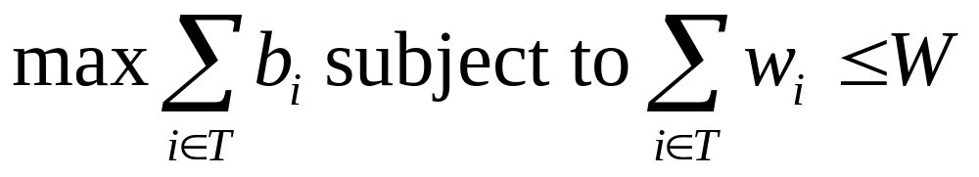
0-1 Knapsack problem
Problem, in other words, is to find
The problem is called a “0-1” problem, because each item must be entirely accepted or rejected.

Slide 52
Floyd Algorithm
The problem: find the shortest path between every pair of vertices of a graph
The graph: may contain negative edges but no negative cycles
A representation: a weight matrix where
W(i,j)=0 if i=j.
W(i,j)=¥ if there is no edge between i and j.
W(i,j)=“weight of edge”
Note: we have shown principle of optimality applies to shortest path problems
Notes:
Algorithms
CS333 / class 22

Slide 53
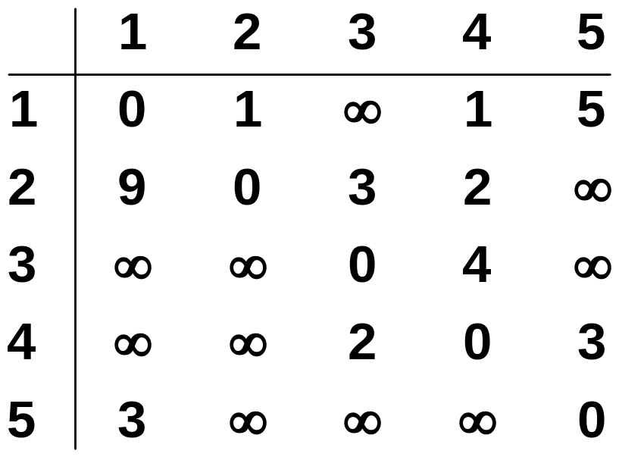
The weight matrix and the graph
1
3
v₁
v₂
9
5
1
2
3
v₅
3
2
v₄
v₃
4
Notes:
Algorithms
CS333 / class 22

Slide 54
Definitions
Formal Definition of String Matching Problem
Assume text is an array T[1..n] of length n and the pattern is an array P[1..m] of length m ≤ n
This basically means that there is a string array T which contains a certain number of characters that is larger than the number of characters in string array P. P is said to be the pattern array because it contains a pattern of characters to be searched for in the larger array T.

Slide 55
Amortized Analysis
Not just consider one operation, but a sequence of operations on a given data structure.
Average cost over a sequence of operations.
Probabilistic analysis:
  Average case running time: average over all possible inputs for one algorithm (operation).
  If using probability, called expected running time.
Amortized analysis:
  No involvement of probability
  Average performance on a sequence of operations, even some operation is expensive.
  Guarantee average performance of each operation among the sequence in worst case.

Slide 56
Three Methods of Amortized Analysis
Aggregate analysis:
  Total cost of n operations/n,
Accounting method:
  Assign each type of operation an (different) amortized cost
  overcharge some operations,
  store the overcharge as credit on specific objects,
  then use the credit for compensation for some later operations.
Potential method:
  Same as accounting method
  But store the credit as “potential energy” and as a whole.

Slide 57
Data Compression and its catgories
Lossless Compression
  where data is compressed and can be reconstituted (uncompressed) without loss of detail or information. These are referred to as bit-preserving or reversible compression systems also.
Lossy Compression
  where the aim is to obtain the best possible fidelity for a given bit-rate or minimizing the bit-rate to achieve a given fidelity measure. Video and audio compression techniques are most suited to this form of compression.
Examples
  Zero length encoding
  Run length encoding etc

Slide 58
Algorithmic vs Problem Complexity
The algorithmic complexity of a computation is some measure of how difficult is to perform the computation (i.e., specific to an algorithm)
The complexity of a computational problem or task is the complexity of the algorithm with the lowest order of growth of complexity for solving that problem or performing that task.
  e.g. the problem of searching an ordered list has at most lgn time complexity.
Computational Complexity: deals with classifying problems by how hard they are.

Slide 59
Complexity Class P
P is the complexity class containing decision problems which can be solved by a deterministic Turing machine using a polynomial amount of computation time, or polynomial time.
P is often taken to be the class of computational problems which are "efficiently solvable" or "tractable“.
Problems that are solvable in theory, but cannot be solved in practice, are called intractable.
There exist problems in P which are intractable in practical terms; for example, some require at least n¹⁰⁰⁰⁰⁰⁰ operations.
P is known to contain many natural problems, including the decision versions of linear programming, calculating the greatest common divisor, and finding a maximum matching. In 2002, it was shown that the problem of determining if a number is prime is in P.

Slide 60
Complexity Class NP
In computational complexity theory, NP ("Non-deterministic Polynomial time") is the set of decision problems solvable in polynomial time on a non-deterministic Turing machine.
It is the set of problems that can be "verified" by a deterministic Turing machine in polynomial time.
All the problems in this class have the property that their solutions can be checked effectively.
This class contains many problems that people would like to be able to solve effectively, including
  the Boolean satisfiability problem (SAT)
  the Hamiltonian path problem (special case of TSP)
  the Vertex cover problem.

Slide 61
Thank you
&
Allah Hafiz

