Slide 1
Lecture 5.
Analysis of Running time of algorithms (Best, Average and Worst cases)

Slide 2
Recap
RAM model is used to measure the run time of an algorithm by counting the number of steps.
Space complexity of an algorithm refer to the amount of memory required to run.
Time complexity of an algorithm refer to its running time, which depends on input size.
  Primitive operations refer to the unit of operation that can be identified in the pseudo-code

Slide 3
Counting Primitive Operations
Algorithm ArrayMax(A,n)
{An array A storing N integers
and find the largest element in A.}
currentMax = A[0]
for (i=1;i<=n-1;i++)
if (currentMax < A[i])
currentMax = A[i]
return currentMax
2 steps + 1 to initialize i
2 step each time (compare i to n, inc i)
n-1 times
2 steps
How often done??
2 steps
1 step
Between 4(n-1) and 6(n-1) in the loop
It depends on the order the numbers appear in in A[]

Slide 4
Run Time Analysis
Pseudo code to find product of two numbers
int method()
{
int a,b,c; --------- c1
a=2; --------- c2
b=3; --------- c2
c= a*b; --------- c3
printf(“Product of a and b is %d”, c);
return 0; ----------- c4
}
Run Time Complexity will be = c1+c2+c2 + c3 + c4
= c1 + 2c2 + c3 + c4 (as all constant)
= C

Slide 5
Run Time Analysis (Cont !!!)
int method()
{
int a,b,large; --------- c1
a=2; --------- c2
b=3; --------- c2
if(a>b) -------- c3
large=a; -------- c2
else
large = b; ------- c2
printf(“Large number is %d”, large);
Return 0; ---------- c4
}
Run Time Complexity will be = c1+c2+c2 + c3 +c2 + c2 + c4
= c1 + 4c2 + c3 +c4 (as all constants)
= C
Note:- =You can say there should be 3c2 instead of 4c2 (Coefficient have no impact)

Slide 6
Run Time Analysis (Cont !!!)
int method()
{
int I, codd, ceven, a[5]={5,4,3,2,1}; --------- c1
ceven=0;codd=0; ----------- c2
for(i=0;i<=4;i++) ------ c3
if(a[i]%2==0) -------- c4
ceven++;-------- c5
else
codd++; ------- c5
printf(“Total evens %d and Total Odd %d”, ceven, codd);
Return 0; ---------- c6
}
Run Time Complexity will be = c1+c2 + n* (c3 +c4 + c5)+ c6
= c1 + c2 + n*c +c6
= n*c + c
= n

Slide 7
Run Time Analysis (Cont !!!)
int method()
{
int I, a[5]; --------- c1
for(i=0;i<=4;i++) ------ c2
Scanf(“%d”, &a[i]);
for(i=0;i<=4;i++)
A[i]=a[i]+5; ----------- c3
for(i=0;i<=4;i++)
print(“%d”, a[i]);
return 0; ---------- c4
}
N
Run Time Complexity will be = c1 + n * c2 + n*(c1+c3) + n * c2 + c4
= c1 + 2n*c2 + n * c
= c1 + n * c + n * c
= 2n*c +c1
= 2n
=n
N
N

Slide 8
Run Time Analysis (Cont !!!)
int method()
{
int r,c, a[][]= { {1,2}, {1,3}}; --------- c1
for(c=0;c<=1;c++) ------ c2
for(r=0;r<=1;r++)
a[r][c]=a[r][c]+5;----------- c3+c4+c5
for(c=0;c<=1;c++)
for(r=0;r<=1;r++)
printf(“%d”, a[r][c]);
return 0; ---------- c6
}
Note:-
C3 refer to array scripts use
C4 refer to arithmetic op +
C5 refer to assignment
N * m = n ²
Run Time Complexity will be = c1 + n * m * (c2+c3+c4+c5) + n * m * c4 + c6
= c1 +c6 + n*m*c + n*m*c +
= 2*n*m*c + c
= n*m*c
= n*m = n²
N * m = n ²

Slide 9
Run Time Analysis (Cont !!!)
int method()
{
int r,c,,s, a[][]= { {1,2}, {1,3}}; --------- c1
S=0; ------------- c2
for(c=0;c<=1;c++) ------ c3
{ for(r=0;r<=1;r++)
a[r][c]=a[r][c]+5; ---- c4+c5 +c2
s=s+a[r][0]; ------------- c4+c5 +c2
}
Printf(“Sum of element of 1st row %d”, s);
return 0; ---------- c6
}
Note:-
C4 refer to array scripts use
C5 refer to arithmetic op +
C2 refer to assignment
Run Time Complexity will be = c1 + n * m * (c2+c3+c4+c5) + n (c2+c3+c4+c5 )+c6
= c1+c6 + n*m*c + n*c
= n*m + n + c
= n² + n
N times
N * m = n ²

Slide 10
Types of Algorithm Complexity
Worst Case Complexity:
  the function defined by the maximum number of steps taken on any instance of size n
Best Case Complexity:
  the function defined by the minimum number of steps taken on any instance of size n
Average Case Complexity:
  the function defined by the average number of steps taken on any instance of size n

Slide 11
Types of Algorithm Complexity
(Example: Linear Search)
5 | 7 | 2 | 6 | 9 | 12 | 1
Worst Case Complexity:
  You want to search 1 in above array which is at location N
  You need N steps
Best Case Complexity:
  You want to search 5 in above array which is at location 1
  You need 1 steps
Average Case Complexity:
  You want to search 2 or 9 etc in above array
  You need 3 steps for 2 and 5 steps for 9

Slide 12
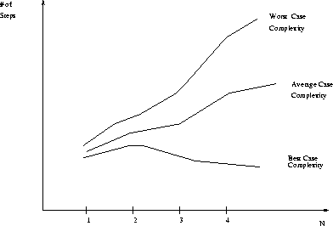
Best, Worst, and Average Case Complexity
Number of steps
Worst Case Complexity
Average Case Complexity
Best Case Complexity
N
(input size)

Slide 13
Relationship between complexity types and running time of Algorithms
Worst case
  Provides an upper bound on running time
  An absolute guarantee that the algorithm would not run longer, no matter what the inputs are
Best case
  Provides a lower bound on running time
  Input is the one for which the algorithm runs the fastest
Average case
  Provides a prediction about the running time
  Assumes that the input is random

Slide 14
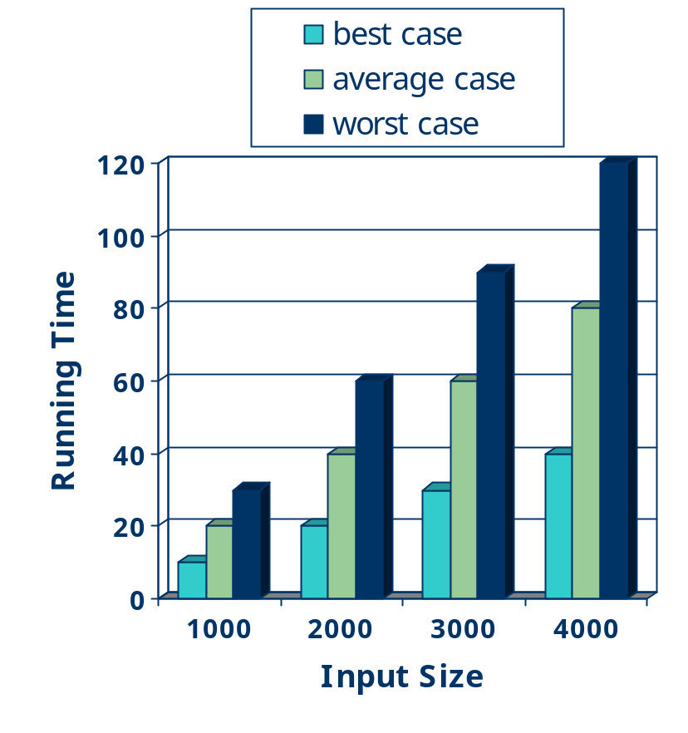
Running Time
Most algorithms transform input objects into output objects.
The running time of an algorithm typically grows with the input size.
Average case time is often difficult to determine.
We focus on the worst case running time.
  Easier to analyze
  Crucial to applications such as games, finance and robotics

Slide 15
Home Work
Exercise-1.
  Write a pseudo code which find the sum of two 3*3 matrics and then calculate its running time.
Exercise-2.
  Write a pseudo code which read a number N and print whether it is prime or not . After that, calculate the run time complexity

Slide 16
Summary
Number of steps you need to find the complexity of an algorithm
Run time complexity vary due to use fo different constructs such as simple, nested and consecutive loop, selection and assignment statement.
Types of algorithms complexity are best, average and worst which also depend on number of steps or comparisons

Slide 17
In Next Lecturer
In next lecture, we will talk about the asymptotic analysis fro comparisons of algorithms.

