Slide 1
Lecture 6.
Order of growth and asymptotic analysis

Slide 2
Recap
Run time complexity of an algorithm can be found by using RAM model
Measuring of Space and time complexity are important to find the performance of proposed algorithms
  For run time complexity, identification of input size and number of primitive operations is necessary

Slide 3
How do we analyze algorithms?
We need to define a number of objective measures.
(1) Compare execution times?
Not good: times are specific to a particular computer
(2) Count the number of statements executed?
Not good: number of statements vary with the programming
language as well as the style of the individual programmer. (see example on next slide)

Slide 4
How do we analyze algorithms Example (# of statements)
Algorithm 1 Algorithm 2
arr[0] = 0; for(i=0; i<N; i++)
arr[1] = 0; arr[i] = 0;
arr[2] = 0;
...
arr[N-1] = 0;
Notes:
Discrete Mathematics and its Applications
26年 11月 7日
(c)2001-2002, Michael P. Frank

Slide 5
How do we analyze algorithms (Cont !!!)
(3). Express running time as a function of the input size n (i.e., f(n)).
  To compare two algorithms with running times f(n) and g(n), we need a rough measure of how fast a function grows.
  Such an analysis is independent of machine time, programming style, etc.
Notes:
Discrete Mathematics and its Applications
26年 11月 7日
(c)2001-2002, Michael P. Frank

Slide 6
Example-1. (Run time Cost Analysis)
Associate a "cost" with each statement.
Find the "total cost“ by finding the total number of times each statement is executed.
Algorithm 1 Algorithm 2
Cost Cost
arr[0] = 0; c₁ for(i=0; i<N; i++) c₂
arr[1] = 0; c₁ arr[i] = 0; c₁
arr[2] = 0; c₁
... ...
arr[N-1] = 0; c₁
----------- -------------
c₁+c₁+...+c₁ = c₁ x N (N+1) x c₂ + N x c₁ =
(c₂ + c₁) x N + c₂

Slide 7
Example-2 . (Run time Cost Analysis)
Algorithm 3 Cost
sum = 0; c₁
for(i=0; i<N; i++) c₂
for(j=0; j<N; j++) c₂
sum += arr[i][j]; c₃
------------
c₁ + c₂ x (N+1) + c₂ x N x (N+1) + c₃ x N²

Slide 8
Asymptotic Analysis
To compare two algorithms with running times f(n) and g(n), we need a rough measure that characterizes how fast each function grows.
Hint: use rate of growth
Compare functions in the limit, that is, asymptotically!
  (i.e., for large values of n)

Slide 9
Rate/order of Growth
Consider the example of buying elephants and goldfish:
Cost: cost_of_elephants + cost_of_goldfish
Cost ~ cost_of_elephants (approximation)
The low order terms in a function are relatively insignificant for large n
n⁴ + 100n² + 10n + 50 ~ n⁴
i.e., we say that n⁴ + 100n² + 10n + 50 and n⁴ have the same rate of growth

Slide 10
Rate/order of Growth
Let f(n) = 3n²+5n+6
Important point to be noted when you are finding order of growth
  Remove all constants of function f(n) for an algorithm, such as
    remove 6 from above f(n)
  Remove low order terms such as
    Remove or ignore 5n from above f(n)
  Remove coefficient of high order term such
    Remove or ignore 3 from above f(n)

Slide 11
Rate of Growth ≡Asymptotic Analysis
Using rate of growth as a measure to compare different functions implies comparing them asymptotically.
If f(x) is faster growing than g(x), then f(x) always eventually becomes larger than g(x) in the limit (for large enough values of x).
Notes:
Discrete Mathematics and its Applications
26年 11月 7日
(c)2001-2002, Michael P. Frank

Slide 12
Example
Suppose you are designing a web site to process user data (e.g., financial records).
Suppose program A takes f_{A}(n)=30n+8 microseconds to process any n records, while program B takes f_{B}(n)=n²+1 microseconds to process the n records.
Which program would you choose, knowing you’ll want to support millions of users?
Notes:
Discrete Mathematics and its Applications
26年 11月 7日
(c)2001-2002, Michael P. Frank

Slide 13
Visualizing Orders of Growth
On a graph, as
you go to the
right, a faster
growing
function
eventually
becomes
larger...
f_{A}(n)=30n+8
Value of function →
f_{B}(n)=n²+1
Increasing n →
Notes:
Discrete Mathematics and its Applications
26年 11月 7日
(c)2001-2002, Michael P. Frank

Slide 14
Big-O Notation
We say f_{A}(n)=30n+8 is order n, or O(n).
It is, at most, roughly proportional to n.
f_{B}(n)=n²+1 is order n², or O(n²). It is, at most, roughly proportional to n².
In general, an O(n²) algorithm will be slower than O(n) algorithm.
Warning: an O(n²) function will grow faster than an O(n) function.
Notes:
Discrete Mathematics and its Applications
26年 11月 7日
(c)2001-2002, Michael P. Frank

Slide 15
Examples (Order of Growth)
We say that n⁴ + 100n² + 10n + 50 is of the order of n⁴ or O(n⁴)
We say that 10n³ + 2n² is O(n³)
We say that n³ - n² is O(n³)
We say that 10 is O(1),
We say that 1273 is O(1)
Notes:
Discrete Mathematics and its Applications
26年 11月 7日
(c)2001-2002, Michael P. Frank

Slide 16
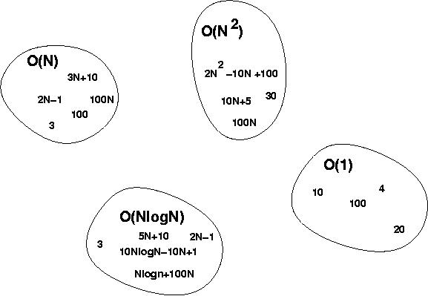
Big-O Visualization
Notes:
Discrete Mathematics and its Applications
26年 11月 7日
(c)2001-2002, Michael P. Frank

Slide 17
Computing running time
Algorithm 1 Algorithm 2
Cost Cost
arr[0] = 0; c1 for(i=0; i<N; i++) c2
arr[1] = 0; c1 arr[i] = 0; c1
arr[2] = 0; c1
...
arr[N-1] = 0; c1
----------- -------------
c1+c1+...+c1 = c1 x N (N+1) x c2 + N x c1 =
(c2 + c1) x N + c2
O(n)
Notes:
Discrete Mathematics and its Applications
26年 11月 7日
(c)2001-2002, Michael P. Frank

Slide 18
Computing running time (Cont !!!)
Algorithm Cost
sum = 0; c1
for(i=0; i<N; i++) c2
for(j=0; j<N; j++) c2
sum += arr[i][j]; c3 ------------
c1 + c2 x (N+1) + c2 x N x (N+1) + c3 x N x N
O(n²)
Notes:
Discrete Mathematics and its Applications
26年 11月 7日
(c)2001-2002, Michael P. Frank

Slide 19
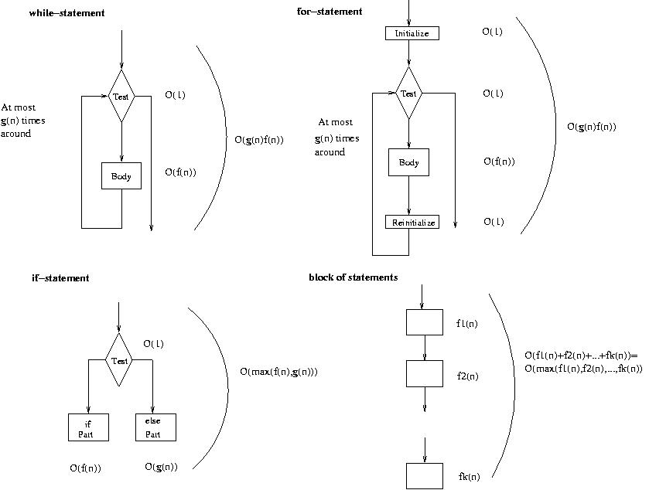
Running time of various statements
while-loop
for-loop
If statement
Block of statements
Notes:
Discrete Mathematics and its Applications
26年 11月 7日
(c)2001-2002, Michael P. Frank

Slide 20
Examples
i = 0;
while (i<N) {
X=X+Y; // O(1)
result = mystery(X); // O(N), just an example...
i++; // O(1)
}
The body of the while loop: O(N)
Loop is executed: N times
N x O(N) = O(N²)
Notes:
Discrete Mathematics and its Applications
26年 11月 7日
(c)2001-2002, Michael P. Frank

Slide 21
Examples (Cont !!!)
if (i<j)
for ( i=0; i<N; i++ )
X = X+i;
else
X=0;
Max ( O(N), O(1) ) = O (N)
O(N)
O(1)
Notes:
Discrete Mathematics and its Applications
26年 11月 7日
(c)2001-2002, Michael P. Frank

Slide 22
Summary
Running time of an algorithm is represented theorugh a function f(n) or g(n) refer to the input size n.
Rate/order of growth is a measure to compare two algorithms through its function and it implies to asymptotic analysis
When your finding or analyzing order of growth of an algorithm then you need to ignore following
  Constant terms
  low order terms
  coefficient of high order term
When you have more than one algorithm or pseudo codes for a problem then you apply asymptotic analysis to compare the performance of both for best.

Slide 23
In Next Lecturer
In next lecture, we will use asymptotic analysis definitions for analysis of algorithms.

