Slide 1
Lecture 7.
Asymptotic definitions for the analysis of algorithms

Slide 2
Recap
Function f(n) or g(n) are designed for algorithm with respect to the input size n.
Constant terms, low order terms and coefficient of high order term are ignored during the analysis of order of growth for an algorithm
If you are interested to compare two functions of algorithm then apply asymptotic analysis.

Slide 3
Asymptotic Notation
O notation: asymptotic “less than”:
  f(n)=O(g(n)) implies: f(n) “≤” g(n)
Ω notation: asymptotic “greater than”:
  f(n)= Ω (g(n)) implies: f(n) “≥” g(n)
Θ notation: asymptotic “equality”:
  f(n)= Θ (g(n)) implies: f(n) “=” g(n)
Notes:
Discrete Mathematics and its Applications
26年 11月 8日
(c)2001-2002, Michael P. Frank

Slide 4
Definition: O(g), at most order g
Let f,g are functions R→R.
We say that “f is at most order g”, if:
∃c,k: f(x) ≤ cg(x), ∀x>k
  “Beyond some point k, function f is at most a constant c times g (i.e., proportional to g).”
“f is at most order g”, or “f is O(g)”, or “f=O(g)” all just mean that f∈O(g).
Sometimes the phrase “at most” is omitted.
Notes:
Discrete Mathematics and its Applications
26年 11月 8日
(c)2001-2002, Michael P. Frank

Slide 5
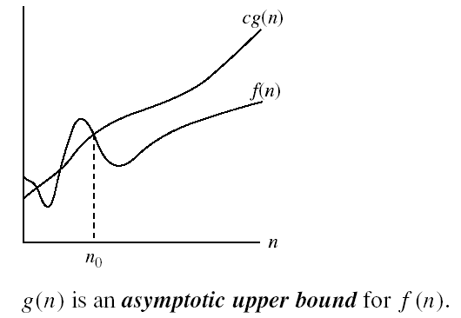
Big-O Visualization
k
Notes:
Discrete Mathematics and its Applications
26年 11月 8日
(c)2001-2002, Michael P. Frank

Slide 6
Points about the definition
Note that f is O(g) as long as any values of c and k exist that satisfy the definition.
But: The particular c, k, values that make the statement true are not unique: Any larger value of c and/or k will also work.
You are not required to find the smallest c and k values that work. (Indeed, in some cases, there may be no smallest values!)
Notes:
Discrete Mathematics and its Applications
26年 11月 8日
(c)2001-2002, Michael P. Frank

Slide 7
“Big-O” Proof Examples
Show that 30n+8 is O(n).
  Show ∃c,k: 30n+8 ≤ cn, ∀n>k .
    Let c=31, k=8. Assume n>k=8. Then
    cn = 31n = 30n + n > 30n+8, so 30n+8 < cn.
Show that n²+1 is O(n²).
  Show ∃c,k: n²+1 ≤ cn², ∀n>k: .
    Let c=2, k=1. Assume n>1. Then
    cn² = 2n² = n²+n² > n²+1, or n²+1< cn².
Notes:
Discrete Mathematics and its Applications
26年 11月 8日
(c)2001-2002, Michael P. Frank

Slide 8
Big-O example, graphically
Note 30n+8 isn’t
less than n
anywhere (n>0).
It isn’t even
less than 31n
everywhere.
But it is less than
31n everywhere to
the right of n=8.
cn =
31n
30n+8
30n+8
∈O(n)
Value of function →
n
n>k=8 →
Increasing n →
Notes:
Discrete Mathematics and its Applications
26年 11月 8日
(c)2001-2002, Michael P. Frank

Slide 9
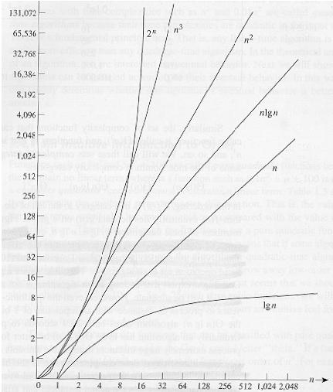
Common orders of magnitude
Notes:
Discrete Mathematics and its Applications
26年 11月 8日
(c)2001-2002, Michael P. Frank

Slide 10
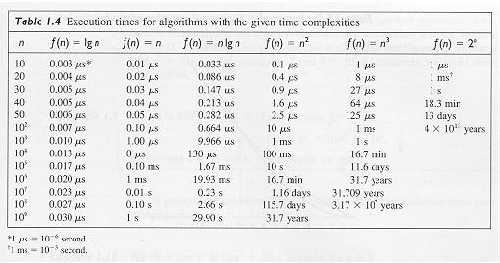
Common orders of magnitude
Notes:
Discrete Mathematics and its Applications
26年 11月 8日
(c)2001-2002, Michael P. Frank

Slide 11
Order-of-Growth in Expressions
“O(f)” can be used as a term in an arithmetic expression .
E.g.: we can write “x²+x+1” as “x²+O(x)” meaning “x² plus some function that is O(x)”.
Formally, you can think of any such expression as denoting a set of functions:
“x²+O(x)” :≡ {g | ∃f∈O(x): g(x)= x²+f(x)}
Notes:
Discrete Mathematics and its Applications
26年 11月 8日
(c)2001-2002, Michael P. Frank

Slide 12
Useful Facts about Big O
Constants ...
∀c>0, O(cf)=O(f+c)=O(f−c)=O(f)
Sums:
- If g∈O(f) and h∈O(f), then g+h∈O(f).
- If g∈O(f₁) and h∈O(f₂), then
g+h∈O(f₁+f₂) =O(max(f₁,f₂))
(Very useful!)
Notes:
Discrete Mathematics and its Applications
26年 11月 8日
(c)2001-2002, Michael P. Frank

Slide 13
More Big-O facts
Products:
If g∈O(f₁) and h∈O(f₂), then gh∈O(f₁f₂)
Big O, as a relation, is transitive:
f∈O(g) ∧ g∈O(h) → f∈O(h)
Notes:
Discrete Mathematics and its Applications
26年 11月 8日
(c)2001-2002, Michael P. Frank

Slide 14
More Big O facts
∀ f,g & constants a,b∈R, with b≥0,
  af = O(f) (e.g. 3x² = O(x²))
  f+O(f) = O(f) (e.g. x²+x = O(x²))
  |f|^{1-b} = O(f) (e.g. x⁻¹ = O(x))
  (log_{b} |f|)ª = O(f) (e.g. log x = O(x))
  g=O(fg) (e.g. x = O(x log x))
  fg ≠ O(g) (e.g. x log x ≠ O(x))
  a=O(f) (e.g. 3 = O(x))
Notes:
Discrete Mathematics and its Applications
26年 11月 8日
(c)2001-2002, Michael P. Frank

Slide 15
Definition: Ω(g), at least order g
Let f,g be any function R→R.
We say that “f is at least order g”, written Ω(g), if ∃c,k: f(x) ≥ cg(x), ∀x>k
  “Beyond some point k, function f is at least a constant c times g (i.e., proportional to g).”
  Often, one deals only with positive functions and can ignore absolute value symbols.
“f is at least order g”, or “f is Ω(g)”, or “f= Ω(g)” all just mean that f∈ Ω(g).
Notes:
Discrete Mathematics and its Applications
26年 11月 8日
(c)2001-2002, Michael P. Frank

Slide 16
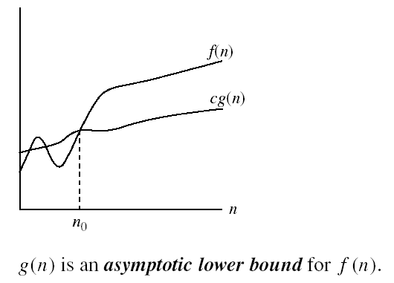
Big- Ω Visualization
Notes:
Discrete Mathematics and its Applications
26年 11月 8日
(c)2001-2002, Michael P. Frank

Slide 17
Definition: Θ(g), exactly order g
If f∈O(g) and g∈O(f) then we say “g and f are of the same order” or “f is (exactly) order g” and write f∈Θ(g).
Another equivalent definition:
∃c₁c₂,k: c₁g(x)≤f(x)≤c₂g(x), ∀x>k
“Everywhere beyond some point k, f(x) lies in between two multiples of g(x).”
Θ(g) ≡ O(g) ∩ Ω(g)
(i.e., f∈O(g) and f∈Ω(g) )
Notes:
Discrete Mathematics and its Applications
26年 11月 8日
(c)2001-2002, Michael P. Frank

Slide 18

Big- Θ Visualization
Notes:
Discrete Mathematics and its Applications
26年 11月 8日
(c)2001-2002, Michael P. Frank

Slide 19
Rules for Θ
Mostly like rules for O( ), except:
∀ f,g>0 & constants a,b∈R, with b>0,
af ∈ Θ(f) ← Same as with O.
f ∉ Θ(fg) unless g=Θ(1) ← Unlike O.
|f| ^{1-b} ∉ Θ(f), and ← Unlike with O.
(log_{b} |f|)^{c} ∉ Θ(f). ← Unlike with O.
The functions in the latter two cases we say are strictly of lower order than Θ(f).
Notes:
Discrete Mathematics and its Applications
26年 11月 8日
(c)2001-2002, Michael P. Frank

Slide 20
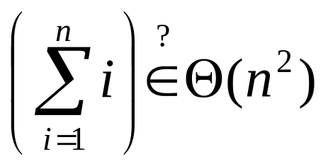
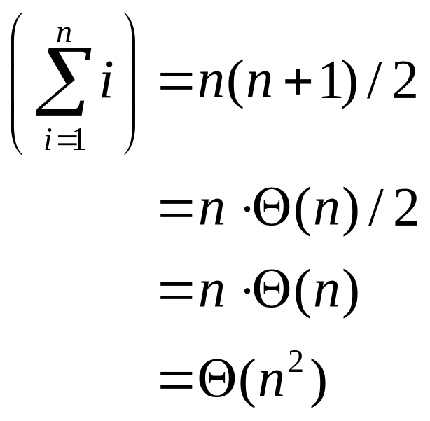
Θ example
Determine whether:
Quick solution:
Notes:
Discrete Mathematics and its Applications
26年 11月 8日
(c)2001-2002, Michael P. Frank

Slide 21



Relations Between Q, O, W

Slide 22
Other Order-of-Growth Relations
o(g) = {f | ∀c ∃k: f(x) < cg(x), ∀x>k}
“The functions that are strictly lower order than g.” o(g) ⊂ O(g) − Θ(g).
ω(g) = {f | ∀c ∃k: cg(x) < f(x), ∀x>k }
“The functions that are strictly higher order than g.” ω(g) ⊂ Ω(g) − Θ(g).
Notes:
Discrete Mathematics and its Applications
26年 11月 8日
(c)2001-2002, Michael P. Frank

Slide 23
Relations Between the Relations
Subset relations between order-of-growth sets.
R→R
O( f )
Ω( f )
• f
o( f )
Θ( f )
ω( f )
Notes:
Discrete Mathematics and its Applications
26年 11月 8日
(c)2001-2002, Michael P. Frank

Slide 24
Review: Orders of Growth
Definitions of order-of-growth sets, ∀g:R→R
O(g) ≡ {f | ∃ c,k: f(x) ≤ cg(x), ∀x>k }
o(g) ≡ {f | ∀c ∃k: f(x) < cg(x),∀x>k }
Ω(g) ≡ {f| | ∃c,k : f(x) ≥ cg(x),∀x>k }
ω(g) ≡ {f | ∀ c ∃k: f(x) >cg(x), ∀x>k}
Θ(g) ≡ {f | ∃c₁c₂,k: c₁g(x)≤f(x)|≤c₂g(x), ∀x>k}
Notes:
Discrete Mathematics and its Applications
26年 11月 8日
(c)2001-2002, Michael P. Frank

Slide 25
Summary
Asymptotic analysis helps to highlight the order of growth of functions to compare algorithms
Common asymptotic notation are of O, o, Ω, ω and Θ.
Definitions of each notation uses the two constants k (or n0 ) and c.
Constant k refer to the point where two function shows same value.
While constant c refer to the value of multiple time growth of f(n) with respect to g(n).

Slide 26
In Next Lecturer
In next lecture, we will discuss the analysis of recursive algorithms.

