Slide 1
Lecture 9.
Arithmetic and geometric series and mathematical induction

Slide 2
Recap
We have to use seven steps from taking a problem scenario and to analyzing its run time complexity. These steps are for those problems which are attempted without recursive approach.
A recursive function or method s that method which called itself from within body until its base condition fulfill.
There are two components of a recursive method i.e. base and recursive part.
A recursive relation is form by considering base condition and total recursive calls with some constants

Slide 3
Recap
Constants for recursive relation are a, b and c or others.
  One constant refer to cost of base condition (i.e a)
  One constant refer to total recursive calling (i.e. b)
  One constant refer to cost of those steps which are performed outside the recursive calls.
Always consider worst case analysis for recursive relations.

Slide 4
What is arithmetic Sequence
An Arithmetic Sequence is defined as a sequence in which there is a common difference between consecutive terms.

Slide 5
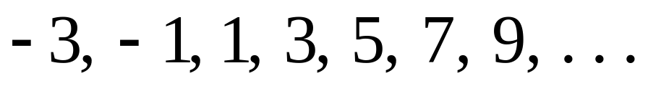
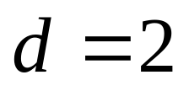
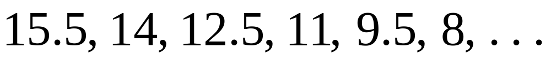
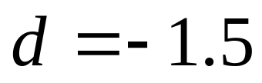
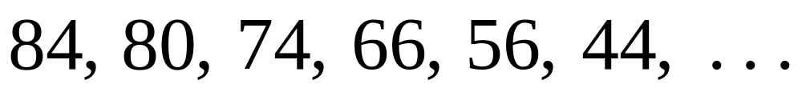
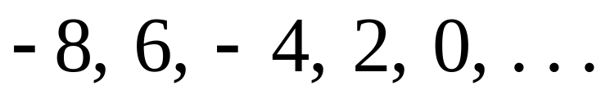
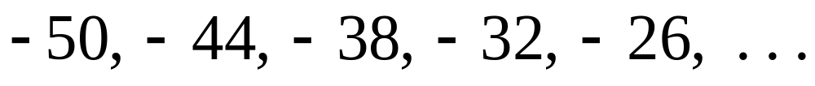
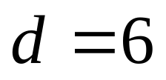
Which of the following sequences are arithmetic? .
YES
YES
NO
NO
YES

Slide 6

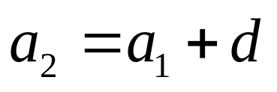
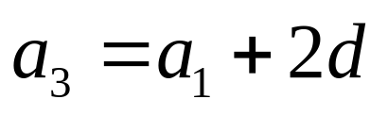
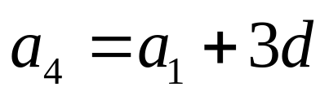
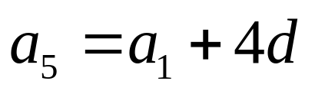
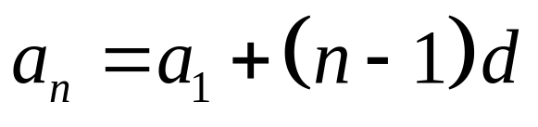
The general form of an ARITHMETIC sequence.
First Term:
Second Term:
Third Term:
Fourth Term:
Fifth Term:
nth Term:

Slide 7





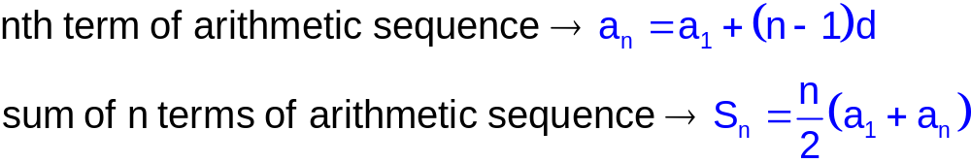
Arithmetic Series )

Slide 8



Given an arithmetic sequence with
x
38
15
NA
-3
X = 80

Slide 9

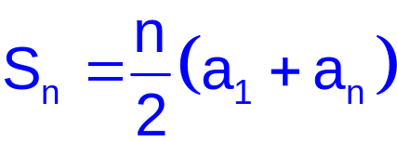
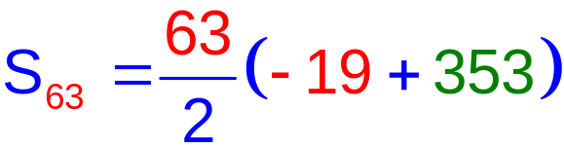
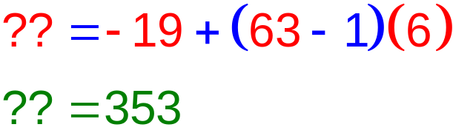

Example-1
-19
??
353
63
x
6

Slide 10


Example-2
1.5
x
16
NA
0.5

Slide 11


Example-3
9
633
x
NA
24
X = 27

Slide 12



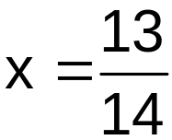
Example-4
-6
20
29
NA
x

Slide 13


Example-5
Find two arithmetic means between –4 and 5
-4
5
-4, ____, ____, 5
4
NA
x
The two arithmetic means are –1 and 2, since –4, -1, 2, 5
forms an arithmetic sequence

Slide 14

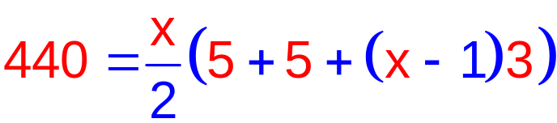
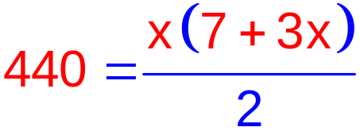



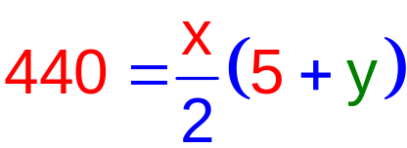
Example-6
5
Find n for the series in which
y
x
440
3
Graph on positive window
X = 16

Slide 15
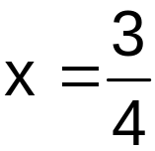

Example-7
Find three arithmetic means between 1 and 4
1
1, ____, ____, ____, 4
4
5
NA
x
The three arithmetic means are 7/4, 10/4, and 13/4
since 1, 7/4, 10/4, 13/4, 4 forms an arithmetic sequence

Slide 16

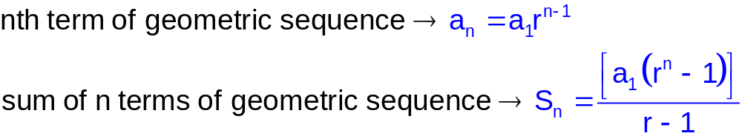
Geometric Series

Slide 17
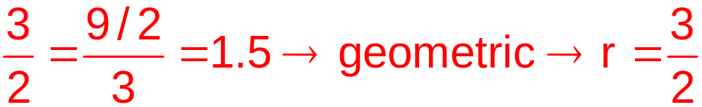
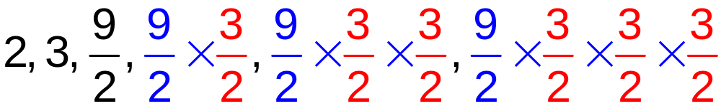
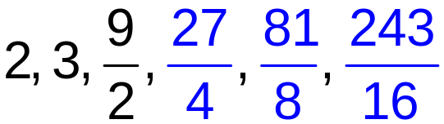
Example-1
Find the next three terms of 2, 3, 9/2, ___, ___, ___
3 – 2 vs. 9/2 – 3… not arithmetic

Slide 18
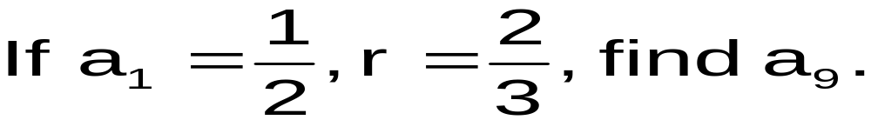

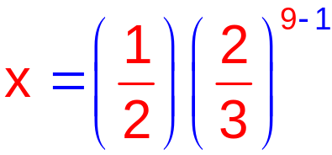
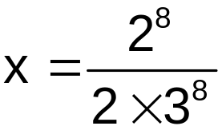
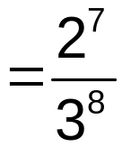

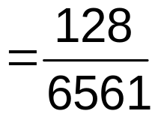
Example-2
1/2
x
9
NA
2/3

Slide 19
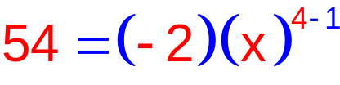


Example-3
Find two geometric means between –2 and 54
-2, ____, ____, 54
-2
54
4
NA
x
The two geometric means are 6 and -18, since –2, 6, -18, 54
forms an geometric sequence

Slide 20
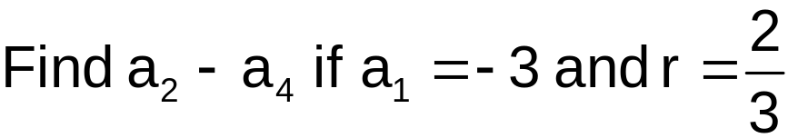
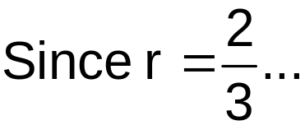
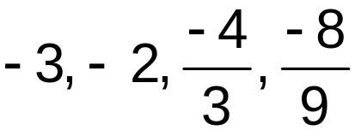
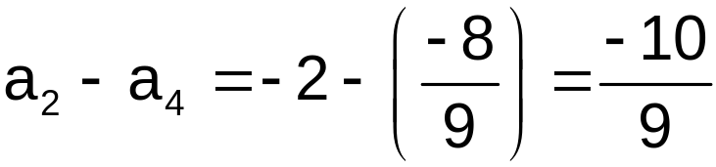
Example-4
-3, ____, ____, ____

Slide 21


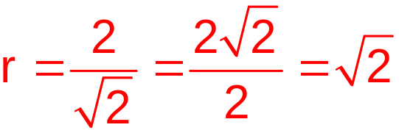
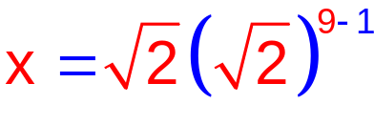
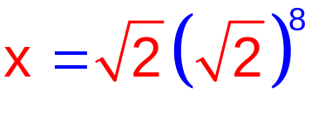

Example-5
9
x
NA

Slide 22



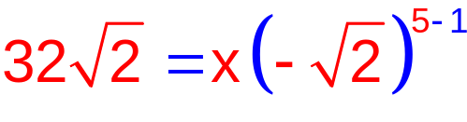

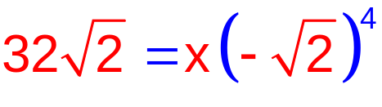


Example-6
x
5
NA

Slide 23

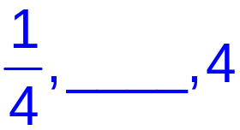

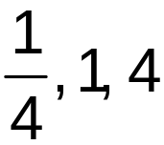
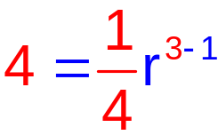
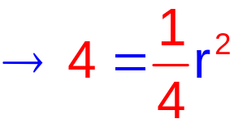


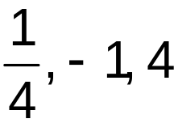
Example-7
*** Insert one geometric mean between ¼ and 4***
1/4
*** denotes trick question
3
NA

Slide 24
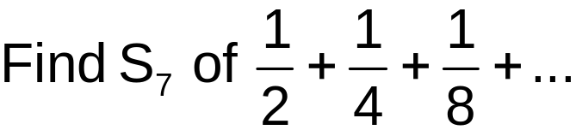

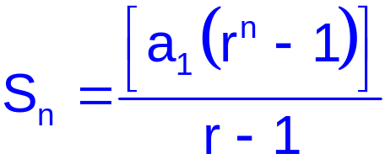
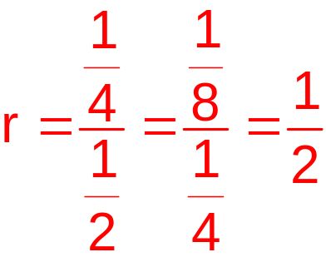
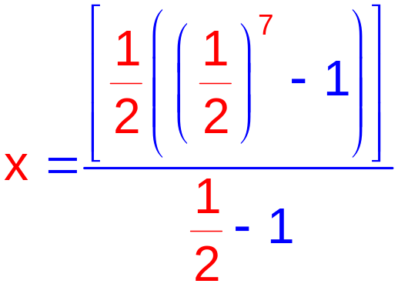


Example-8
1/2
7
x

Slide 25




Series and their sum
Infinite Arithmetic
No Sum
1, 4, 7, 10, 13, ….
3, 7, 11, …, 51
Finite Arithmetic
1, 2, 4, …, 64
Finite Geometric
Infinite Geometric
r > 1
r < -1
No Sum
1, 2, 4, 8, …
Infinite Geometric
-1 < r < 1

Slide 26

Sigma Notation
UPPER BOUND
(NUMBER)
SIGMA
(SUM OF TERMS)
NTH TERM
(SEQUENCE)
LOWER BOUND
(NUMBER)

Slide 27




















Slide 28










Sigma Notation (Example-1)

Slide 29



Sigma Notation (Example-2)

Slide 30



Form a Sigma Notation (Example-1)
Rewrite using sigma notation: 3 + 6 + 9 + 12
Arithmetic, d= 3

Slide 31


Form a Sigma Notation (Example-2)
Rewrite using sigma notation: 16 + 8 + 4 + 2 + 1
Geometric, r = ½

Slide 32


Form a Sigma Notation (Example-3)
Rewrite using sigma notation: 19 + 18 + 16 + 12 + 4
Not Arithmetic, Not Geometric
19 + 18 + 16 + 12 + 4
-1 -2 -4 -8

Slide 33



Form a Sigma Notation (Example-4)
Rewrite the following using sigma notation:
Numerator is geometric, r = 3
Denominator is arithmetic d= 5
NUMERATOR:
DENOMINATOR:
SIGMA NOTATION:

Slide 34
Principle of Mathematical Induction
Let P(n) be a predicate defined for integers n.
Suppose the following statements are true:
1. Basis step:
P(a) is true for some fixed a∈Z .
2. Inductive step: For all integers k ≥ a,
if P(k) is true then P(k+1) is true.
Then for all integers n ≥ a, P(n) is true.

Slide 35
Example: Sum of Odd Integers
Proposition: 1 + 3 + … + (2n-1) = n²
for all integers n≥1.
Proof (by induction):
1) Basis step:
The statement is true for n=1: 1=1² .
2) Inductive step:
Assume the statement is true for some k≥1
(inductive hypothesis) ,
show that it is true for k+1 .

Slide 36
Example: Sum of Odd Integers
Proof (cont.):
The statement is true for k:
1+3+…+(2k-1) = k² (1)
We need to show it for k+1:
1+3+…+(2(k+1)-1) = (k+1)² (2)
Showing (2):
1+3+…+(2(k+1)-1) = 1+3+…+(2k+1) =
1+3+…+(2k-1)+(2k+1) =
k²+(2k+1) = (k+1)² .
We proved the basis and inductive steps,
so we conclude that the given statement true. ■
by (1)

Slide 37


Important theorems proved by mathematical induction
Theorem 1 (Sum of the first n integers):
For all integers n≥1,
Theorem 2 (Sum of a geometric sequence):
For any real number r except 1, and any integer n≥0,

Slide 38
Proving a divisibility property by mathematical induction
Proposition: For any integer n≥1,
7^{n} - 2^{n} is divisible by 5. (P(n))
Proof (by induction):
1) Basis step:
The statement is true for n=1: (P(1))
7¹ – 2¹ = 7 - 2 = 5 is divisible by 5.
2) Inductive step:
Assume the statement is true for some k≥1 (P(k))
(inductive hypothesis) ;
show that it is true for k+1 . (P(k+1))

Slide 39
Proving a divisibility property by mathematical induction
Proof (cont.): We are given that
P(k): 7^{k} - 2^{k} is divisible by 5. (1)
Then 7^{k} - 2^{k} = 5a for some a∈Z . (by definition) (2)
We need to show:
P(k+1): 7^{k+1} - 2^{k+1} is divisible by 5. (3)
7^{k+1} - 2^{k+1} = 7·7^{k} - 2·2^{k} = 5·7^{k} + 2·7^{k} - 2·2^{k}
= 5·7^{k} + 2·(7^{k} - 2^{k}) = 5·7^{k} + 2·5a (by (2))
= 5·(7^{k} + 2a) which is divisible by 5. (by def.)
Thus, P(n) is true by induction.

Slide 40
Summary
The sum of finite arithmetic series can be found by using following formula
The sum of finite Geometric series can be found by using following formula
The sum of infinite Geometric series can be found by using following formula

Slide 41
Summary
Mathematical induction principle is used to varify or proof the predicates or proposition such as a value is divisible by 5

Slide 42
In Next Lecturer
In next lecture, we will discuss the analysis of recursive relation using different methods.

