Slide 1
COMMUNICATION AND ITS FORMS
1- Non-verbal communication. It is interesting to note that non-verbal communication is used both intentionally and unintentionally.
2- Verbal communication.
When we speak, we are communicating much more than just the content of our words.
3- Written communication.
4- Visual communication.

Slide 2
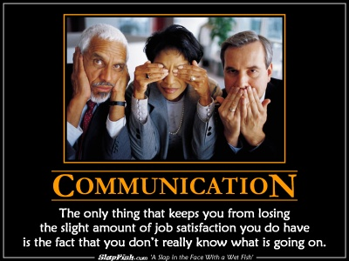
Communication - definition
The process by which people exchange information or express their thoughts and feelings….

Slide 3

VERBAL – NON-VERBAL
verbal
1. Spoken rather than written
2. Relating to words or using words
3. Relating to a verb

Slide 4
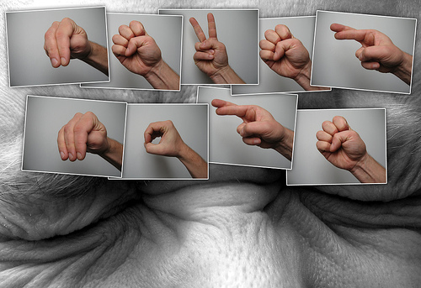
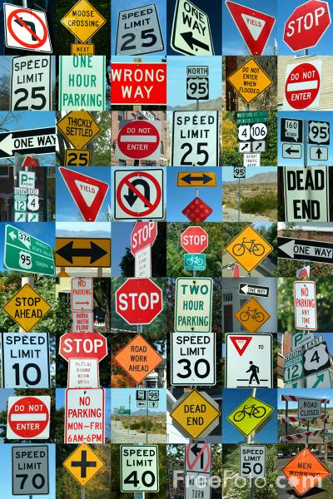
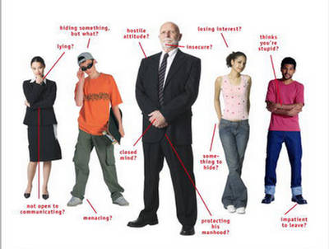
Non-verbal

Slide 5
Verbal communication
Oral (spoken)
1. face to face
(interaction, gestures, facial expressions, voice,tone, fillers, pauses, laughter, sighs, repetition,
hesitation, explanation, simple, spontaneous, cannot be taken back)
Formal / informal
2. on the phone
(speaker´s body language is not seen)

Slide 6
Verbal communication
Written
1. formal letters, texts, emails
(more complicated, more formal, requires planning and more time, structured, precise choice of words, can be reread, stored, editted,one-way)
2. Informal letters, text messages, emails, chat
(less complicated, less formal, spontaneous, punctuation, pictures, smiles, chat – immediate feedback)

Slide 7
3- Written communication
Examples…
4- Visual communication
GIFS.
Screenshots.
Screen recordings.
Videos.
Pie charts, Graphs
Infographics.
Data visualizations.
Slide
Emojis

Slide 8
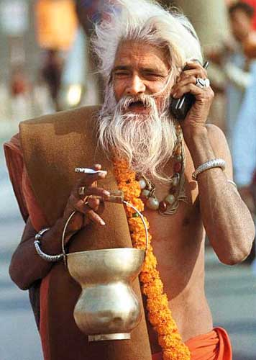


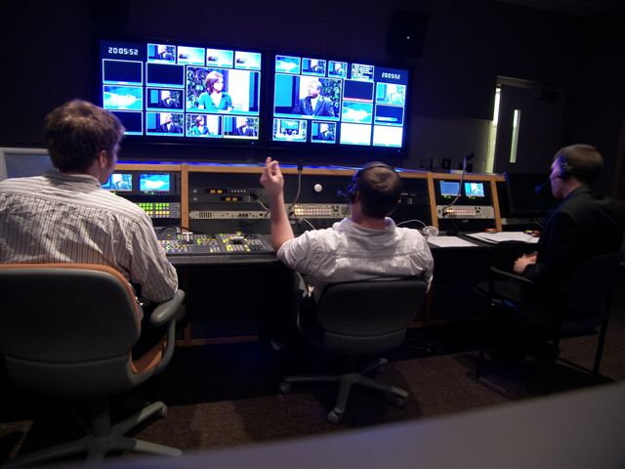
Communication and New Technologies

Slide 9
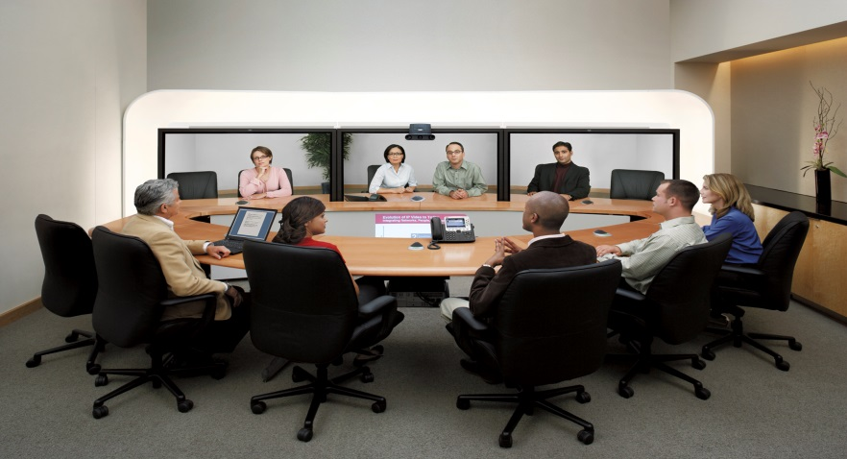
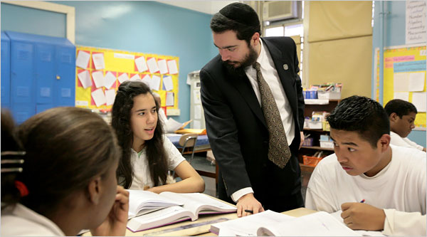
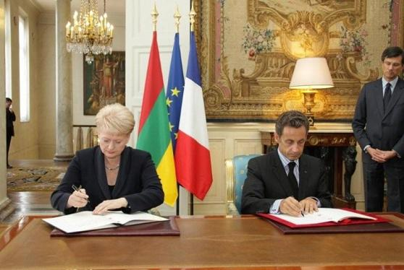
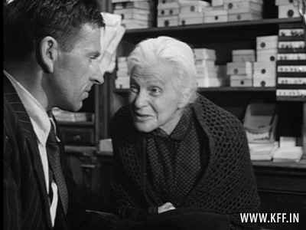
Communication in different situations

Slide 10
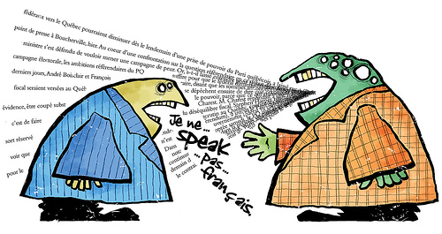
Communication and Languages
Esperanto
English
Urdu
Arabic
EU
taught at school
get to know other culture
business
self-confidence

Slide 11
