Slide 1




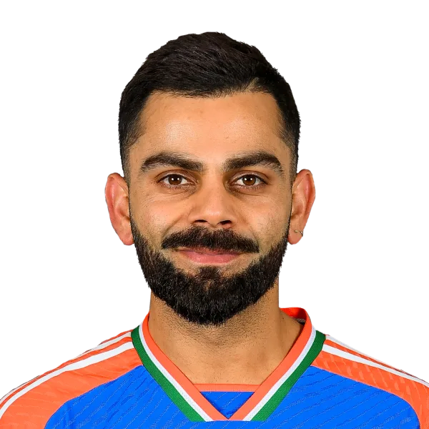



CRICHEROES IMPACT METRIC CHALLENGE
ImpactMeter
Context-Aware Cricket Impact Analytics
Team: Jetha Ke Jabaaz
Vishal Baraiya (Lead)
Deven Machchhar
Chintan Sitapara
Nabhag Sorathiya
INSTITUTIONAL AFFILIATIONS

Slide 2

Traditional Statistics Fail to Capture Match Context
Metric
Limitation
The "Context" Problem
Runs
Doesn't consider match pressure or game situation
Strike Rate
Ignores the specific phase of the game (Powerplay vs. Death)
A 30-run knock in a tense chase can influence the match outcome more than 70 runs scored in a comfortable game.
Wickets
Doesn't capture the actual impact on the match outcome.
OUR GOAL
Design a Context-Aware Player
Impact Metric.

Slide 3




Introducing ImpactMeter: Measuring True Player Impact
Impact = Performance × Context × Pressure
Performance Metrics
Pressure Index
Traditional statistics like runs, wickets, and strike rates as the foundation of player output.
Quantifying situational stress using required run rates, wickets fallen, and balls remaining.
Match Context
Phase Contributions
Adjusting performance based on game phases (Powerplay, Middle, Death) and specific match situations.
Weighted impact analysis that values contributions relative to their strategic importance.

Slide 4

Our Proposed Approach: The ImpactMeter Pipeline
01
IPL Ball-by-Ball Data
Raw historical data ingestion and cleaning.
Key Features Used
02
Feature Engineering
Runs & Strike Rate
Extracting contextual and pressure-based variables.
Wickets & Economy Rate
Match Phase (PP/Mid/Death)
03
Hybrid Scoring Model
Pressure Index
Rule-Based Impact Score + Random Forest ML Model.
Required Run Rate
Balls Remaining
04
ML-Assisted Impact Score
Refined intelligence for true player evaluation.
05
Rolling Performance Analysis
Last 10 innings trend for current form tracking.

Slide 5





Why ImpactMeter? The Competitive Advantage
Context-Aware Intelligence
Explainable Framework
ML-Enhanced Accuracy
Role-Aware Evaluation
Dynamically adjusts player scores by analyzing match phase, situational pressure, and game state in real-time.
A hybrid rule-based system ensures transparency, allowing every impact score to be traced back to specific events.
Random Forest models identify non-linear patterns and hidden correlations that traditional metrics often miss.
Customized sub-metrics for batters, bowlers, and all-rounders ensure fair and objective performance comparisons.

Slide 6



Current Limitations and Future Roadmap
Current Limitations
Future Roadmap
Dataset Scope
Global Expansion
Primary optimization and training performed on IPL ball-by-ball
Integrating international T20, ODI, and Test datasets for a
data.
universal impact metric.
Pressure Approximation
Granular Context
The pressure index is a statistical model and may not capture all
Incorporating environmental factors like pitch moisture,
psychological nuances.
weather, and stadium dimensions.
Real-time Latency
Live Match Integration
Currently lacks a live-feed integration for ball-by-ball real-time
Developing an API-driven live dashboard for real-time
impact prediction.
broadcaster integration.

Slide 7







ImpactMeter in Action: System Demo
Impact Score Gauge
ML Assisted Impact
Project Resources
A real-time visual indicator of a player's total match impact, normalized across different game situations.
Comparative analysis showing the delta between raw performance stats and machine learning-refined impact scores.
SOURCE CODE
https://github.com/mr-baraiya/ImpactMeter
LIVE DASHBOARD
https://mr-baraiya.github.io/ImpactMeter
Phase Contribution
Impact Trend
Detailed breakdown of impact generated across Powerplay, Middle, and Death overs for specialized role analysis.
Longitudinal tracking of player performance over the last 10 innings to identify form cycles and consistency.

Slide 8



The Middle Over Engine
Key Insights: What the Data Tells Us
Middle overs (7-15) often contribute most significantly to a player's cumulative impact score by setting the platform for the finish.
The Strike Rate Multiplier
In high-pressure chases, Strike Rate has a much stronger correlation with Impact Score than total runs scored.
Data-driven discoveries from the ImpactMeter model reveal critical patterns in modern T20 cricket.
Context is King
The Random Forest model indicates that contextual features (like Required Run Rate) carry more weight than raw counting stats in match-winning scenarios.

Slide 9




Real-World Applications of ImpactMeter
Coaches & Trainers
Performance Analysts
Selectors & Scouts
Fans & Broadcasters
Precisely track player form and identify specific areas for technical improvement based on situational performance.
Deeply understand how specific match contexts influence player output to optimize game-day strategies.
Compare players objectively across different conditions and match situations to build balanced, winning squads.
Enjoy richer, more meaningful analytics on broadcast and digital dashboards for a deeper understanding of the game.
FORM TRACKING
OBJECTIVE SCOUTING
ENHANCED DASHBOARDS
SKILL GAPS
STRATEGY OPTIMIZATION
SQUAD BALANCING
CONTEXTUAL ANALYSIS
FAN ENGAGEMENT

Slide 10

Redefining Cricket Intelligence
"ImpactMeter combines cricket domain knowledge with machine learning to quantify true player impact beyond traditional statistics."
THANK YOU
Team Jetha Ke Jabaaz
CricHeroes Impact Metric Challenge | HACKaMINeD 2026

