Slide 1



Object - Oriented Programming (OOP) Concepts
Presented By Vishal Baraiya
baraiyavishalbhai32@gmail.com

Slide 2
Introduction to OOP
What is OOP? :
Object-Oriented Programming (OOP) is a programming approach that uses classes and objects to design and build software.
Class: A blueprint for creating objects.
Object: An instance of a class, representing real-world entities.
Why OOP? :
OOP helps in organizing code, making it reusable, secure, and easy to maintain by modeling real-world concepts.

Slide 3
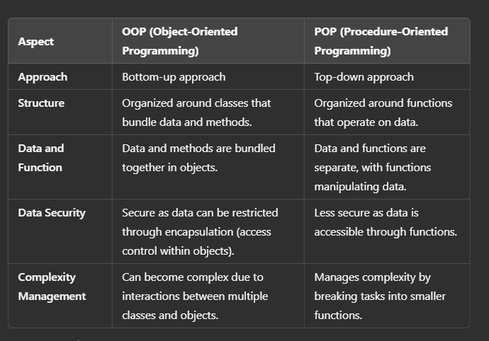
Introduction to OOP

Slide 4




Pillars of OOP
Encapsulation
Inheritance
Polymorphism
Abstraction

Slide 5
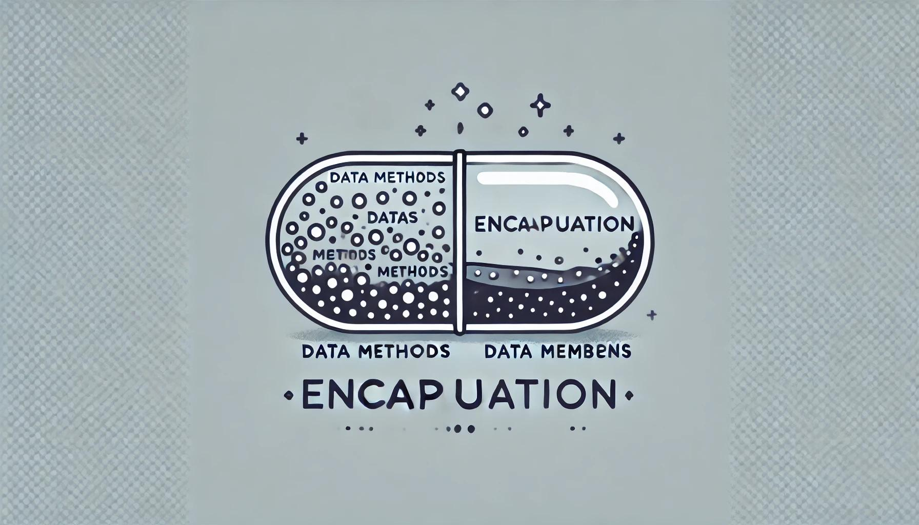
Encapsulation
The wrapping up of data and functions into a single unit is known as encapsulation.
The insulation of the data from direct access by the program is called data hiding or information hiding.
It is the process of enclosing one or more details from the outside world through access rights.
In simple words, "Encapsulation is a process of bringing data members (variables, properties) and member functions (methods) into a single unit."

Slide 6
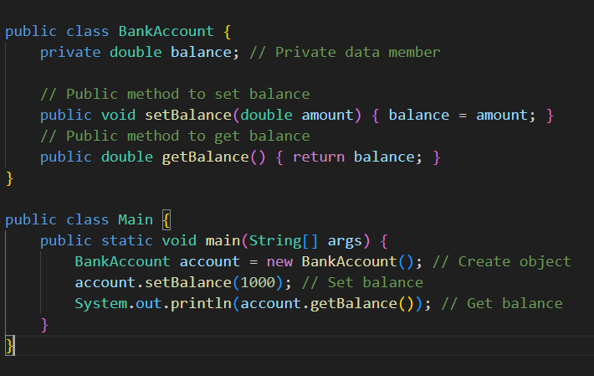

Slide 7
Inheritance
The mechanism of deriving a new class from an old class is called inheritance.
The old class is known as base class while the new class is known as derived class or subclass.
It lets programmers create new classes that share some of the attributes of existing classes.
Inheritance lets us build on previous work without reinventing the wheel.
Inheritance is the most powerful feature of OOP.
Through effective use of inheritance, we can save a lot of time in programming and also reduce errors, which in turn will increase the quality of work and productivity.

Slide 8
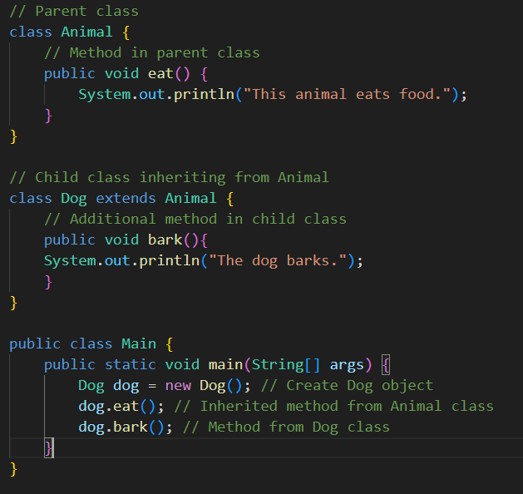

Slide 9
Types Of Inheritance
Inheritance
Single Inheritance
Multilevel Inheritance
Hierarchical Inheritance
Multiple Inheritance
Hybrid Inheritance

Slide 10
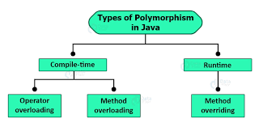
Polymorphism
If one task is performed in different ways, it is known as polymorphism.
OOP concept lets programmers use the same word to mean different things in different contexts.
Polymorphism is taken from the Greek words Poly (many) and morphism (forms).

Slide 11
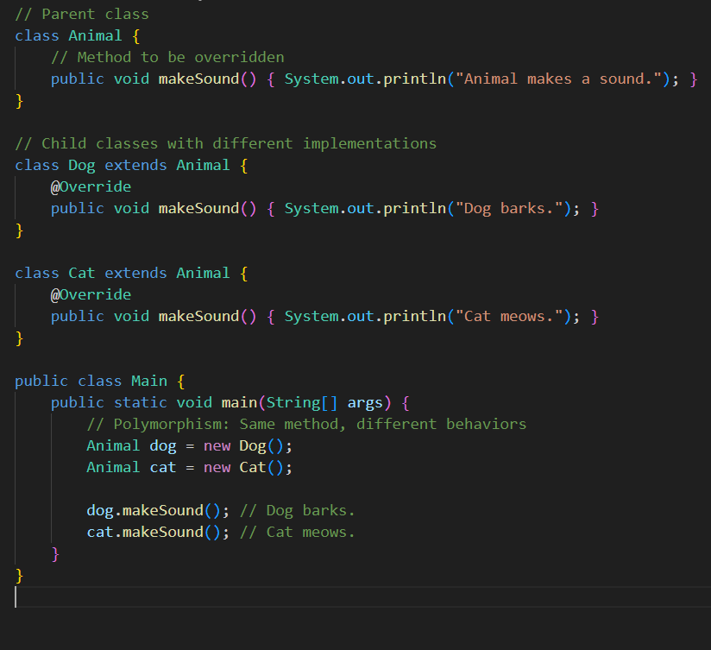

Slide 12
Abstraction
Abstraction refers to the act of representing essential features without including the background details or explanations.
Abstraction provides you a generalized view of your classes or object by providing relevant information.
Abstraction is the process of hiding the working style of an object, and showing the information of an object in understandable manner.
Example:
Electric Switch Board: we need not to worry about the internal work of switch board in order to use it, simply switch on/off to start/stop the device.
Car: you need not to understand how engine works in order to drive a car, you just need to know how to drive the car.
TV Remote: while increasing the TV volume you need not to understand the underlying process, just press the + volume button and it will work.

Slide 13
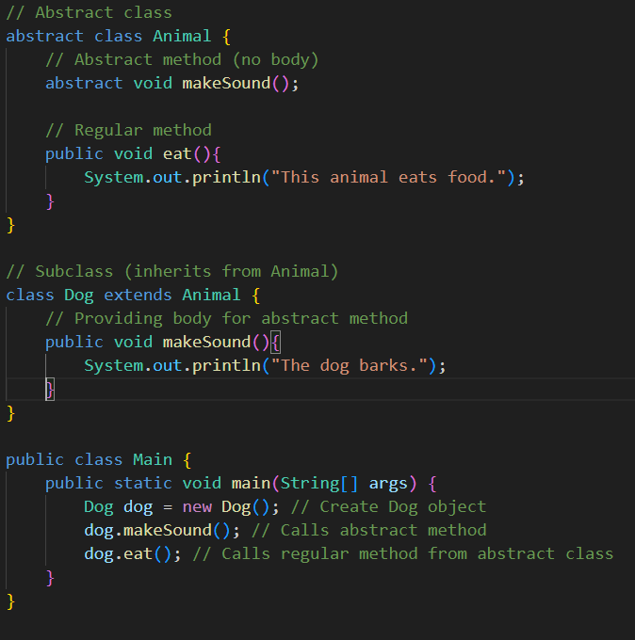

Slide 14

Thank You

