Slide 1
SECURE DATA HIDING IN IMAGES USING STEGANOGRAPHY
CAPSTONE PROJECT
Presented By: Vishal Baraiya
College Name & Department : Darshan University – B.Tech - CSE

Slide 2
OUTLINE
Problem Statement
Technology used
Wow factor
End users
Result
Conclusion
Git-hub Link
Future scope

Slide 3
Problem Statement
Problem
The problem this project addresses is the need for a user-friendly, secure, and efficient tool to hide and retrieve secret messages within image files. Many existing steganography tools are either too complex for non-technical users or lack features like passcode protection, making them less secure. Additionally, some tools do not support common image formats or provide a simple graphical interface for ease of use.
Objectives
Develop a Steganography Tool:
Create a Python-based application that allows users to encode a secret message into an image and decode it using a passcode.
Use the Least Significant Bit (LSB) method for encoding, which ensures minimal visual impact on the image.
Ensure Security:
Implement passcode protection to encrypt the hidden message, ensuring that only

Slide 4
Technology used
1. Python Programming Language:
The script is written in Python, a high-level language that is widely used for its simplicity and readability.
2. Tkinter (Graphical User Interface - GUI):
Tkinter is the standard Python library for creating graphical user interfaces. In this script, it is used to build the entire interface for interacting with the user, allowing image selection, message input, and passcode entry.
3. OpenCV (cv2):
OpenCV is an open-source computer vision and image processing library. It is used here to:
The script uses OpenCV to handle the image processing involved in encoding and decoding the hidden messages.
4. NumPy:
NumPy is a library for numerical computing in Python. It is used here to handle image data as arrays, which makes manipulating the pixel values straightforward.

Slide 5
Wow factors
1. Image-Based Secret Communication:
The ability to hide secret messages in plain sight within an image is pretty cool and opens the door to covert communication. Imagine being able to pass messages in plain images without anyone realizing it!
2. Password-Protected Steganography:
The added layer of a password for decoding ensures that only the intended recipient can unlock the message. It's like a combination of encryption and steganography, adding a layer of security.
3. User-Friendly Interface:
Despite being a technically sophisticated process, the tool is wrapped in an easy-to-use GUI with clear options for encoding and decoding, making it accessible even for non-technical users.
4. Cross-Platform Compatibility:
Since the tool uses Python, which is cross-platform, it can be easily run on Windows, Mac, or Linux as long as the necessary libraries are installed. This makes it versatile.
5. Open-Source & Customizable:
If you know Python, you can modify and extend this tool however you like. Want to add features like multi-image encoding, better encryption algorithms, or even support for audio files? The sky’s the limit.
6. Security + Stealth:
The combination of both steganography and encryption (password-based security) makes this a double-layered form of protection, ensuring that even if someone tries to extract the data, they’ll need the password.

Slide 6
End users
1. Privacy-Conscious Individuals:
2. Security Professionals:
3. Researchers in Cryptography & Information Security:
4. Educational Purposes:
5. Digital Artists or Content Creators:
6. Governments & Military:
7. Media & Entertainment Industry:
8. Humanitarian Organizations:
9. General Consumers:
10. Law Enforcement (Forensics):

Slide 7
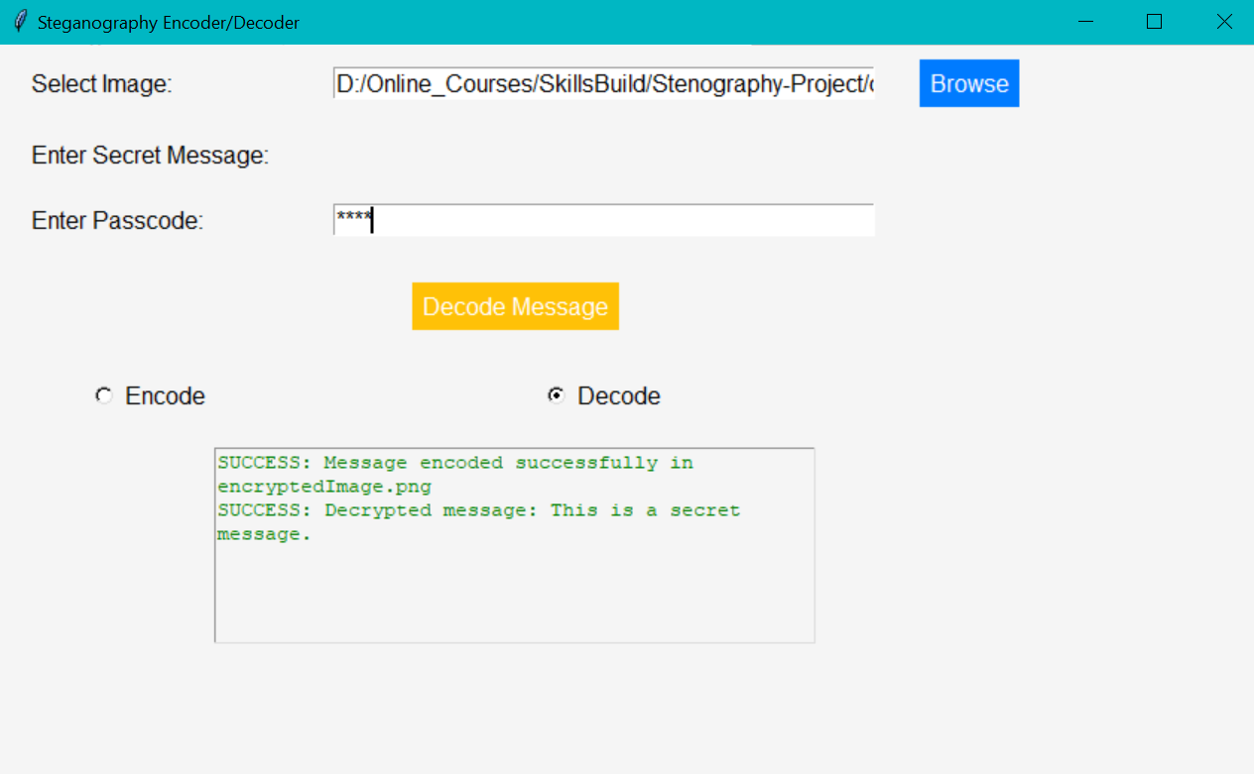
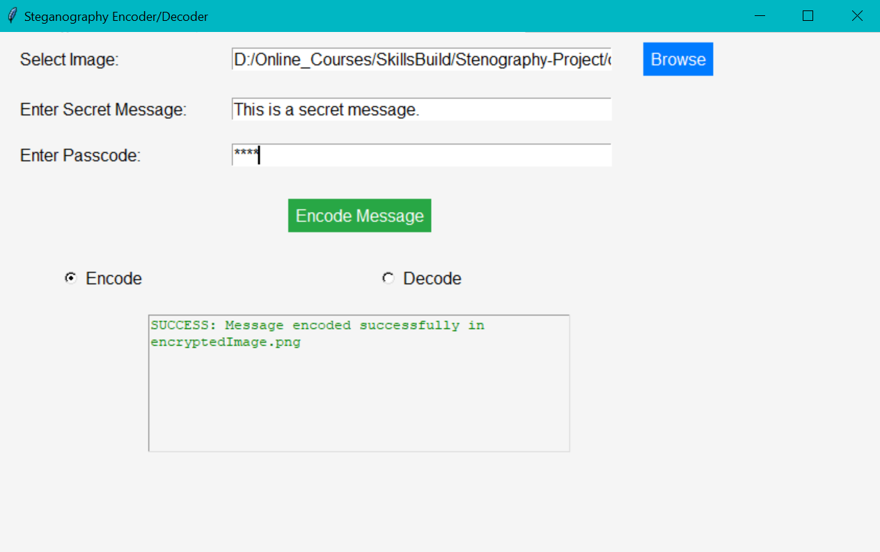
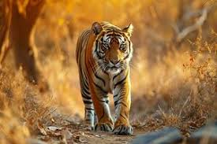

Results

Slide 8
Conclusion
This steganography tool represents a powerful and user-friendly solution for securely hiding messages within images, combining both privacy and creativity in an accessible way. It enables users to encode and decode messages with a password-protected layer of security, ensuring that communication remains confidential and tamper-proof.
The tool offers several benefits:
Seamless Integration: It works without altering the visual integrity of the image, making it ideal for secret communication.
Security: The password protection ensures that only authorized individuals can decode the hidden message, providing an extra layer of security.
User-Friendly Interface: With a simple and intuitive graphical user interface (GUI), the tool makes it easy for even non-technical users to encode and decode messages.
Practical Applications: Beyond just fun or personal use, the tool can be used for practical scenarios like secure communication, watermarking, intellectual property protection, and more.
However, like any technology, it comes with some limitations:
The size of the message is constrained by the image's pixel capacity.
The process depends on the passcode being known, which introduces the risk of data being lost if the passcode is forgotten.
In conclusion, this steganography tool provides a solid foundation for hidden communication, offering both security and creativity. It's a flexible tool that can serve a wide range of individuals, from casual users seeking privacy to professionals in fields like cybersecurity, digital forensics, and even creative industries like digital art.
Whether used for secret messaging, content protection, or just as an experiment in hidden communication, the tool presents exciting possibilities with its combination of simplicity and security.

Slide 9
GitHub Link
https://github.com/mr-baraiya/Stenography-Project

Slide 10
Future scope(optional)
The future scope of this steganography tool has significant potential for enhancement and expansion, both in terms of functionality and user experience. Here are some directions the project can take in the future:
1. Advanced Encoding Techniques:
2. Support for More Media Types:
3. Password Protection and Encryption Enhancements:
4. Steganography for Large Files:
5. Cross-Platform Support::
6. Improved User Interface:Drag-and-Drop Support:
7. Machine Learning for Message Detection:

Slide 11
THANK YOU

