Slide 1
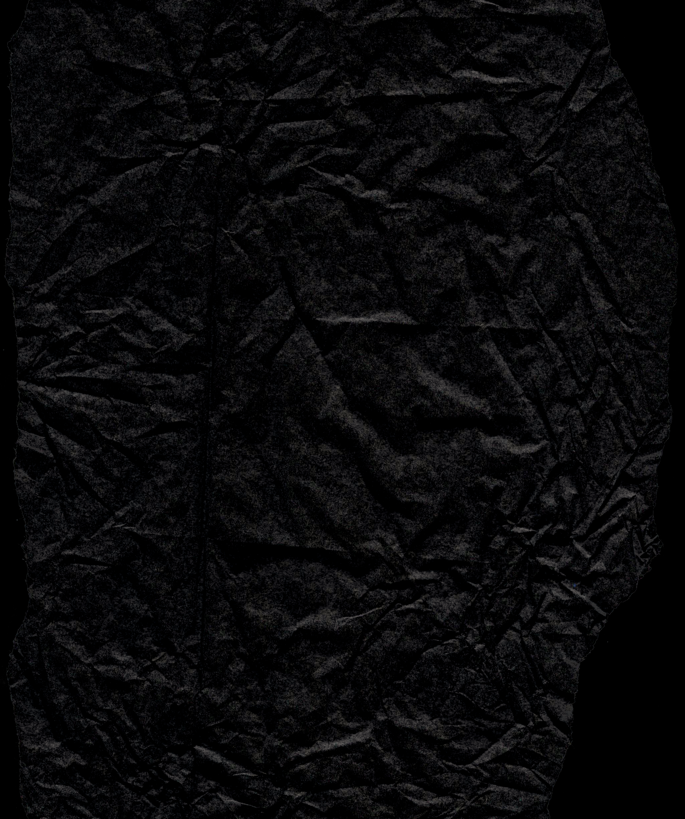






SECURE DATA HIDING IN IMAGES USING STEGANOGRAPHY
Presented By Vishal Baraiya

Slide 2




Project Description
This project is a Python-based application that hides secret messages inside images using LSB steganography with password protection.
Built with Tkinter for a user-friendly GUI and powered by OpenCV and NumPy for image processing, the tool allows secure encoding and decoding of messages.
It supports popular image formats and ensures that only users with the correct password can access the hidden data.
This makes it ideal for private communication, digital forensics, and educational use.

Slide 3
Technology used
1. Python Programming Language:
The script is written in Python, a high-level language that is widely used for its simplicity and readability.
2. Tkinter (Graphical User Interface - GUI):
Tkinter is the standard Python library for creating graphical user interfaces. In this script, it is used to build the entire interface for interacting with the user, allowing image selection, message input, and passcode entry.
3. OpenCV (cv2):
OpenCV is an open-source computer vision and image processing library. It is used here to:
The script uses OpenCV to handle the image processing involved in encoding and decoding the hidden messages.
4. NumPy:
NumPy is a library for numerical computing in Python. It is used here to handle image data as arrays, which makes manipulating the pixel values straightforward.

Slide 4
Wow factors
Image-Based Secret Communication
Password-Protected Steganography
User-Friendly Interface
Cross-Platform Compatibility
Open-Source & Customizable
Security

Slide 5

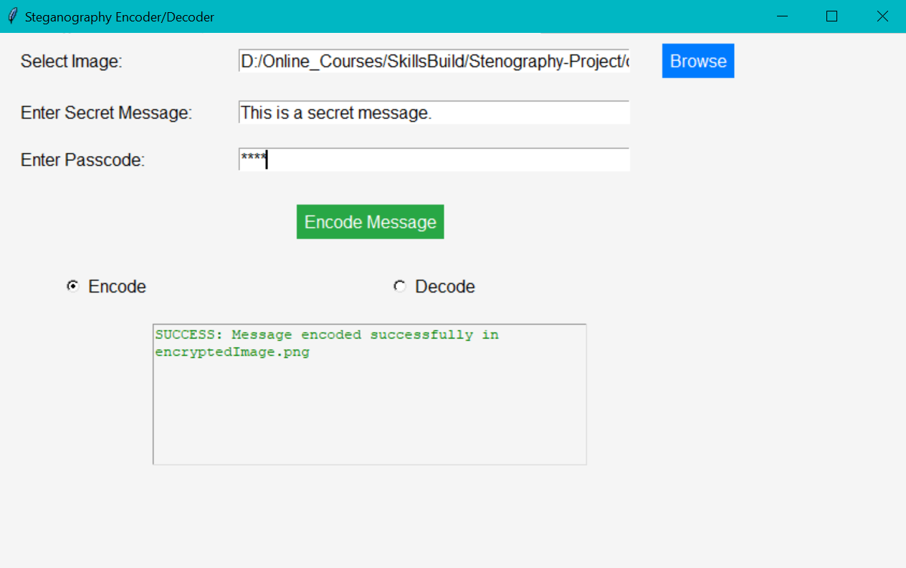
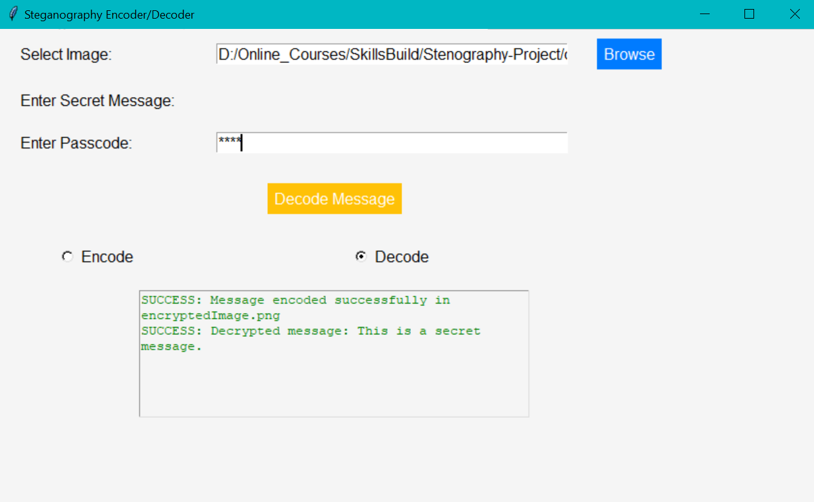


Project Interface

Slide 6



PROCESS
STEP 1
STEP 2
STEP 3
Encode Message
Select an image
Enter your secret message and password
The app hides the message inside the image using LSB steganography
Save & Share
Save the encoded image
Share it safely — it looks just like a normal image
Decode Message
Open the encoded image in the app
Enter the correct password
The hidden message is securely revealed

Slide 7



GROUP RESULT
Successful Message Encoding & Decoding
The tool was able to accurately hide and retrieve secret messages within various image formats (e.g., PNG, JPG) without affecting visual quality.
RESULT 1
RESULT 2
Password Protection Functionality
Messages could only be decoded with the correct password, ensuring that unauthorized users could not access the hidden information — enhancing overall data security.

Slide 8



RESOURCES
Github Link :
https://github.com/mr-baraiya/Stenography-Project

Slide 9


CONCLUSION
The tool securely hides secret messages in images using the LSB steganography method.
Password protection adds an extra layer of security, ensuring only authorized access.
Built with Python, Tkinter, OpenCV, and NumPy, it offers a smooth and efficient user experience.
The project provides a simple, practical, and secure solution for private communication and data protection.

Slide 10


THANK YOU

