Slide 1

Engines

Slide 2

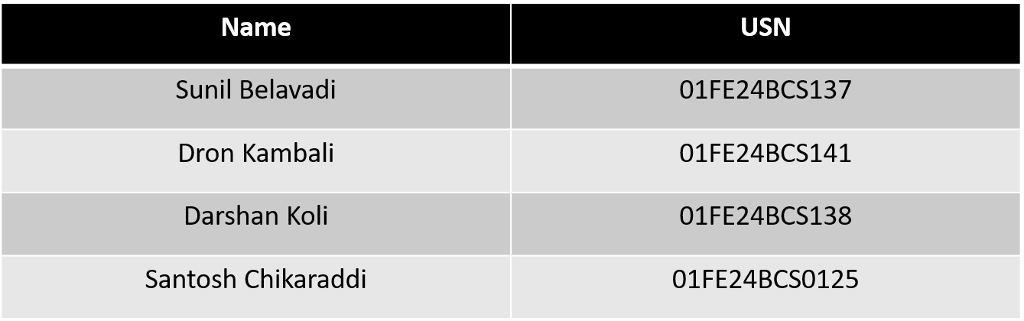
TEAM DETAILS:
Guide Name : Dr.Jayalaxmi.G.N
Theme NO : 8 Theme: Build System and dependency manager

Slide 3
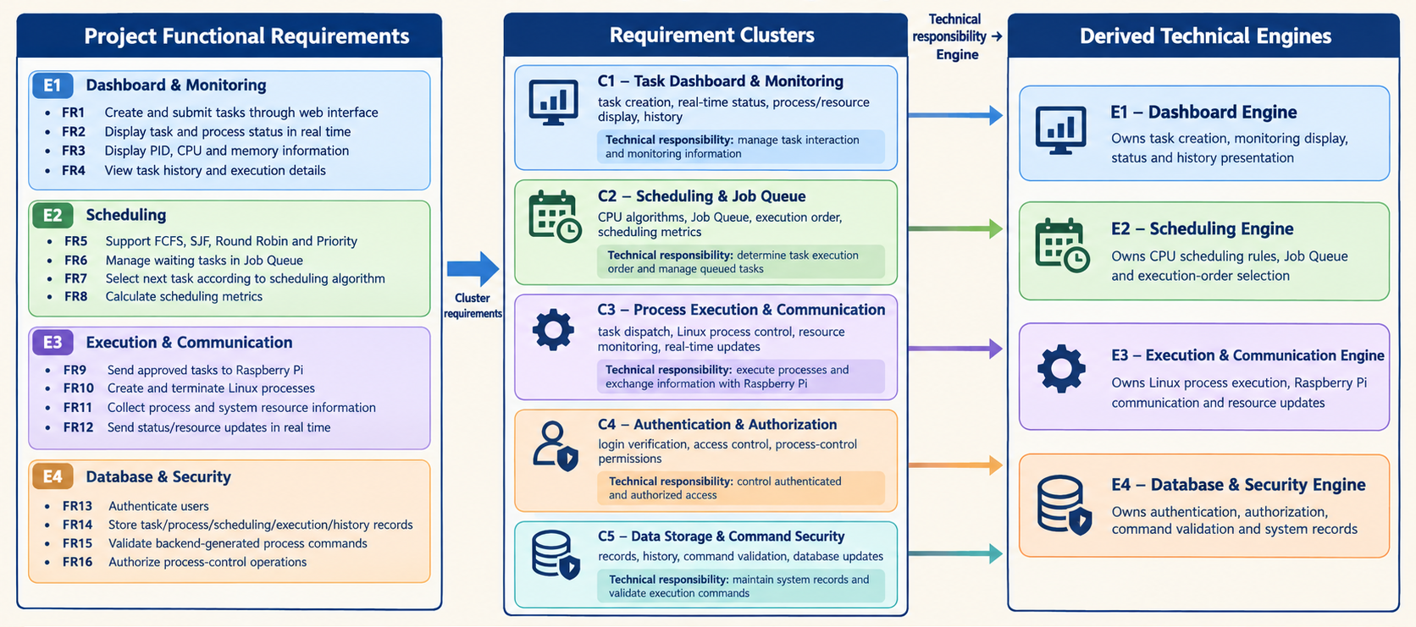
Engine Decomposition
28-09-2026
Department of Computer Science and Engineering

Slide 4
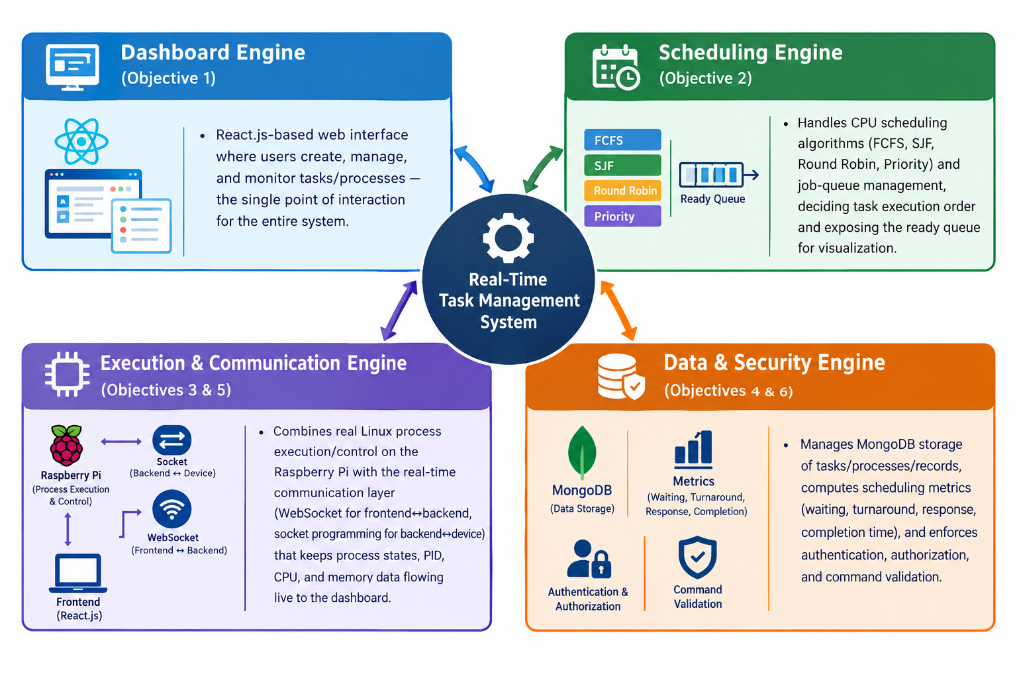
Engines
28-09-2026
Department of Computer Science and Engineering

Slide 5
Dashboard Engine

Slide 6
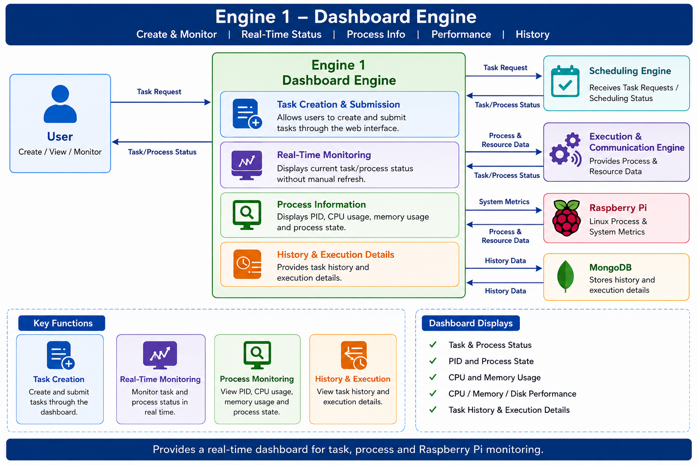
Dashboard Engine
28-09-2026
Department of Computer Science and Engineering

Slide 7

Engine Purpose and Description
The Dashboard Engine provides a web-based interface for creating and monitoring tasks on the Raspberry Pi. It displays process information such as PID, status, CPU, memory, and disk usage, along with detailed process and historical information. It solves the problem of centralized task management and process monitoring.

Slide 8
Functional Requirements
FR ID | Functional Requirement
FR1 | The system shall allow users to create and submit new tasks through the web interface.
FR2 | The system shall display the current status of tasks and processes in real time.
FR3 | The system shall display process information such as PID, CPU usage, and memory usage.
FR4 | The system shall allow users to view task history and execution details.
FR5 | The system shall display overall CPU, memory, and disk utilization of the Raspberry Pi.
FR6 | The system shall provide a detailed view of active processes, including user, status, CPU usage, and memory usage.
FR7 | The system shall display process execution duration and current process state.

Slide 9
Non-Functional Requirement
NFR ID | Non-Functional Requirement
NFR1 | The system shall provide a simple and user-friendly dashboard interface for basic task and process operations.
NFR2 | The dashboard shall update task and process information within 2 seconds under normal system load.
NFR3 | The system shall display process information accurately and consistently with the actual Linux processes running on the Raspberry Pi.
NFR4 | The dashboard shall provide clear and readable displays of CPU, memory, disk, and process information.
NFR5 | The dashboard shall provide real-time monitoring without requiring users to manually reload the application.
NFR6 | The system shall make task history and execution information available for viewing during normal operation.

Slide 10
Use Case / User Story Table
ID | Actor | User Story | Main Flow | Exception Flow
UC1 | User | As a user, I want to create and submit a new task so that I can request its execution through the dashboard. | User enters task details → system validates the task → task is submitted. | Invalid task details → task submission is rejected.
UC2 | User | As a user, I want to view the current status of tasks and processes so that I can monitor them in real time. | User opens dashboard → system receives current status → status is displayed. | Status data unavailable → system displays unavailable status information.
UC3 | User | As a user, I want to view PID, CPU usage, and memory usage so that I can monitor individual processes. | User selects process → system retrieves process information → PID and resource usage are displayed. | Process information unavailable → system displays unavailable process data.
UC4 | User | As a user, I want to view task history and execution details so that I can review previous activities. | User opens App History → system retrieves history → execution details are displayed. | No history available → system displays that no records are available.
UC5 | User | As a user, I want to view CPU, memory, and disk usage so that I can monitor Raspberry Pi performance. | User opens Performance → system retrieves resource data → performance graphs are displayed. | Resource data unavailable → system displays unavailable resource information.
UC6 | User | As a user, I want to view detailed information about active processes so that I can understand their current state and resource usage. | User opens Details → system retrieves active process data → details are displayed. | Process data unavailable → system displays unavailable information.

Slide 11
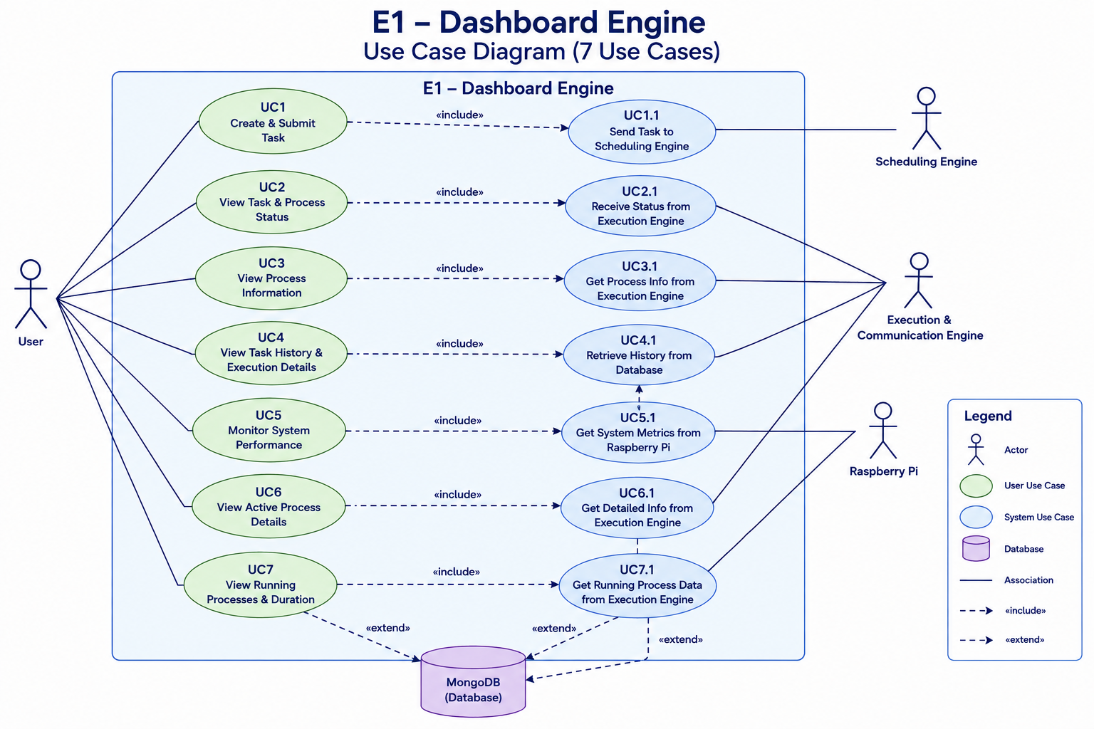
Use Case Diagram

Slide 12
Scheduling Engine

Slide 13
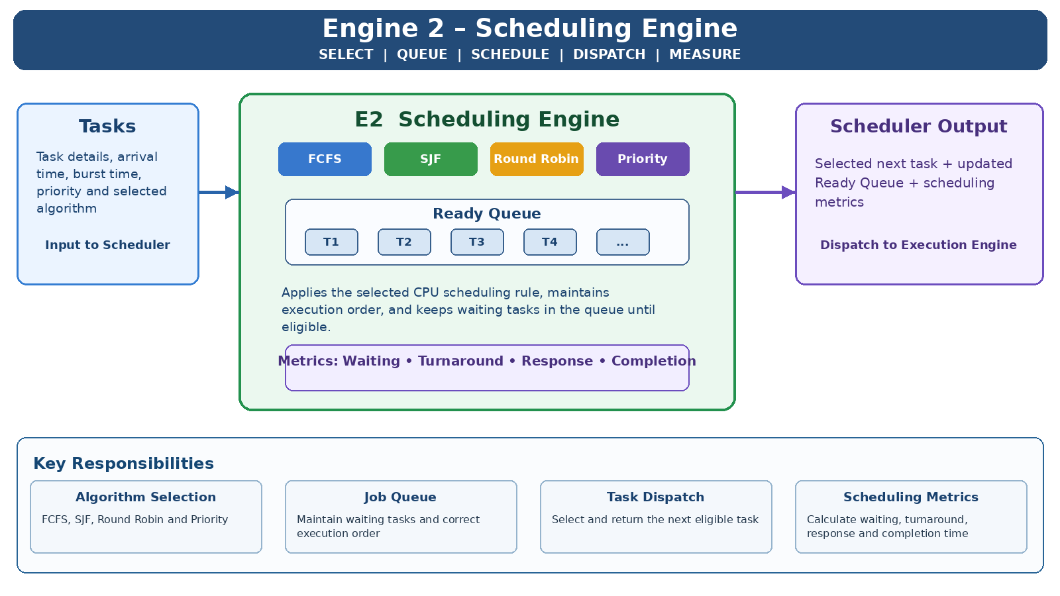

Slide 14
Engine Purpose and Description
The Scheduling Engine is responsible for determining task execution order and managing the Ready Queue. It applies FCFS, SJF, Round Robin, and Priority Scheduling according to the selected method. It selects the next eligible task for execution, maintains queued task state, and produces scheduling metrics such as waiting time, turnaround time. It solves the problem of controlled task ordering and queue management in task execution system.
28-09-2026
Department of Computer Science and Engineering

Slide 15
Functional Requirements
FR ID | Functional Requirement | Priority
FR5 | Support FCFS, SJF, Round Robin, and Priority scheduling algorithms. | Mandatory
FR6 | Place tasks in the Ready Queue based on the selected scheduling algorithm. | Mandatory
FR7 | Select the next task for execution according to the selected scheduling algorithm. | Mandatory
FR8 | Calculate waiting time, turnaround time, response time, and completion time. | Challenge
28-09-2026
Department of Computer Science and Engineering

Slide 16
Non-Functional Requirements
NFR ID | Requirement | Category | Measurable Target
NFR3 | The scheduling engine should select tasks according to the selected scheduling algorithm. | Performance | Selected algorithm applied to 100% of scheduled tasks.
NFR4 | The system should maintain the correct order of tasks in the Ready Queue. | Reliability | Queued tasks retain their scheduling order.
NFR2 | Task and process information should be updated in real time on the dashboard. | Performance | Updates should appear within 2 seconds.
NFR5 | Communication between backend and Raspberry Pi should be reliable. | Reliability | Task requests and process updates delivered without loss during normal operation.
28-09-2026
Department of Computer Science and Engineering

Slide 17
Use Case / User Story Table
ID | Actor | User Story / Description | Main Flow
UC4 | User | Select FCFS/SJF/Round Robin/Priority; scheduler applies it and updates the Ready Queue. | Invalid selection → retain previous valid selection.
UC5 | System | Place tasks in Ready Queue when they cannot execute immediately. | Queue limit → task not added; user notified.
UC6 | System | Select and dispatch the next task according to the scheduling algorithm. | Pi unavailable → task remains queued and is retried.
UC8 | User | View execution history and scheduling metrics for previous tasks. | No history → display empty history message.
28-09-2026
Department of Computer Science and Engineering

Slide 18
Use Case Diagram
Scheduling Engine
Select Scheduling
Algorithm
Manage Ready
Queue
Select Next Task
for Execution
Dispatch Task
According to Algorithm
User
System
Calculate Scheduling
Metrics
View Scheduling Metrics
& Execution History
Actors: User, System • Scheduling flow: Algorithm → Ready Queue → Next Task → Dispatch → Metrics
28-09-2026
Department of Computer Science and Engineering

Slide 19
IN AND OUT SCOPE
IN SCOPE
• CPU scheduling using FCFS, SJF, Round Robin and Priority.
• Ready Queue management and task ordering.
• Selecting the next task for execution.
• Calculating waiting, turnaround, response and completion time.
• Managing queued tasks according to the selected scheduling algorithm.
OUT OF SCOPE
• Task creation and dashboard interface.
• Actual Linux process creation and termination.
• CPU and memory resource monitoring.
• Raspberry Pi communication and socket programming.
• Authentication, database management and command validation.
• User interface and real-time process monitoring.
28-09-2026
Department of Computer Science and Engineering

Slide 20
Execution & Communication Engine

Slide 21
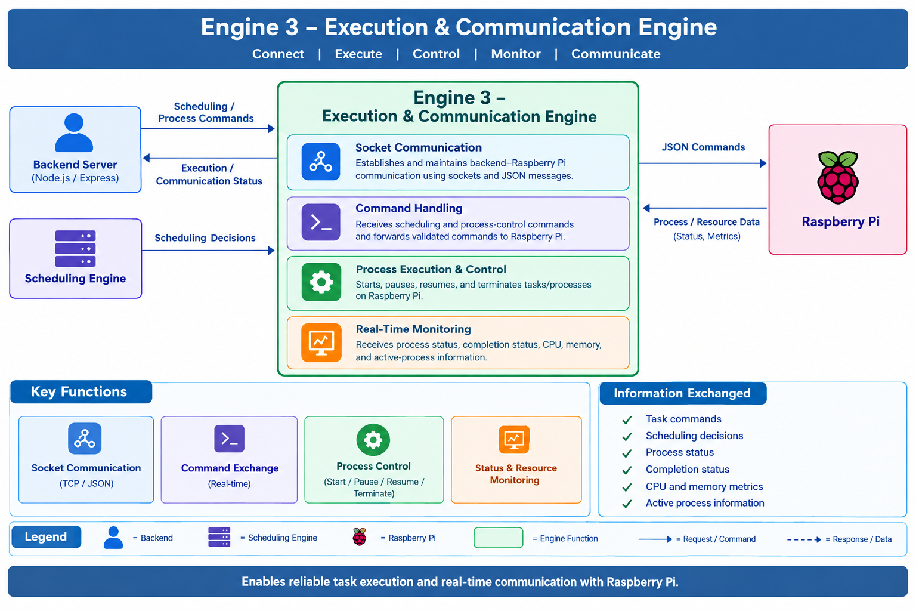

Slide 22
Engine Purpose and Description
To execute scheduled tasks on the Raspberry Pi and provide reliable, real-time communication between the backend and the Raspberry Pi process environment.
The Execution & Communication Engine receives scheduling decisions and process-control commands from the backend, communicates them to the Raspberry Pi using socket-based JSON messaging, manages task execution and process-control operations, and continuously receives process status and system information from the Raspberry Pi for real-time monitoring.

Slide 23
Functional Requirements
FR ID | Functional requirement | Functional requirement description
FR-1 | Establish Raspberry Pi Connection | The system shall establish and maintain a socket-based connection between the backend and Raspberry Pi.
FR-2 | Exchange Process Commands | The system shall send process-related commands from the backend to the Raspberry Pi using structured JSON messages.
FR-3 | Execute Tasks on Raspberry Pi | The system shall initiate the execution of scheduled tasks as processes on the Raspberry Pi.
FR-4 | Process Control | The system shall support process-control operations such as starting, stopping, pausing, resuming, and terminating processes.
FR-5 | Transmit Scheduling Decisions | The system shall receive scheduling decisions from the Scheduling Engine and communicate the corresponding execution commands to the Raspberry Pi.
FR-6 | Receive Process Status | The system shall receive real-time process information from the Raspberry Pi, including process state, execution status, and completion status.

Slide 24
FR ID | Functional requirement | Functional requirement description
FR-7 | Real-Time Status Updates | The system shall forward Raspberry Pi process updates to the Dashboard Engine through the backend in real time.
FR-8 | Handle Process Completion | The system shall detect completed processes and update their status in the system accordingly.
FR-9 | Handle Communication Failures | The system shall detect connection failures between the backend and Raspberry Pi and report the communication status to the dashboard.
FR-10 | Resource Monitoring | The system shall collect relevant Raspberry Pi resource information such as CPU usage, memory usage, and active process information.
FR-11 | Maintain Communication Logs | The system shall record important communication events, process commands, execution responses, and communication errors for monitoring and debugging.

Slide 25
Use Case / User Story Table
ID | Actor | User Story | Main Flow | Exception Flow
UC-1 | System Administrator / Backend | Establish a Raspberry Pi connection so process commands can be exchanged. | 1. Initiate socket connection. 2. Pi accepts connection. 3. Verify connection. 4. Mark Pi connected. | If connection fails, report the failure and attempt reconnection.
UC-2 | Scheduling Engine | Send scheduling decisions to Raspberry Pi so selected tasks can be executed. | 1. Generate decision. 2. Convert to JSON. 3. Send through socket. 4. Pi processes command. | If delivery fails, record the failure and report the communication error.
UC-3 | User / Dashboard | Start a task so it can be executed on Raspberry Pi. | 1. Select/create task. 2. Backend receives request. 3. Pass task to scheduler. 4. Send command. 5. Start process. | If task cannot start, mark it failed and display the status.
UC-4 | User / Dashboard | Control a running process so its execution can be managed. | 1. Select process. 2. Select pause/resume/terminate. 3. Validate command. 4. Send to Pi. 5. Perform operation. | If process is unavailable or operation fails, return an error and update status.
UC-5 | Raspberry Pi | Send process status to the backend so execution can be monitored in real time. | 1. Monitor processes. 2. Prepare status data. 3. Send to backend. 4. Update task state. 5. Update dashboard. | If data is invalid or unavailable, reject it and record the communication error.
UC-6 | System | Detect process completion so completed tasks are reflected correctly. | 1. Pi detects completion. 2. Send completion status. 3. Update task record. 4. Display completed state. | If the completion message is missing, retain the previous state and continue monitoring.

Slide 26
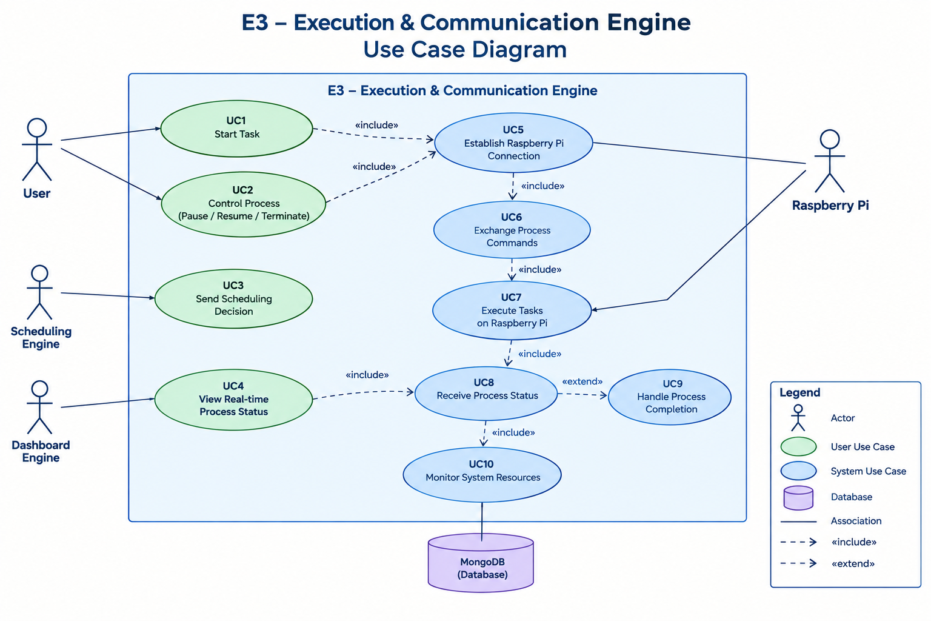
Use Case diagram

Slide 27
IN AND OUT SCOPE
In-Scope
Establish socket-based communication between the backend and Raspberry Pi.
Exchange task commands and process information using JSON messages.
Receive scheduling decisions from the Scheduling Engine.
Send task execution commands to the Raspberry Pi.
Start, pause, resume, and terminate processes on the Raspberry Pi.
Receive real-time process status and completion information.
Monitor CPU, memory, and active-process information from the Raspberry Pi.
Detect and report communication and process-execution errors.
Out-of-Scope
Designing or replacing the Linux kernel CPU scheduler.
Developing a custom operating system or Linux kernel.
Designing or implementing CPU scheduling algorithms.
Managing persistent task and process records in MongoDB.
User authentication and authorization mechanisms.
Designing the React dashboard and its user interface.
Direct hardware-level control of the Raspberry Pi.
Cloud-based or multi-device distributed task execution.

Slide 28
Database and Security Engine

Slide 29
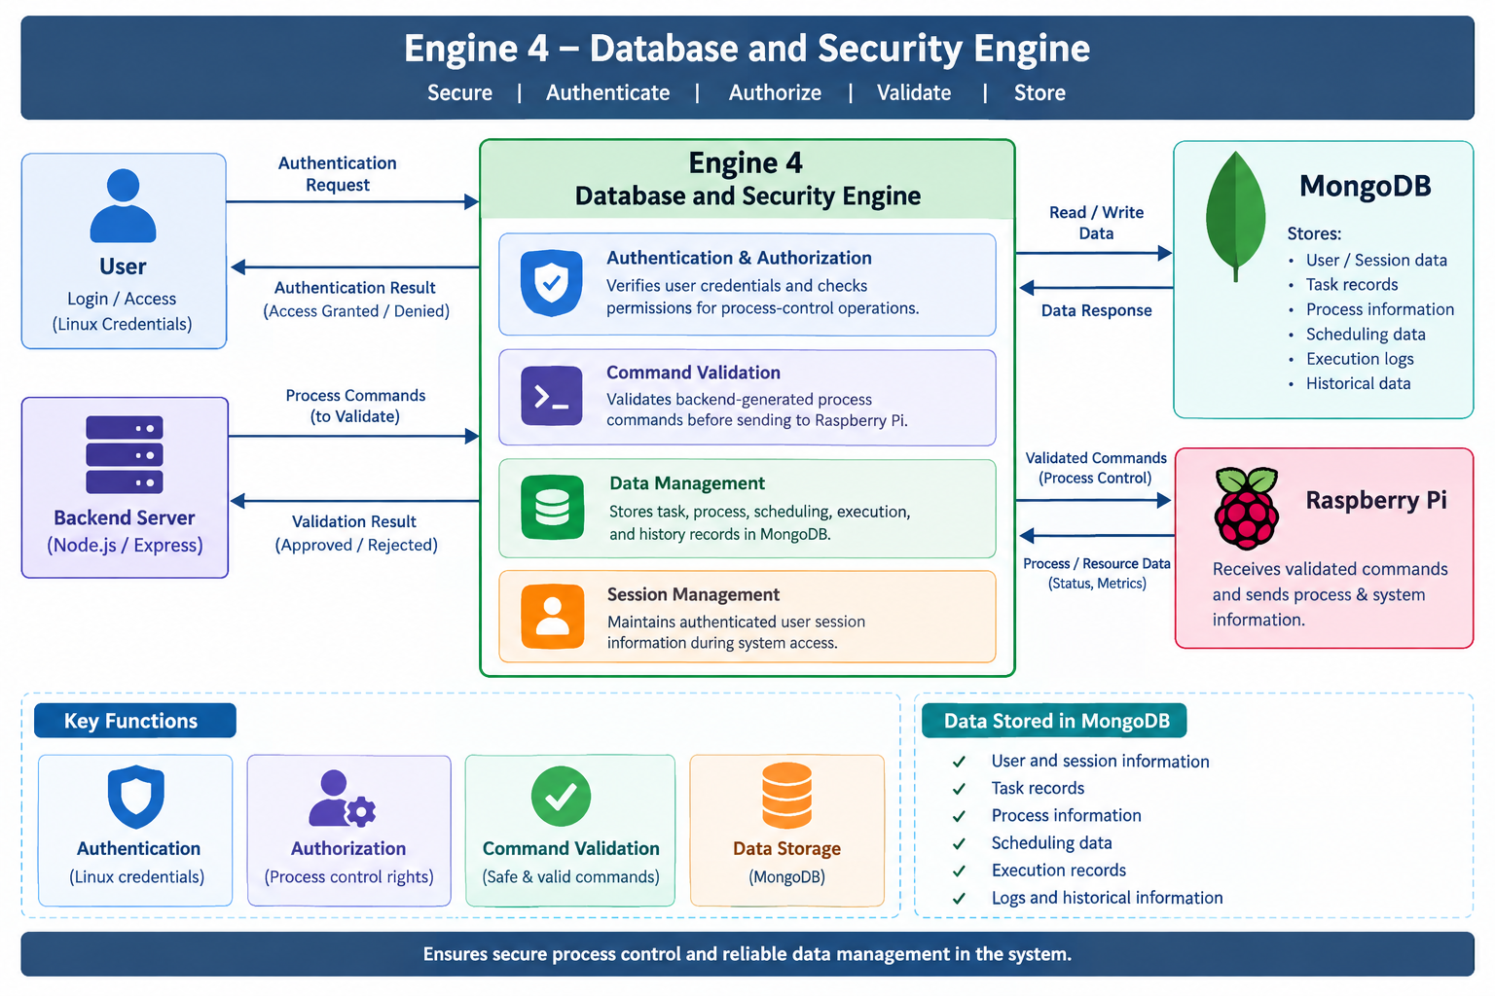

Slide 30
Engine Purpose and Description
The Database & Security Engine is responsible for authenticating and authorizing users, validating backend-generated process commands, and maintaining system records. It exists to ensure that only authorized users can perform process-management operations and that only valid commands are sent for execution. The engine also stores task, process, scheduling, execution, and history information for later retrieval. It solves the problem of secure process control and reliable data management in the system.

Slide 31
Functional Requirements
FR ID | Functional Requirement
FR1 | The system shall authenticate users before allowing access to task-management functions.
FR2 | The system shall authorize users before allowing process-control operations.
FR3 | The system shall validate backend-generated process commands before sending them to the Raspberry Pi.
FR4 | The system shall store task, process, scheduling, execution, and history records in MongoDB.
FR5 | The system shall maintain authenticated user session information during system access.
FR6 | The system shall reject invalid or unsafe process commands and prevent their execution.
FR7 | The system shall update stored process and task information when new status or resource data is received from the Raspberry Pi.
FR8 | The system shall retrieve stored task, process, scheduling, and execution history for authorized users.

Slide 32
Non-Functional Requirement
NFR ID | NFR
NFR1 | The system shall authenticate valid user credentials within 2 seconds under normal system load.
NFR2 | The system shall complete authorization checks within 2 seconds for 95% or more of process-control requests.
NFR3 | The system shall validate backend-generated process commands within 2 seconds for 95% or more of valid requests.
NFR4 | The system shall successfully store at least 95% of valid task, process, scheduling, and execution records during normal operation.
NFR5 | The system shall successfully retrieve at least 95% of requested stored records during normal operation.
NFR6 | The system shall maintain 99% data consistency between received system information and the corresponding stored records during normal operation.

Slide 33
Use Case / User Story Table
ID | Actor | User Story | Main Flow | Exception Flow
UC1 | User | As a user, I want to authenticate myself so that only valid users can access the system. | User enters login details → system verifies credentials → access is granted. | Invalid credentials → access is denied.
UC2 | User | As an authenticated user, I want to perform process-control operations so that I can manage my processes. | User requests process operation → system checks authorization → operation is allowed. | Unauthorized request → operation is rejected.
UC3 | System | As the system, I want to validate backend-generated process commands so that only valid commands are sent to Raspberry Pi. | Backend generates command → command is validated → valid command is approved. | Invalid or unsafe command → command is rejected and not sent.
UC4 | System | As the system, I want to store task, process, scheduling, and execution records so that the information is available for future use. | System receives data → validates data → stores the record in MongoDB. | Invalid data or database failure → record is rejected or storage is retried.
UC5 | System | As the system, I want to update stored process and task information so that the database contains the latest execution information. | Raspberry Pi sends updated information → system receives it → corresponding database record is updated. | Invalid or incomplete information → update is rejected.
UC6 | User | As an authorized user, I want to view stored task and execution history so that I can review previous process activities. | User requests history → authorization is checked → records are retrieved from MongoDB → history is displayed. | No history available → system displays that no records are available.

Slide 34
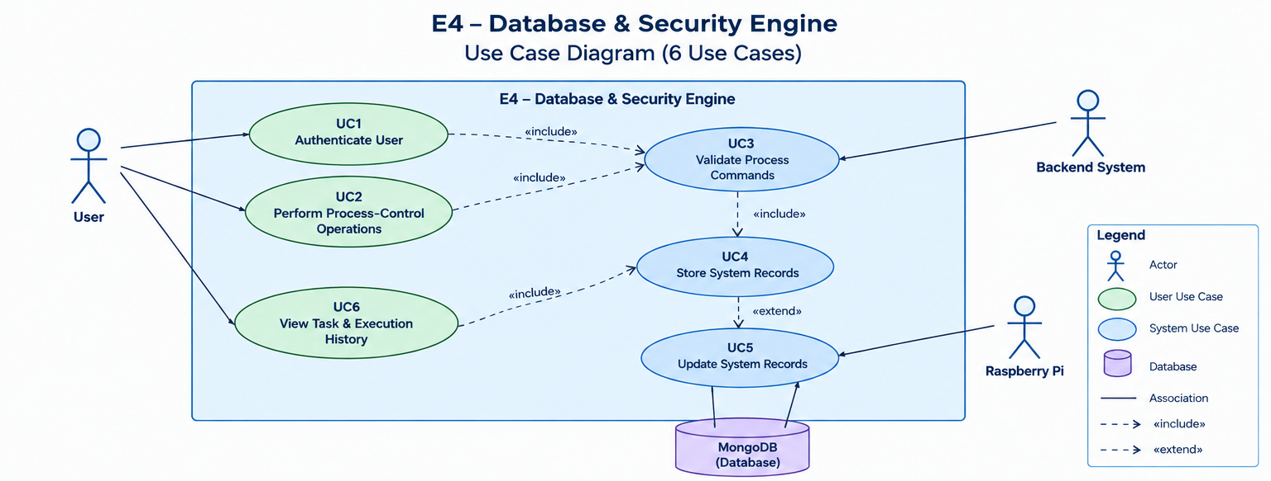
Use Case Diagram

Slide 35
IN AND OUT SCOPE
IN SCOPE
User authentication and login verification.
User authorization for process-control operations.
Validation of backend-generated process commands before execution.
Rejection of invalid or unsafe commands.
Storing task, process, scheduling, execution, and history records in MongoDB.
Updating stored records with new process and task information.
Retrieving stored task and execution history for authorized users.
Maintaining user/session information during system access.
Out-of-Scope
Creating or scheduling tasks.
Managing the Job Queue or selecting the next task.
Creating, terminating, or directly controlling Linux processes on Raspberry Pi.
Monitoring CPU and memory usage.
Handling real-time WebSocket or socket communication.
Implementing the CPU scheduling algorithms.
Executing arbitrary OS commands.
Managing Raspberry Pi hardware resources.

