Slide 1

Task Manager for Raspberry pi

Slide 2
TEAM DETAILS:
Name | USN
Sunil Belavadi | 01FE24BCS137
Dron Kambali | 01FE24BCS141
Darshan Koli | 01FE24BCS138
Santosh Chikaraddi | 01FE24BCS0125
Guide Name : Dr.Jayalaxmi.G.N
Theme NO : 8 Theme: Build System and dependency manager

Slide 3
Problem Statement
PROBLEM STATEMENT
Existing methods lack a centralized system to manage task scheduling, process execution, and resource monitoring in real time. Proposed solution integrates these functions into a single dashboard, enabling users to create, schedule, execute, terminate, and monitor processes along with their scheduling metrics.
17-09-2026
Department of Computer Science and Engineering
10

Slide 4
Project Objectives
Demonstrate real-time task scheduling and execution — Show how tasks are scheduled and executed while their status is updated in real time.
Demonstrate CPU scheduling algorithms — Apply FCFS, SJF, Round Robin, and Priority Scheduling to determine task execution order.
Demonstrate resource-based task queuing — Queue tasks when sufficient CPU or memory resources are not available.
Monitor Linux processes and resources in real time — Track process state, PID, CPU usage, and memory usage during execution.
Analyze task execution and scheduling performance — Calculate metrics such as waiting time, turnaround time, response time, and completion time.
Demonstrate web-to-Raspberry Pi process management — Show how tasks are controlled through the web system and executed as actual Linux processes on the Raspberry Pi
17-09-2026
Department of Computer Science and Engineering
11

Slide 5
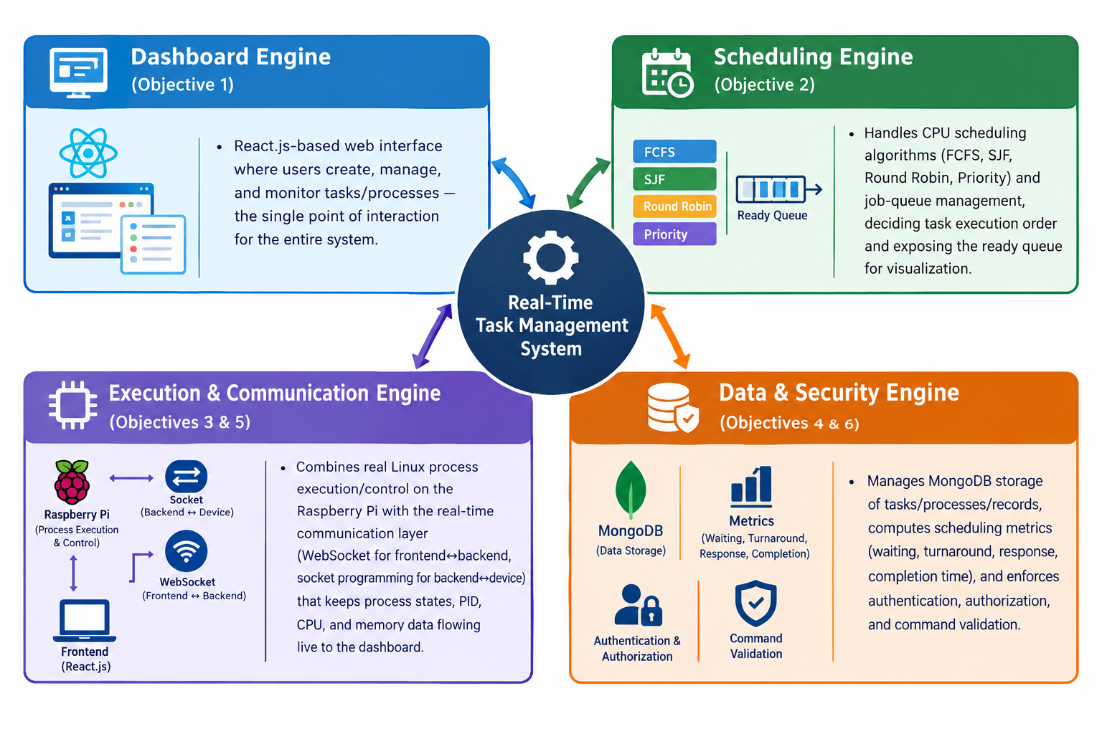
Engines
17-09-2026
Department of Computer Science and Engineering
11

Slide 6
Technology Stack
PROJECT TYPE
Distributed process-management system
TECHNOLOGY STACK
Frontend: React.js
Backend: Node.js + Express.js
Database: MongoDB
Real-time communication: WebSocket
Device communication: Socket Programming
Execution environment: Raspberry Pi running Linux
17-09-2026
Department of Computer Science and Engineering
2

Slide 7
Concepts Used
Course | Concept Used | Application in this Project
SE | Modular system design, phased SDLC | Separates frontend, backend, scheduling engine, process manager, database and device components for systematic build & test.
DSA | Queue | Maintains tasks waiting for execution before the scheduling engine selects the next task.
OS | CPU scheduling algorithms | Supports FCFS, SJF, Round Robin and Priority Scheduling; demonstrates execution order.
OS | Process creation, termination & states | Raspberry Pi performs actual Linux process operations and reports PID and process state.
OS | CPU & memory resource monitoring | Demonstrates monitoring of CPU and memory usage of active processes.
DBMS | MongoDB | Stores task, process, scheduling, execution and log information.
CN | Client-server communication | React communicates with the Node.js backend; backend communicates with Raspberry Pi.
CN | Socket programming / WebSocket / JSON | Provides real-time bidirectional communication between system components.
WT | React & web application architecture | Provides the browser-based dashboard for task creation, monitoring and process control.
17-09-2026
Department of Computer Science and Engineering
3

Slide 8
Existing Problem & Who Is Affected
EXISTING PROBLEM / CURRENT SITUATION
Intended to demonstrate OS process management through a web interface rather than relying only on command-line interaction.
Users need a single dashboard to create tasks, select scheduling algorithms, view the ready queue, monitor running processes, terminate processes and view execution history.
Scheduling logic must determine execution order, while the Raspberry Pi must perform actual Linux process-management operations.
Without a central real-time flow, process information, scheduling decisions and resource usage would be difficult to observe together.
17-09-2026
Department of Computer Science and Engineering
4

Slide 9
Why the Existing Approach Is Inadequate
LIMITATIONS OF THE CURRENT APPROACH
Manual command-line process management does not provide a unified visual task-management and scheduling dashboard.
Process creation, termination, scheduling and resource monitoring are otherwise separated across tools.
A manual approach does not provide a centralized job queue and real-time process-state display.
Difficult to demonstrate scheduling metrics such as waiting time, turnaround time, response time and completion time in one interface.
17-09-2026
Department of Computer Science and Engineering
5

Slide 10
Stakeholder Table
Stakeholder | Needs & Expectations | Current Pain Points | Infl.
System User / Operator | Simple task creation, scheduling selection, process control and real-time status. | Process operations otherwise spread across command-line / system tools. | H
Project Demonstrator / Student | Visible scheduling order, states, metrics, queues and resource usage. | Difficult to show all concepts together in a single environment. | H
System Administrator | Authentication, authorization, validation and connection monitoring. | Unauthorized or invalid commands could affect the Raspberry Pi. | H
Developer / Maintainer | Modular design, clear JSON communication, maintainable components. | Tightly coupled components make debugging and extension harder. | M
Raspberry Pi / Device Environment | Reliable socket communication and valid process commands. | Connection failure or unexpected process termination can interrupt execution. | M
17-09-2026
Department of Computer Science and Engineering
6

Slide 11
Primary vs. Secondary Stakeholders & Key Insights
PRIMARY STAKEHOLDERS
SECONDARY STAKEHOLDERS
System User / Operator
Project Demonstrator / Student
System Administrator
Raspberry Pi execution environment
Developer / Maintainer
Database / infrastructure support
KEY INSIGHT SUMMARY
The common need is a centralized view of task scheduling and actual process execution.
Users need to create and control tasks without directly managing every Linux process from the command line.
Demonstrators need scheduling algorithms, process states, queues and performance metrics visible in real time.
Administrative controls matter because the Raspberry Pi can create and terminate operating-system processes.
The architecture needs both a user-friendly dashboard and controlled backend-to-device communication.
17-09-2026
Department of Computer Science and Engineering
7

Slide 12
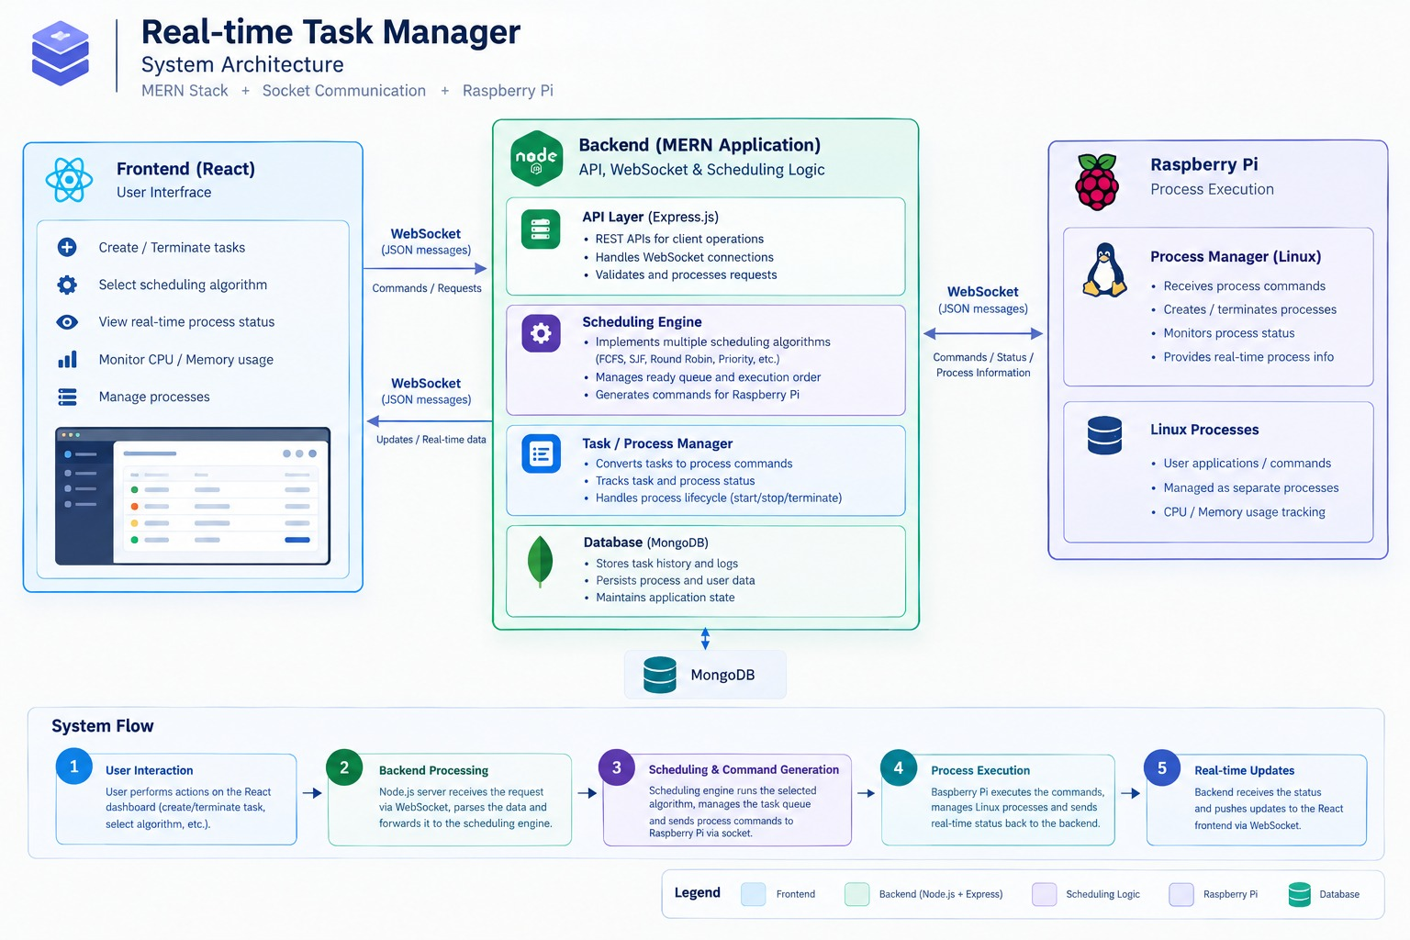
APPENDIX
Project Architecture
ARCHITECTURE FLOW
17-09-2026
Department of Computer Science and Engineering
20

Slide 13
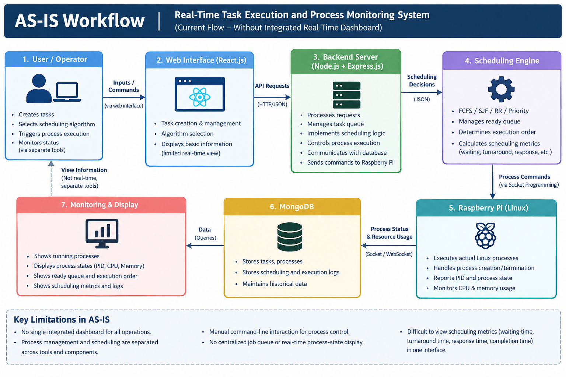
AS-IS Workflow Diagram
17-09-2026
Department of Computer Science and Engineering
8

Slide 14
Step-by-Step Baseline Workflow
 | Actor | Action | Tool / System | Pain Point
1 | User | Defines a task / command | Command line / manual entry | No centralized task dashboard.
2 | User | Starts or prepares the process | Linux terminal / system utility | Process control is separate from scheduling demonstration.
3 | User / Student | Chooses or explains scheduling order | Manual / separate program | Scheduling and real process execution are disconnected.
4 | User | Checks process state and PID | Linux process utilities | Requires separate monitoring.
5 | User | Checks CPU and memory | System monitoring utilities | Resource information not unified with task status.
6 | User | Records results / metrics | Manual notes / separate output | Difficult to observe real-time lifecycle & compare metrics.
Bottlenecks & Inefficiencies
No single dashboard combines creation, scheduling & execution.
Scheduling and Linux operations are hard to show as one lifecycle.
No centralized ready-queue view.
Manual observation gives no automatic real-time updates.
17-09-2026
Department of Computer Science and Engineering
9

Slide 15
Observed Problems → Underlying Needs
Observed Problem | Underlying Need | Linked Stakeholder(s)
Tasks, scheduling and process execution are separated. | Centralized task-management dashboard. | User, Demonstrator
Scheduling order is difficult to demonstrate with actual processes. | Integrated scheduling engine supporting multiple algorithms. | Demonstrator, Developer
Ready tasks are not centrally visible in a live queue. | Ready-queue management and visualization. | User, Demonstrator
Process state/PID/resource data requires separate monitoring. | Real-time process monitoring. | User, Demonstrator, Administrator
Process-control commands can be risky if not validated. | Authentication, authorization and command validation. | Administrator, Developer
Execution and scheduling results need persistence. | Store task, process, scheduling and execution records. | Demonstrator, Developer
17-09-2026
Department of Computer Science and Engineering
12

Slide 16
In-Scope & Out-of-Scope
IN-SCOPE
OUT-OF-SCOPE
Web-based React dashboard for task creation & monitoring.
Node.js + Express backend for logic & task management.
WebSocket communication (frontend ↔ backend).
Scheduling engine: FCFS, SJF, Round Robin, Priority.
Ready-queue management & execution-order determination.
Lifecycle tracking: NEW, READY, RUNNING, WAITING, TERMINATED.
Backend-to-Raspberry Pi socket communication (JSON).
Actual Linux process creation, termination & monitoring.
PID, CPU and memory monitoring.
MongoDB storage for tasks, processes, records & logs.
Scheduling metrics: waiting, turnaround, response, completion time.
Basic authentication, authorization & command validation.
Large-scale multi-device orchestration — broader device fleets would expand infrastructure complexity.
AI-based automatic scheduling optimization —focuses on standard scheduling algorithms.
Native mobile application — presentation layer is a React web dashboard.
Arbitrary OS command execution — security requirements call for command validation.
17-09-2026
Department of Computer Science and Engineering
13

Slide 17
Technical Feasibility
Aspect | Assessment | Justification
Frontend / Backend Stack | Feasible | React, Node.js and Express are standard web technologies suitable for the dashboard and application layer.
Scheduling Algorithms | Feasible | FCFS, SJF, Round Robin and Priority Scheduling are used and implemented as backend modules.
Database | Feasible | MongoDB is explicitly selected for task, process, scheduling and log persistence.
WebSocket Communication | Feasible | WebSocket/JSON communication between frontend and backend.
Socket Programming | Feasible with testing | The backend can communicate with the Raspberry Pi through socket-based JSON messages.
Linux Process Management | Feasible | Raspberry Pi provides actual Linux process creation, termination, PID and resource monitoring.
Real-Time Monitoring | Feasible with effort | Continuous process information must be forwarded to the dashboard; connection & update handling must be tested.
Security | Feasible with controls | Authentication, authorization, input validation and command validation are defined requirements.
17-09-2026
Department of Computer Science and Engineering
15

Slide 18
Operational, Time & Resource Feasibility
OPERATIONAL FEASIBILITY
TIME FEASIBILITY
RESOURCE FEASIBILITY
Operated through a browser-based dashboard.
Users observe process states & resources without raw Linux commands.
Controlled workload processes demonstrate scheduling behaviours.
Feature set bounded around dashboard, scheduling engine, sockets, Pi & MongoDB.
Divided into modules: frontend, backend/task manager, scheduling engine, Pi service, database, testing.
Scope controlled to the features listed as In-Scope.
Software: React.js, Node.js, Express.js, WebSocket, MongoDB, JSON.
Hardware: Raspberry Pi running Linux + network connection.
Conventional web-development & Linux process-management tools.
17-09-2026
Department of Computer Science and Engineering
16

Slide 19
Project-Level Risks
ID | Risk Description |  | Imp. | Mitigation Strategy
R1 | Raspberry Pi becomes unreachable or socket connection fails. |  | H | Connection monitoring, reconnection handling, clear disconnected state.
R2 | Invalid or unsafe process commands are submitted. |  | H | Validate commands, restrict workloads, authenticate & authorize.
R3 | Scheduling implementation produces incorrect order or metrics. |  | H | Test each algorithm with known task sets; verify all metrics.
R4 | Real-time updates are delayed or lost. |  | M | Structured JSON messages, connection-state handling, periodic updates.
R5 | Unexpected process termination causes inconsistent task state. |  | M | Detect termination on Pi and synchronize lifecycle state with backend.
R6 | MongoDB connection failure causes loss of persistence. |  | M | Handle DB errors, keep runtime state separately, retry/reconnect.
R7 | Project scope becomes too large. |  | H | Limit to defined algorithms, single Pi environment, core features.
R8 | Raspberry Pi resource limits affect workload execution. |  | M | Use controlled workloads; avoid excessive concurrent processes.
17-09-2026
Department of Computer Science and Engineering
17

