Slide 1
A SoS Step
Input files
Output files
Dependent files
Step process
Task
Actions
Actions
Tasks can be executed and monitored externally
Actions
Actions
A step process can contain arbitrary python statements and SoS actions.

Slide 2
A SoS Workflow
Step
Step
Step
Step
Step

Slide 3
Default
group_by input option
for_each input option
input=_input
action
_input
action
_var
action
[‘s1’,‘s2’]
input
[‘s1’]
‘m1’
_input
_input
action
[‘s1’,‘s2’]
_var
Input: None
action
[‘s2’]
‘m2’
action
group_by=‘single’
var=[‘m1’,‘m2’], for_each=‘var’
group_by and for_each options
input and output directive
input directive
_var
action
_output
_input
‘m1’
input=_input
action
[‘a1’]
_var
action
_output
[‘a1’,‘a2’]
input
‘m2’
output
[‘a1’,‘a2’]
_var
action
[‘b1’,‘b2’,‘b3’,‘b4’]
input: [‘a1’,‘a2’]
_output
output directive
_input
‘m1’
[‘a2’]
_var
_output
action
_output=output
action
‘m2’
[‘b1’,‘b2’,‘b3’,‘b4’]
input: [‘a1’,‘a2’] output: [‘b1’,‘b2’,‘b3’,‘b4’]
group_by=‘single’
var=[‘m1’,‘m2’] for_each=‘var’
Output: [‘b1’,‘b2’,‘b3’,‘b4’]

Slide 4
Without group_by and for_each, paired_with=‘var’
Previous
output
Step input
Step output
input = _input
_output = output
var = _var
input is sent
all at once as _input
_output becomes output
With group_by and/or for_each, paired_with=‘var’
_input, _var
Step output
_output
Previous
output
Step input
input
_input. _var
Step output
_output
output
var
_input, _var
Step output
_output
Subsets of input become _input with matching subsets of var (_var)
output is the collection of _output

Slide 5
Default workflow with no input or output directives
Step 1
Step 2
Step 3
Step 4
Workflow with defined input and output
Step 1
Step 2
Step 3
a2
a3
Step 4
Logical
View
a1
a2
a1
a3
a5
None
Step 5
Step 6
a2
a6
Step 7
Step 8
a6
a6
None
a7
a7
a8
Step 3
a3
Step 1
Step 5
a1
a5
Processing
View
Step 2
a2
Step 7
a7
Step 8
a8
Step 5
a6
Step 6
None

Slide 6
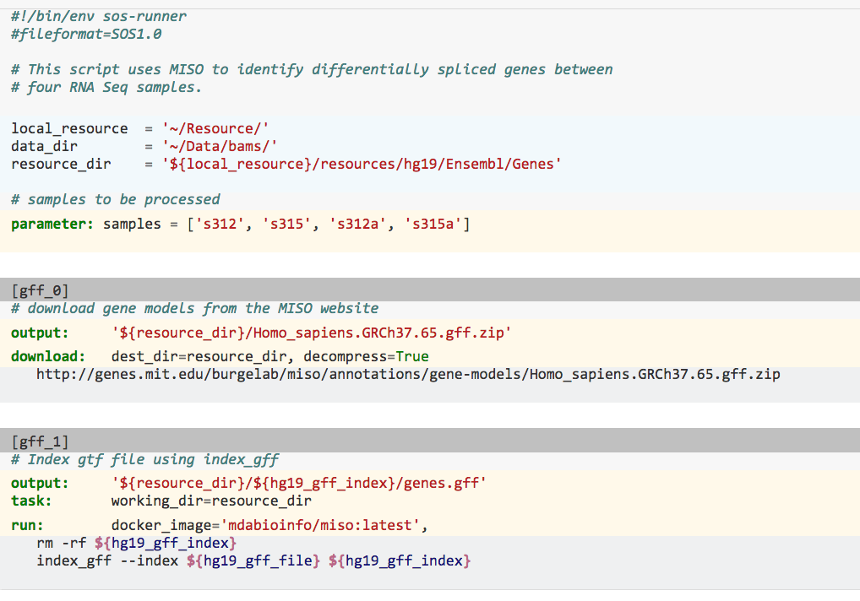
Excerpt from a SoS script
File header
Description
Global definitions
Command line option
Step header
Output files
Action in script format
Task
Action

