Slide 1


BNM Institute of Technology
An Autonomous college under VTU, Approved by AICTE, Accredited as grade A Institution by NAAC till 31.12.2026.
All Eligible UG branches – CSE, ECE, EEE, ISE & ME, accredited by NBA till 30.06.2025
Post box no. 7087, 27th cross, 12th Main, Banashankari II Stage, Bengaluru- 560070, INDIA
Ph: 91-80-26711780/81/82 Email: principal@bnmit.in, bnmitprincipal@gmail.com, www.bnmit.org
Project Work Presentation
on
Development of Autonomous Vehicle with Advanced Braking and Lane Control System
ABDUL MANNAN S
1BG20EC013
Under the guidance of
Manjunath G. Asuti
Associate Professor, Dept of ECE, BNMIT

Slide 2
TABLE OF CONTENTS
INTRODUCTION
OBJECTIVES
MOTIVATION
LITERATURE SURVEY
METHODOLOGY
FLOWCHART
BLOCK DIAGRAM
HARDWARE COMPONENTS
SOFTWARE REQUIREMENTS
CONCLUSION
REFERENCES

Slide 3
INTRODUCTION
Autonomous vehicles, also known as self-driving cars, are vehicles equipped with sensors, software, and algorithms that enable them to navigate and operate without human input.
The development of autonomous vehicles is rapidly progressing, driven by advancements in artificial intelligence, sensor technology, and computing power.
These vehicles have the potential to transform transportation by improving safety, reducing traffic congestion, and providing mobility for those who cannot drive themselves.
Utilize sensors to detect potential collisions and automatically apply brakes to prevent accidents.
Employ sensors to detect lane markings and provide steering assistance (e.g., Lane Keeping Assist) to maintain lane positioning.

Slide 4
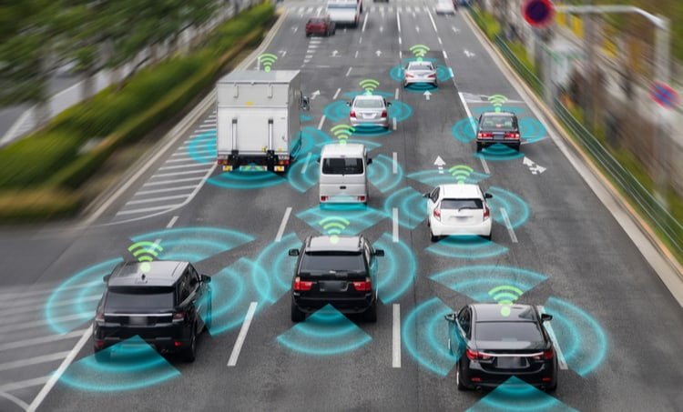
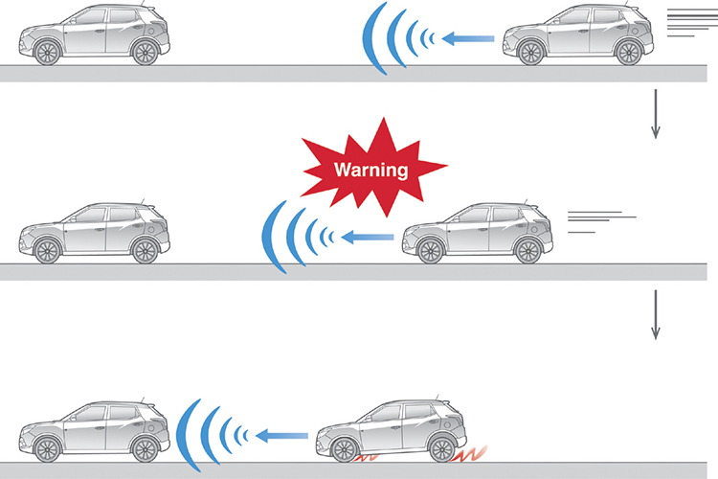
Continue…
Lane Keep Assist
Advanced Vehicle Braking

Slide 5
OBJECTIVES
This project focuses on creating a working model of an autonomous vehicle with the necessary hardware and software components.
Implement a braking system, such as Automatic Emergency Braking, that utilizes sensors to detect potential collisions and automatically apply brakes to prevent or mitigate accidents.
Integrate a lane control system, such as Lane Keeping Assist (LKA), which utilizes sensors to detect lane markings and provides steering assistance to keep the vehicle centered within its lane.
Assess the effectiveness and reliability of the integrated braking and lane control systems in a simulated or controlled environment.
This project aims to contribute to the ongoing development of autonomous vehicles by showcasing the potential of advanced braking and lane control systems to enhance safety and pave the way for future advancements.

Slide 6
MOTIVATION
Road Safety Crisis: Road accidents are a leading cause of death and injury worldwide. Autonomous vehicles with advanced safety systems have the potential to significantly reduce these casualties.
Human Error Reduction: Human error is a major contributing factor to road accidents. Autonomous vehicles can eliminate this factor, leading to safer roads.
Improved Traffic Flow: Autonomous vehicles can communicate with each other and infrastructure, potentially optimizing traffic flow and reducing congestion.
Accessibility for All: Autonomous vehicles can provide mobility to individuals who cannot drive themselves due to age, disability, or other factors.
Technological Advancement: This project contributes to the cutting edge of autonomous vehicle technology, paving the way for future innovation and development.

Slide 7
LITERATURE SURVEY
Title of Paper | Authors | Publication Year | Description
Automatic Braking System. | Hemant Suryawanshi Rohan Sarode | 2021 | In this paper, the proposed system aims to detect potential hazards on the road and autonomously apply brakes to prevent collisions.
Automatic Braking System Using Ultrasonic Sensor. | J.V.Sai Ram,K.M.S.V.Manikanta, G.Pavanth, B.Jagadeep and Dr. B.Raghu Kumar | 2017 | In this paper, the authors propose the utilization of ultrasonic sensors to detect obstacles and trigger braking actions in vehicles.

Slide 8
Title of Paper | Authors | Publication Year | Description
Intelligent Braking System Using Ultrasonic Sensor. | Manju Kumari, Shambhu Kumar, Anand Kumar Nikita Kumari | 2020 | The system is designed to detect obstacles in the vehicle's path and automatically engage the brakes to prevent collisions.
Smart Braking System Using Ultrasonic Sensor and Actuator. | Shailendra Singh, Yogesh Jangid, Sahil Gupta Virendra Solanki | 2019 | In this paper, the authors present a smart braking system that utilizes both ultrasonic sensors and actuators.
Design and Analysis of Intelligent Braking System. | Mr. Tushar Kavatkar, Mr. Harshal Salvi Mrs. MinaRahate | 2017 | the authors delve into the design and analysis of a braking system equipped with intelligent features.

Slide 9
METHODOLOGY
Define Project Scope: Clearly define the features and capabilities you want in your automatic driving system.
Gather Materials: Collect all the necessary hardware and software components. This includes an Arduino board, motor drivers, GPS module, sensors (for lane detection and obstacle avoidance), actuators (for braking), and other relevant components.
Setup Arduino Environment: Set up the Arduino development environment on your computer.
Connect Hardware: Wire up all the components to the Arduino board. Connect the GPS module, motor drivers, sensors, and actuators according to the specifications provided in their respective datasheets.
Code Development: Write the Arduino code to read GPS data, interpret it for navigation, control the motors for driving, and implement the lane control and braking mechanisms. Use libraries and sample code provided for the GPS module and any other sensors.

Slide 10
Continue…
Advanced Braking System: Implement an advanced braking system using actuators. The system should be able to detect obstacles or sudden changes in the environment and apply brakes accordingly. This could involve using distance sensors, accelerometers, or other relevant sensors.
Testing and Calibration: Test each component individually and then integrate them into the overall system. Calibrate sensors and actuators to ensure accurate and reliable performance.

Slide 11
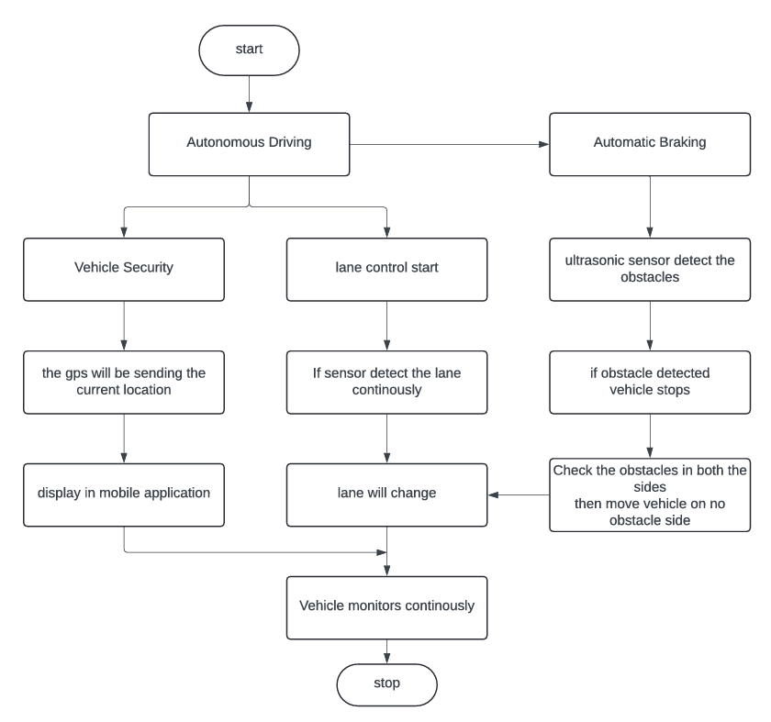
FLOWCHART

Slide 12
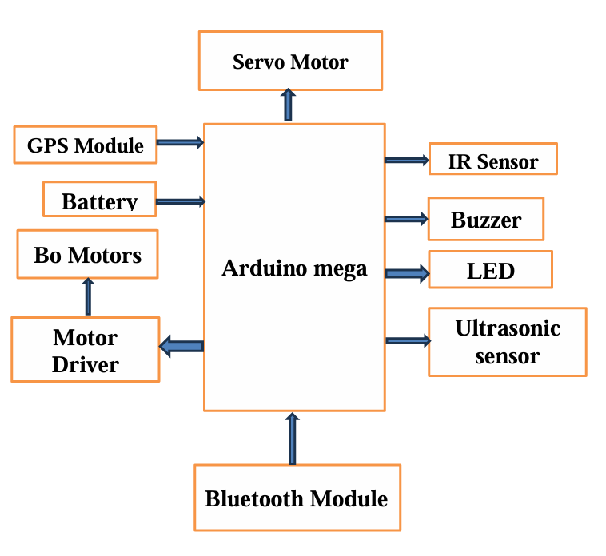
BLOCK DIAGRAM

Slide 13
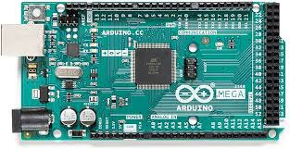
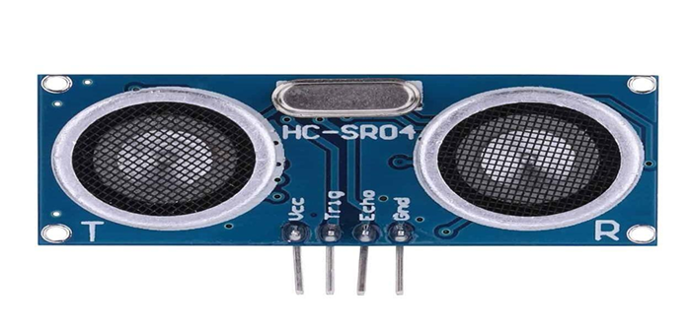
HARDWARE COMPONENTS
Arduino Mega: The Arduino Mega is a versatile and user-friendly microcontroller board featuring digital and analog input/output pins for prototyping electronics projects.
Ultrasonic Sensor: Ultrasonic sensors use high-frequency sound waves to detect object presence, distance, and level for contactless measurement.

Slide 14
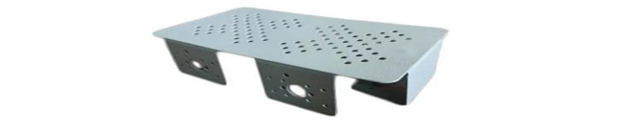
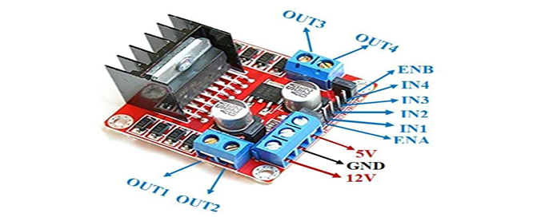
Continue….
Car Chassi: Aluminum is a popular material for car chassis because it is lightweight and strong.
Motor Driver: The L298N is a dual H-Bridge motor driver which allows speed and direction control of two DC motors at the same time.

Slide 15
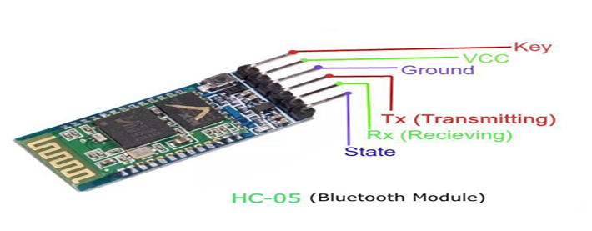
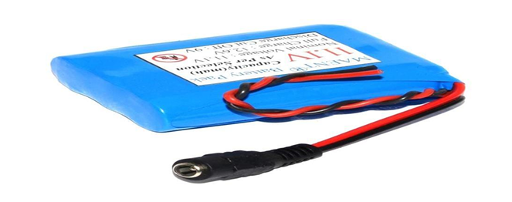
Continue….
Bluetooth Module: The HC05 Bluetooth module is used as UART serial converter module and can easily transfer the UART data through the wireless Bluetooth.
12v Battery: 12V batteries are common types of batteries that are used in powering boats, cars, RVs and other forms of automobiles.

Slide 16
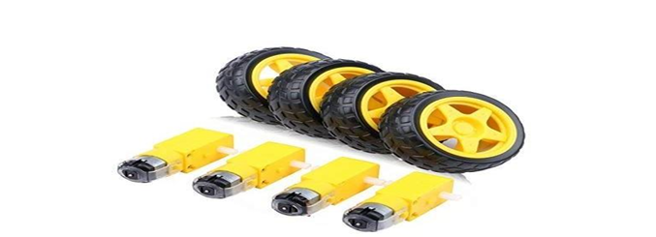
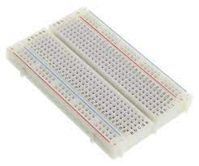
Continue….
Bo Motor: A BO motor is a type of electric motor that is powered by a rechargeable battery.
Bread Board: A breadboard (sometimes called a plug block) is used for building temporary circuits.

Slide 17
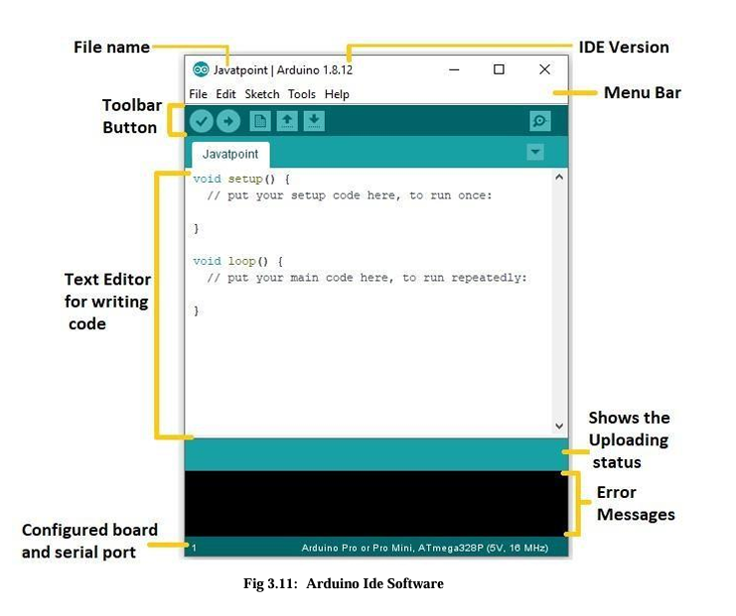
SOFTWARE REQUIREMENT
Arduino IDE: The Arduino Integrated Development Environment (IDE) is a software application used for programming Arduino microcontroller boards. It provides a user-friendly interface for writing, compiling, and uploading code to an Arduino board.

Slide 18
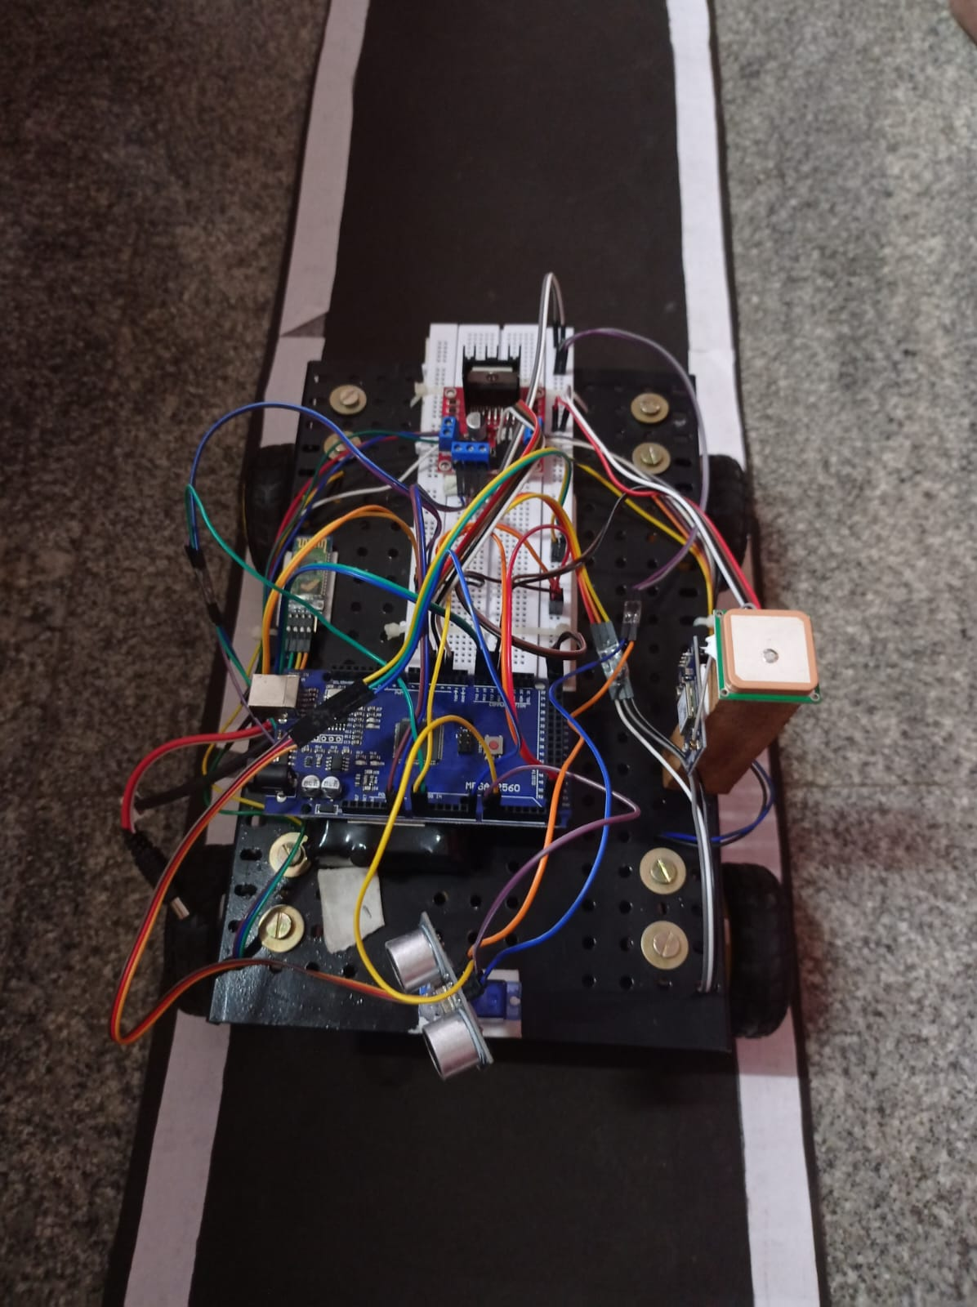
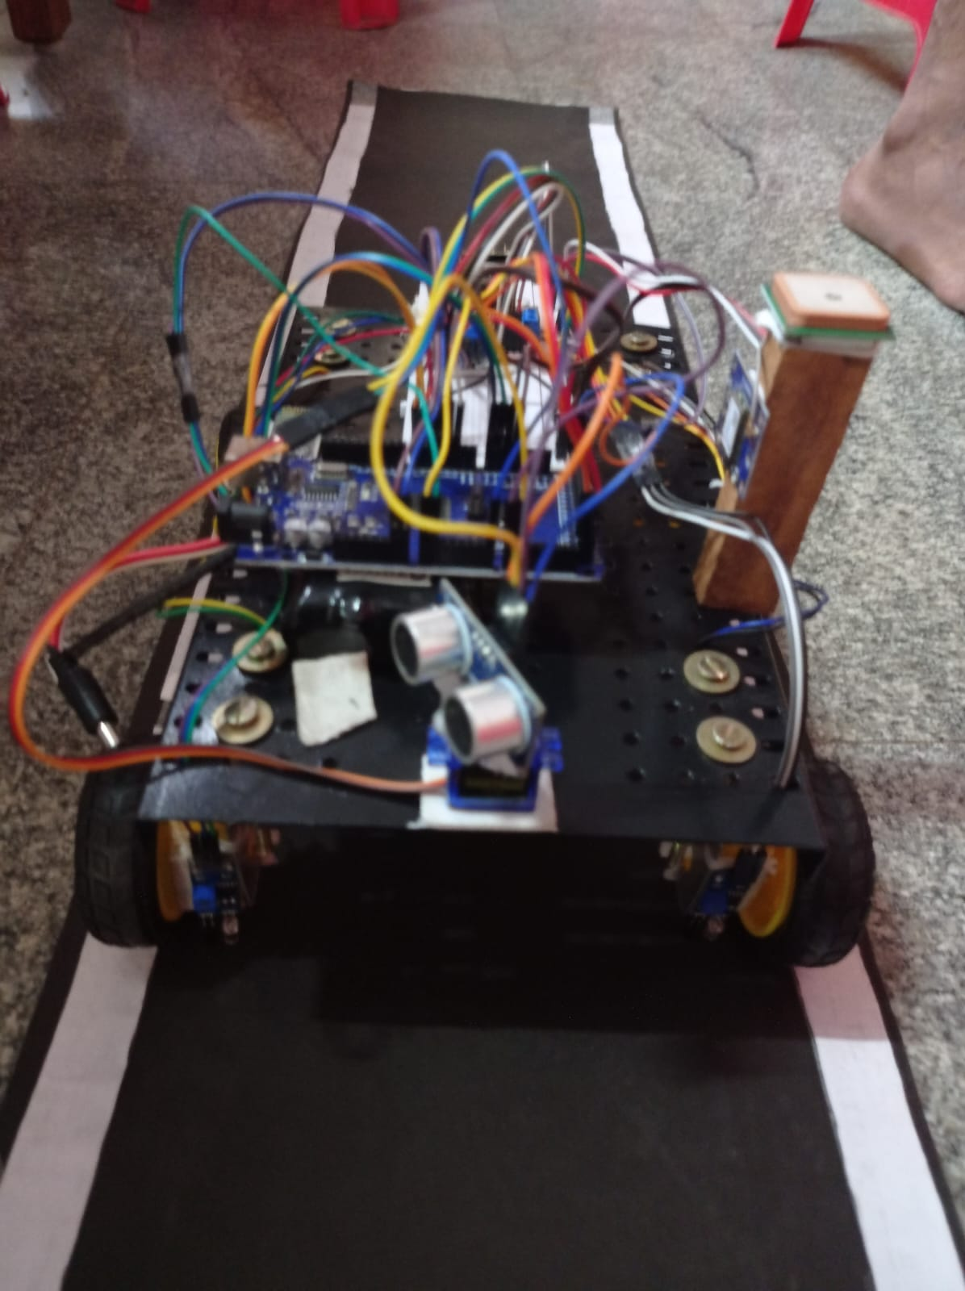
PROJECT ASSEMBLY

Slide 19
Continue…
The development of autonomous vehicles with advanced braking and lane control systems represents a significant milestone in transportation innovation.
These systems offer enhanced safety, precision navigation, and seamless integration, paving the way for a future with safer and more efficient transportation.
As technology continues to evolve, collaboration between industry stakeholders, policymakers, and regulatory bodies will be crucial in realizing the full potential of autonomous vehicles.
With ongoing research and development, autonomous vehicles equipped with advanced systems are poised to revolutionize mobility and reshape the way we travel.

Slide 20
REFERENCES
[1] Hemant Suryawanshi and Rohan Sarode are proposed “AUTOMATIC BRAKING SYSTEM” International Research Journal of Engineering and Technology .IRJET, Volume: 08Issue: 04. e-ISSN Online: 2395-0056 .page no: 2047-2050,Apr 2
[2] J.V.Sai Ram,K.M.S.V.Manikanta, G.Pavanth, B.Jagadeep and Dr. B.Raghu Kumar “Automatic Braking System Using Ultrasonic Sensor” International Journal of Innovative Science and Research Technology. IJISRT, Volume 2, Issue 4, ISSN No: - 2456 - 2165, page no: 398-404.April– 2017
[3] Manju Kumari, Shambhu Kumar, Anand Kumar and Nikita Kumari “Intelligent Braking System Using Ultrasonic Sensor” International Journal of Science and Research, IJSR. Volume 9, Issue 11, ISSN: 2319-7064,page no: 823-827November 2020

Slide 21
Continue….
[4] Shailendra Singh, Yogesh Jangid, Sahil Gupta and Virendra Solanki “Smart Braking System Using Ultrasonic Sensor and Actuator” International Research Journal of Engineering and Technology, IRJET, Volume: 06, Issue: 06, eISSN: 2395-0056, page no: 90-92, June 2019
[5] Mr. Tushar Kavatkar, Mr. Harshal Salvi and Mrs. MinaRahate “Design and Analysis of Intelligent Braking System” International Journal of Engineering Development and Research, IJEDR, Volume 5, Issue 1 ,ISSN: 2321-9939

Slide 22
Thank You

