Slide 1

✦ SENP-X
Understanding the role of the Product Owner in Agile
Owning the Outcome from Vision to Delivery
Diego Avella · AI Product Manager · Scrum Master

Slide 2
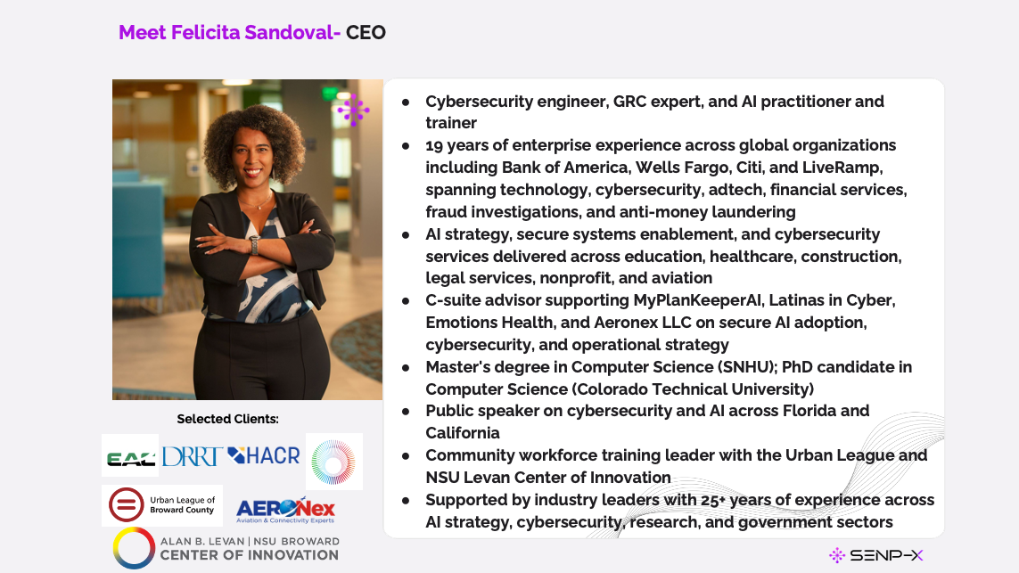
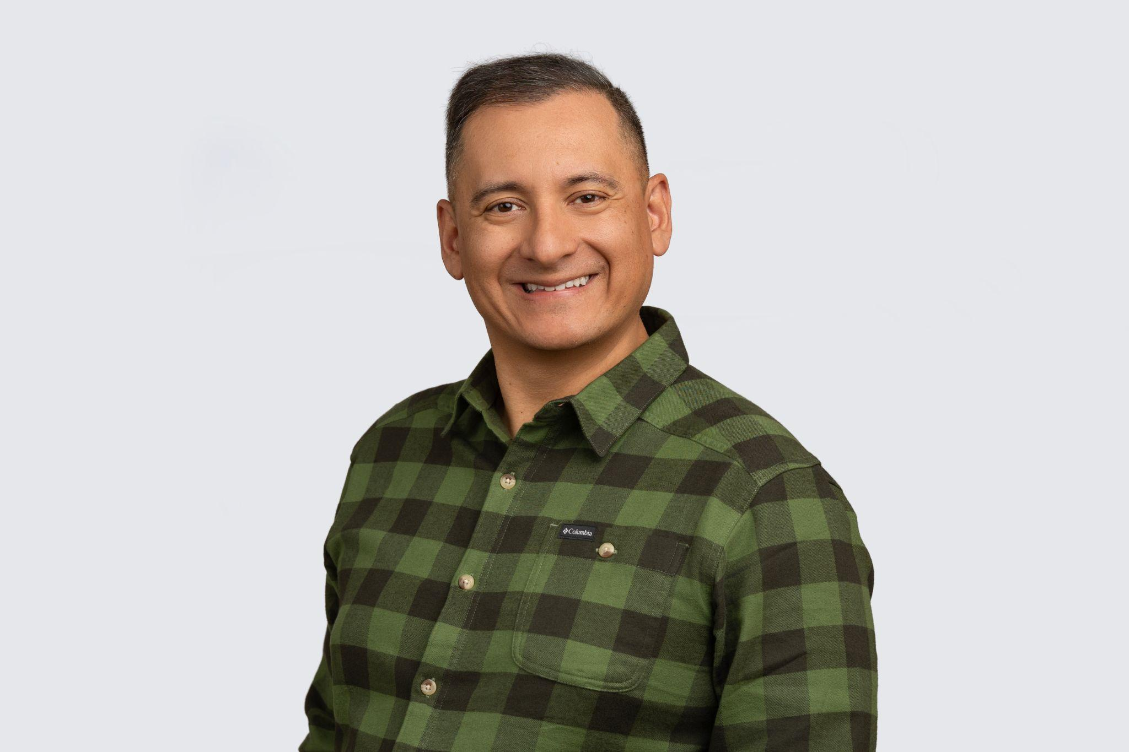
SENP-X
Meet Diego Avella — Your Facilitator
→ AI Product Manager and Certified Scrum Master with 20+ years of experience
→ Connects technology, product strategy, business execution, agile delivery, UX thinking, and AI strategy
→ MBA · Master's in Cybersecurity and Analytics (in progress)
→ Experienced across fintech, real estate tech, SaaS, and enterprise platforms
→ Public speaker on AI product management, agile delivery, and responsible AI
→ Advisor on AI adoption, governance, and product-led transformation
SENP-X

Slide 3
✦ SENP-X
Understanding the role of the Product Owner in Agile
Owning the Outcome from Vision to Delivery
Diego Avella · AI Product Manager · Scrum Master

Slide 4
SENP-X
Meet Diego Avella — Your Facilitator
→ AI Product Manager and Certified Scrum Master with 20+ years of experience
→ Connects technology, product strategy, business execution, agile delivery, UX thinking, and AI strategy
→ MBA · Master's in Cybersecurity and Analytics (in progress)
→ Experienced across fintech, real estate tech, SaaS, and enterprise platforms
→ Public speaker on AI product management, agile delivery, and responsible AI
→ Advisor on AI adoption, governance, and product-led transformation
SENP-X

Slide 5
SENP-X
Your Turn
A quick round of introductions
Your name and role
1
What product or project are you working on?
2
One thing you hope to take away from today
3
Keep it to 30 seconds each we'll have plenty of time for discussion during activities.
SENP-X

Slide 6
SENP-X
If your product fails tomorrow
whose fault is it?
Don't answer out loud. Just answer in your head.
SENP-X

Slide 7
✦ SENP-X
This role exists to close a gap
Between what the business wants and what users actually need.
Business wants
→
Users need
PO
Long-term vision
→
Next sprint
PO
Strategy
→
Execution
PO
SENP-X

Slide 8
✦ SENP-X
The Product Owner
doesn't own the backlog*.
The Product Owner
owns the outcome.

Slide 9
✦ SENP-X
BE
Who the Product Owner must be.

Slide 10
✦ SENP-X
The Product Owner's Triple Demand
BE
KNOW
DO
Identity
Direction
Execution
→ Available
→ Three perspectives
→ Backlog
→ Knowledgeable
→ Vision
→ INVEST · MoSCoW · Kano
→ Empowered
→ Roadmap & Story Map
→ Events · Stakeholders
SENP-X

Slide 11
✦ SENP-X
The PO must BE three things.
Available
Knowledgeable
Empowered
Present and accessible for decisions and daily questions.
Knows product, users, market, business, and enough tech.
Has actual authority to decide — not a backlog secretary.
WITHOUT IT
WITHOUT IT
WITHOUT IT
Engineers waiting, guessing, building wrong
Decisions take 5 days, not 5 minutes
Every call goes to a committee
SENP-X

Slide 12
✦ SENP-X
Activity 1
Score yourself honestly.
Rate yourself 1–5 on each: Available · Knowledgeable · Empowered
Identify one specific gap per dimension.
Page 1 of your handout.
2 min solo

Slide 13
✦ SENP-X
KNOW
What the Product Owner must understand.

Slide 14
✦ SENP-X
Three perspectives, every decision
Business
Value
Technical
Feasibility
User
Experience
Strong value · weak UX → churn | Loved by users · not feasible → burns the team
SENP-X

Slide 15
✦ SENP-X
Vision: Why does this product exist?
FOR
target customer
WHO
statement of need
OUR PRODUCT
product name
IS A
product category
THAT
key benefit
UNLIKE
competition
OUR PRODUCT
key differentiation
SENP-X

Slide 16
✦ SENP-X
Now · Next · Later
Commit to themes, not features.
NOW
NEXT
LATER
This quarter
After current
Longer horizon
Active themes and work in flight.
Next theme. High confidence, less detail.
Strategic direction. Themes only.
SENP-X

Slide 17
✦ SENP-X
Story Map: Visualize the user journey
Discover
Sign Up
Configure
Use Daily
Get Support
MVP
MVP
MVP
MVP
MVP
Release 2
Release 2
Release 2
Release 2
Release 2
Release 3
Release 3
Release 3
Release 3
Release 3
A flat backlog can't show you what's missing. A story map can.
SENP-X

Slide 18
✦ SENP-X
DO
How the Product Owner orders and delivers the work.

Slide 19
✦ SENP-X
The Product Backlog
WHAT IT IS
WHAT IT IS NOT
→ Ordered list of everything needed
→ A wish list
→ Living, evolves continuously
→ A dump for every idea proposed
→ Single source of work
→ A static document
→ Features, fixes, tech work, research
→ A rigid project plan
→ Yours to own and not a committee's
→ A graveyard for 6-month-old items
SENP-X

Slide 20
✦ SENP-X
A quality bar for every story
I
Independent
Can be built without depending on three other stories
N
Negotiable
A conversation starter, not a contract
V
Valuable
Delivers value to a user or the business
E
Estimable
The team can size it
S
Small
Can be built within a sprint
T
Testable
There's a clear way to know it's done
SENP-X

Slide 21
✦ SENP-X
Make testable concrete with Gherkin
Given · When · Then: This eliminates ambiguity
AS A user, I WANT to reset my password SO THAT I can regain access if I've forgotten it.
↓ becomes ↓
Given:
I am on the login page and I've forgotten my password.
When:
I click 'Forgot Password' and enter my email address.
Then:
I receive a reset email within 5 minutes and can set a new password.
Developers know what to build. Testers know what to verify. You know what done means.
SENP-X

Slide 22
✦ SENP-X
Three prioritization tools
MoSCoW
Kano
Pareto
For this release
Type of effort
Sanity check
→ Must have
→ Basic: table stakes
→ 80% of value
→ Should have
→ Performance: more is better
→ from 20% of features
→ Could have
→ Delighter: unexpected love
→ Find that 20%
→ Won't have
→ Protect it
Be willing to use Won't
Most teams skip delighters
Focus is the discipline
SENP-X

Slide 23
✦ SENP-X
Activity 3
Pressure-test five stories.
In pairs:
1. Score each story against INVEST — pass/fail per letter.
2. Classify each story with MoSCoW for a 2-month launch.
Page 4 of your handout.
6 minutes

Slide 24
✦ SENP-X
The PO at each Scrum event
EVENT
PO ROLE
COMMON FAILURE
Sprint Planning
Show up prepared. Clear sprint goal.
Figuring out priorities live
Daily Scrum
Not required. Be reachable.
Turning it into status
Sprint Review
Bring stakeholders. Capture feedback.
Demo with no feedback loop
Retrospective
Participate as team member.
Skipping or dominating
Refinement
Lead. Get top of backlog ready.
Never refining or too far ahead
SENP-X

Slide 25
✦ SENP-X
Map your stakeholders
HIGH POWER
KEEP SATISFIED
MANAGE CLOSELY
Brief · No surprises
Detail · Regular · Deep
MONITOR
KEEP INFORMED
LOW POWER
Light touch
Generous detail
LOW INTEREST
HIGH INTEREST
SENP-X

Slide 26
✦ SENP-X
Before you leave
Three commitments.
1
BE
Which dimension will I strengthen this month?
2
KNOW or DO
Which artifact will I get in better shape this quarter?
3
RELATIONSHIPS
Which stakeholder will I manage differently this week?

Slide 27
✦ SENP-X
You own the outcome.
The frameworks will follow.
Diego Avella
AI Product Manager · Scrum Master
Thank you. Questions?

Slide 28

✦ SENP-X
Let's Stay Connected
Scan the QR code to connect on LinkedIn
Diego Avella
linkedin.com/in/diego-avella

Slide 29
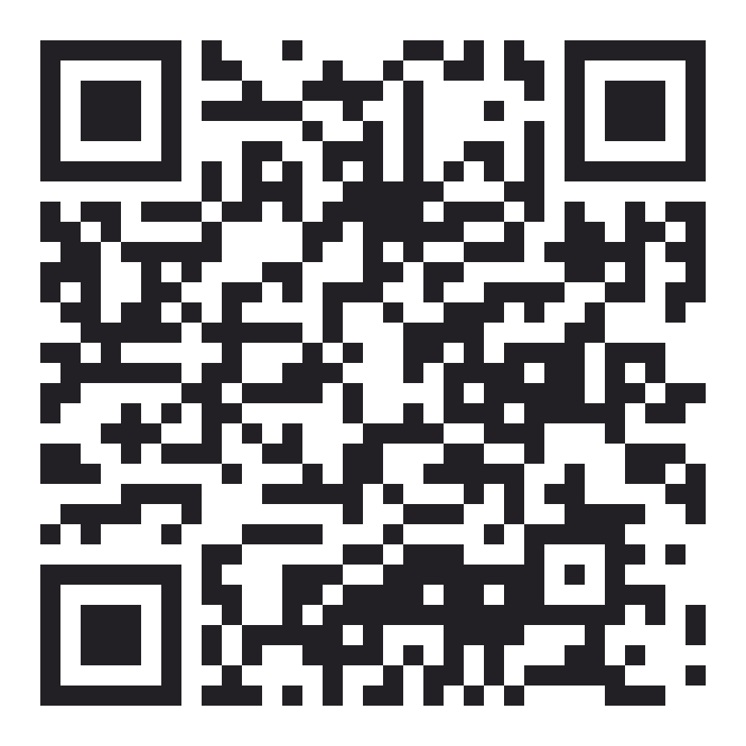
✦ SENP-X
Get the Resources here
Scan the QR code to download the repository
Diego Avella
https://github.com/mr-dap-lab/productownerresources

