Slide 1
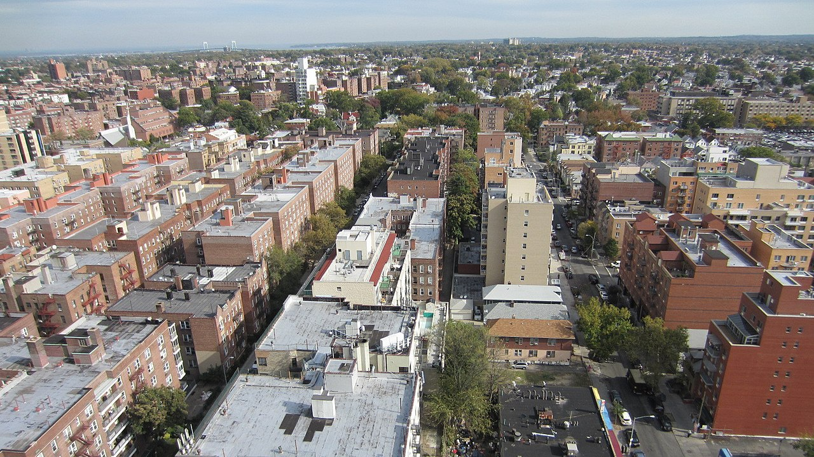
Urban Boundary Layer
Observations & Analysis
Research Update
Presented: 01/04/22

Slide 2
Project Updates
Completed
Spectral analysis using lidar and EC data (Slides 3 & 4)
Draft of paper outline (Slide 5)
GOES-R data visualization algorithm (SST + LST) (Slide 6)
In process
Getting Mesonet flux data for 2018, 2020, 2021
Identifying case study days (typical heat wave example, typical normal example, typical sea breeze example) Quality control procedures for lidar and radiometer data
AMDAR flight data in process

Slide 3
Spectral Analysis
Combination of normalization methods attempted
No. | Frequency normalization (x-axis) | Spectral normalization (y-axis) | Results
1 | fS_{w} / u*² | fz/U | Slide 4
2 | fS_{w} / U² | fz/U | Slide 5
3 | fS_{w} / w² | fz/U | Slide 6
4 | fS_{w} / u*² | fh/U | Slide 7
5 | fS_{w} / U² | fh/U | Slide 8
6 | fS_{w} / w² | fh/U | Slide 9

Slide 4
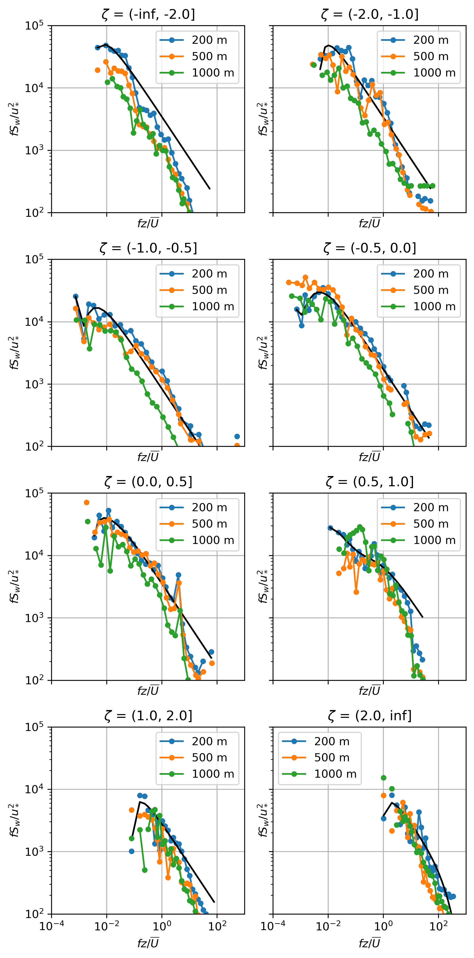

Slide 5
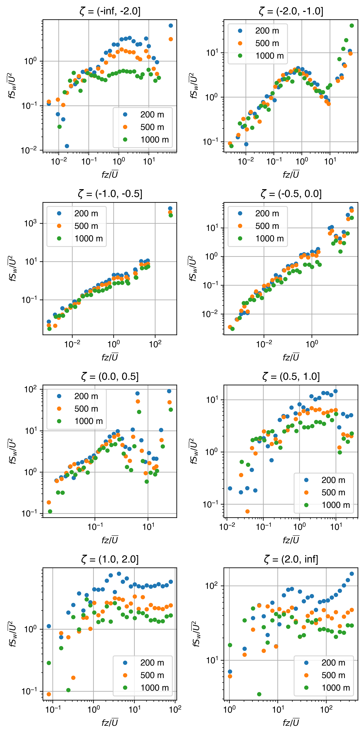

Slide 6
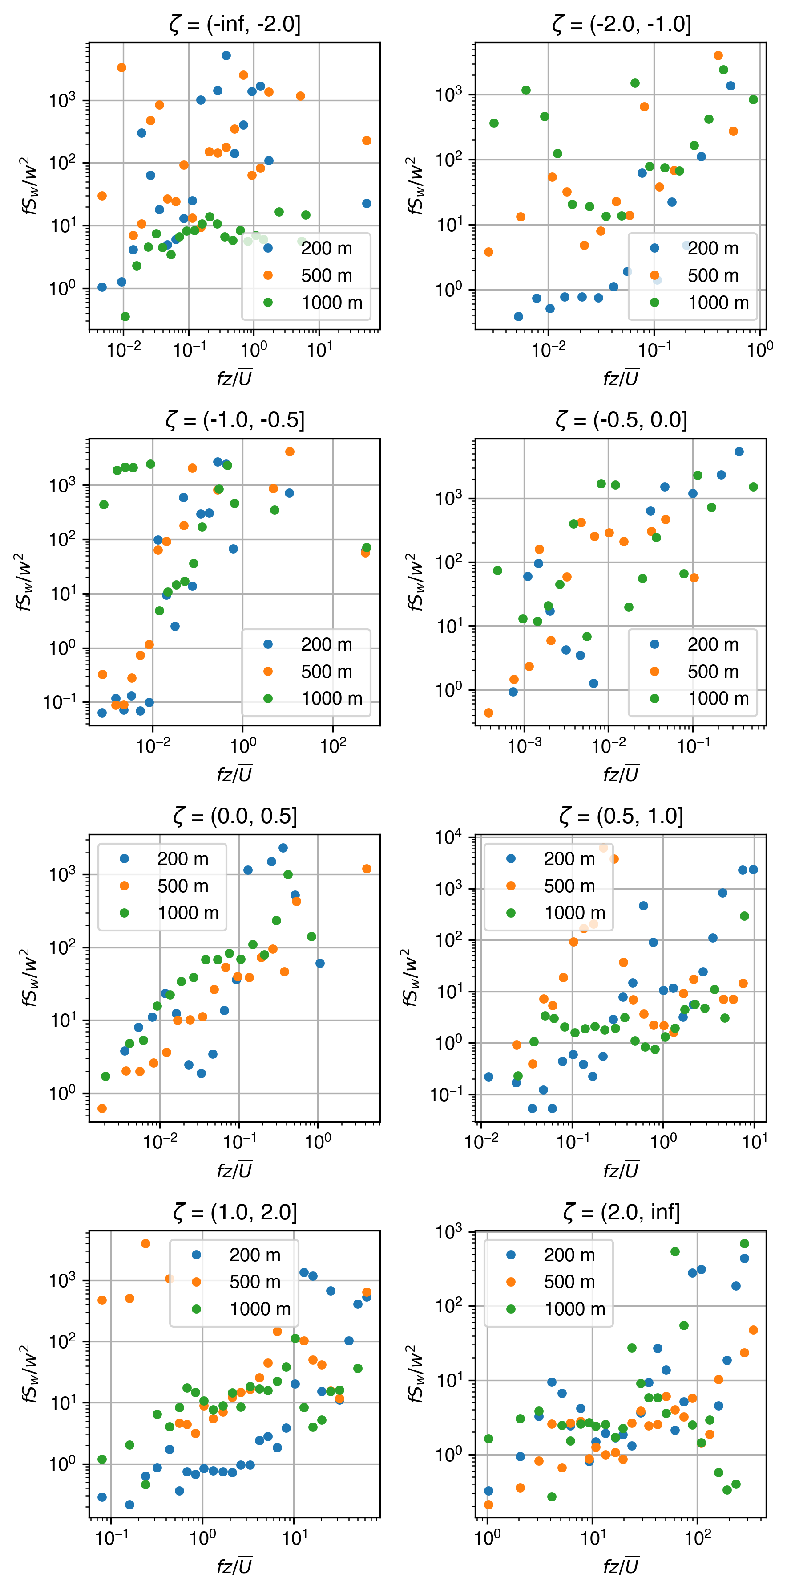

Slide 7
Issues
Boundary layer height estimation
  Lidar method (Barlow et al., 2011, Huang et al., 2017) using 𝞼_{w}² is difficult
    Insufficient quality data to estimate MLH
Barlow, Janet F., et al. "Boundary layer dynamics over London, UK, as observed using Doppler lidar during REPARTEE-II." Atmospheric Chemistry and Physics 11.5 (2011): 2111-2125.
Huang, Meng, et al. "Estimate of boundary-layer depth over Beijing, China, using Doppler lidar data during SURF-2015." Boundary-Layer Meteorology 162.3 (2017): 503-522.

