Slide 1


STUDENT FITNESS PLATFORM
Campus Gym Buddy
Connecting students. Building consistency. Making fitness social.
Business Need
Many students have access to the campus gym, but they may avoid going because they feel uncomfortable working out alone, lack confidence, or cannot easily find workout partners with similar goals.
System Solution
Campus Gym Buddy gives verified students a safe platform to create profiles, join small workout groups, match by goals and skill level, and schedule gym sessions.
Key Benefits
• Increases campus gym participation
• Builds motivation and accountability
• Creates a stronger campus community
• Supports wellness, confidence, and belonging
• Improves trust through student verification
Created by Brian Barrios-Hernandez, Md Usman Goni, and Pablo Jacome (Team 10)
2026

Slide 2
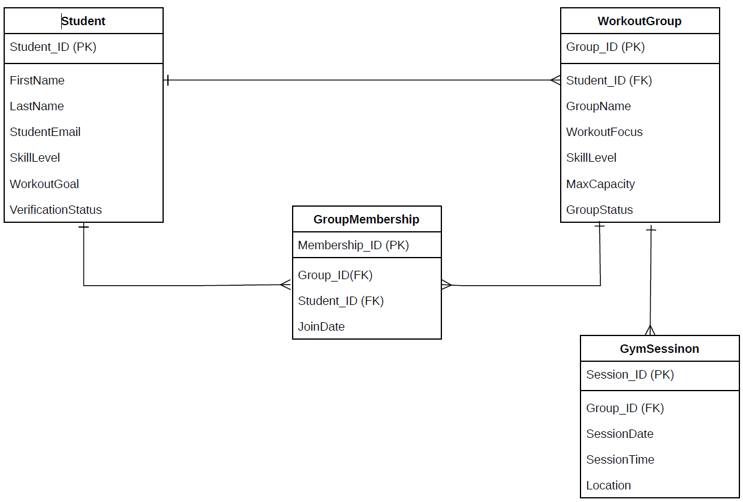
Information Captured in the Data Model
The database stores the information needed to connect students, manage group capacity, track membership, and organize gym sessions.
Student
Group Membership
Relationship logic
(Who is using the system )
(Which students joined
which groups )
Name + email
Skill level
Workout goal
Verification status
Student ID
Group ID
Join date
Member count
Workout Group
Gym Session
(What group students join)
(When and where groups meet)
Group name
Workout focus
Skill level
Max capacity/status
Session Date
Session time
Location
Assigned group

Slide 3
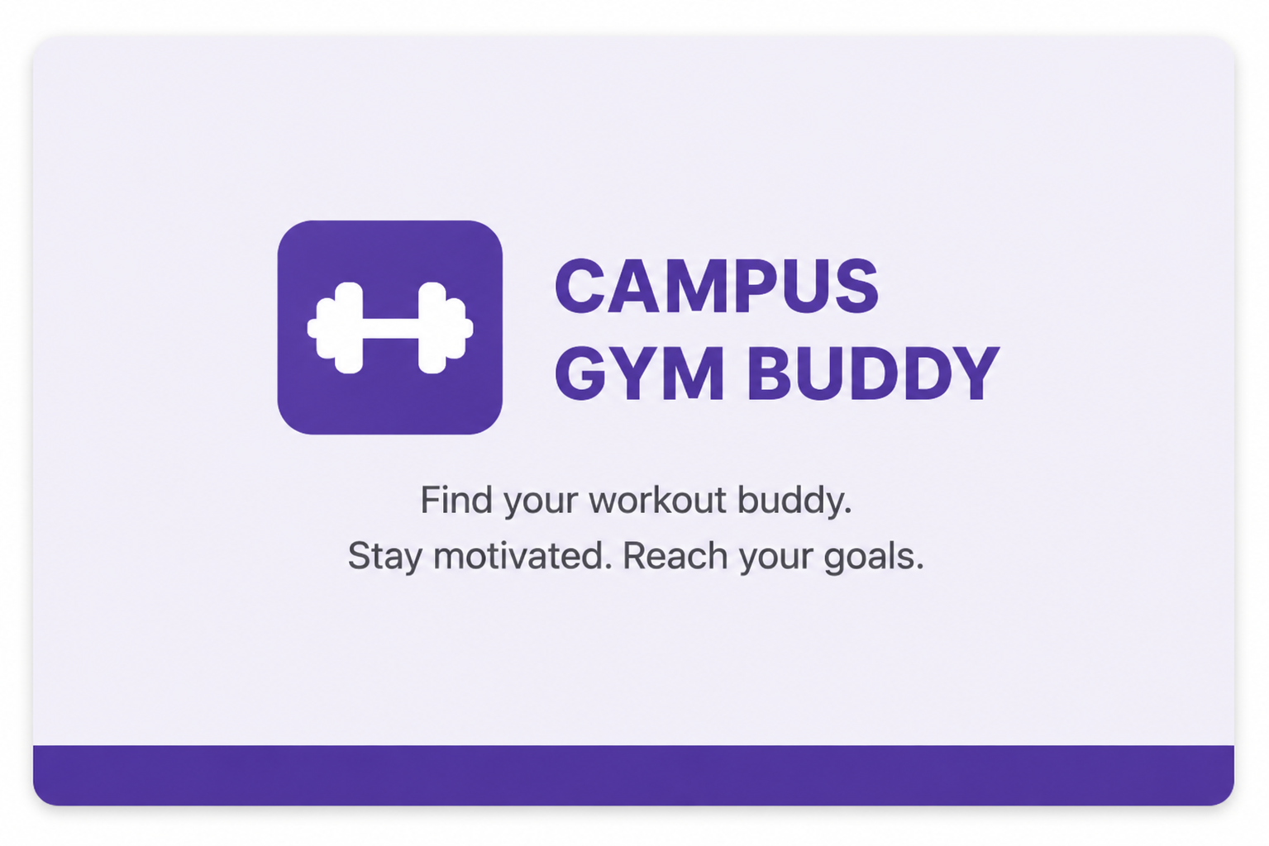
Live Demo Walkthrough
1
Student Registration
No sign-up required — integrated with Cal State LA student portal
Only verified active students can access the system
Discover & Match
2
Browse active workout groups
Filter by workout focus and skill level
View available spots and group details
3
Create a Group
Enter group name and workout focus (e.g., cardio, strength)
Select skill level and group size
4
Once Join a Group
Join available workout groups
View group members and details
Schedule sessions with date, time, and location

Slide 4

System Overview — Use-Case Diagram
«Campus Gym Buddy System»
Manage Student Profile
<<Include>>
Create Workout
Group
🔧 Campus Verification System
🎓 Student
Create Workout Group
Search workout groups
<<Extend>>
Join Workout Group
Manage Group Membership
Schedule Workout Session
View group/Session Details

Slide 5
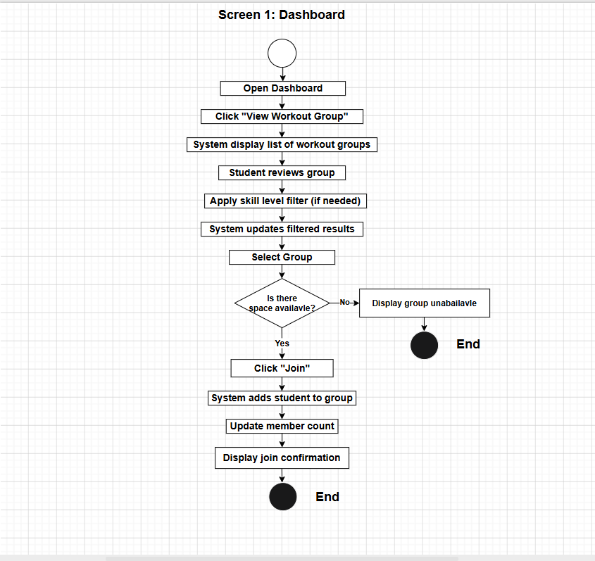
Process Flow — Joining a Workout Group
START
Student logs in
& searches groups
Browse available
groups by goal / schedule
Group has < 5
members?
No -> Show "group full" or "request denied"
Send join request
to group creator
Creator
approves?
No -> Show "group full" or "request denied"
Student added
to membership
Session scheduled
& confirmed
END
Activity flow shows the complete path a student takes from searching to confirmed group membership

