Slide 1
Explainable Double DQN for Ultrafiltration Control in Hemodialysis
Selected Topics: Reinforcement Learning & Explainable AI · Group 2
Gomana Hossam Eldine
ID 231013248
Yousef Mohamed Hasabo
ID 231011574
Mohanad Mostfa Ali
ID 231012398
Zyad Gbriel
ID 231002617
Notes:
Hello, we are Group 2. In this project an RL agent learns how fast to remove water from a patient during dialysis. We use a Double DQN to learn the policy, and Integrated Gradients to explain each choice.

Slide 2
Project idea
An RL agent learns how fast to remove water during dialysis; Integrated Gradients shows why it chose each action.
1
2
3
Simulate
Learn
Explain
Real patient profiles go into a small simulator. One session = 16 steps of 15 minutes.
A Double DQN agent tries water-removal rates and learns from the reward.
Integrated Gradients shows which inputs pushed each choice.
Notes:
Our idea in one sentence: an RL agent learns how fast to remove water during dialysis, and Integrated Gradients shows why it chose each action. There are three steps. First we simulate patients. Then the agent learns by trial and error. Then we explain its choices.

Slide 3
Problem statement: an RL problem
Medical context: dialysis removes extra water from the blood. Removing it too fast makes blood pressure fall.
16 decisions in a row
Delayed reward
A trade-off
The agent picks a rate every 15 minutes, 16 times per session.
A fast rate now can drop blood pressure some steps later.
Remove the water, but keep blood pressure safe.
Why not a fixed rule? It uses one rate all session and does not react when blood pressure falls.
Why look inside? A neural-network policy is a black box. We must see which inputs drive each choice.
Notes:
Dialysis removes extra water from the blood. If we remove it too fast, blood pressure falls. That is the only medical idea we need. As an RL problem: the agent makes 16 decisions in a row. The effect of a choice shows up later, so the reward is delayed. And there is a trade-off between removing water and keeping blood pressure safe. A fixed rule cannot react to the patient. And to trust a learned policy, we must see what it looks at.

Slide 4
Literature review
Paper | What it gives our RL work
Yang et al. 2022 [1] | RL (Duel-DDQN) for a dialysis decision: dry weight
van Hasselt et al. 2016 [2] | Double DQN: our learning algorithm
Sundararajan et al. 2017 [3] | Integrated Gradients: our explanation method
Li et al. 2025 [4] | Explainable model that warns of blood-pressure problems
Wang et al. 2025 [5] | Predicts low blood pressure, but no control
Kanbay et al. 2020 [6] | Rules for our simulator and the 13 mL/kg/h limit
Cheungpasitporn et al. 2026 [9] | Review: AI and RL in kidney care
Tang et al. 2026 [10] | Review of RL for treatment: clear S, A, R; need for explanations
The gap: papers [4, 5] only predict risk. No paper explains a learned controller during the session. We do that with DDQN + IG.
Notes:
Here are the papers we build on, and what each one gives our RL work. Yang et al. used a deep Q-network for a related dialysis decision. Van Hasselt et al. give us Double DQN. Sundararajan et al. give us Integrated Gradients. The 2025 papers only predict low blood pressure; they do not control anything. Kanbay et al. give the simulator rules. The two 2026 reviews show that RL for treatment is active and that explanations are needed. The gap: nobody explains a learned controller inside the session.

Slide 5
Proposed approach: environment and data
UCI CKD data [7, 8]
Simulator
RL agent
400 real patient profiles
4 simple equations
learns by trial and error
320
training patients
80
test patients (never seen in training)
From the data: age, diastolic blood pressure, urine albumin. The ckd label is not used.
Why this data: real, open (CC BY 4.0) and widely used; no public dialysis time series exists.
Notes:
Our environment is a simple simulator. Real patient profiles from the UCI CKD dataset start each session: age, blood pressure and urine albumin. We do not train on the dataset label. We split the 400 patients: 320 for training and 80 for testing. We chose this data because it is real, open and widely used, and there is no public minute-by-minute dialysis data.

Slide 6
MDP: state S and action A
State feature | Plain meaning
overload | water still to remove (kg)
removed | water removed so far (kg)
sbp | systolic blood pressure (top number)
dbp | diastolic blood pressure (bottom number)
hr | heart rate
time | how far into the session (0 to 1)
age | patient age
albumin | blood protein that helps water refill
Action A: UF rate (mL/kg/h)
0
5
8
10
13
0 = stop. 13 = highest safe rate [6].
The agent sees the state, picks an action, and gets a reward. Then it sees the next state.
Notes:
The agent sees the state, picks an action, and gets a reward. The state has 8 numbers about the patient. Each is divided by a fixed number so it is between about 0 and 1. The action is one of 5 water-removal rates. 13 is the highest safe rate from the literature.

Slide 7
MDP: transition S → S′ and reward R
(1)
dv = min(u · W · Δt / 1000, overload); overload′ = overload − dv
Water removed this step = rate × weight × time.
(2)
SBP′ = SBP − a·(1 + age_f)·(u − refill) + b·(SBP₀ − SBP) + noise
Removing water faster than the body refills lowers blood pressure.
(3)
DBP′ = DBP + 0.5·(SBP′ − SBP) + noise
The bottom pressure follows the top pressure.
(4)
HR′ = HR₀ + c·(SBP₀ − SBP′) + noise
The heart beats faster when pressure falls.
Reward R = dv − 10·[SBP′ < 90] − 2·overload (last step only)
+ for water removed · −10 for each low-pressure step · −2 per kg of water left at the end
Notes:
Four simple equations move the patient 15 minutes forward. One: the water removed is the rate times weight times time. Two: removing water faster than the body can refill lowers blood pressure; older patients drop more; pressure slowly comes back. Three: the bottom number follows the top number. Four: the heart beats faster when pressure falls. The reward pays for water removed, gives minus 10 for each low-pressure step, and minus 2 per kilogram left at the end.

Slide 8
From Q-learning to Double DQN
1
Q(s, a)
Expected total reward if we take action a in state s, then act well.
2
Q-learning
Q(s, a) ← r + γ · max Q(s′, a′) (Bellman update)
3
DQN
A table cannot store continuous states, so a neural network learns Q.
4
Problem
The same network picks and scores the next action, so Q is too high (overestimation).
5
Double DQN
The online network picks the action; the target network scores it.
DQN target: y = r + γ · max_a′ Q_target(s′, a′)
Double DQN: y = r + γ · Q_target( s′, argmax_a′ Q_online(s′, a′) )
γ (gamma) = how much future reward counts. Picking and scoring with two networks stops the too-high values [2].
Notes:
Q of s and a means: how much total reward we expect if we take action a in state s and then act well. Q-learning updates it with the Bellman rule: reward now plus gamma times the best Q of the next state. A table cannot store our continuous state, so DQN uses a neural network. But DQN uses the same network to pick the best next action and to score it. Noise makes the max too high, so DQN overestimates. Double DQN fixes this: the online network picks, the target network scores.

Slide 9
Our DDQN agent
8
64
64
5
In: the 8 state numbers. Out: one Q-value for each of the 5 rates. The agent takes the biggest.
state
ReLU
ReLU
Q-values
Part | Our value | Why it is there
Replay buffer | 50,000 steps, batch 64 | Random old steps, so one batch is not one session
ε-greedy | 1.0 → 0.05 over first 60% of 1500 episodes | Explore first, then use what it learned
Target network | copied every 200 learning steps | A stable goal to learn toward
Discount γ | 0.99 | Future reward counts almost as much as now
Optimizer | Adam, lr 1e-3, Huber loss, grad clip 10 | Steady updates; big errors do not explode
Notes:
The network is small: 8 inputs, two hidden layers of 64, and 5 outputs, one Q-value per rate. The agent picks the rate with the biggest Q-value. Each part has a reason. The replay buffer stores old steps and gives random batches, so the batches are not all from one session. Epsilon-greedy explores at the start. The target network gives a stable goal. Gamma 0.99 means the future counts a lot. Adam, Huber loss and gradient clipping keep the updates steady.

Slide 10
Training loop
for seed in 0..4:
for episode in 1..1500:
s = reset() # random training patient
ε = decay(episode) # 1.0 → 0.05
repeat 16 steps:
a = random if rand < ε else argmax Q(s)
s′, r = step(a)
buffer.store(s, a, r, s′)
batch = buffer.sample(64)
update Q_online on DDQN target
every 200 updates: Q_target ← Q_online
s = s′
5
seeds (0–4)
1500
episodes per seed
16
steps per episode
24,000
steps per seed
Notes:
This is the loop in train.py. For each of 5 seeds we run 1500 episodes. Each episode is one patient session of 16 steps. At each step the agent picks an action with epsilon-greedy, the simulator moves one step, we store the step in the buffer, sample 64 old steps, and update the online network with the Double DQN target. Every 200 updates we copy the online network into the target network. Epsilon goes down after each episode.

Slide 11
Proposed solution: baselines and why
Rule-based
Tabular Q-learning
No learning. One constant rate per patient to remove the water in 4 h, max 13 mL/kg/h.
Classic RL with a table. State cut into bins: 5 water × 5 BP × 16 time steps. 3000 episodes.
What if we do not learn?
Do we need a network?
Standard DQN
Double DQN (ours)
Same network and settings as ours, but without the Double fix.
Online network picks, target network scores.
What does the Double fix add?
Our method.
Notes:
We compare four controllers. The rule-based one does not learn: it picks one constant rate per patient that would remove the water in four hours, never above 13. Tabular Q-learning is classic RL with a table: we cut the state into bins, 5 for water, 5 for blood pressure, and 16 time steps. Standard DQN uses the same network as ours but without the Double fix. Double DQN is our method. Each baseline answers one question.

Slide 12
Proposed solution: the pipeline
1. Train
2. Check
3. Explain
4. Report
DDQN + DQN
5 seeds · 320 patients
convergence
stability · safety
IG, only if
approved
table, curves,
IG figures
If the check fails, main.py stops before IG.
Why check first? Explaining a model that has not learned well tells us nothing.
The approval is tied to the exact model file (SHA-256 hash = a fingerprint of the file).
All seeds are fixed, so the results can be repeated.
$ python main.py
Notes:
One command, python main.py, runs everything. It trains DDQN and DQN on 5 seeds. Then it checks convergence, stability and safety. Only if the check approves the model do we run Integrated Gradients. If not, main.py stops. Why? Explaining a model that has not learned well tells us nothing. The approval is tied to the exact model file with a SHA-256 hash, a fingerprint of the file.

Slide 13
Results: test patients
Controller | Mean reward ↑ | Sessions with low BP ↓ | Low-BP steps per session ↓ | Water left (kg) ↓ | Rate jump ↓
DDQN (ours) | 1.022 ± 0.251 | 1.0% ± 1.5 | 0.010 ± 0.015 | 0.545 ± 0.090 | 1.62 ± 0.56
Standard DQN | 1.027 ± 0.106 | 1.8% ± 1.5 | 0.024 ± 0.022 | 0.496 ± 0.056 | 2.37 ± 0.47
Tabular Q-learning | −0.710 ± 0.595 | 2.8% ± 0.7 | 0.184 ± 0.066 | 0.542 ± 0.035 | 3.92 ± 0.15
Rule-based (13 cap) | −41.574 | 50% | 4.40 | 0.110 | 0.00
100 test sessions per seed, mean ± std over 5 seeds. Rate jump = average change of the UF rate between steps (mL/kg/h).
≈
DDQN and DQN: same reward
1.0%
vs 1.8% low-BP sessions
50%
rule: low BP in half the sessions
Notes:
We test each controller on 100 sessions with the 80 test patients, for each of the 5 seeds. Numbers are mean plus or minus standard deviation over seeds. Higher reward is better; lower is better for the other columns. DDQN and DQN get the same reward. DDQN has fewer low-pressure sessions, 1.0 versus 1.8 percent. The rule removes the most water but half its sessions have low pressure.

Slide 14
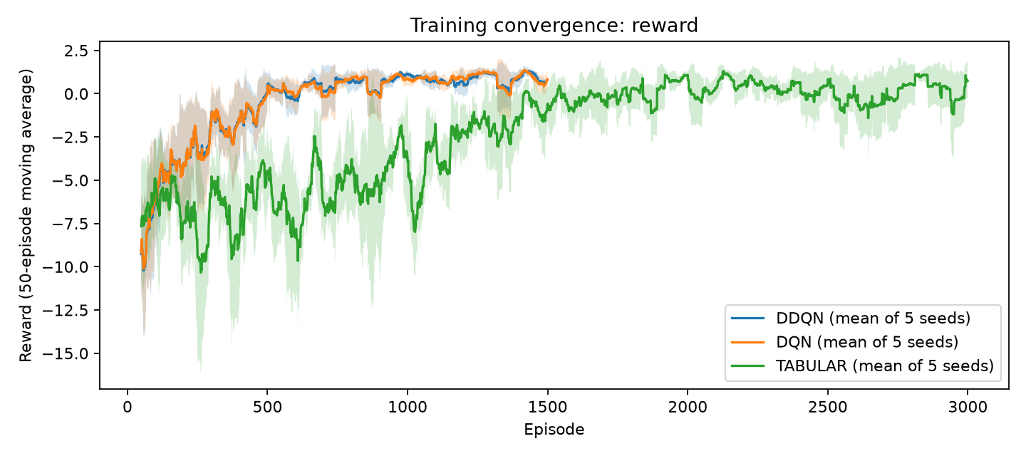
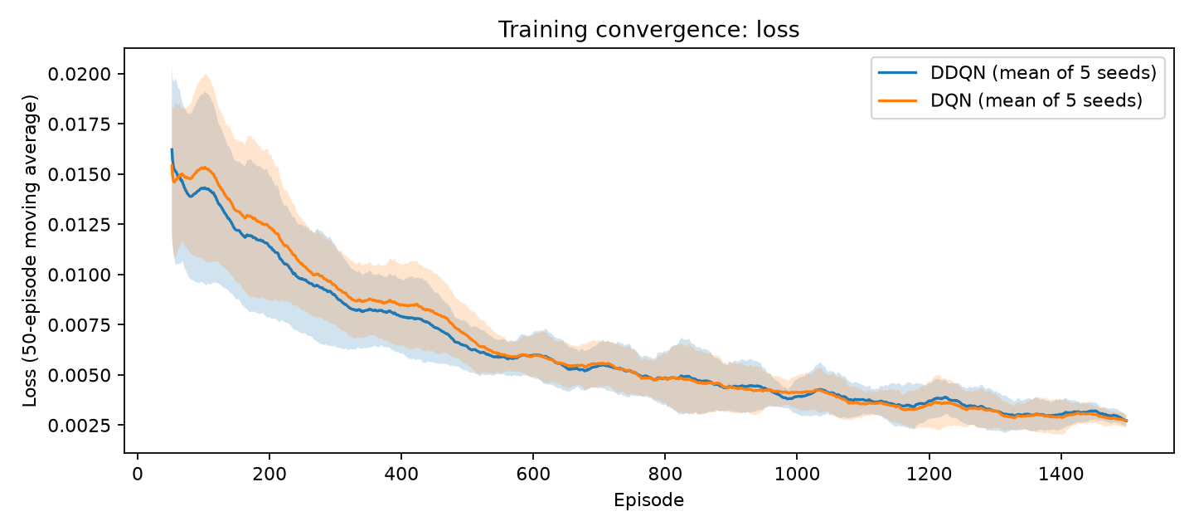
Learning curves and checks (before IG)
✓ Converged
✓ Stable
✓ Safe
APPROVED
for IG
Rewards stopped changing, on all 5 seeds
5 seeds agree: spread 0.25 < 0.5
Few unsafe sessions: worst seed 4% ≤ 5%
DDQN, 5 seeds, 100 test sessions per seed (results/validation_report.md)
Notes:
Left: the reward goes up and then becomes flat for DDQN and DQN. Right: the loss. We run three checks before IG. Converged: the rewards stopped changing, on every seed. Stable: the 5 seeds agree, the spread is 0.25, below 0.5. Safe: few unsafe sessions, the worst seed has 4 percent, within 5 percent. All three pass, so IG is approved. Honest note: our first convergence rule failed seed 2 because its rewards are noisy, so we switched to a test that accounts for noise before approving.

Slide 15
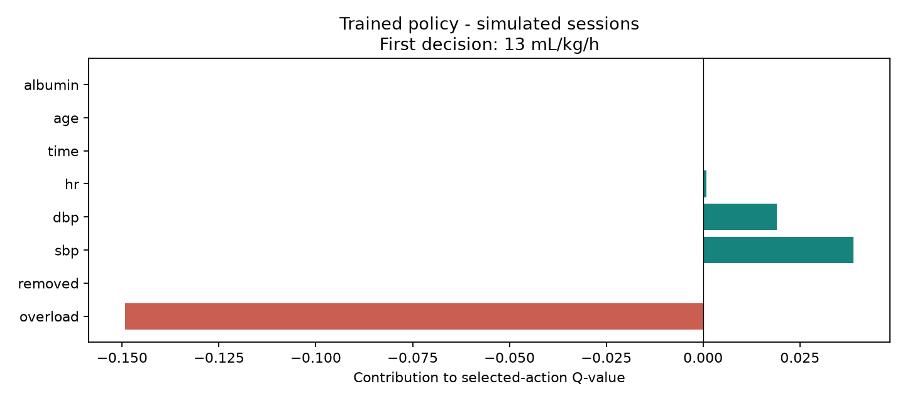
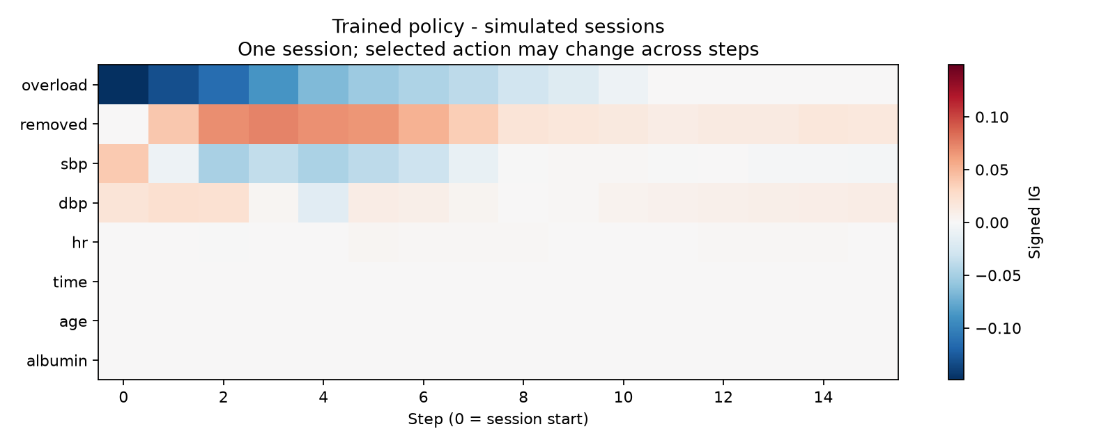
Integrated Gradients, simply
IG_i = (x_i − b_i) · ∫₀¹ ∂Q_a / ∂x_i dα [3]
= how much input i pushed the chosen action, compared with a reference patient b.
Top: one decision (rate 13)
Water left pulls it down; blood pressure pushes it up.
Bottom: one session
Water left matters most early, then fades.
The parts add up to the Q-value change (checked on every decision).
Notes:
Integrated Gradients compares the patient with a reference patient. It walks from the reference to the real input and adds up how much each input changes the Q-value of the chosen action. The result is how much each input pushed the choice. Top: one decision, rate 13. More water to remove pulls its Q-value down compared with the reference; blood pressure pushes it up. Bottom: one whole session. Water left matters most at the start and fades as water is removed. The numbers add up exactly, which we check on every decision.

Slide 16
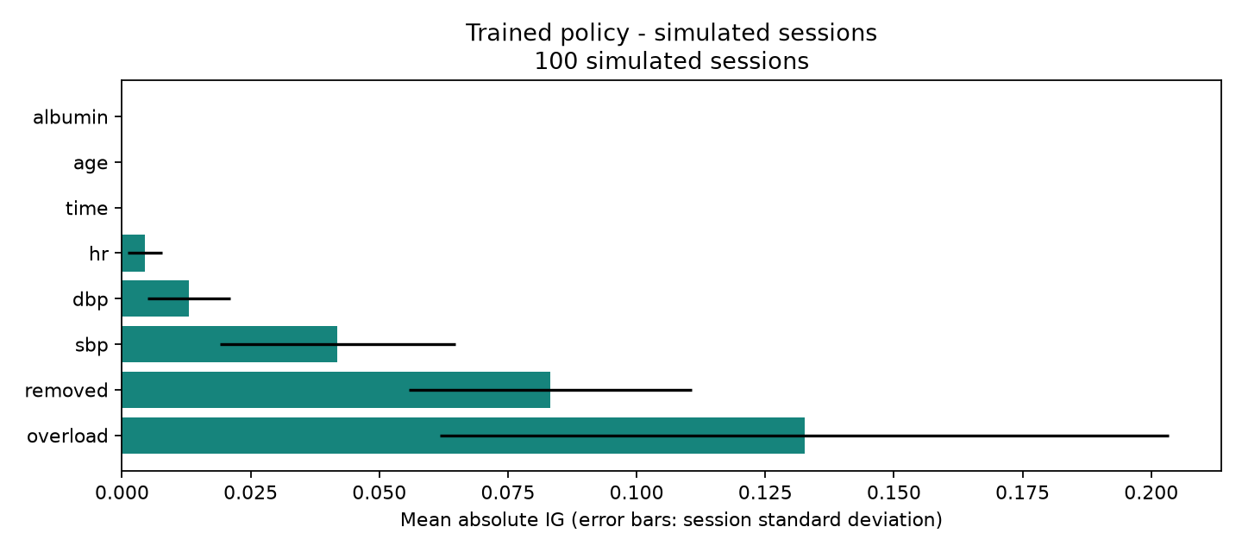
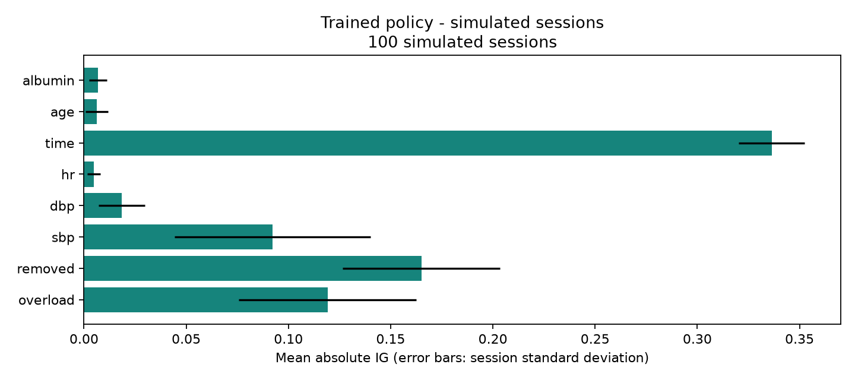
IG across 1600 decisions
Reference 1: default (no extra water)
Reference 2: average training patient
mean |IG| | overload | removed | sbp | dbp | hr | time | age | albumin
Default | 0.133 | 0.083 | 0.042 | 0.013 | 0.004 | 0* | 0* | 0*
Average | 0.119 | 0.165 | 0.092 | 0.018 | 0.005 | 0.336 | 0.006 | 0.007
* zero by design: this reference keeps time, age and albumin equal to the patient's own values
The agent uses water left, water removed and blood pressure most; age and albumin barely matter.
Notes:
We ran IG on 100 sessions, 1600 decisions, with two reference patients. With the default reference, water left matters most, then water removed, then systolic pressure. Time, age and albumin are zero there by design. With the average training patient as reference, time is large too, but age and albumin are still tiny. So the agent uses water left, water removed and blood pressure most; age and albumin barely matter.

Slide 17
Discussion
What we found
DDQN ≈ DQN on reward (1.022 vs 1.027)
DDQN is safer: 1.0% vs 1.8% low-BP sessions
DDQN is smoother: rate jump 1.62 vs 2.37
Fixed rule: most water removed, but unsafe in 50% of sessions
Limits
Simple, hand-tuned simulator, not real sessions
IG sessions use all 400 profiles, not only test patients
IG is not cause and effect
IG results depend on the reference patient
Bottom line: same reward as DQN, but safer and smoother, in simulation only.
Notes:
To be honest: DDQN does not beat DQN on reward; the difference is inside the noise. But DDQN is safer, 1.0 versus 1.8 percent low-pressure sessions, and smoother, 1.62 versus 2.37. The fixed rule removes the most water, but half its sessions are unsafe, so learning helps. Limits: the simulator is simple and hand-tuned. IG shows what the network uses, not cause and effect.

Slide 18
Future work
1
Prioritized replay
2
Dueling network
Learn more often from steps with big errors.
Split Q into state value + action advantage.
3
More seeds + tuning
4
Offline RL on real data
Search learning rate, γ, buffer size, ε schedule.
Learn from logged sessions (Lin et al. 2019).
5
Contrastive IG
Explain why action A and not action B.
Notes:
Next steps for the RL part. Prioritized replay: learn more often from surprising steps. A dueling network: separate how good the state is from how good each action is. More seeds and tuning of the settings. Offline RL on real dialysis sessions, for example the Lin et al. 2019 dataset. And contrastive IG, to explain why the agent chose action A and not B.

Slide 19
References (1/3)
[1] Z. Yang, Y. Tian, T. Zhou, Y. Zhu, P. Zhang, J. Chen, and J. Li, “Optimization of Dry Weight Assessment in Hemodialysis Patients via Reinforcement Learning,” IEEE Journal of Biomedical and Health Informatics, vol. 26, no. 10, pp. 4880–4891, 2022, doi: 10.1109/JBHI.2022.3192021. https://doi.org/10.1109/JBHI.2022.3192021
[2] H. van Hasselt, A. Guez, and D. Silver, “Deep Reinforcement Learning with Double Q-learning,” in Proceedings of AAAI, 2016. Original paper: https://arxiv.org/abs/1509.06461
[3] M. Sundararajan, A. Taly, and Q. Yan, “Axiomatic Attribution for Deep Networks,” in Proceedings of ICML, PMLR, vol. 70, pp. 3319–3328, 2017. https://proceedings.mlr.press/v70/sundararajan17a.html
[4] Z. Li, S. Hao, S. Shi, L. Li, and Z. Tao, “An explainable machine learning model for early warning of hypertensive and hypotensive anomalies in maintenance hemodialysis patients,” BMC Nephrology, vol. 26, art. 318, 2025, doi: 10.1186/s12882-025-04270-5. https://link.springer.com/article/10.1186/s12882-025-04270-5 (Publisher notes a September 2025 correction.)
Notes:
References in IEEE style, numbered as cited on the slides. Full list with links in literature_review.md.

Slide 20
References (2/3)
[5] P. Wang et al., “Construction and application of machine learning models for predicting intradialytic hypotension,” PLOS One, vol. 20, no. 10, e0333357, 2025, doi: 10.1371/journal.pone.0333357. https://journals.plos.org/plosone/article?id=10.1371/journal.pone.0333357
[6] M. Kanbay, L. A. Ertuglu, B. Afsar, E. Ozdogan, D. Siriopol, A. Covic, C. Basile, and A. Ortiz, “An update review of intradialytic hypotension: concept, risk factors, clinical implications and management,” Clin. Kidney J., vol. 13, no. 6, pp. 981–993, 2020, doi: 10.1093/ckj/sfaa078. https://doi.org/10.1093/ckj/sfaa078
[7] L. Rubini, P. Soundarapandian, and P. Eswaran, “Chronic Kidney Disease,” UCI Machine Learning Repository, 2015, doi: 10.24432/C5G020. https://doi.org/10.24432/C5G020
Notes:
References in IEEE style, numbered as cited on the slides. Full list with links in literature_review.md.

Slide 21
References (3/3)
[8] H. Polat, H. Danaei Mehr, and A. Cetin, “Diagnosis of chronic kidney disease based on support vector machine by feature selection methods,” J. Med. Syst., vol. 41, no. 4, art. 55, 2017, doi: 10.1007/s10916-017-0703-x. https://doi.org/10.1007/s10916-017-0703-x
[9] W. Cheungpasitporn, A. Athavale, L. Ghazi, K. B. Kashani, T. Colicchio, J. L. Koyner, J. Chen, J. H. Ix, G. Nadkarni, and J. A. Neyra, “Transforming nephrology through artificial intelligence: a state-of-the-art roadmap for clinical integration,” Clin. Kidney J., vol. 19, no. 2, art. sfag004, 2026, doi: 10.1093/ckj/sfag004. https://doi.org/10.1093/ckj/sfag004
[10] Z. Tang, P. Sun, R. Liang, S. Tong, Y. Yang, M. Yang, and H. Chen, “Reinforcement learning for treatment decision-making in sepsis: a scoping review,” npj Digit. Med., 2026, doi: 10.1038/s41746-026-03034-1. https://doi.org/10.1038/s41746-026-03034-1
Notes:
References in IEEE style, numbered as cited on the slides. Full list with links in literature_review.md.

