Slide 1
Visualising the data on a world map splitting it into training and testing sets
TEAM MEMMBERS
BALASINGAM. T
GOKULA KRISHNAN. D
GOWTHAM. R
JAYAPRAKASH. S
IRAIYANBU. P. S
DEIVA KUMAR. V
COLLEGE name : mrk it

Slide 2
Basic introduction
Introduction
Hello, Welcome to the world of EDA using Data Visualization. Exploratory data analysis is a way to better understand your data which helps in further Data preprocessing. And data visualization is key, making the exploratory data analysis process streamline and easily analyzing data using wonderful plots and charts.

Slide 3
Training dataset
Training Dataset
Training Dataset: The sample of data used to fit the model.
The actual dataset that we use to train the model (weights and biases in the case of a Neural Network). The model sees and learns from this data.

Slide 4
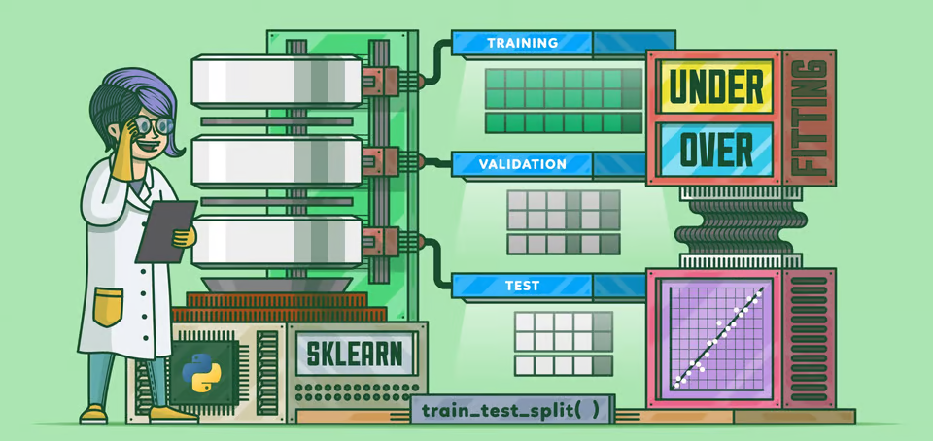
Training validation test

Slide 5
Load the data set
Kaggle hosts a data set which contains the price at which houses were sold for King County, which includes Seattle between May 2014 and May 2015. You can download the data set from Kaggle or load it from my GitHub. The code below loads the data set.
url = 'https://raw.githubusercontent.com/mGalarnyk/Tutorial_Data/master/King_County/kingCountyHouseData.csv'
df = pd.read_csv(url)
# Selecting columns I am interested in
columns = ['bedrooms','bathrooms','sqft_living','sqft_lot','floors','price']
df = df.loc[:, columns]
df.head(10)

Slide 6
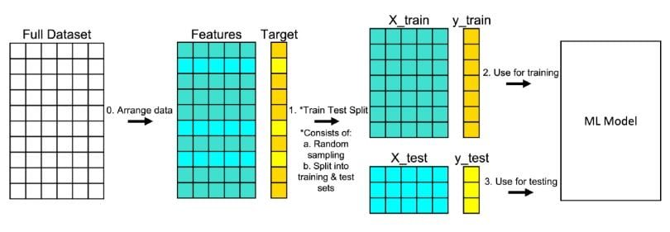
procedure
What Is the Train Test Split Procedure?
Train test split is a model validation procedure that allows you to simulate how a model would perform on new/unseen data. Here is how the procedure works:
train-test-split graphic model

Slide 7
abstract
Machine learning supports prediction and inference in multivariate and complex datasets where observations are spatially related to one another. Frequently, these datasets depict spatial autocorrelation that violates the assumption of identically and independently distributed data. Overlooking this correlation result in over-optimistic models that fail to account for the geographical configuration of data. Furthermore, although different data split methods account for spatial autocorrelation, these methods are inflexible, and the parameter training and hyperparameter tuning of the machine learning model is set with a different prediction difficulty than the planned real-world use of the model. In other words, it is an unfair training-testing process. We present a novel method that considers spatial autocorrelation and planned real-world use of the spatial prediction model to design a fair train-test split.

Slide 8
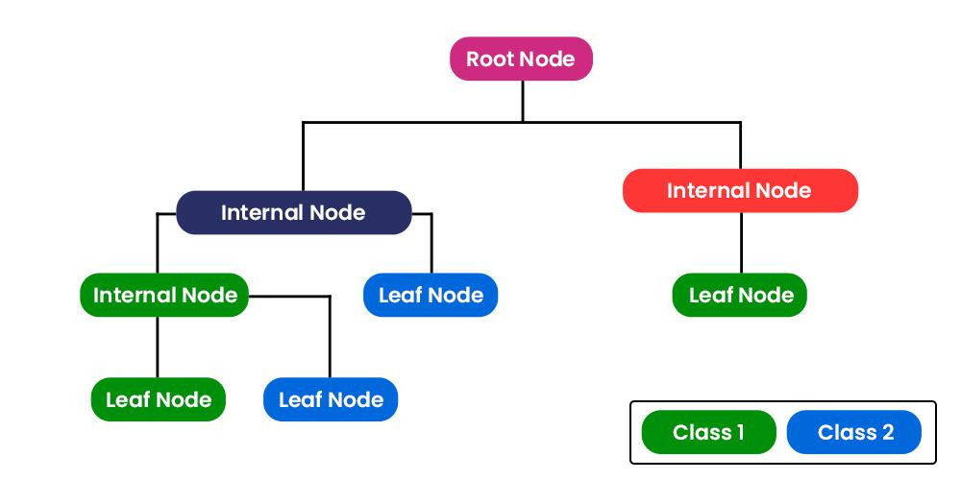
nodes

Slide 9
Dataset split ratio
About the dataset split ratio
Now that you know what these datasets do, you might be looking for recommendations on how to split your dataset into Train, Validation and Test sets.
This mainly depends on 2 things. First, the total number of samples in your data and second, on the actual model you are training.
Some models need substantial data to train upon, so in this case you would optimize for the larger training sets. Models with very few hyperparameters will be easy to validate and tune, so you can probably reduce the size of your validation set, but if your model has many hyperparameters, you would want to have a large validation set as well(although you should also consider cross validation). Also, if you happen to have a model with no hyperparameters or ones that cannot be easily tuned, you probably don’t need a validation set too!

Slide 10
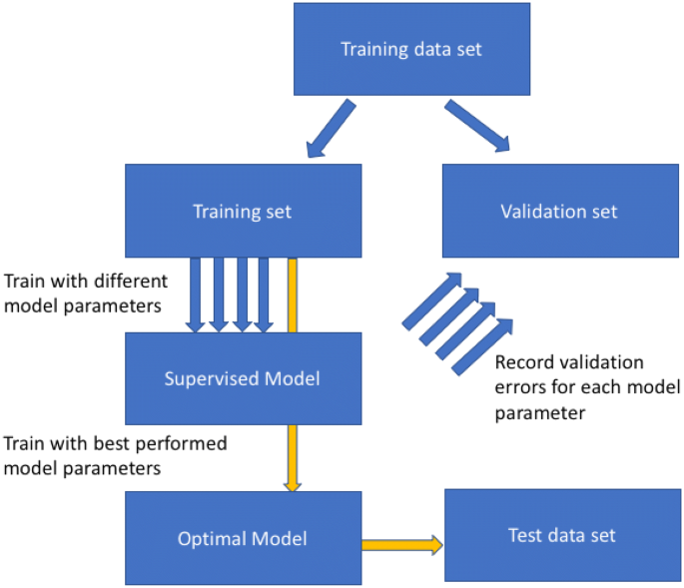

Slide 11
Data set
The Test dataset provides the gold standard used to evaluate the model. It is only used once a model is completely trained(using the train and validation sets). The test set is generally what is used to evaluate competing models (For example on many Kaggle competitions, the validation set is released initially along with the training set and the actual test set is only released when the competition is about to close, and it is the result of the the model on the Test set that decides the winner). Many a times the validation set is used as the test set, but it is not good practice. The test set is generally well curated. It contains carefully sampled data that spans the various classes that the model would face, when used in the real world.

Slide 12
program
# import modules
import pandas as pd
from sklearn.linear_model import LinearRegression
from sklearn.model_selection import train_test_split
# read the dataset
df = pd.read_csv('Real estate.csv')
# get the locations
X = df.iloc[:, :-1]
y = df.iloc[:, -1]
# split the dataset
X_train, X_test, y_train, y_test = train_test_split(
X, y, test_size=0.05, random_state=0)

Slide 13
Example:
In this example, we’re gonna use the K-nearest neighbors classifier model.
In this example the following steps are executed :
The necessary packages are imported.
iris data is loaded from sklearn.datasets.
feature and target arrays are created(X andy).
The arrays created are split into train and test sets. 30% of the dataset goes into the test set, which means 70% data is a train set.
A basic Knn model is created using the KNeighborsClassifier class.
Train sets fit in the knn model.
the predict() method is used to carry out predictions on the X_test set.

Slide 14
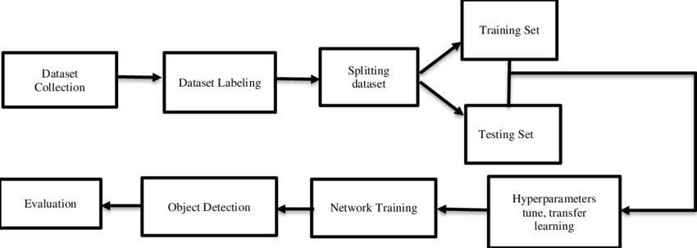
Flow chart

Slide 15
Test set
The test set is the set of data used to evaluate the final performance of a trained model.
It serves as an unbiased measure of how well the model generalizes to unseen data, assessing its generalization capabilities in real-world scenarios. By keeping the test set separate throughout the development process, we obtain a reliable benchmark of the model’s performance.
The test dataset also helps gauge the trained model's ability to handle new data. Since it represents unseen data that the model has never encountered before, evaluating the model fit on the test set provides an unbiased metric into its practical applicability.

Slide 16
Training set
The training set is the portion of the dataset reserved to fit the model. In other words, the model sees and learns from the data in the training set to directly improve its parameters.
To maximize model performance, the in the future.
training set must be (i) large enough to yield meaningful results (but not too large that the model overfits) and (ii) representative of the dataset as a whole. This will allow the trained model to predict any unseen data that may appear

Slide 17
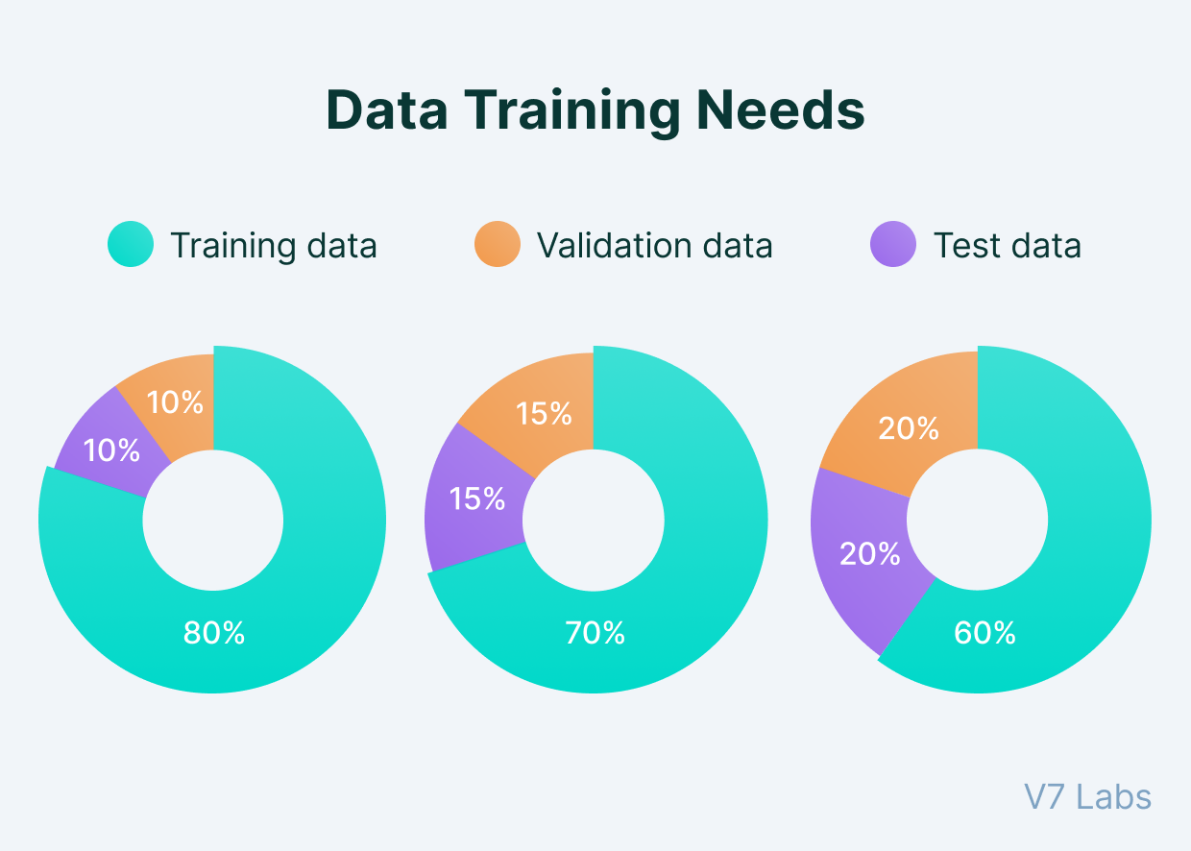

Slide 18
Thank you

