Slide 1
Secure File Encryptor
Presented by:
M Kashif Sultan (FA23-BCS-381)
Haris Zafar (FA23-BCS-385)
M Umer Farooq (FA23-BCS-402)
Abdul Rehman (FA23-BCS-374)

Slide 2
Abstract
Python-based desktop tool using AES-256 (preferred) and DES for file encryption.
Features: GUI with CustomTkinter, PBKDF2 with SHA-256, metadata preservation for audio, multithreading, and custom file headers.

Slide 3
Motivation
Need for strong encryption in an increasingly digital world.
- Lack of user-friendly encryption tools
- Metadata loss in multimedia files
- Support legacy systems (DES)

Slide 4
Problem Statement
Users lack access to simple yet secure file encryption.
- Current tools are complex or insecure
- Metadata not preserved
- Security vs Usability trade-off

Slide 5
Objectives
✔ Secure encryption (AES-256/DES)
✔ PBKDF2 with SHA-256 for passwords
✔ GUI with progress indicators
✔ Metadata support for audio
✔ Compatibility and error handling

Slide 6
Contributions
- Developed secure file encryptor with GUI
- Metadata preservation in WAV/MP3
- AES-256 + PBKDF2 used
- Multithreaded for performance

Slide 7
Scope and Limitations
✔ File encryption with AES-256/DES
✔ Audio metadata support (WAV)
✘ No RSA/cloud sync/mobile app
✘ DES for legacy use only

Slide 8
System Requirements
Hardware: 1GHz CPU, 2GB+ RAM, 100MB storage
OS: Windows/Linux
Python 3.8+, PyCryptodome, CustomTkinter

Slide 9
System Design
✔ Confidentiality: AES-256 + PBKDF2
✔ Integrity: Checksum/validation
✔ Availability: Offline desktop app

Slide 10
Methodology
- GUI input (file + password)
- Key derivation (PBKDF2)
- Encryption (AES-256/DES with IV)
- Metadata header
- Decryption & restoration

Slide 11
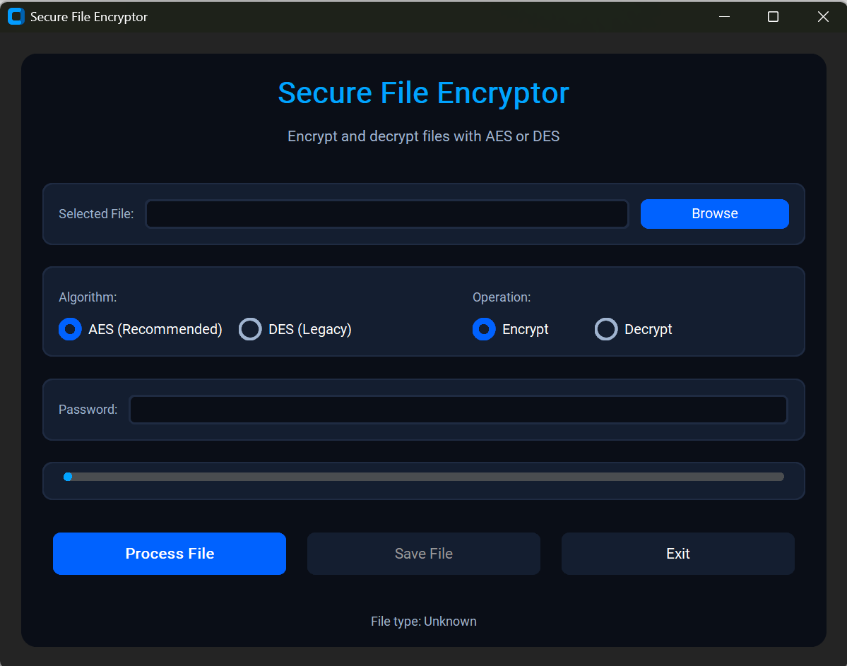
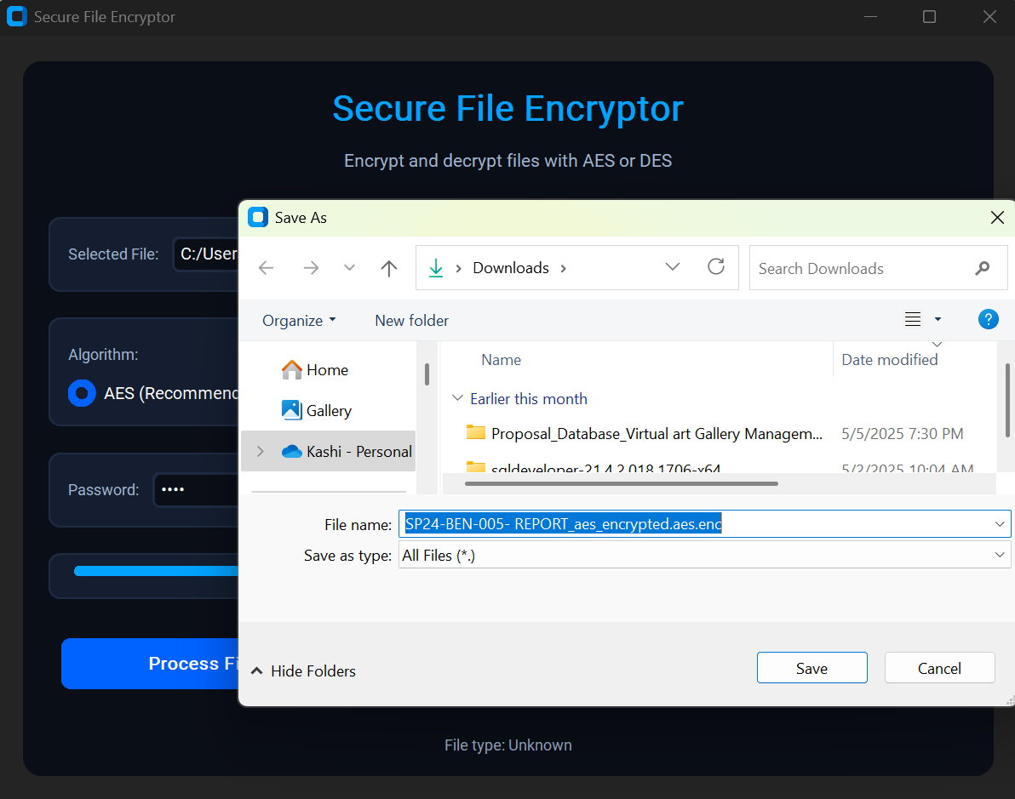
Screenshots

Slide 12
Testing and Evaluation
✔ AES-256: 0.5–2 sec (10MB)
✔ 100% success with valid passwords
✔ 90% usability by non-tech users
✔ No memory leakage

Slide 13
Results and Discussions
✔ AES slower but stronger than DES
✔ WAV metadata fully preserved
✔ Better usability vs generic tools

Slide 14
Conclusion
- AES-256/DES support with GUI
- Metadata retention
- Secure and user-friendly
- Outperforms generic tools

Slide 15
Future Work
- Add SHA-3 support
- Improve performance with multithreading
- Extend support for MP3/FLAC metadata
- Package as standalone app

Slide 16
References
[1] Hellman (1977) - DES
[2] Rijndael (1999) - AES
[3] Kaliski (2000) - PBKDF2
[4] Garcia (2017) - Audio Metadata
[5] Johnson (2021) - Usability
[6] Chen (2022) - Cloud Encryption

