Slide 1
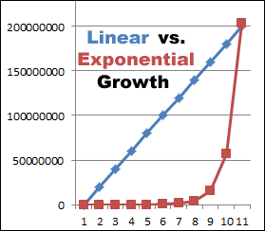
Linear vs. Exponential Growth
With linear growth each point on the X-axis represents the same increase each time. For example, each time you move right on the X-axis, the Y-axis value increases by 10 each time.
With exponential growth each point on the X-axis represents a different amount each time. For example, it might increase by 2, then 4, then 8, then 16, then 32, etc.
Generally, linear growth is faster at the beginning, but eventually exponential growth will far outpace it.
Image Source: https://www.truck-drivers-money-saving-tips.com/image-files/linear-vs-exponential-growth-narrow.gif

