Slide 1
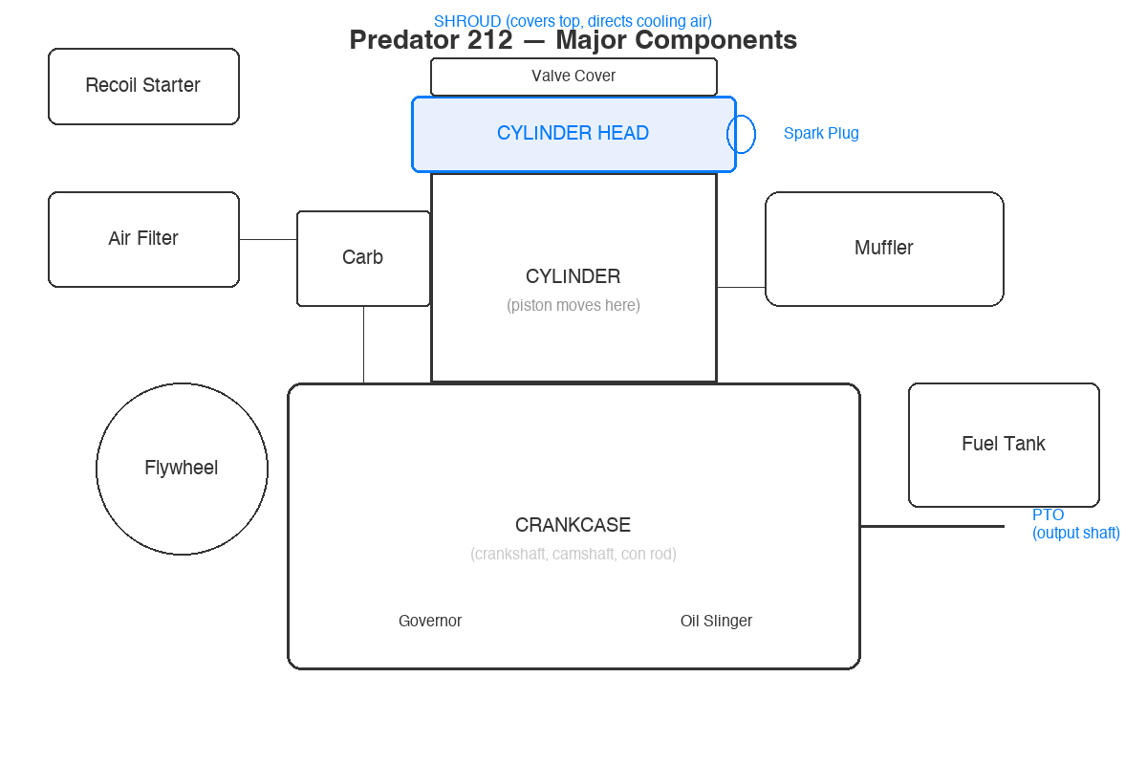
Anatomy of the Small Engine
Quiz Review — Study Guide
CVHS Engines & Fabrication | Predator 212
Notes:
Welcome to the quiz review and study guide. We'll go through every question, explain the correct answer, and give you a 'Think About It' framework so you understand the reasoning — not just the answer. Use this to study for retakes or deepen your understanding.

Slide 2
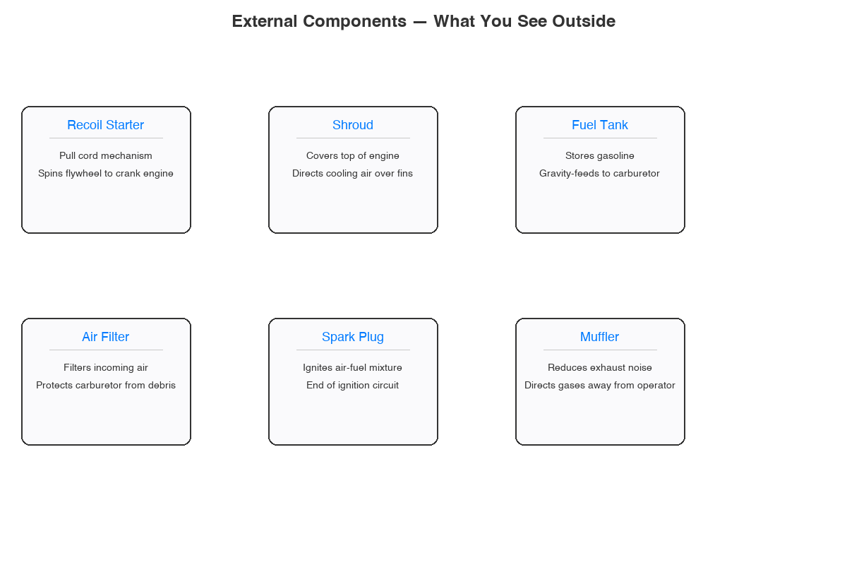
External Components
The parts you see on the outside of the engine

Slide 3
Question 1
What is the primary function of the recoil starter on a small engine?
A. Regulates engine speed
B. Cools the cylinder
C. Cranks the engine to start it
D. Lubricates the crankshaft
Notes:
Question Q1: What is the primary function of the recoil starter on a small engine?
Let students think before advancing.

Slide 4
Question 1 — Answer
What is the primary function of the recoil starter on a small engine?
A. Regulates engine speed
B. Cools the cylinder
C. Cranks the engine to start it
D. Lubricates the crankshaft
Think About It: What happens when you pull the starter cord? You're physically spinning the flywheel and crankshaft to get the first combustion cycle going.
Notes:
ANSWER: Cranks the engine to start it
The recoil starter is the pull-cord mechanism mounted on top of the engine. When you pull it, the rope spins the flywheel, which turns the crankshaft, which moves the piston through its first cycles until the engine fires. Students should remember the physical sensation of pulling it during teardown — that resistance they felt was compression.
THINK ABOUT IT: What happens when you pull the starter cord? You're physically spinning the flywheel and crankshaft to get the first combustion cycle going.

Slide 5
Question 2
What component covers the top of the engine and directs airflow for cooling?
A. Valve cover
B. Crankcase
C. Shroud
D. Muffler
Notes:
Question Q2: What component covers the top of the engine and directs airflow for cooling?
Let students think before advancing.

Slide 6
Question 2 — Answer
What component covers the top of the engine and directs airflow for cooling?
A. Valve cover
B. Crankcase
C. Shroud
D. Muffler
Think About It: Picture the engine from above. What's the big plastic/metal cover that sits over everything and has vents? It channels air from the flywheel fan across the cooling fins.
Notes:
ANSWER: Shroud
The shroud is the large cover on top of the engine that works with the flywheel fan to direct air across the cylinder fins. Without it, the engine would overheat. During teardown, this was the first thing students removed. It's air-cooled — no radiator — so the shroud is critical.
THINK ABOUT IT: Picture the engine from above. What's the big plastic/metal cover that sits over everything and has vents? It channels air from the flywheel fan across the cooling fins.

Slide 7
Question 3
What does the fuel tank store?
A. Hydraulic fluid
B. Engine oil
C. Gasoline
D. Coolant
Notes:
Question Q3: What does the fuel tank store?
Let students think before advancing.

Slide 8
Question 3 — Answer
What does the fuel tank store?
A. Hydraulic fluid
B. Engine oil
C. Gasoline
D. Coolant
Think About It: The Predator 212 is a gasoline engine with a spark plug. Oil goes in the crankcase. This engine is air-cooled (no coolant). Hydraulic fluid is for hydraulic systems, not engines.
Notes:
ANSWER: Gasoline
Straightforward question that reinforces fundamentals. The Predator 212 is a spark-ignition gasoline engine. Engine oil goes in the crankcase through the oil fill cap — it's a completely separate system. This engine is air-cooled so there's no coolant. Hydraulic fluid is used in hydraulic systems like log splitters, not in the engine itself.
THINK ABOUT IT: The Predator 212 is a gasoline engine with a spark plug. Oil goes in the crankcase. This engine is air-cooled (no coolant). Hydraulic fluid is for hydraulic systems, not engines.

Slide 9
Question 4
What is the purpose of the air filter on a small engine?
A. Cools the incoming air
B. Prevents dirt and debris from entering the carburetor
C. Filters the exhaust gases
D. Cleans the engine oil
Notes:
Question Q4: What is the purpose of the air filter on a small engine?
Let students think before advancing.

Slide 10
Question 4 — Answer
What is the purpose of the air filter on a small engine?
A. Cools the incoming air
B. Prevents dirt and debris from entering the carburetor
C. Filters the exhaust gases
D. Cleans the engine oil
Think About It: Follow the air path: outside air → air filter → carburetor → intake valve → combustion chamber. The filter is the first line of defense on the intake side.
Notes:
ANSWER: Prevents dirt and debris from entering the carburetor
The air filter sits on the intake side before the carburetor. If dirt gets past it, it goes straight into the carburetor jets and then into the cylinder — causing wear and damage. During teardown, students saw how dirty these can get. A clogged air filter restricts airflow and makes the engine run rich.
THINK ABOUT IT: Follow the air path: outside air → air filter → carburetor → intake valve → combustion chamber. The filter is the first line of defense on the intake side.

Slide 11
Question 5
The spark plug is responsible for:
A. Compressing the piston rings
B. Pumping fuel into the cylinder
C. Igniting the air-fuel mixture in the combustion chamber
D. Opening the exhaust valve
Notes:
Question Q5: The spark plug is responsible for:
Let students think before advancing.

Slide 12
Question 5 — Answer
The spark plug is responsible for:
A. Compressing the piston rings
B. Pumping fuel into the cylinder
C. Igniting the air-fuel mixture in the combustion chamber
D. Opening the exhaust valve
Think About It: Follow the ignition circuit: magneto on flywheel → ignition coil → spark plug wire → spark plug → spark across the gap → ignites the mixture.
Notes:
ANSWER: Igniting the air-fuel mixture in the combustion chamber
The spark plug is the endpoint of the ignition system. The flywheel magnets spin past the ignition coil, generating a high-voltage pulse that travels down the spark plug wire and jumps the gap at the plug tip. This spark ignites the compressed air-fuel mixture during the power stroke. Students should remember the gap measurement from teardown.
THINK ABOUT IT: Follow the ignition circuit: magneto on flywheel → ignition coil → spark plug wire → spark plug → spark across the gap → ignites the mixture.

Slide 13
Question 6
What does the muffler do?
A. Stores excess fuel
B. Reduces exhaust noise and directs exhaust gases away from the operator
C. Increases engine horsepower
D. Filters incoming air
Notes:
Question Q6: What does the muffler do?
Let students think before advancing.

Slide 14
Question 6 — Answer
What does the muffler do?
A. Stores excess fuel
B. Reduces exhaust noise and directs exhaust gases away from the operator
C. Increases engine horsepower
D. Filters incoming air
Think About It: Think about what comes OUT of the engine after combustion. Burnt gases exit through the exhaust port → muffler. It quiets the noise and points gases away safely.
Notes:
ANSWER: Reduces exhaust noise and directs exhaust gases away from the operator
The muffler bolts to the exhaust port on the cylinder. After the power stroke, burnt gases are pushed out through the exhaust valve and into the muffler. The baffles inside reduce noise. It also directs hot gases away from the operator. Fun fact: removing or modifying the muffler is part of the Stage 1 upgrade on our drift trike build.
THINK ABOUT IT: Think about what comes OUT of the engine after combustion. Burnt gases exit through the exhaust port → muffler. It quiets the noise and points gases away safely.

Slide 15
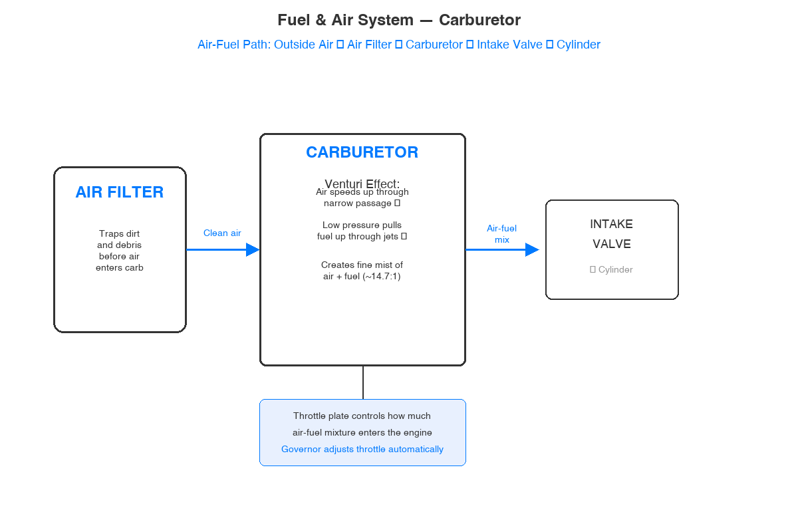
Fuel & Air System
Getting the right mix into the combustion chamber

Slide 16
Question 7
The carburetor's job is to:
A. Compress the air-fuel mixture
B. Mix air and fuel in the correct ratio for combustion
C. Ignite the fuel
D. Lubricate the piston
Notes:
Question Q7: The carburetor's job is to:
Let students think before advancing.

Slide 17
Question 7 — Answer
The carburetor's job is to:
A. Compress the air-fuel mixture
B. Mix air and fuel in the correct ratio for combustion
C. Ignite the fuel
D. Lubricate the piston
Think About It: The carburetor sits between the air filter and the intake valve. Its job is mixing — air and fuel in the right proportion (~14.7:1 by weight for gasoline).
Notes:
ANSWER: Mix air and fuel in the correct ratio for combustion
The carburetor uses the venturi effect — as air flows through a narrowing passage, it speeds up and creates low pressure, which draws fuel up through jets. The result is a fine mist of air and fuel in approximately a 14.7:1 ratio. Students adjusted the carburetor during Stage 1 mods. Too rich = black smoke, too lean = overheating.
THINK ABOUT IT: The carburetor sits between the air filter and the intake valve. Its job is mixing — air and fuel in the right proportion (~14.7:1 by weight for gasoline).

Slide 18
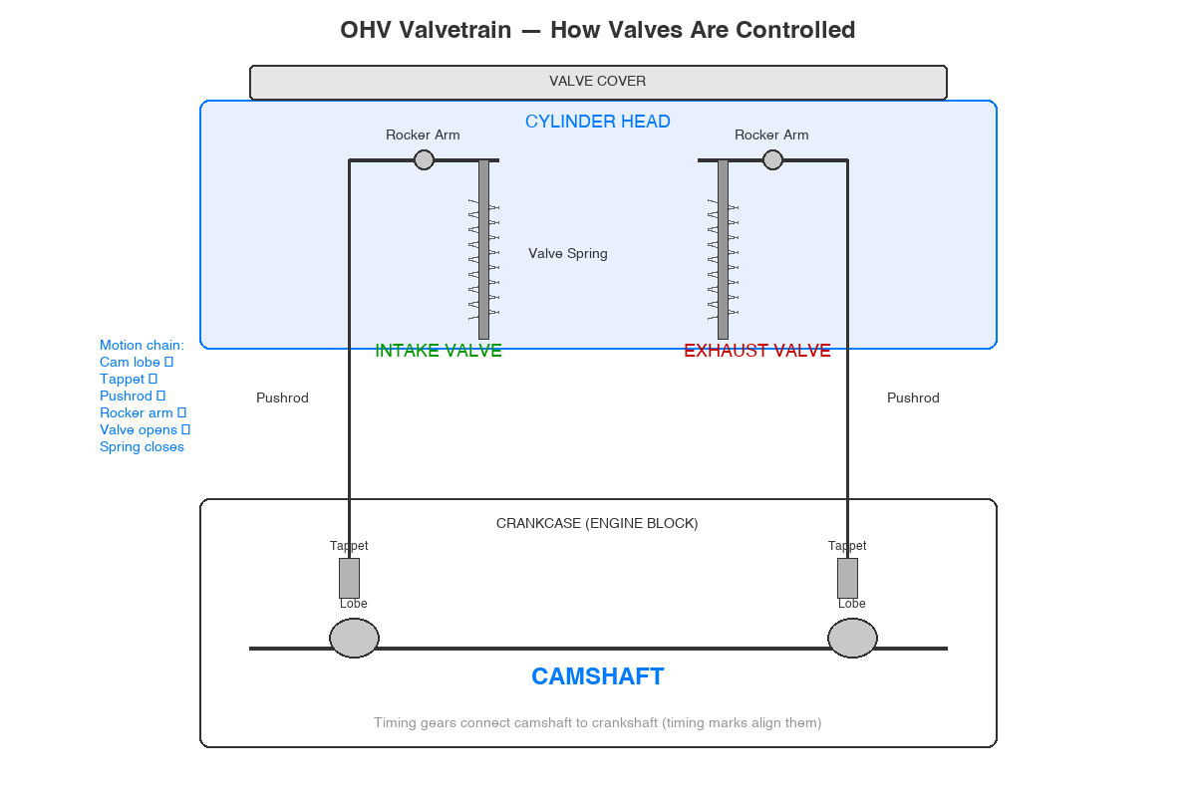
Valvetrain
Controlling what goes in and what comes out

Slide 19
Question 8
What is located under the valve cover?
A. Rocker arms and valve springs
B. Oil slinger and governor
C. Piston and connecting rod
D. Crankshaft and camshaft
Notes:
Question Q8: What is located under the valve cover?
Let students think before advancing.

Slide 20
Question 8 — Answer
What is located under the valve cover?
A. Rocker arms and valve springs
B. Oil slinger and governor
C. Piston and connecting rod
D. Crankshaft and camshaft
Think About It: Remember pulling the valve cover off during teardown? Right underneath were the rocker arms sitting on top of the valve stems, with springs wrapped around them.
Notes:
ANSWER: Rocker arms and valve springs
When students removed the valve cover during teardown, they saw the rocker arms, valve springs, and the tops of the valve stems. The rocker arms pivot to push the valves open, and the springs pull them closed. This is a key visual memory from the hands-on work.
THINK ABOUT IT: Remember pulling the valve cover off during teardown? Right underneath were the rocker arms sitting on top of the valve stems, with springs wrapped around them.

Slide 21
Question 9
What do the rocker arms do?
A. Transfer camshaft motion to open and close the valves
B. Regulate engine speed
C. Connect the piston to the crankshaft
D. Seal the combustion chamber
Notes:
Question Q9: What do the rocker arms do?
Let students think before advancing.

Slide 22
Question 9 — Answer
What do the rocker arms do?
A. Transfer camshaft motion to open and close the valves
B. Regulate engine speed
C. Connect the piston to the crankshaft
D. Seal the combustion chamber
Think About It: Rocker arms are the mechanical link between the camshaft (below) and the valves (above). Cam lobe pushes up → pushrod → rocker arm pivots → valve opens.
Notes:
ANSWER: Transfer camshaft motion to open and close the valves
The rocker arms are lever mechanisms that transfer the camshaft's rotational motion into the linear push needed to open the valves. In the Predator 212 OHV design: cam lobe rotates → pushes tappet up → push rod goes up → rocker arm pivots → valve opens. When the cam lobe rotates away, the valve spring closes the valve.
THINK ABOUT IT: Rocker arms are the mechanical link between the camshaft (below) and the valves (above). Cam lobe pushes up → pushrod → rocker arm pivots → valve opens.

Slide 23
Question 10
The cylinder head is sealed to the cylinder by a:
A. Crankcase cover
B. Piston ring
C. Valve spring
D. Head gasket
Notes:
Question Q10: The cylinder head is sealed to the cylinder by a:
Let students think before advancing.

Slide 24
Question 10 — Answer
The cylinder head is sealed to the cylinder by a:
A. Crankcase cover
B. Piston ring
C. Valve spring
D. Head gasket
Think About It: What sits BETWEEN the cylinder head and the cylinder block? A gasket — it seals the combustion chamber so no compression leaks out.
Notes:
ANSWER: Head gasket
The head gasket creates a seal between the cylinder head and the cylinder block. Without it, compression would leak out and the engine wouldn't run properly. During teardown, students saw this gasket when they removed the head. A blown head gasket is a common engine failure mode.
THINK ABOUT IT: What sits BETWEEN the cylinder head and the cylinder block? A gasket — it seals the combustion chamber so no compression leaks out.

Slide 25
Question 11
How many valves does the Predator 212 have?
A. 4 (two intake, two exhaust)
B. 1 (intake only)
C. 2 (one intake, one exhaust)
D. 3 (two intake, one exhaust)
Notes:
Question Q11: How many valves does the Predator 212 have?
Let students think before advancing.

Slide 26
Question 11 — Answer
How many valves does the Predator 212 have?
A. 4 (two intake, two exhaust)
B. 1 (intake only)
C. 2 (one intake, one exhaust)
D. 3 (two intake, one exhaust)
Think About It: Single-cylinder OHV engine = one intake valve (lets fresh air-fuel in) and one exhaust valve (lets burnt gases out). Two valves total.
Notes:
ANSWER: 2 (one intake, one exhaust)
The Predator 212 is a single-cylinder OHV engine with two valves: one intake and one exhaust. The intake valve opens during the intake stroke to let the air-fuel mixture in, and the exhaust valve opens during the exhaust stroke to let burnt gases out. Students saw both when they removed the head.
THINK ABOUT IT: Single-cylinder OHV engine = one intake valve (lets fresh air-fuel in) and one exhaust valve (lets burnt gases out). Two valves total.

Slide 27
Question 12
Carbon deposits inside the combustion chamber are caused by:
A. Water in the fuel tank
B. Incomplete combustion of fuel and oil over time
C. A loose spark plug
D. Too much airflow through the carburetor
Notes:
Question Q12: Carbon deposits inside the combustion chamber are caused by:
Let students think before advancing.

Slide 28
Question 12 — Answer
Carbon deposits inside the combustion chamber are caused by:
A. Water in the fuel tank
B. Incomplete combustion of fuel and oil over time
C. A loose spark plug
D. Too much airflow through the carburetor
Think About It: Carbon is the residue from fuel and oil that didn't completely burn. Over time it builds up on the piston crown, valves, and chamber walls.
Notes:
ANSWER: Incomplete combustion of fuel and oil over time
Carbon deposits are the black crusty buildup students saw inside the combustion chamber during teardown. They come from fuel and oil that didn't fully combust. Running rich, oil burning past worn rings, and extended use all contribute. Cleaning carbon deposits is part of regular maintenance.
THINK ABOUT IT: Carbon is the residue from fuel and oil that didn't completely burn. Over time it builds up on the piston crown, valves, and chamber walls.

Slide 29
Question 19
What does the camshaft do?
A. Spins the flywheel
B. Pumps oil through the engine
C. Controls the opening and closing timing of the intake and exhaust valves
D. Ignites the air-fuel mixture
Notes:
Question Q19: What does the camshaft do?
Let students think before advancing.

Slide 30
Question 19 — Answer
What does the camshaft do?
A. Spins the flywheel
B. Pumps oil through the engine
C. Controls the opening and closing timing of the intake and exhaust valves
D. Ignites the air-fuel mixture
Think About It: The camshaft has lobes (bumps) that push against the valve train at precise times. Each lobe controls when a valve opens and for how long.
Notes:
ANSWER: Controls the opening and closing timing of the intake and exhaust valves
The camshaft has egg-shaped lobes that push against tappets at precisely timed intervals. As the camshaft rotates, each lobe opens a valve through the pushrod/rocker arm chain. The cam profile determines lift and duration. Cam upgrades are a common mod, though we're skipping that on our drift trike.
THINK ABOUT IT: The camshaft has lobes (bumps) that push against the valve train at precise times. Each lobe controls when a valve opens and for how long.

Slide 31
Question 20
Timing marks on the crankshaft and camshaft gears ensure that:
A. The engine runs at the correct RPM
B. The valves open and close at the correct time relative to piston position
C. The spark plug fires at maximum compression
D. The oil pump delivers the right pressure
Notes:
Question Q20: Timing marks on the crankshaft and camshaft gears ensure that:
Let students think before advancing.

Slide 32
Question 20 — Answer
Timing marks on the crankshaft and camshaft gears ensure that:
A. The engine runs at the correct RPM
B. The valves open and close at the correct time relative to piston position
C. The spark plug fires at maximum compression
D. The oil pump delivers the right pressure
Think About It: The crankshaft and camshaft must be synchronized. If timing is off, a valve could be open when the piston comes up — catastrophic. The timing marks align them correctly.
Notes:
ANSWER: The valves open and close at the correct time relative to piston position
Timing marks are reference dots on the crankshaft gear and camshaft gear. When assembled, these marks must align so valve events happen at exactly the right piston positions. If timing is off, the piston could hit an open valve. Students should remember aligning these marks during reassembly.
THINK ABOUT IT: The crankshaft and camshaft must be synchronized. If timing is off, a valve could be open when the piston comes up — catastrophic. The timing marks align them correctly.

Slide 33
Question 28
Valve springs are responsible for:
A. Opening the valves during the intake stroke
B. Sealing the cylinder head to the block
C. Closing the valves after the camshaft lobe pushes them open
D. Connecting the rocker arms to the push rods
Notes:
Question Q28: Valve springs are responsible for:
Let students think before advancing.

Slide 34
Question 28 — Answer
Valve springs are responsible for:
A. Opening the valves during the intake stroke
B. Sealing the cylinder head to the block
C. Closing the valves after the camshaft lobe pushes them open
D. Connecting the rocker arms to the push rods
Think About It: The camshaft OPENS the valve (pushes it). But what CLOSES it? The spring! It pulls the valve back to its seat when the cam lobe rotates away.
Notes:
ANSWER: Closing the valves after the camshaft lobe pushes them open
Valve springs provide the return force that closes valves. The camshaft opens them; the spring closes them. Spring tension is critical — too weak and the valve "floats" at high RPM. We're skipping stiffer valve springs on the drift trike since we won't hit high RPM.
THINK ABOUT IT: The camshaft OPENS the valve (pushes it). But what CLOSES it? The spring! It pulls the valve back to its seat when the cam lobe rotates away.

Slide 35
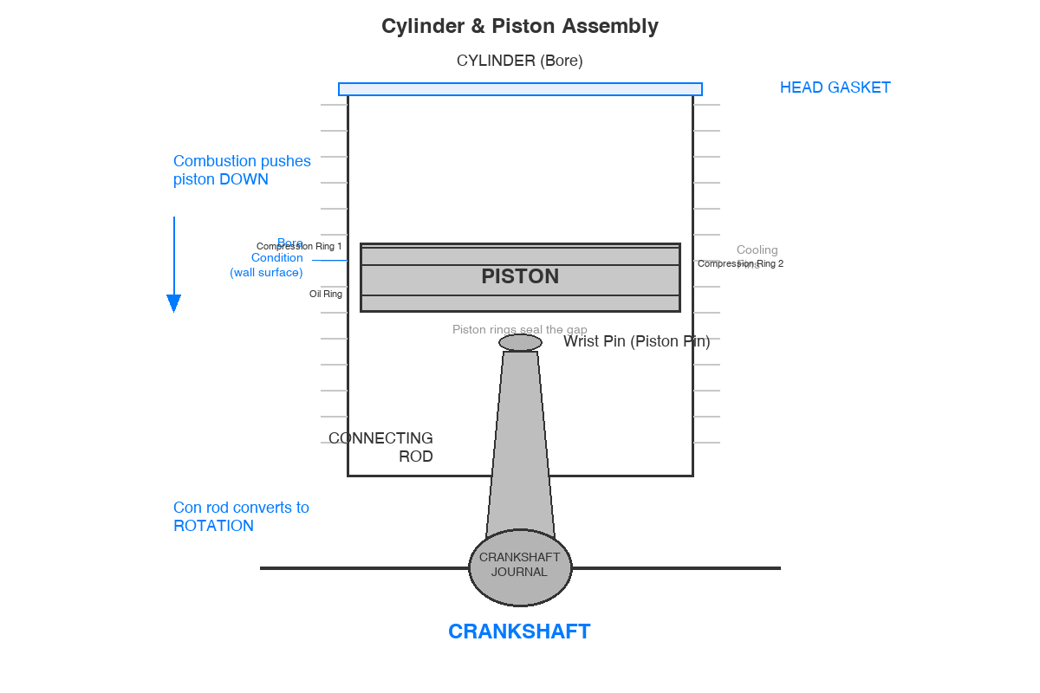
Cylinder & Piston Assembly
Where the magic happens — converting combustion to motion

Slide 36
Question 13
The cylinder (jug) is the part of the engine where:
A. The camshaft is housed
B. The recoil starter attaches
C. The piston moves up and down during operation
D. Fuel is stored before combustion
Notes:
Question Q13: The cylinder (jug) is the part of the engine where:
Let students think before advancing.

Slide 37
Question 13 — Answer
The cylinder (jug) is the part of the engine where:
A. The camshaft is housed
B. The recoil starter attaches
C. The piston moves up and down during operation
D. Fuel is stored before combustion
Think About It: The cylinder is the round bore — the tube where the piston slides up and down. It's the main working chamber of the engine.
Notes:
ANSWER: The piston moves up and down during operation
The cylinder (mechanics call it the "jug") is the precision-bored tube where the piston reciprocates. The cylinder wall must be smooth and round for the piston rings to seal properly. Students saw the bore condition when they pulled the piston out during teardown.
THINK ABOUT IT: The cylinder is the round bore — the tube where the piston slides up and down. It's the main working chamber of the engine.

Slide 38
Question 14
What is the purpose of piston rings?
A. Open and close the valves
B. Connect the piston to the crankshaft
C. Hold the wrist pin in place
D. Seal the gap between the piston and cylinder wall
Notes:
Question Q14: What is the purpose of piston rings?
Let students think before advancing.

Slide 39
Question 14 — Answer
What is the purpose of piston rings?
A. Open and close the valves
B. Connect the piston to the crankshaft
C. Hold the wrist pin in place
D. Seal the gap between the piston and cylinder wall
Think About It: The piston is slightly smaller than the cylinder bore. The rings expand outward to seal that gap — keeping compression above and oil below.
Notes:
ANSWER: Seal the gap between the piston and cylinder wall
Piston rings ride in grooves on the piston and press outward against the cylinder wall. Compression rings seal combustion pressure above the piston, and the oil ring scrapes excess oil off the wall. Without good ring seal, you lose compression and burn oil. Students saw the ring grooves during teardown.
THINK ABOUT IT: The piston is slightly smaller than the cylinder bore. The rings expand outward to seal that gap — keeping compression above and oil below.

Slide 40
Question 15
The wrist pin (piston pin) connects the:
A. Connecting rod to the crankshaft
B. Piston to the connecting rod
C. Camshaft to the crankshaft
D. Valve to the rocker arm
Notes:
Question Q15: The wrist pin (piston pin) connects the:
Let students think before advancing.

Slide 41
Question 15 — Answer
The wrist pin (piston pin) connects the:
A. Connecting rod to the crankshaft
B. Piston to the connecting rod
C. Camshaft to the crankshaft
D. Valve to the rocker arm
Think About It: Think about the mechanical chain: piston → [wrist pin] → connecting rod → crankshaft. The wrist pin is the pivot point between piston and rod.
Notes:
ANSWER: Piston to the connecting rod
The wrist pin passes through the piston and the small end of the connecting rod, creating a pivot joint. This allows the connecting rod to swing as the piston moves straight up and down while the crankshaft rotates. Students pushed this pin out during teardown.
THINK ABOUT IT: Think about the mechanical chain: piston → [wrist pin] → connecting rod → crankshaft. The wrist pin is the pivot point between piston and rod.

Slide 42
Question 16
What does "bore condition" refer to when inspecting a cylinder?
A. The depth of the combustion chamber
B. The condition of the inner cylinder wall surface
C. The size of the exhaust port
D. The number of piston rings installed
Notes:
Question Q16: What does "bore condition" refer to when inspecting a cylinder?
Let students think before advancing.

Slide 43
Question 16 — Answer
What does "bore condition" refer to when inspecting a cylinder?
A. The depth of the combustion chamber
B. The condition of the inner cylinder wall surface
C. The size of the exhaust port
D. The number of piston rings installed
Think About It: "Bore" = the inside of the cylinder. "Condition" = is the surface smooth, scratched, scored, or worn? You're checking the cylinder wall quality.
Notes:
ANSWER: The condition of the inner cylinder wall surface
Bore condition describes the state of the cylinder wall surface. A healthy bore has fine crosshatch marks from honing that help retain oil. A damaged bore shows scoring, scratches, or glazing. During teardown, students looked inside the cylinder for these conditions. Bad bore = poor ring seal = lost compression.
THINK ABOUT IT: "Bore" = the inside of the cylinder. "Condition" = is the surface smooth, scratched, scored, or worn? You're checking the cylinder wall quality.

Slide 44
Question 17
The crankshaft converts:
A. Air pressure into vacuum
B. Rotational motion into up-and-down motion
C. Fuel into electricity
D. The up-and-down motion of the piston into rotational motion
Notes:
Question Q17: The crankshaft converts:
Let students think before advancing.

Slide 45
Question 17 — Answer
The crankshaft converts:
A. Air pressure into vacuum
B. Rotational motion into up-and-down motion
C. Fuel into electricity
D. The up-and-down motion of the piston into rotational motion
Think About It: Picture the piston going up and down. What shape converts linear motion to rotation? A crank — just like a bicycle pedal converts your up-down leg motion into wheel rotation.
Notes:
ANSWER: The up-and-down motion of the piston into rotational motion
The crankshaft converts the piston's reciprocating motion into rotational motion that can drive equipment. Think of a bicycle pedal: your legs go up and down, but the crank converts that into wheel rotation. The connecting rod links the piston to the crankshaft's offset journal.
THINK ABOUT IT: Picture the piston going up and down. What shape converts linear motion to rotation? A crank — just like a bicycle pedal converts your up-down leg motion into wheel rotation.

Slide 46
Question 18
The connecting rod links the:
A. Crankshaft to the camshaft
B. Flywheel to the starter
C. Valve to the rocker arm
D. Piston to the crankshaft
Notes:
Question Q18: The connecting rod links the:
Let students think before advancing.

Slide 47
Question 18 — Answer
The connecting rod links the:
A. Crankshaft to the camshaft
B. Flywheel to the starter
C. Valve to the rocker arm
D. Piston to the crankshaft
Think About It: Follow the power chain: combustion pushes piston down → connecting rod transfers that force → crankshaft rotates. The rod links piston to crank.
Notes:
ANSWER: Piston to the crankshaft
The connecting rod is the mechanical link between the piston and the crankshaft. The small end connects to the piston via the wrist pin, and the big end wraps around the crankshaft journal. We're installing a billet rod (ARC 6254) on the drift trike for strength.
THINK ABOUT IT: Follow the power chain: combustion pushes piston down → connecting rod transfers that force → crankshaft rotates. The rod links piston to crank.

Slide 48
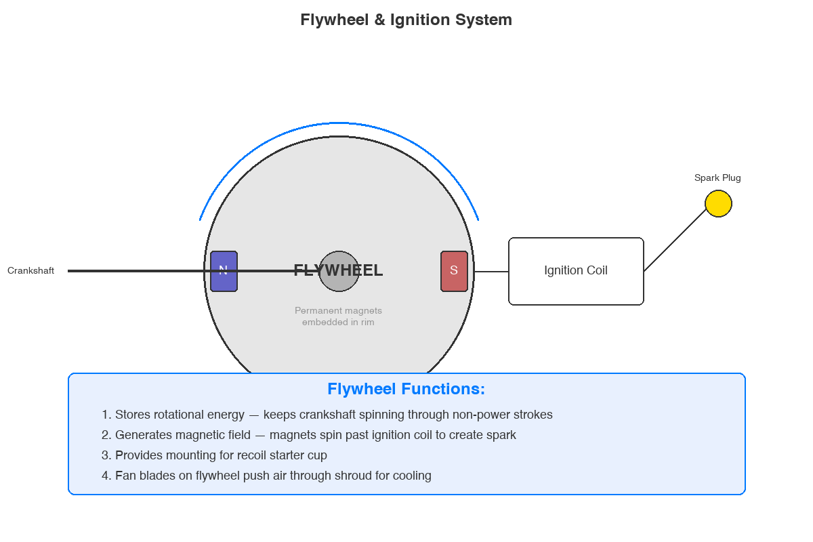
Engine Systems
Lubrication, speed control, energy storage, and power output

Slide 49
Question 21
The crankcase houses which of the following components?
A. Piston, cylinder, and spark plug
B. Carburetor, air filter, and fuel tank
C. Valve cover, rocker arms, and valves
D. Crankshaft, camshaft, and connecting rod
Notes:
Question Q21: The crankcase houses which of the following components?
Let students think before advancing.

Slide 50
Question 21 — Answer
The crankcase houses which of the following components?
A. Piston, cylinder, and spark plug
B. Carburetor, air filter, and fuel tank
C. Valve cover, rocker arms, and valves
D. Crankshaft, camshaft, and connecting rod
Think About It: The crankcase is the lower half of the engine block. What lives INSIDE the bottom? The rotating parts: crankshaft, camshaft, connecting rod.
Notes:
ANSWER: Crankshaft, camshaft, and connecting rod
The crankcase is the lower engine housing containing the crankshaft, camshaft (connected by timing gears), and the lower portion of the connecting rod. It also holds the engine oil in its sump. During teardown, splitting the crankcase revealed all these components.
THINK ABOUT IT: The crankcase is the lower half of the engine block. What lives INSIDE the bottom? The rotating parts: crankshaft, camshaft, connecting rod.

Slide 51
Question 22
What is the function of the governor on a small engine?
A. Controls the ignition timing
B. Engages the recoil starter
C. Pumps oil to the bearings
D. Regulates engine speed under varying loads to prevent over-revving
Notes:
Question Q22: What is the function of the governor on a small engine?
Let students think before advancing.

Slide 52
Question 22 — Answer
What is the function of the governor on a small engine?
A. Controls the ignition timing
B. Engages the recoil starter
C. Pumps oil to the bearings
D. Regulates engine speed under varying loads to prevent over-revving
Think About It: The governor is a speed-limiting system. When the engine speeds up, the governor reduces throttle. When it bogs down, the governor opens the throttle. It maintains steady RPM.
Notes:
ANSWER: Regulates engine speed under varying loads to prevent over-revving
The governor uses centrifugal weights to sense engine speed and automatically adjust the throttle. On our drift trike, we're removing the governor for direct throttle control — but that means the rider must manage RPM manually.
THINK ABOUT IT: The governor is a speed-limiting system. When the engine speeds up, the governor reduces throttle. When it bogs down, the governor opens the throttle. It maintains steady RPM.

Slide 53
Question 23
The oil slinger in the Predator 212 lubricates the engine by:
A. Spinning and splashing oil from the sump onto internal components
B. Pumping oil under high pressure through galleries
C. Mixing oil directly into the fuel
D. Dripping oil from the valve cover onto the piston
Notes:
Question Q23: The oil slinger in the Predator 212 lubricates the engine by:
Let students think before advancing.

Slide 54
Question 23 — Answer
The oil slinger in the Predator 212 lubricates the engine by:
A. Spinning and splashing oil from the sump onto internal components
B. Pumping oil under high pressure through galleries
C. Mixing oil directly into the fuel
D. Dripping oil from the valve cover onto the piston
Think About It: The Predator 212 uses splash lubrication, not a pressurized oil pump. A paddle on the camshaft gear dips into the oil sump and flings oil everywhere.
Notes:
ANSWER: Spinning and splashing oil from the sump onto internal components
The Predator 212 uses splash lubrication — a small paddle (oil slinger) attached to the camshaft gear dips into the oil sump as it rotates and flings oil onto internals. No oil pump or pressurized system. This is why keeping the correct oil level is critical.
THINK ABOUT IT: The Predator 212 uses splash lubrication, not a pressurized oil pump. A paddle on the camshaft gear dips into the oil sump and flings oil everywhere.

Slide 55
Question 24
The flywheel's primary functions include:
A. Cooling the engine and filtering air
B. Storing rotational energy to keep the crankshaft spinning between power strokes and generating a magnetic field for ignition
C. Compressing the fuel mixture
D. Connecting the carburetor to the intake valve
Notes:
Question Q24: The flywheel's primary functions include:
Let students think before advancing.

Slide 56
Question 24 — Answer
The flywheel's primary functions include:
A. Cooling the engine and filtering air
B. Storing rotational energy to keep the crankshaft spinning between power strokes and generating a magnetic field for ignition
C. Compressing the fuel mixture
D. Connecting the carburetor to the intake valve
Think About It: The flywheel is a heavy wheel on the crankshaft. Its mass stores kinetic energy AND it has magnets that spin past the ignition coil to generate spark.
Notes:
ANSWER: Storing rotational energy to keep the crankshaft spinning between power strokes and generating a magnetic field for ignition
The flywheel serves dual purposes: mass stores rotational energy through the non-power strokes, and permanent magnets generate the ignition pulse. We're installing a billet flywheel (ARC 6695) — lighter, stronger, better balance at higher RPM.
THINK ABOUT IT: The flywheel is a heavy wheel on the crankshaft. Its mass stores kinetic energy AND it has magnets that spin past the ignition coil to generate spark.

Slide 57
Question 25
The PTO (Power Take-Off) side of the engine is where:
A. The muffler attaches
B. The air filter is located
C. The recoil starter is mounted
D. The output shaft exits the engine to drive equipment or a drivetrain
Notes:
Question Q25: The PTO (Power Take-Off) side of the engine is where:
Let students think before advancing.

Slide 58
Question 25 — Answer
The PTO (Power Take-Off) side of the engine is where:
A. The muffler attaches
B. The air filter is located
C. The recoil starter is mounted
D. The output shaft exits the engine to drive equipment or a drivetrain
Think About It: PTO = Power Take-Off. It's where power LEAVES the engine. The output shaft sticks out from this side to connect to whatever the engine drives.
Notes:
ANSWER: The output shaft exits the engine to drive equipment or a drivetrain
PTO stands for Power Take-Off — the crankshaft extends out from this side to attach driven equipment. In our case, the centrifugal clutch and sprocket for the drift trike drivetrain. The PTO side is opposite the flywheel/starter side.
THINK ABOUT IT: PTO = Power Take-Off. It's where power LEAVES the engine. The output shaft sticks out from this side to connect to whatever the engine drives.

Slide 59
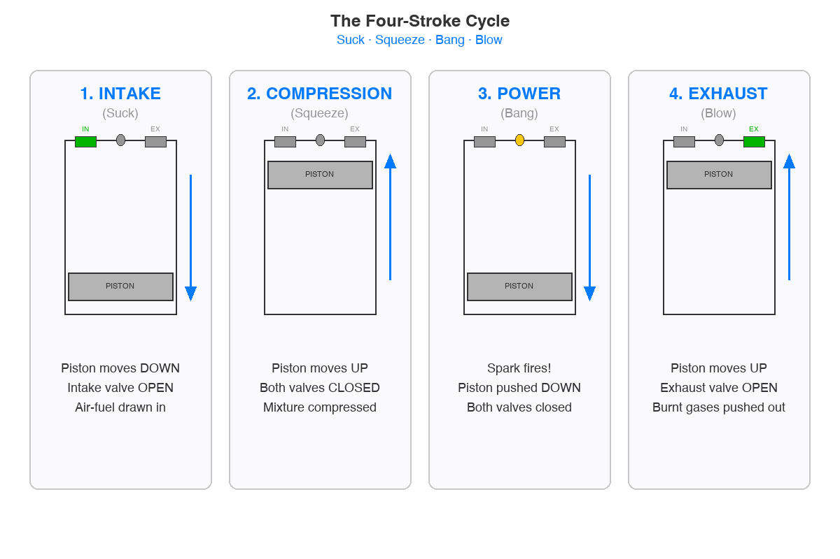
Four-Stroke Cycle & Classification
How it all comes together

Slide 60
Question 26
What are the four strokes in a four-stroke engine cycle, in order?
A. Intake, Compression, Power, Exhaust
B. Intake, Power, Compression, Exhaust
C. Compression, Intake, Exhaust, Power
D. Power, Exhaust, Intake, Compression
Notes:
Question Q26: What are the four strokes in a four-stroke engine cycle, in order?
Let students think before advancing.

Slide 61
Question 26 — Answer
What are the four strokes in a four-stroke engine cycle, in order?
A. Intake, Compression, Power, Exhaust
B. Intake, Power, Compression, Exhaust
C. Compression, Intake, Exhaust, Power
D. Power, Exhaust, Intake, Compression
Think About It: Suck, Squeeze, Bang, Blow — the mechanic's shorthand. Intake (suck), Compression (squeeze), Power (bang), Exhaust (blow).
Notes:
ANSWER: Intake, Compression, Power, Exhaust
The four strokes: 1) INTAKE — piston down, intake valve open, mixture drawn in. 2) COMPRESSION — both valves closed, piston up, mixture squeezed. 3) POWER — spark fires, piston pushed down. 4) EXHAUST — piston up, exhaust valve open, burnt gases out. Mnemonic: Suck, Squeeze, Bang, Blow.
THINK ABOUT IT: Suck, Squeeze, Bang, Blow — the mechanic's shorthand. Intake (suck), Compression (squeeze), Power (bang), Exhaust (blow).

Slide 62
Question 27
During the compression stroke, what is happening?
A. Both valves are closed and the piston moves upward, compressing the air-fuel mixture
B. The spark plug fires and the piston moves downward
C. The intake valve is open and fuel is entering the cylinder
D. The exhaust valve is open and gases are leaving the cylinder
Notes:
Question Q27: During the compression stroke, what is happening?
Let students think before advancing.

Slide 63
Question 27 — Answer
During the compression stroke, what is happening?
A. Both valves are closed and the piston moves upward, compressing the air-fuel mixture
B. The spark plug fires and the piston moves downward
C. The intake valve is open and fuel is entering the cylinder
D. The exhaust valve is open and gases are leaving the cylinder
Think About It: Compression = squeeze. Both valves MUST be closed (sealed chamber), and the piston moves UP to compress the mixture.
Notes:
ANSWER: Both valves are closed and the piston moves upward, compressing the air-fuel mixture
During compression, both valves are closed creating a sealed chamber. The piston moves from BDC to TDC, compressing the mixture. This raises temperature and pressure for a powerful combustion event. The compression ratio on the Predator 212 is about 8.5:1.
THINK ABOUT IT: Compression = squeeze. Both valves MUST be closed (sealed chamber), and the piston moves UP to compress the mixture.

Slide 64
Question 29
The Predator 212 is classified as what type of engine?
A. Two-cylinder, two-stroke, liquid-cooled
B. Single-cylinder, four-stroke, air-cooled, overhead valve (OHV)
C. Single-cylinder, two-stroke, air-cooled
D. V-twin, four-stroke, liquid-cooled
Notes:
Question Q29: The Predator 212 is classified as what type of engine?
Let students think before advancing.

Slide 65
Question 29 — Answer
The Predator 212 is classified as what type of engine?
A. Two-cylinder, two-stroke, liquid-cooled
B. Single-cylinder, four-stroke, air-cooled, overhead valve (OHV)
C. Single-cylinder, two-stroke, air-cooled
D. V-twin, four-stroke, liquid-cooled
Think About It: Count the cylinders (1), count the strokes (4), how is it cooled (air — fins + shroud), where are the valves (overhead = in the head).
Notes:
ANSWER: Single-cylinder, four-stroke, air-cooled, overhead valve (OHV)
The Predator 212 classification: Single-cylinder, Four-stroke, Air-cooled, OHV. Knowing how to classify an engine by these characteristics is fundamental to small engine work.
THINK ABOUT IT: Count the cylinders (1), count the strokes (4), how is it cooled (air — fins + shroud), where are the valves (overhead = in the head).

Slide 66
Question 30
What does OHV (Overhead Valve) mean?
A. The valves are located on the side of the cylinder block
B. The camshaft is located above the valves in the cylinder head
C. The engine has no valves and uses ports instead
D. The valves are located in the cylinder head above the piston, with the camshaft in the block driving them via pushrods or tappets
Notes:
Question Q30: What does OHV (Overhead Valve) mean?
Let students think before advancing.

Slide 67
Question 30 — Answer
What does OHV (Overhead Valve) mean?
A. The valves are located on the side of the cylinder block
B. The camshaft is located above the valves in the cylinder head
C. The engine has no valves and uses ports instead
D. The valves are located in the cylinder head above the piston, with the camshaft in the block driving them via pushrods or tappets
Think About It: OHV = Overhead Valve. Valves are OVERHEAD (in the head), but the camshaft stays DOWN in the block. Cam pushes up through tappets and pushrods to reach the valves above.
Notes:
ANSWER: The valves are located in the cylinder head above the piston, with the camshaft in the block driving them via pushrods or tappets
OHV means valves in the cylinder head, camshaft in the block. Motion reaches valves through tappets, pushrods, and rocker arms. Different from OHC (cam also in head) or flathead (valves in block beside cylinder).
THINK ABOUT IT: OHV = Overhead Valve. Valves are OVERHEAD (in the head), but the camshaft stays DOWN in the block. Cam pushes up through tappets and pushrods to reach the valves above.

Slide 68
Key Takeaways
→ Know the air-fuel path: filter → carb → intake valve → cylinder → exhaust valve → muffler
→ Know the valve chain: cam lobe → tappet → pushrod → rocker arm → valve opens → spring closes
→ Know the cycle: Intake → Compression → Power → Exhaust (Suck, Squeeze, Bang, Blow)
→ Know your engine: Single-cylinder, four-stroke, air-cooled, OHV
→ When in doubt — trace the path of air, fuel, force, or motion through the engine
Notes:
Five mental models for any small engine question. Trace the path — air, fuel, force, motion. If you can follow the chain start to finish, you can figure out what each component does.

Slide 69
Crescent Valley High School
Engines & Fabrication Program
Mr. McAteer | 2025–2026

