Slide 1
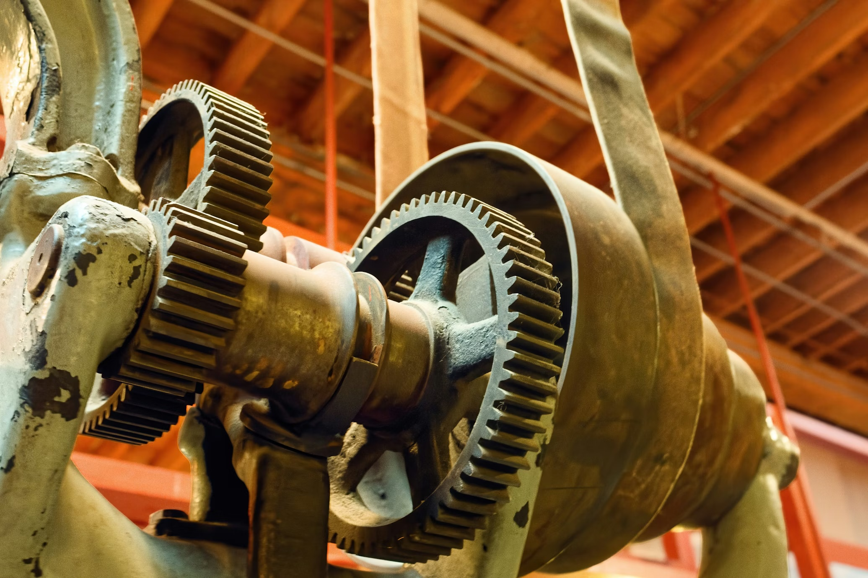
Metal Types
Metals & Manufacturing
Notes:
WELCOME & OPENING (2 min)
Welcome to our unit on metal types. Just like we learn to identify different species of wood in woodworking, in metals class we need to be able to identify and understand the properties of different metals — because choosing the wrong metal for a job can mean the difference between a project that lasts a lifetime and one that fails on day one.
Key question to pose: "If I handed you two pieces of metal that looked almost identical, how would you tell them apart?" (Let students brainstorm — weight, magnetism, color, spark test). We'll come back to this.

Slide 2
What About Metal?
Notes:
TRANSITION (1 min)
In woodworking, students learn to tell the difference between hardwoods and softwoods — oak vs. pine, maple vs. cedar. Each one has a color, a grain, a hardness, and a best use.
Metals are the same way. Steel isn't just "steel." Aluminum isn't just "aluminum." There are families, grades, and alloys — and each one behaves differently when you cut it, weld it, bend it, or finish it.
Today we're going to build your metal vocabulary so you can walk into any shop and know what you're working with.

Slide 3
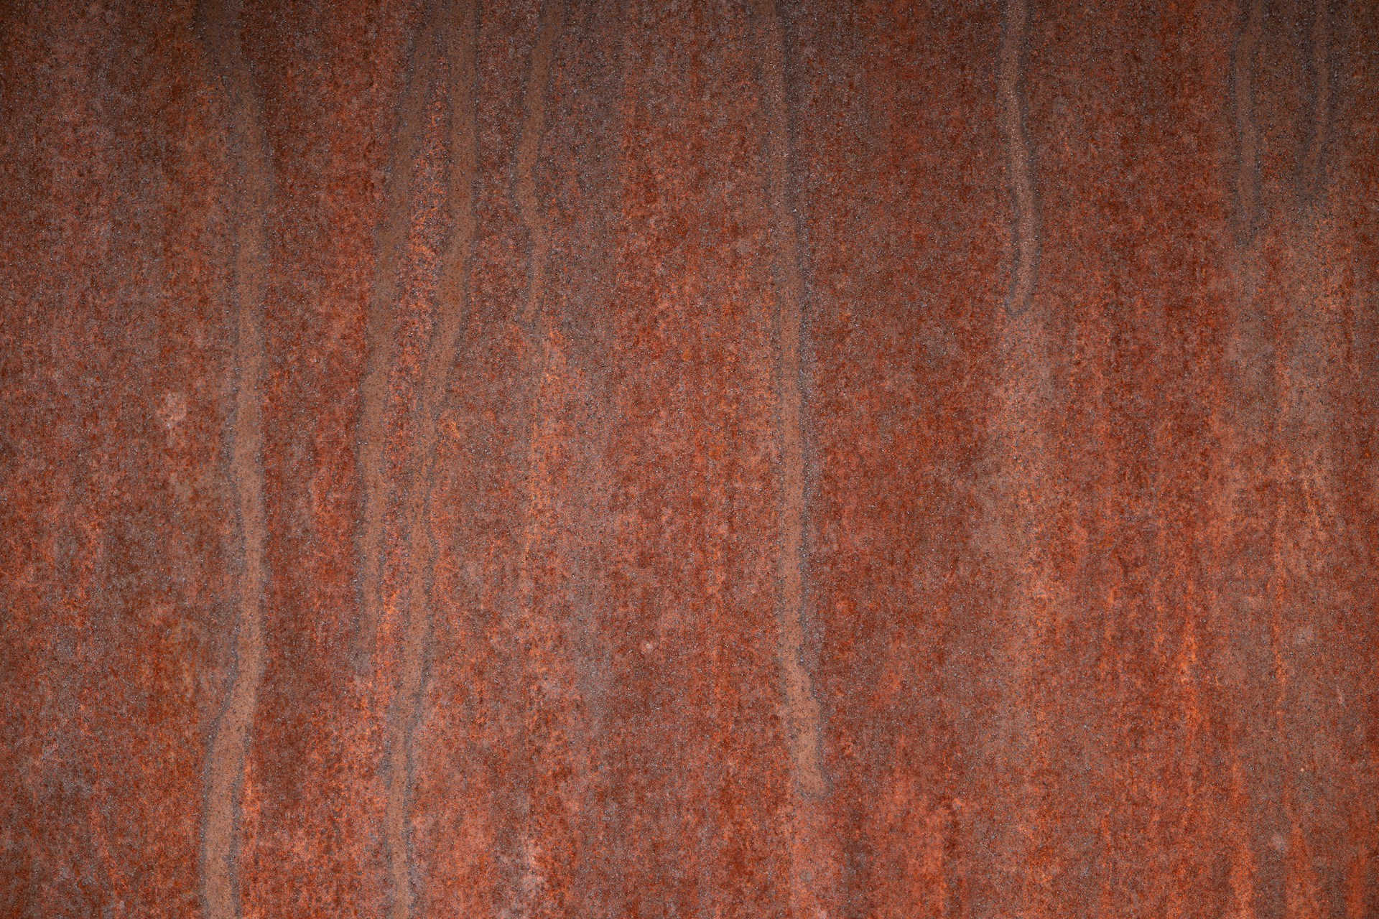
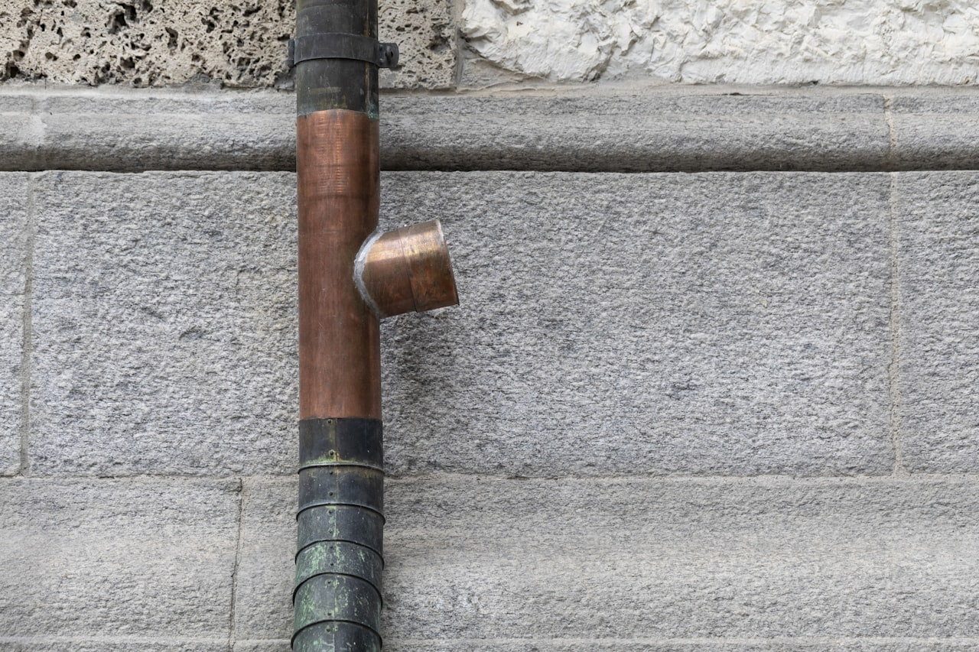
Terms: Ferrous vs. Non-Ferrous
Ferrous
Non-Ferrous
Contains iron (Fe)
Magnetic
Prone to rust (oxidation)
Generally stronger
Examples: steel, cast iron, wrought iron
Contains no iron
Not magnetic
Naturally corrosion resistant
Generally lighter
Examples: aluminum, copper, brass, titanium
Notes:
KEY CONCEPTS (5 min)
This is the single most important classification in metals. Write "Ferrous" and "Non-Ferrous" on the board.
Ferrous comes from the Latin word ferrum meaning iron — that's why iron's chemical symbol is Fe. ANY metal that contains iron as its primary ingredient is ferrous.
Quick demo idea: Grab a magnet and walk around the shop. Touch it to different metals. If it sticks = ferrous. If it doesn't = non-ferrous.
Check for understanding: "Is stainless steel ferrous or non-ferrous?" (Trick question — it IS ferrous because it contains iron, but the chromium content prevents rust.)

Slide 4
Why Do You Care?
The harder the metal, the more it wears your tools
"Machinability" = how easy it is to cut, drill, and shape
Wrong metal + wrong process = ruined project
Different metals require different welding wire, gas, and settings
Cost varies wildly — mild steel is ~$1/lb, stainless can be ~$3-4/lb
Notes:
RELEVANCE CONNECTION (3 min)
This is the "so what?" slide. Metal selection directly affects shop work.
Analogies to woodworking:
- Sanding oak vs. pine = machining stainless vs. aluminum.
- Balsa for a shelf = aluminum where you need steel strength.
Real consequences:
- MIG weld aluminum with steel wire = contaminated weld, scrapped part.
- Lathe speeds for steel on aluminum = clogged tool, bad finish.
- Pick stainless when mild steel works = 3x material cost.
Engagement prompt: "Has anyone tried to drill through something and the drill bit just squealed and smoked? What happened?"

Slide 5
Metal Identification Methods
1. Magnet Test
2. Spark Test (Grinder)
Sticks = ferrous (contains iron)
Doesn't stick = non-ferrous (aluminum, copper, brass)
Caution: some stainless is weakly magnetic
Simplest field test — always start here
Mild steel: long white sparks, many forks (carbon bursts)
Stainless: short dark-red sparks, very few forks
Cast iron: short red sparks, very fine streams
Aluminum & copper: no sparks at all
3. Weight / Density Feel
4. Visual / Color Cues
Aluminum: shockingly light (~1/3 of steel)
Steel & stainless: heavy, similar to each other
Copper & brass: noticeably heavier than steel
Titanium: lighter than steel, heavier than aluminum
Mild steel: dark grey with bluish mill scale
Aluminum: bright silver-white, stays clean
Copper: distinctive reddish-orange, develops green patina
Brass: gold/yellow tone — unmistakable
Notes:
METAL IDENTIFICATION (5 min)
In woodworking, students ID species by grain, color, and smell. Metals use different methods — but the same principle: systematic testing.
MAGNET TEST — always start here. It's the fastest sort into ferrous vs. non-ferrous. Demo: walk around the shop with a magnet.
SPARK TEST — touch metal to bench grinder and observe the spark pattern. This is how experienced machinists ID unknown steel. Safety: wear face shield, keep fingers clear.
- Mild steel: long, white, bushy sparks with lots of carbon forks
- Stainless: short, dark-red, few forks (low carbon)
- Cast iron: short, red, fine streams
- Non-ferrous metals don't spark at all
WEIGHT TEST — have students hold same-size pieces of different metals. The difference between aluminum and steel is dramatic.
VISUAL TEST — color is less reliable than the others (freshly ground surfaces look similar) but mill scale, patina, and surface finish give clues.
Activity idea: Set up a station with 5-6 unmarked metal samples. Students use all four tests to identify each one. Give them a worksheet to record results.

Slide 6
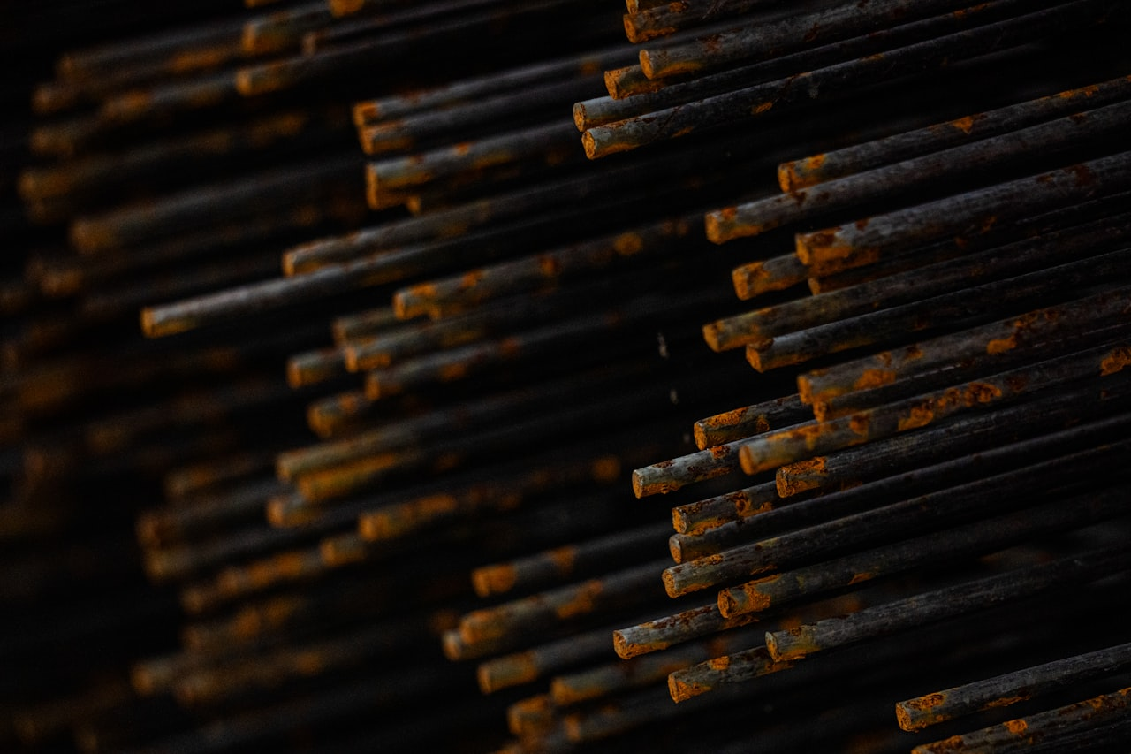
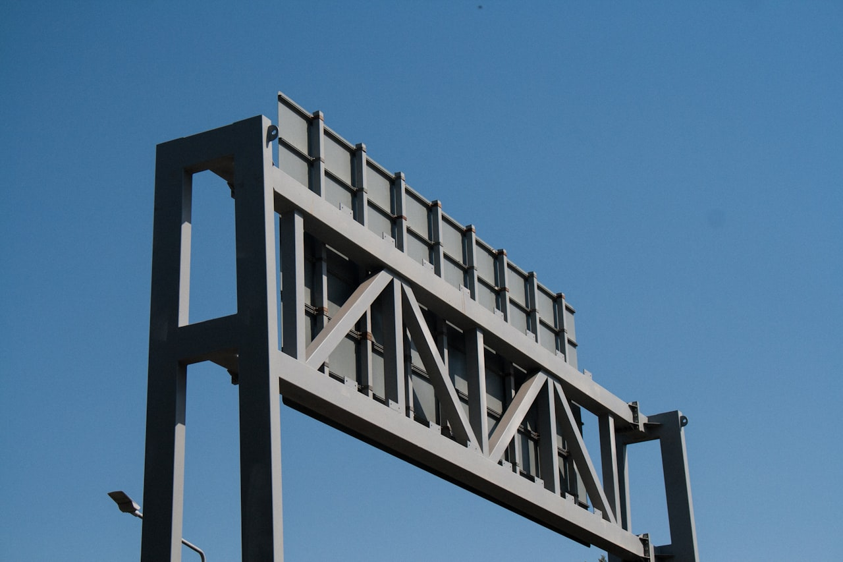
Mild Steel (1018 / A36)
FERROUS
Color: dark grey, bluish mill scale
Hardness: low-medium (Brinell ~126)
Machinability: excellent
Weldability: excellent — easiest to weld
Density: 7.87 g/cm³ (heavy)
Magnetic: yes
Corrosion: rusts easily — oil or prime it
Carbon content: 0.18% (low carbon)
Cost: ~$1/lb — the cheapest structural metal
The "pine" of metals — learn on this first
Notes:
MILD STEEL DEEP DIVE (5 min)
Mild steel is the bread and butter of any metals shop.
Naming: "1018" = AISI/SAE grade. "10" = plain carbon, "18" = 0.18% carbon. "A36" = ASTM structural grade. Most flat bar, angle, and tube in shop is A36.
Identification:
- Silvery grey with dark blue-grey mill scale
- Magnetic — always sticks
- Spark test: long, white, branching with lots of forks
- WILL rust bare. Oil or prime immediately.
In our shop: MIG weld with ER70S-6 wire, C25 gas. Machines beautifully.
Analogy: "Mild steel is to metals what pine is to woodworking."

Slide 7
4140 Chrome-Moly Steel (4140)
FERROUS
Color: dark grey, similar to mild steel
Hardness: medium-high (Brinell ~197 annealed, ~500+ hardened)
Machinability: good when annealed, poor when hardened
Weldability: weldable — preheat required (400°F)
Density: 7.85 g/cm³ (same as mild steel)
Magnetic: yes
Corrosion: rusts — slightly better than mild steel
Alloy: 1% chromium + 0.2% molybdenum + 0.4% carbon
Heat treatable — can be hardened & tempered
The "red oak" of metals — harder, more demanding, premium result
Notes:
4140 CHROME-MOLY DEEP DIVE (5 min)
4140 is the step up from mild steel. When a project needs more strength or wear resistance, this is what you reach for.
Naming: "41" = chromium-molybdenum alloy family, "40" = 0.40% carbon. More carbon = harder, less ductile. The chromium and moly add toughness and hardenability.
Key difference from mild steel: 4140 can be HEAT TREATED. You can harden it to Rockwell 55+ then temper it back to the toughness you need. Mild steel can't do this.
In our shop:
- Machines well in the annealed state (buy it annealed)
- Welding: need to preheat to ~400F and slow-cool to prevent cracking
- Used for: axles, shafts, gears, tooling, motorsport parts, roll cage tubes
- 4130 (similar alloy, less carbon) is the go-to for roll cages and bike frames
Analogy: "4140 is the red oak of metals — you pay more, it's harder to work, but the finished product is a cut above."

Slide 8
Tool Steel (A2 / D2)
FERROUS
Color: dark grey — looks like other steels until hardened
Hardness: very high (Rockwell 58-62 HRC hardened)
Machinability: fair annealed, extremely poor hardened
Weldability: very difficult — risk of cracking
Density: 7.86 g/cm³
Magnetic: yes
Corrosion: moderate (D2 has 12% chromium — semi-stainless)
Carbon: 1.0% (A2) to 1.5% (D2) — very high carbon
Used for: dies, punches, cutting tools, blades, jigs
The "exotic hardwood" of metals — specialized, unforgiving
Notes:
TOOL STEEL DEEP DIVE (5 min)
Tool steel is what we make our tools FROM. When you need a cutting edge that stays sharp or a die that stamps thousands of parts without deforming.
Naming:
- A2 = air-hardening tool steel. Heat it, let it air cool — it hardens on its own.
- D2 = high-carbon, high-chromium (12%) die steel. Sometimes called semi-stainless.
- O1 = oil-hardening tool steel — quench in oil. Traditional knifemaker's steel.
In our shop:
- Students won't machine hardened tool steel (it would destroy our tooling)
- You CAN machine it in the annealed state, then send it out for heat treatment
- Used for making custom fixtures, punches, stamps, and project components that need wear resistance
Safety: hardened tool steel is BRITTLE. If you drop it, it can crack or chip. Flying chips from tool steel are extremely sharp.
Analogy: "Tool steel is like ebony or cocobolo — you don't use it for everything, but when you need extreme hardness and edge retention, nothing else will do."

Slide 9
Cast Iron (Grey / Ductile)
FERROUS
Color: dark grey, rough sandy surface (as-cast)
Hardness: medium-high (Brinell ~200 grey, ~250 ductile)
Machinability: excellent (grey iron) — chips are powder/dust
Weldability: very difficult — preheating and special rods required
Density: 7.15 g/cm³ (slightly lighter than steel)
Magnetic: yes
Corrosion: rusts, but slower than mild steel
Carbon: 2-4% — much higher than any steel
Brittle — does NOT bend, it snaps
The "workhorse" of machine frames — every lathe and mill sits on it
Notes:
CAST IRON DEEP DIVE (5 min)
Cast iron is everywhere in the shop — but not as raw material for student projects. It's what your machines are MADE of.
Why teach it: students need to understand that the lathe bed, the mill table, the vise body — these are all cast iron. It absorbs vibration (dampening), it's extremely rigid, and it machines to a beautiful flat surface.
Types:
- Grey iron: most common. The graphite flakes make it easy to machine (chips come off as powder, not curls). But it's brittle — don't drop a vise!
- Ductile iron: graphite is spheroidal, giving it some flex. Used for pipe fittings.
Identification:
- Very dark grey, rough/sandy texture on unfinished surfaces
- Machined surfaces are smooth, dark grey with a slight sheen
- Spark test: short, red, fine streams — less showy than steel
- Chips are powdery (grey iron) — be careful, they stain everything
Shop rule: NEVER weld cast iron without talking to the instructor first. It requires preheat to 500F+ and special nickel rods. A cold weld WILL crack.
Where you see it: engine blocks, brake rotors, manhole covers, pipe fittings, machine tool frames, woodworking bench vises.

Slide 10
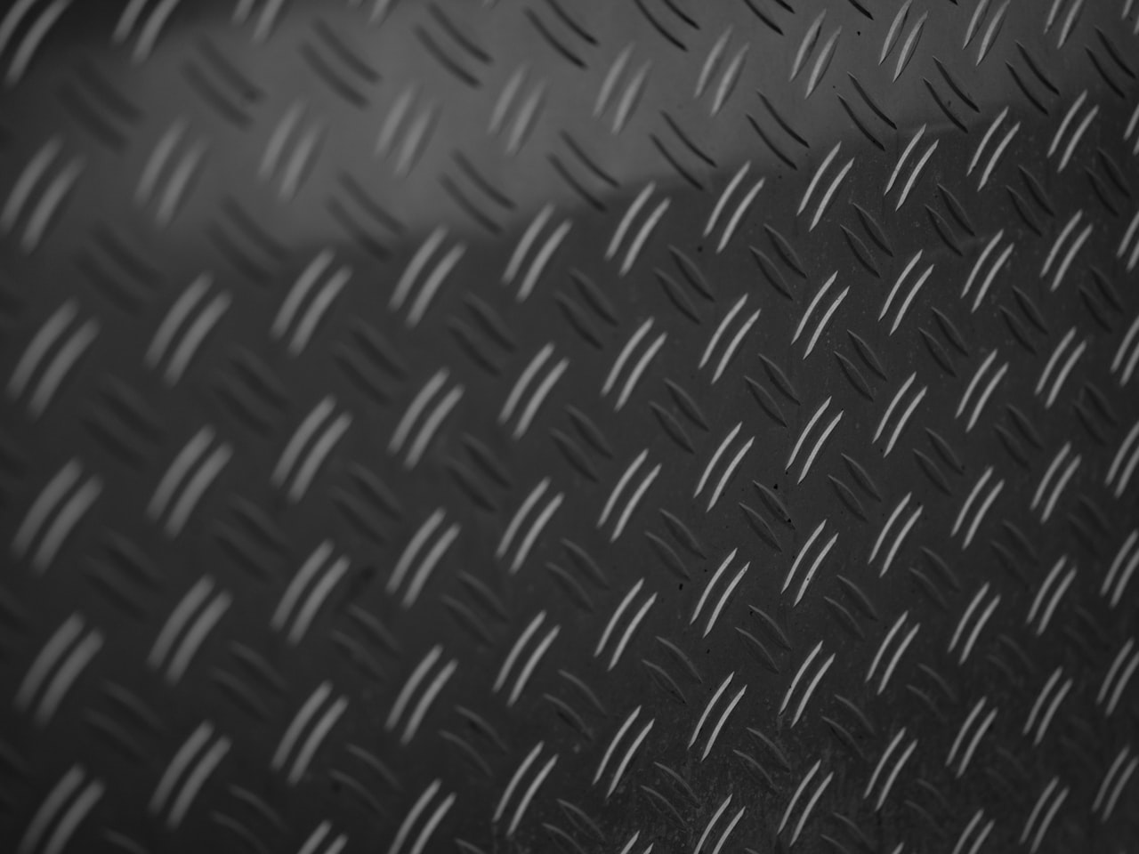
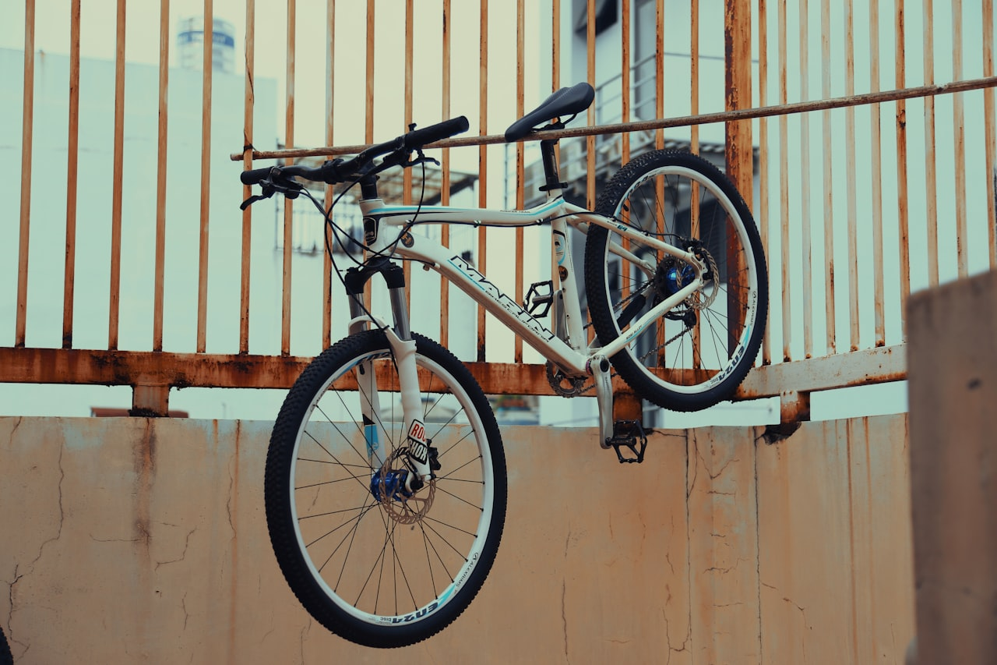
6061 Aluminum
NON-FERROUS
Color: silver-white, bright
Hardness: medium (Brinell ~95)
Machinability: very good
Weldability: weldable (TIG preferred, MIG possible)
Density: 2.70 g/cm³ (~1/3 the weight of steel)
Magnetic: no
Corrosion: naturally resistant (oxide layer)
Alloy series: 6xxx (magnesium + silicon)
Heat treatable — T6 temper is strongest
The "poplar" of metals — light, versatile, everywhere
Notes:
6061 ALUMINUM DEEP DIVE (5 min)
If mild steel is the pine, 6061 aluminum is the poplar — lighter, softer, very versatile.
Naming: "6061" — the "6" means magnesium + silicon. "6061-T6" = heat treated for max strength.
Identification:
- Bright silver-white, much lighter looking than steel
- Pick it up — shockingly light. 1/3 the weight of steel.
- NOT magnetic. No spark on grinder.
In our shop:
- Machines FAST — 2-3x spindle speed vs. steel
- "Gummy" — chips can weld to cutting tool without proper speed/feed
- Welding: aluminum wire, 100% argon, AC (TIG) or special MIG setup
Where you see it: Bike frames, aircraft, phones, laptops, car wheels.

Slide 11
Copper (C110 / C101)
NON-FERROUS
Color: distinctive reddish-orange (unmistakable)
Hardness: low (Brinell ~50) — very soft
Machinability: fair — gummy and smears
Weldability: solderable & brazeable, TIG weldable
Density: 8.96 g/cm³ (heavier than steel!)
Magnetic: no
Corrosion: develops green patina (verdigris), never rusts
Conductivity: best of any common metal (electrical & thermal)
Cost: ~$4-5/lb — expensive, but scrap value is high
The "cherry" of metals — beautiful, functional, mid-range difficulty
Notes:
COPPER DEEP DIVE (5 min)
Copper is one of the oldest metals humans have worked — the Copper Age predates the Bronze Age. Students often recognize it from plumbing and electrical work.
Why it matters:
- #1 electrical conductor (after silver). Every wire in this building is copper.
- #1 thermal conductor in common use. That's why pots and pans have copper bottoms.
- Antimicrobial — copper surfaces kill bacteria. Hospital door handles.
Identification:
- Color is unmistakable — reddish-orange, develops green patina over time
- Noticeably HEAVY — denser than steel
- Not magnetic
- Very soft — you can scratch it with a fingernail (pure copper)
In our shop:
- Used for electrical projects, decorative work, art pieces
- Soldering and brazing are more common than welding
- Machining: tends to be gummy. Sharp tools, moderate speed, use cutting fluid.
- Scrap copper has real value — NEVER throw it away
Where you see it: Electrical wiring, plumbing pipes, roofing (Statue of Liberty!), heat exchangers, decorative art, circuit boards.

Slide 12
Brass (360 Free-Machining / 260 Cartridge)
NON-FERROUS
Color: gold/yellow — unmistakable
Hardness: low-medium (Brinell ~120 for 360 brass)
Machinability: outstanding — the best machining metal
Weldability: solderable & brazeable easily
Density: 8.50 g/cm³ (heavier than steel)
Magnetic: no
Corrosion: excellent resistance, does not rust
Composition: copper + zinc alloy (60-70% Cu, 30-40% Zn)
Non-sparking — safe for explosive environments
The "maple" of metals — machines beautifully, premium look
Notes:
BRASS DEEP DIVE (5 min)
Brass is a machinist's dream. If you want students to experience what a perfect finish looks like off the lathe, hand them a piece of 360 brass.
Types:
- 360 (free-machining brass): 3% lead added for chip breaking. Creates beautiful, short chips that fly away clean. The gold standard for screw machine parts.
- 260 (cartridge brass): 70/30 copper/zinc. More ductile, used for ammunition, musical instruments, decorative hardware.
Identification:
- Gold/yellow color — impossible to confuse with anything else
- Heavy — noticeably heavier than steel for the same size
- Not magnetic
- Rings like a bell when you tap it (compared to steel's dull clang)
In our shop:
- Lathe projects in brass look incredible with minimal polishing
- Great for decorative hardware, handles, fittings, nameplates
- NON-SPARKING — this is why tools for use around explosives are made from brass
- Scrap brass has good value — keep it separate from steel and aluminum
Where you see it: Door hardware, musical instruments (trumpets!), ammunition casings, plumbing fittings, decorative trim, marine hardware.

Slide 13
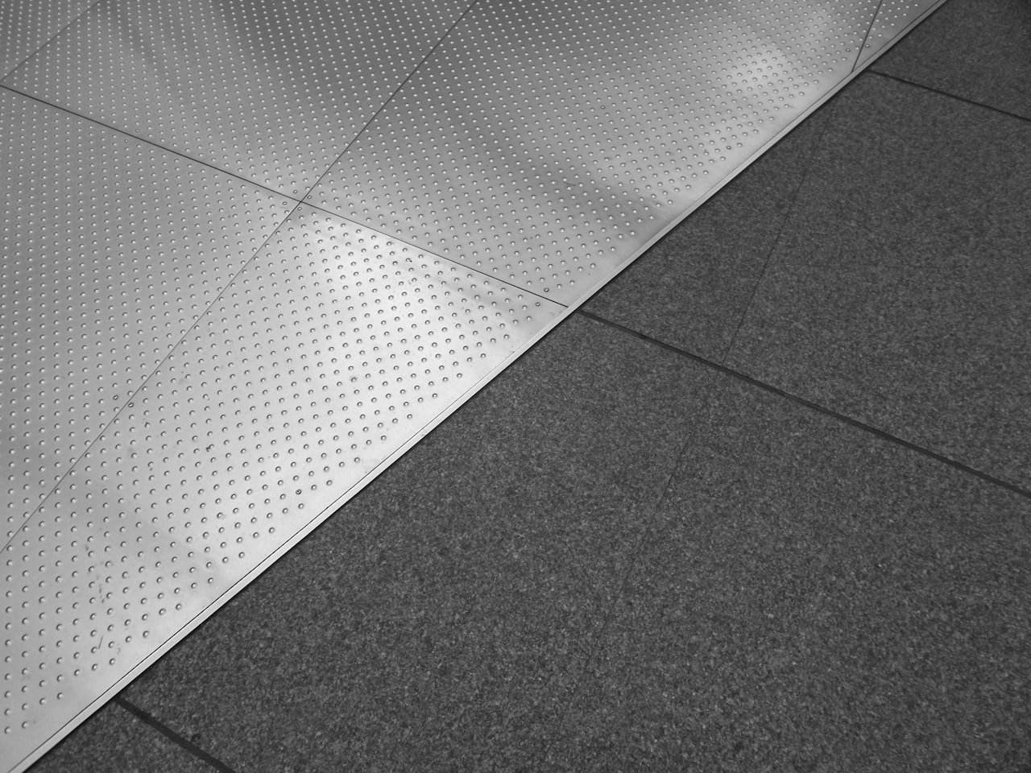

Titanium (Grade 5 / Ti-6Al-4V)
NON-FERROUS
Color: medium grey with slight blue/purple tint
Hardness: high (Brinell ~334 for Grade 5)
Machinability: poor — generates extreme heat
Weldability: TIG only, requires argon shielding everywhere
Density: 4.43 g/cm³ (lighter than steel, heavier than aluminum)
Magnetic: no
Corrosion: exceptional — nearly immune
Strength-to-weight: best of any common metal
Cost: ~$15-25/lb — extremely expensive
The "purple heart" of metals — exotic, hard, impressive
Notes:
TITANIUM DEEP DIVE (5 min)
Titanium is the aerospace wonder metal. Students may not work with it in our shop, but they need to know it exists and why it's special.
Naming: Grade 5 (Ti-6Al-4V) = 6% aluminum, 4% vanadium. This is the most common titanium alloy — used in 50%+ of all titanium applications.
Why it's special:
- As strong as steel at 60% of the weight
- As corrosion-resistant as stainless (better, actually)
- Biocompatible — your body won't reject it (hip replacements, dental implants)
- Heat resistant — jet engines operate at 1000F+
Why it's difficult:
- Generates extreme heat when machined — requires flood coolant
- Work hardens like stainless but worse
- Welding MUST be shielded on BOTH sides — any oxygen contamination turns it brittle
- Expensive: a 1" round bar of Ti-6Al-4V costs what a full stick of mild steel costs
Identification:
- Lighter than steel but heavier than aluminum (distinct "in between" feel)
- Not magnetic
- Spark test: brilliant white sparks (distinctive)
- When ground, can develop blue/purple oxide colors
Where you see it: Aircraft frames, jet engines, surgical implants, high-end bicycle frames, spacecraft, premium watches, golf clubs.

Slide 14
Stainless Steel (304 / 316)
FERROUS (still contains iron!)
Color: bright silver, stays shiny
Hardness: high (Brinell ~200)
Machinability: poor — work hardens
Weldability: weldable (TIG preferred)
Density: 8.00 g/cm³ (slightly heavier than mild steel)
Magnetic: depends on grade (304 weakly magnetic)
Corrosion: highly resistant (10.5%+ chromium)
Cost: ~$3-4/lb — 3-4x mild steel
Don't cross-contaminate with carbon steel tools!
The "premium" metal — worth it when corrosion matters
Notes:
STAINLESS STEEL DEEP DIVE (5 min)
Stainless steel is the most misunderstood metal in the shop.
Naming:
- 304: most common. 18% chromium, 8% nickel ("18-8").
- 316: added molybdenum for marine/medical.
- Chromium (min 10.5%) forms invisible, self-healing protective layer.
Identification:
- Stays bright — no mill scale, no rust.
- Slightly heavier than mild steel.
- Magnet test unreliable — some grades are slightly magnetic.
- Spark test: short, dark-red, very few forks.
Critical shop rules:
- NEVER use tools on stainless that touched carbon steel (cross-contamination = rust spots)
- Keep dedicated stainless tools marked separately
- Work hardens — keep feeds aggressive, tools sharp
Where you see it: Kitchen, food processing, surgical, marine, architecture.

Slide 15
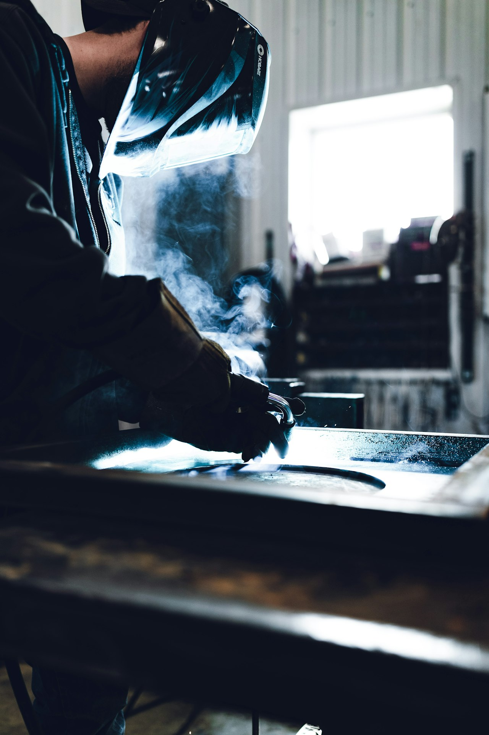
MIG Welding
Gas Metal Arc Welding (GMAW)
How it works: wire-fed electrode melts into the joint
Shielding gas protects the weld pool from contamination
Steel setup: ER70S-6 wire + C25 gas (75% Ar / 25% CO2)
Aluminum setup: ER4043 wire + 100% Argon
Easiest welding process to learn
"Point and shoot" — the hot glue gun of welding
Travel speed matters — too fast = cold weld, too slow = burn-through
Wire speed + voltage must be balanced
Notes:
MIG WELDING OVERVIEW (5 min)
MIG is the first welding process most students learn.
Explain: "Hot glue gun, but feeds metal wire. Arc is ~6,000F. Shielding gas is an invisible bubble keeping oxygen out."
Key settings:
- Wire speed: filler amount (too much = blobby, too little = no fusion)
- Voltage: arc length and heat
- Travel speed: hardest for beginners
Common mistakes: gun too far, moving too fast, dirty metal, wrong polarity.
Safety: Never look at arc without helmet (min shade 10). Arc eye is no joke.

Slide 16
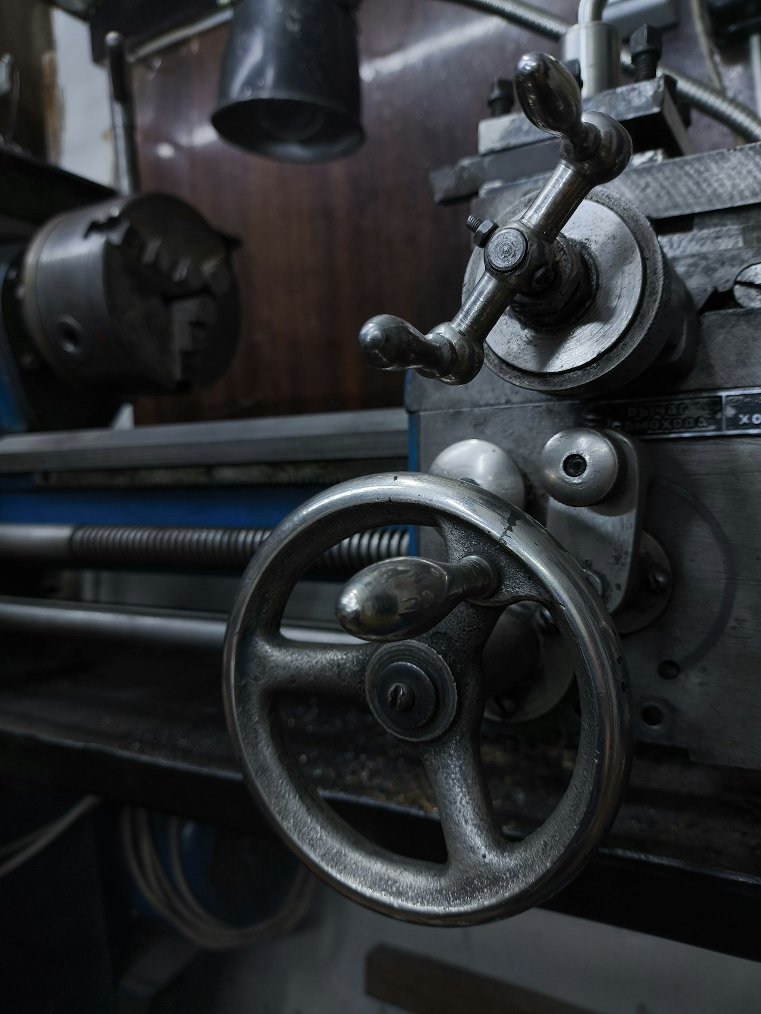
Lathe Turning
Cylindrical Machining
How it works: workpiece spins, cutting tool stays still
Creates round/cylindrical shapes
Operations: facing, turning, boring, threading, knurling
RPM changes by material:
Steel: ~300-600 RPM
Aluminum: ~800-1500 RPM
Stainless: ~200-400 RPM (slow!)
Cutting fluid reduces heat and improves finish
Never leave the chuck key in the chuck
Notes:
LATHE TURNING OVERVIEW (5 min)
The lathe: oldest machine tool, still essential.
Key concept: WORK spins, TOOL stays still. Opposite of drill/mill. Because work spins, everything a lathe makes is round.
Speed:
- Aluminum: high RPMs (soft, conducts heat)
- Stainless: LOW RPMs (work-hardens)
- Rule: softer = faster RPM, harder = slower
Safety:
1. NEVER leave chuck key in chuck — projectile
2. No loose clothing, gloves, or jewelry
3. Safety glasses always
4. Stand to side of chuck, not in front

Slide 17
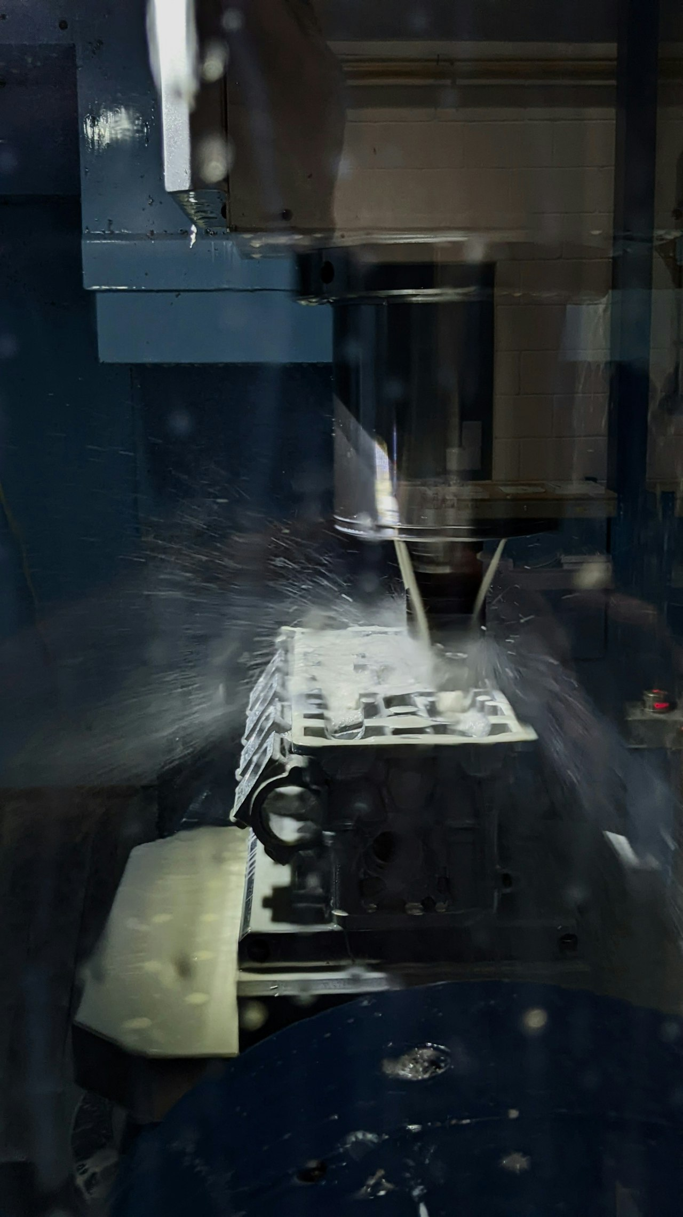
Milling
Precision Material Removal
How it works: spinning cutter removes material from clamped workpiece
Creates flat surfaces, slots, pockets, and contours
Operations: face milling, end milling, slot cutting, drilling
Feed rate changes by material:
Steel: moderate feed, lower RPM
Aluminum: aggressive feed, higher RPM
Stainless: light feed, low RPM, constant cutting fluid
Workholding is critical — vise must be tight
Climb milling vs. conventional — know the difference
Notes:
MILLING OVERVIEW (5 min)
The mill makes everything the lathe can't — flat surfaces, square shapes, pockets.
Key concept: TOOL spins, WORK stays still (on movable table). Multiple flutes, each takes a small bite.
Material tips:
- Aluminum: 2-3 flute end mills (chip evacuation)
- Steel: 4 flute, slower RPM
- Stainless: sharp tools critical (dull = work-hardening cycle)
Safety:
- Workpiece MUST be securely clamped
- Chips with brush, never hands
- Safety glasses + face shield for heavy cuts

Slide 18
Wood-to-Metal Analogy
Bridging what you know to what you’re learning
Wood | Metal Equivalent | Why the Match | Difficulty
Pine | Mild Steel | Cheap, common, easy to work, learn on this | Beginner
Poplar | 6061 Aluminum | Light, versatile, softer, everywhere | Beginner
Red Oak | 4140 Cr-Mo Steel | Harder, more demanding, premium result | Intermediate
Maple | Brass | Machines beautifully, polishes to a premium look | Intermediate
Cherry | Copper | Beautiful finish, mid-range difficulty, ages well | Intermediate
Walnut | Stainless Steel | Premium, harder to work, worth the effort | Advanced
Purple Heart | Titanium | Exotic, expensive, hard, impressive result | Expert
White Oak | Cast Iron | Heavy, durable, structural, been used for centuries | Specialized
Notes:
WOOD-TO-METAL ANALOGY (5 min)
This slide bridges what students already know from woodworking to the new metal vocabulary they're building. Go through each row and ask if anyone has worked with that wood species — then explain how the metal equivalent behaves similarly.
Key teaching points:
- Pine/Mild Steel: "You learn on pine because it's forgiving. Same with mild steel. If you mess up, the material cost is low and the process is easy."
- Poplar/Aluminum: "Both are light, both are versatile, both are softer than their premium cousins."
- Red Oak/4140: "Red oak demands sharp tools and proper technique. So does 4140. But the finished product is noticeably better."
- Cherry/Copper: "Both develop a beautiful patina over time. Both require care to get a great finish."
- Purple Heart/Titanium: "Both are exotic, expensive, and hard — but when someone pulls off a project in either material, it's impressive."
- White Oak/Cast Iron: "Both have been used for structural applications for centuries. Heavy, durable, and not going anywhere."
The difficulty column reinforces the idea of progression: start with beginner materials, build skills, then tackle harder metals as confidence grows.

Slide 19
Quick Reference Ferrous Metals
Property | Mild Steel | 4140 Cr-Mo | Tool Steel | Cast Iron | Stainless
Hardness | Low-Med | Med-High | Very High | Med-High | High
Machinability | Excellent | Good | Fair | Excellent | Poor
Weldability | Excellent | Moderate | Difficult | Difficult | Moderate
Rusts? | Yes! | Yes | Moderate | Slowly | No
Heat Treatable | No | Yes | Yes | No | No
Magnetic? | Yes | Yes | Yes | Yes | Varies
Relative Cost | $ | $$ | $$$ | $ | $$$
Notes:
FERROUS QUICK REFERENCE (3 min)
Walk through the table column by column. Key talking points:
- Mild Steel: best all-around for beginners. Cheap, welds great, machines great.
- 4140: when you need more strength + heat treatability. Motorsport, tooling.
- Tool Steel: extreme hardness. Dies, punches, blades. Don't machine it hardened.
- Cast Iron: excellent machining (powder chips!), but don't try to weld it.
- Stainless: corrosion king, but difficult to machine and expensive.
Activity: "If you're building a go-kart frame on a budget, which column do you pick?" (Mild steel.) "If the frame needs to be heat treated for a racing class?" (4140.)

Slide 20
Quick Reference Non-Ferrous Metals
Property | 6061 Aluminum | Copper | Brass | Titanium
Weight | Light (~1/3) | Heavy | Heavy | Medium
Machinability | Very Good | Fair | Outstanding | Poor
Weldability | Moderate | Solderable | Solderable | TIG only
Corrosion | Resistant | Patina | Resistant | Exceptional
Magnetic? | No | No | No | No
Special | 1/3 weight | Best conductor | Non-sparking | Strength/weight
Relative Cost | $$ | $$$ | $$ | $$$$
Notes:
NON-FERROUS QUICK REFERENCE (3 min)
Key talking points per column:
- 6061 Aluminum: the lightweight workhorse. When weight matters.
- Copper: electrical/thermal champion. Beautiful but heavy and gummy.
- Brass: the machinist's dream metal. Makes everything look premium.
- Titanium: the exotic — strongest per pound, most corrosion-resistant, most expensive.
Notice ALL non-ferrous metals are non-magnetic. That's your first sort.
Discussion: "You're designing a lightweight drone bracket that needs to survive outdoors. Which column?" (Aluminum for cost/weight. Titanium if budget is unlimited.)
Key takeaway: There's no "best" metal. Only the best metal FOR THE JOB. Every choice is a trade-off between strength, weight, cost, corrosion resistance, and workability.

