Slide 1
ATM threat alerting system
19CCE381 IoT and Computing Lab Term Project
GROUP - 17
MOHAN V | CB.EN.U4CCE20033
SOORYA S | CB.EN.U4CCE20059
TAUSHIQ B | CB.EN.U4CCE20064
VARUN S | CB.EN.U4CCE20069

Slide 2

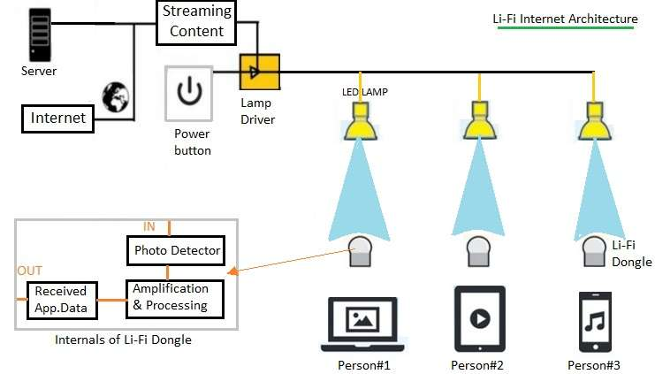

Abstract
The Idea of Designing and Implementation of ATM threat alerting project is born with the observation in our real life incidents happening around us.
This project deals with prevention of ATM theft from robbery.
So to overcome the drawback in the existing technology. When ever robbery occurs, the situation is analyzed and the emotion of the user and the thief are detected using the camera mounted in the ATM.
The alert message is sent to nearest police station. Pi-Camera used to capture the situation and send the message within time to the nearby police station and corresponding bank through the GSM. ATM is switched off which will prevent the thief to threaten the user to withdraw money.
This will prevent the robbery and the person involving in robbery can be easily caught.

Slide 3
Flow Diagram
Transmitter side:
Pi-Camera in ATM detects threat
Image is captured
Alert message and image is encoded as binary code
Binary Data sent through LED light
Binary Data received through Photodiode in ceiling
Binary code is Decoded
Decoded message is sent to police station and bank’s server
ATM is switched off
Receiver side:

Slide 4
Components
Tx Side
Pi-Camera
LED
Resistor
Rx Side
Photo
Transistor
Potentiometer
GSM module

Slide 5
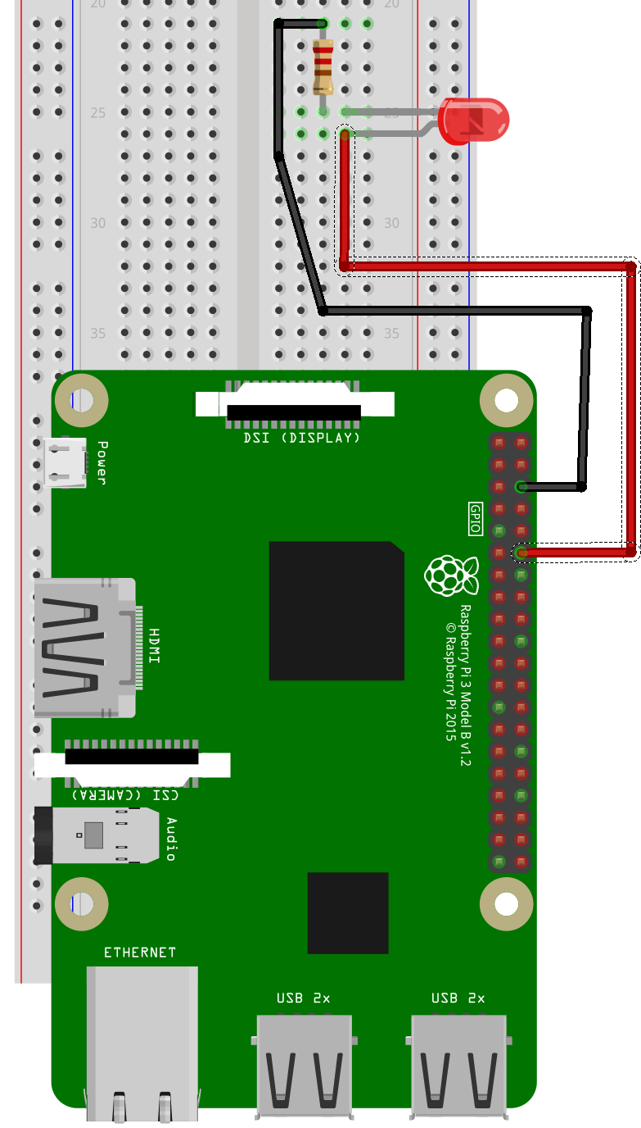
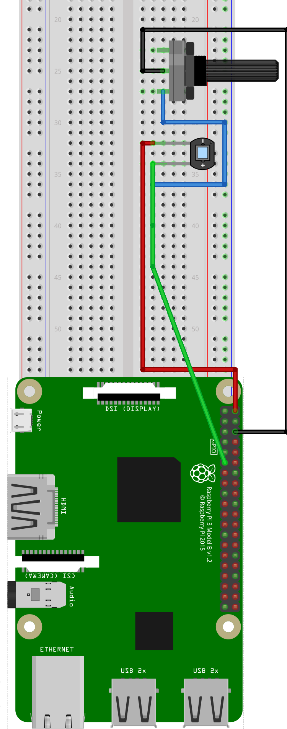
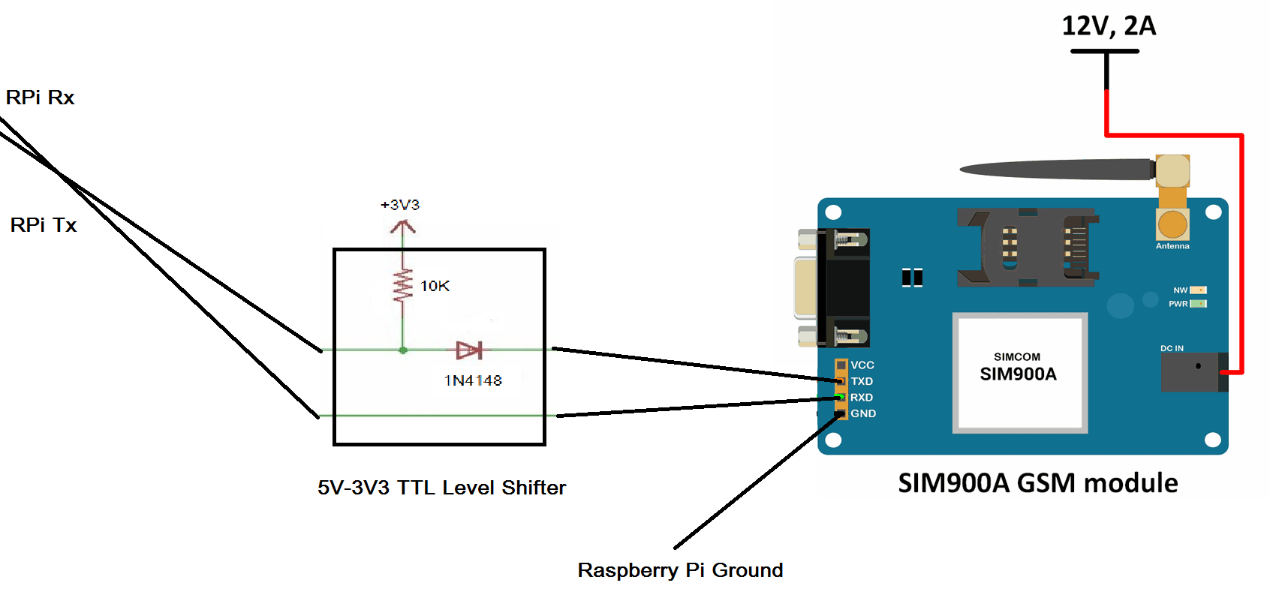

Transmitter side:
Circuit Diagram
Receiver side:

Slide 6




Uses
Immediate action of police upon the robbery
Complete information of this event to the bank
Analytics of the possibilities of robbery places
Independent of ATM’s internet – because of separate GSM module

