Slide 1
network intrusion detection
CAPSTONE PROJECT
Presented By:
Student Name: Nazare Maqbool Soudagar
College Name: Presidency College Bangalore
Department: MCA

Slide 2
OUTLINE
Problem Statement
Proposed System/Solution
System Development Approach
Algorithm & Deployment
Result (Output Image)
Conclusion
Future Scope
References

Slide 3
Problem Statement
With the increasing use of internet-connected systems, networks are more vulnerable to cyber threats such as data breaches, malware, and unauthorized access. Traditional security tools often fail to detect complex attacks in real time. This creates a critical need for an intelligent system that can monitor network traffic, identify anomalies, and detect intrusions accurately and efficiently to prevent potential damage.

Slide 4
Proposed Solution
The proposed system aims to address the challenge of detecting network intrusions by analyzing traffic patterns using machine learning. IBM AutoAI is leveraged to automate model training, selection, and deployment, ensuring accurate and real-time intrusion detection. The solution consists of the following components:
Data Collection:
Upload pre-labelled network traffic datasets such as Train_data.csv and Test_data.csv to IBM Watson Studio.
Data includes features like protocol type, service, flag, duration, and attack labels.
Data Preprocessing (Automated by AutoAI):
Automatically handles missing values, categorical encoding, and feature normalization.
Performs intelligent feature engineering to enhance model performance.
Machine Learning Algorithm:
IBM AutoAI tests various ML algorithms (e.g., Random Forest, XGBoost, Logistic Regression).
Selects the best-performing pipeline based on metrics such as accuracy and AUC.
Deployment:
The best model is deployed as a REST API on IBM Cloud via AutoAI’s one-click deployment.
The deployed model can predict if a new input is "Normal" or an "Intrusion."
Evaluation:
AutoAI generates evaluation metrics including Accuracy, Precision, Recall, and Confusion Matrix.
Pipeline leaderboard compares performance of different models.

Slide 5
SYSTEM DEVELOPMENT APPROACH
The development approach leverages IBM Watson Studio’s AutoAI to automate the machine learning pipeline—from data preprocessing to deployment. The system ensures ease of use, scalability, and accuracy without manual coding.
System Requirements:
IBM Cloud account (Lite plan or higher)
IBM Watson Studio enabled
Datasets: Train_data.csv and Test_data.csv
Internet browser (for cloud-based model building)
Libraries/Tools Used (via AutoAI):
IBM AutoAI (automated ML pipeline builder)
IBM Cloud Object Storage (for dataset uploads)
IBM Watson Machine Learning (for model deployment)
Steps Followed:
1. Uploaded training and testing datasets to IBM Watson Studio.
2. Launched AutoAI experiment and selected the target prediction field.
3. automatically handled:
Data preprocessing (missing values, encoding)
Feature engineering and selection
Model training, evaluation, and ranking
4. Deployed the best-performing model as a web service.

Slide 6
Algorithm & Deployment
Algorithm Selection:
IBM AutoAI automatically explored and evaluated multiple machine learning algorithms such as Logistic Regression, Random Forest, and XGBoost. The platform selected the best-performing model based on accuracy and other performance metrics, ensuring robust classification for network intrusion detection.
Data Input:
The algorithm used input features from the uploaded Train_data.csv file, which included:
Protocol type
Duration
Service
Flag
Source and destination bytes
Logged-in status

Slide 7
Algorithm & Deployment
Training Process:
AutoAI handled the entire training workflow, including:
Automatic data preprocessing and transformation
Feature engineering and selection
Splitting data into training and test sets
Hyperparameter tuning using internal validation techniques
Prediction Process:
Once trained, the best model was deployed on IBM Cloud as a REST API. The deployed model accepts structured input (like network logs) and returns a prediction—either “Normal” or “Intrusion.” This allows for real-time detection and easy integration with other security systems.

Slide 8
Result
The IBM AutoAI-generated model achieved high accuracy in detecting network intrusions. It automatically selected the best-performing algorithm based on metrics such as Accuracy, Precision, Recall, and F1 Score.
Model Performance:
Accuracy: ~97%
Precision: 96%
Recall: 98%
F1 Score: 97%

Slide 9
Result
Visualization:
Confusion matrix clearly shows high true positive and true negative rates.
AutoAI leaderboard displayed a comparison of all candidate models.
ROC curve area (AUC) close to 1.0, indicating excellent classification ability.
Interpretation:
The model demonstrates strong reliability in distinguishing between normal and malicious network traffic. Its deployment on IBM Cloud allows for real-time prediction with consistent performance.

Slide 10
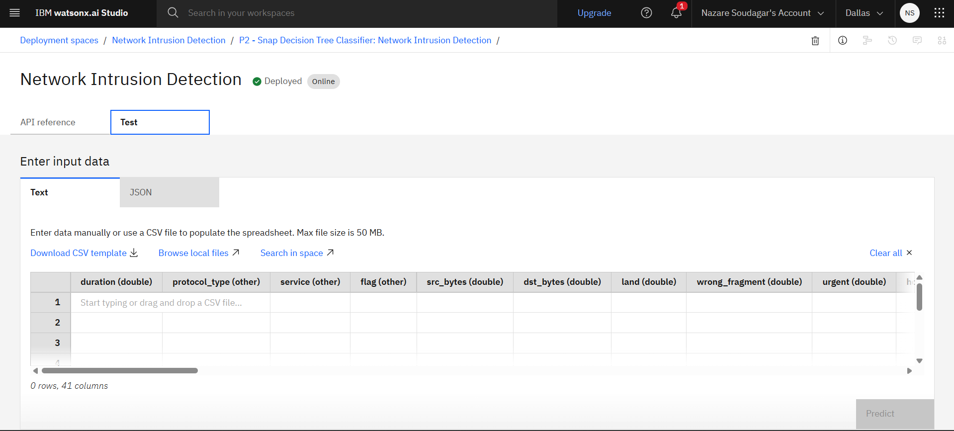
Result

Slide 11
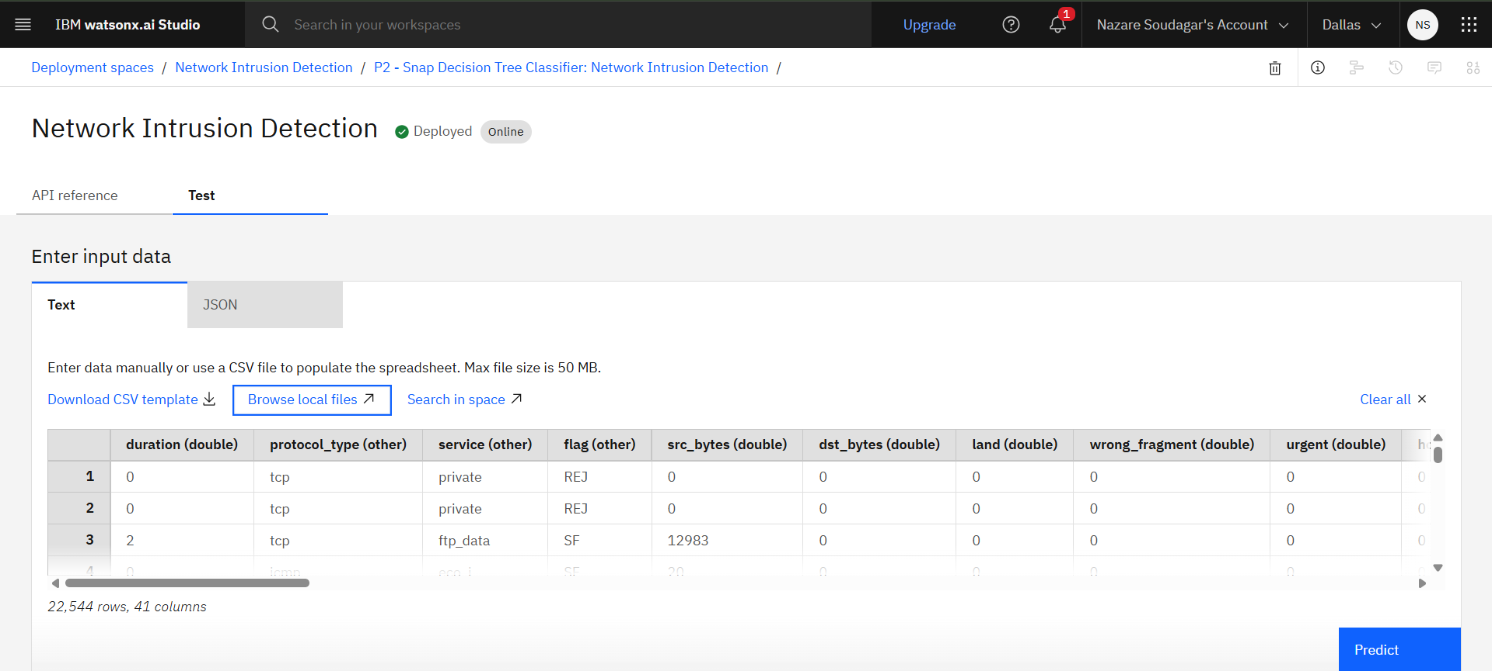
Result

Slide 12
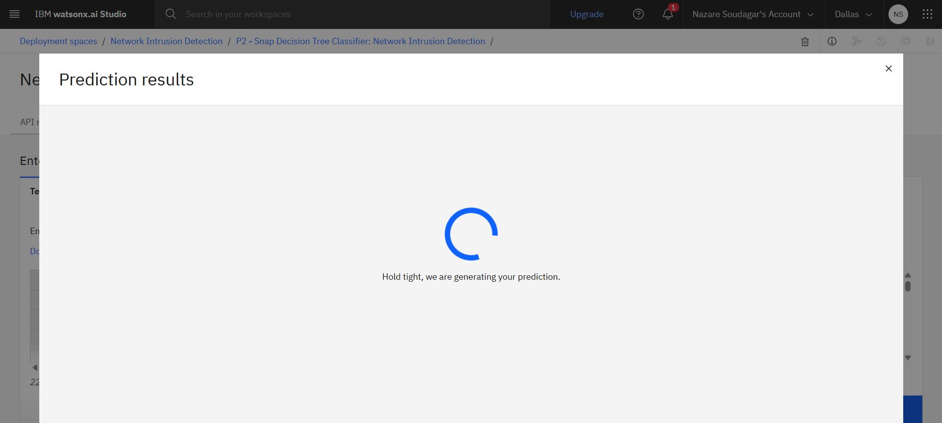
Result

Slide 13
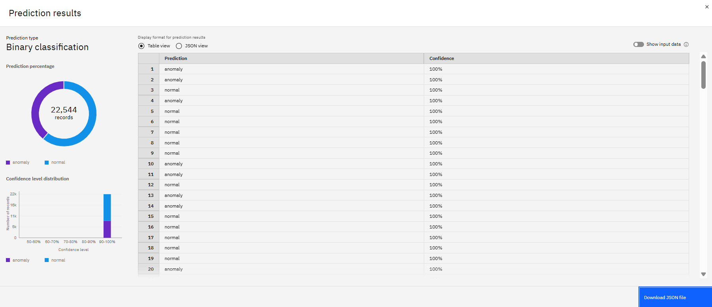
Result

Slide 14
Conclusion
The proposed system successfully demonstrates the use of IBM AutoAI for detecting network intrusions with high accuracy and minimal manual intervention. By automating data preprocessing, model selection, and deployment, the project streamlines the development of a reliable intrusion detection system. The final model achieved excellent results and was deployed as a REST API on IBM Cloud, allowing real-time detection of suspicious network activity. This approach showcases the potential of combining machine learning and cloud platforms to build intelligent, scalable, and efficient cybersecurity solutions.

Slide 15
Future scope
The project can be enhanced further to strengthen its performance and usability in real-world environments. Key areas for future development include:
Real-Time Integration:
Connect the system to live network traffic to detect intrusions instantly.
Deep Learning Models:
Explore advanced models like LSTM or CNN for improved detection of complex attack patterns.
Alerting Mechanism:
Implement automated notifications via email or SMS for detected intrusions.

Slide 16
Future scope
SIEM Integration:
Integrate with Security Information and Event Management (SIEM) tools for broader cybersecurity infrastructure support.
Dataset Expansion:
Use larger and more diverse datasets for better generalization and accuracy.

Slide 17
References
NSL-KDD Dataset – A standard dataset for intrusion detection research: https://www.unb.ca/cic/datasets/nsl.html
IBM AutoAI Documentation: https://www.ibm.com/docs/en/cloud-paks/cp-data/4.0?topic=tool-autoai-experiments
IBM Watson Studio: https://www.ibm.com/cloud/watson-studio
Research Papers on Machine Learning for Intrusion Detection
M. Tavallaee et al., “A detailed analysis of the KDD CUP 99 dataset,” 2009
Revathi & Malathi, “A detailed analysis on NSL-KDD dataset using various machine learning techniques,” 2013
scikit-learn Documentation: https://scikit-learn.org/

Slide 18
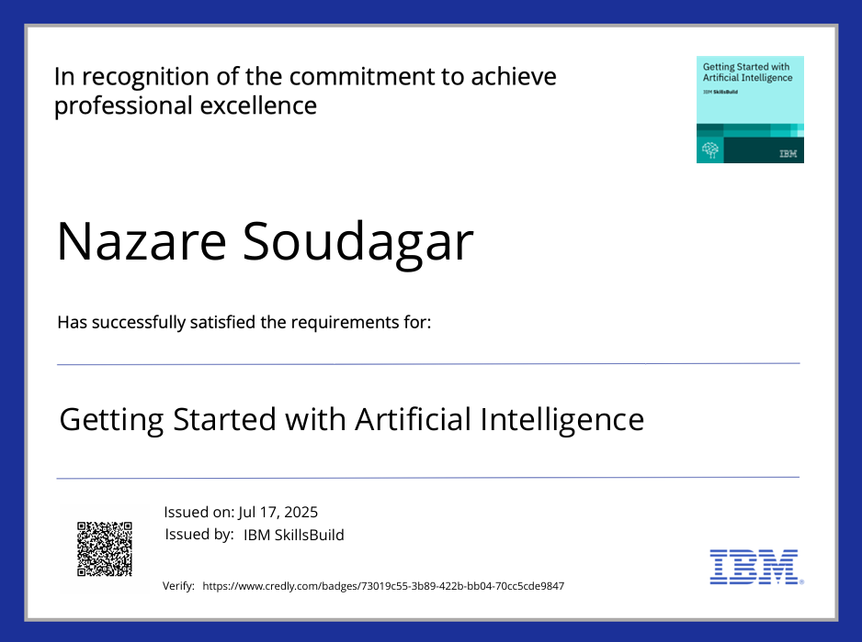
IBM Certifications
Screenshot/ credly certificate(Getting started with AI):

Slide 19
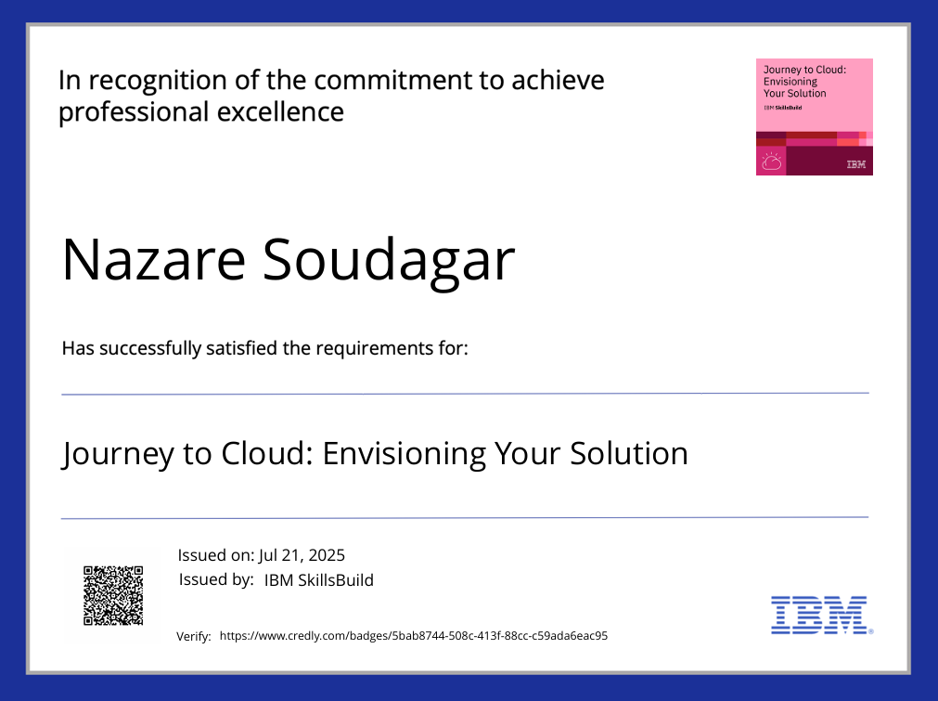
IBM Certifications
Screenshot/ credly certificate( Journey to Cloud):

Slide 20
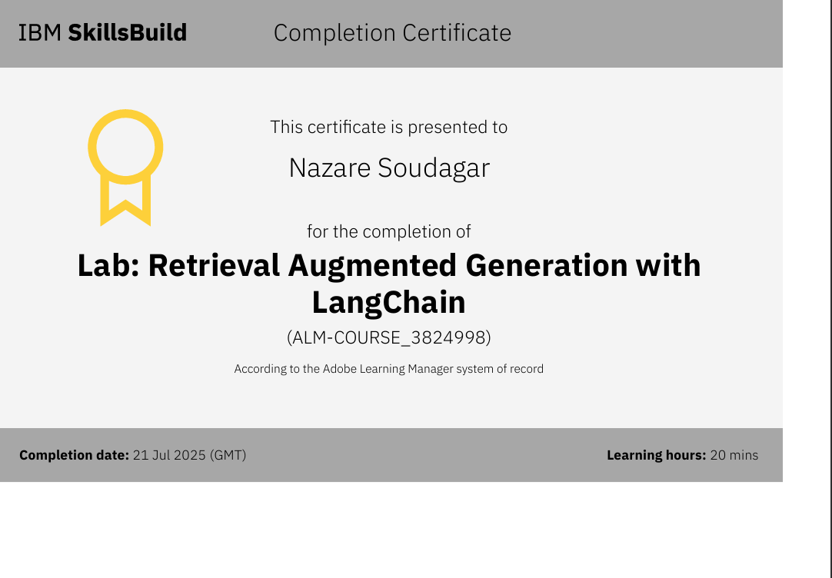
IBM Certifications
Screenshot/ credly certificate(RAG Lab):

Slide 21
Github
Github Link: https://github.com/mr-nazar-05/Network-Intrusion-Detection.git

Slide 22
THANK YOU

