Slide 1
BI PORTFOLIO CASE STUDY
Consumer Shopping Behavior Analysis
SQL analysis, Power BI dashboarding and business recommendations across 3,900 orders

Slide 2
Data Preparation Process
01
02
03
Data Loading
Initial Exploration
Missing Data Handling
Imported dataset using pandas
Structure check and summary statistics
Imputed Review Rating with median values
04
05
Feature Engineering
Database Integration
Created age groups and purchase frequency
Connected to MySQL for analysis

Slide 3
Core KPIs: 3,900 orders, with about 80% from Loyal customers
3,900
3,116
$58 to $60
Total orders
Loyal customer orders, about 80% of orders
Average order value
3.76 / 5
1,737
675
Average review rating as reported (3.75 in the satisfaction section)
Largest category by orders: Clothing
Highest-volume shipping type: Free Shipping

Slide 4
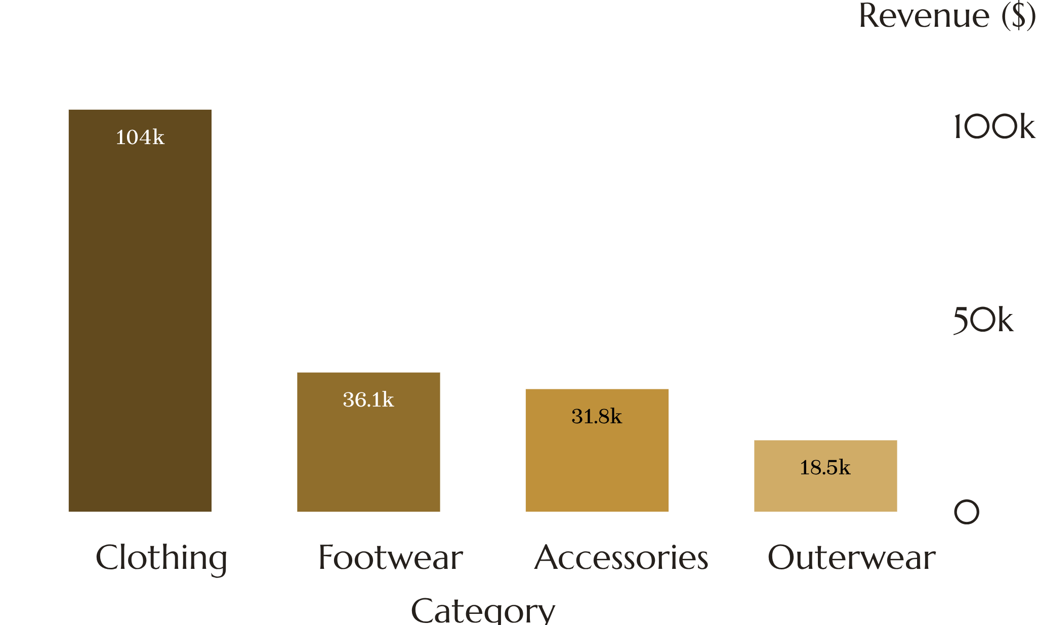
Customer and sales performance: $230,672 revenue across 3,900 orders
Observed: Clothing and Accessories lead revenue-generating categories.
Discounted orders: 1,677 orders, $99,411 revenue (62.96% of the discount-split revenue), AOV $59.28; non-discounted AOV $59.98.
Observed: AOV is nearly identical with and without discounts overall.

Slide 5
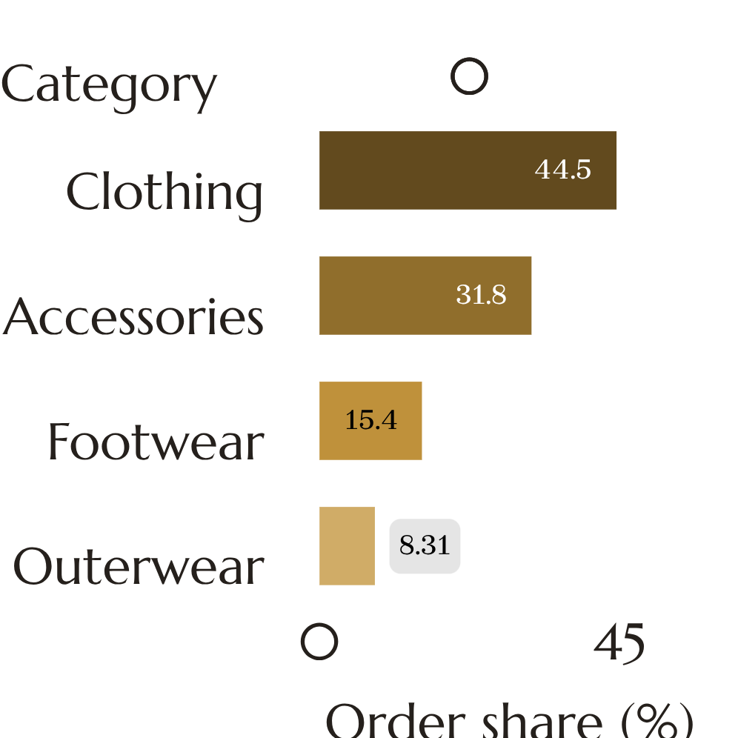
Product categories: Clothing is 44.5% of orders and 44.7% of revenue
CATEGORY | ORDERS | ORDER SHARE % | REVENUE ($) | REVENUE SHARE %
Clothing | 1,737 | 44.54 | 104,264 | 44.73
Accessories | 1,240 | 31.79 | 31,791 | 31.83
Footwear | 599 | 15.36 | 36,093 | 15.49
Outerwear | 324 | 8.31 | 18,524 | 7.95
Total | 3,900 | 100.00 | 230,672 | 100.00
Observed: order share and revenue share are closely aligned in every category.

Slide 6
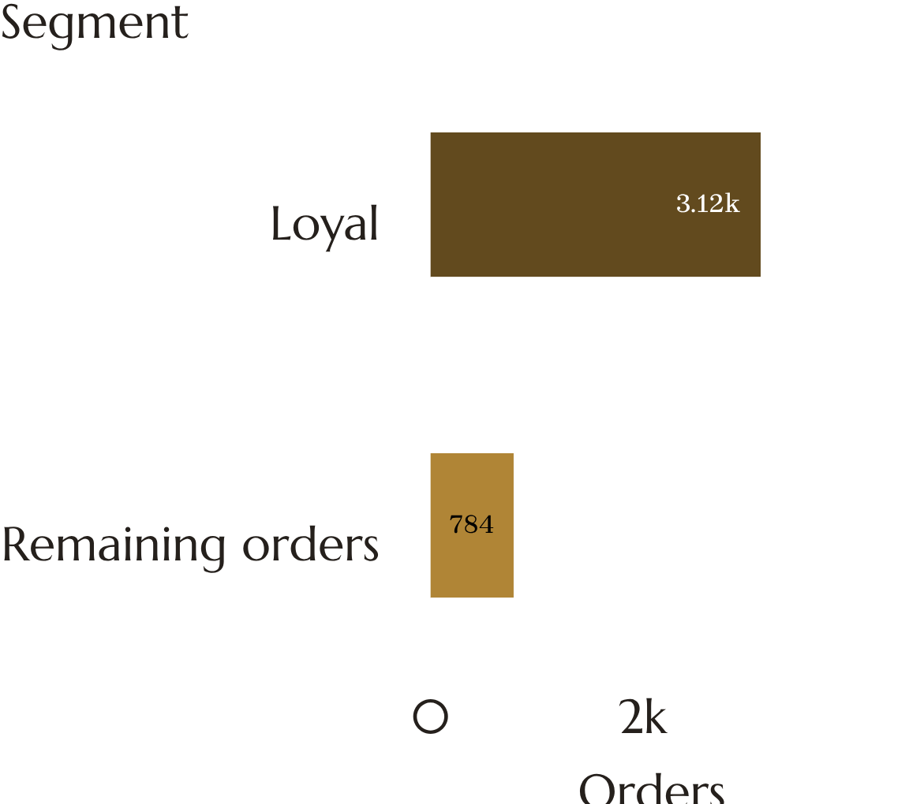
80%
Segmentation and loyalty: Loyal customers place 3,116 of 3,900 orders
OF ORDERS FROM LOYAL CUSTOMERS
Segments by previous purchases: New (1), Regular (2 to 10), Loyal (more than 10)
Observed: Loyal customers account for about 80% of orders
Discount adoption: Loyal 43.65%, Regular 40.43%, a modest gap
Metrics to monitor: repeat purchase behavior, customer lifetime value, purchase frequency, AOV by segment, category preference, promotional dependence

Slide 7
Demographics: balanced across age groups, discounts differ by gender
Observed: no single age group dominates.
Gender: 2,652 male orders, 1,248 female orders.
Observed: all 1,677 discounted transactions are male (63.24% of male orders); none for female customers.
AGE GROUP | ORDERS | REVENUE ($)
Young Adult | 1,028 | 62,143
Middle Age | 986 | 59,197
Adult | 942 | 55,978
Senior | 944 | 55,763
The dataset cannot explain why; targeting, product mix, exposure or data capture are all possible.

Slide 8
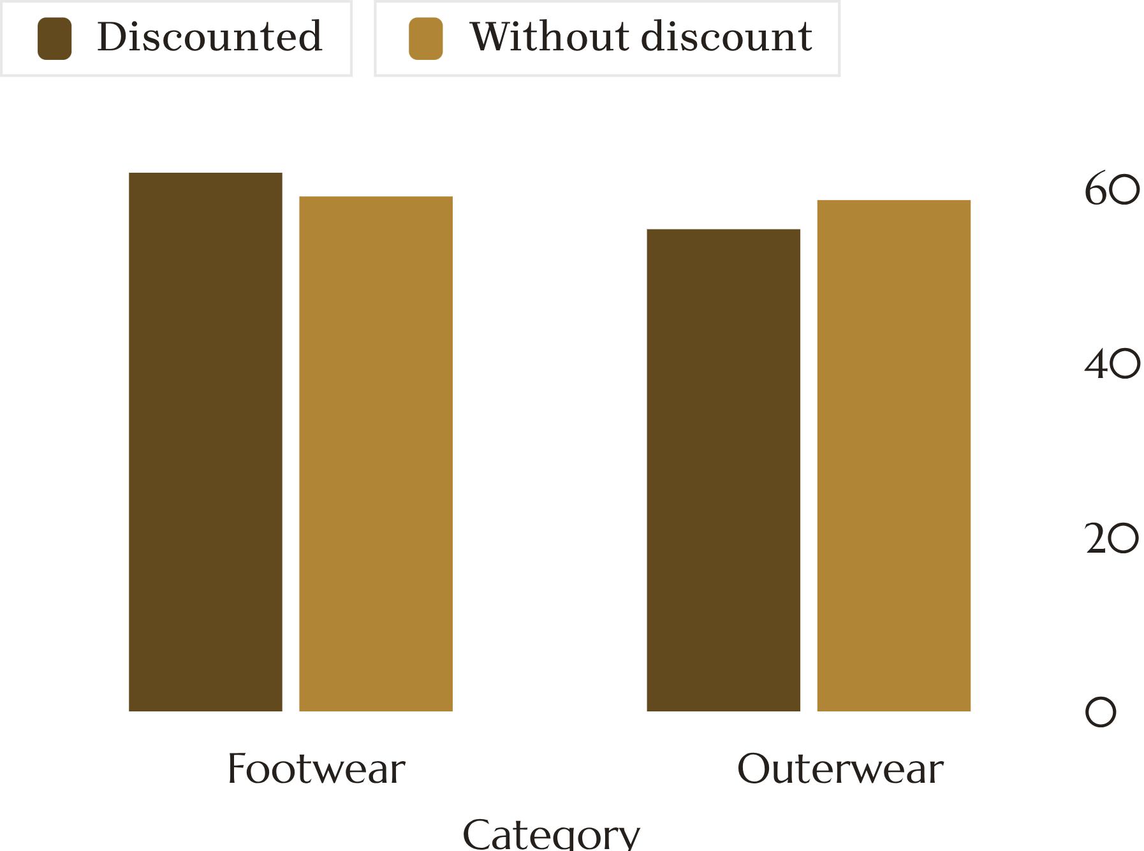
Discounts: usage is broad, the AOV association varies by category
Discount adoption by age is narrow: 41.68% (Middle Age) to 44.17% (Senior); overall 42.99%
Footwear: discounted AOV $61.80 vs $59.08 without, +$2.72
Outerwear: discounted AOV $55.32 vs $58.66 without, -$3.34
Clothing shows almost no difference; Accessories and Outerwear are lower with discounts
Association only: the analysis does not show that discounts caused these differences

Slide 9
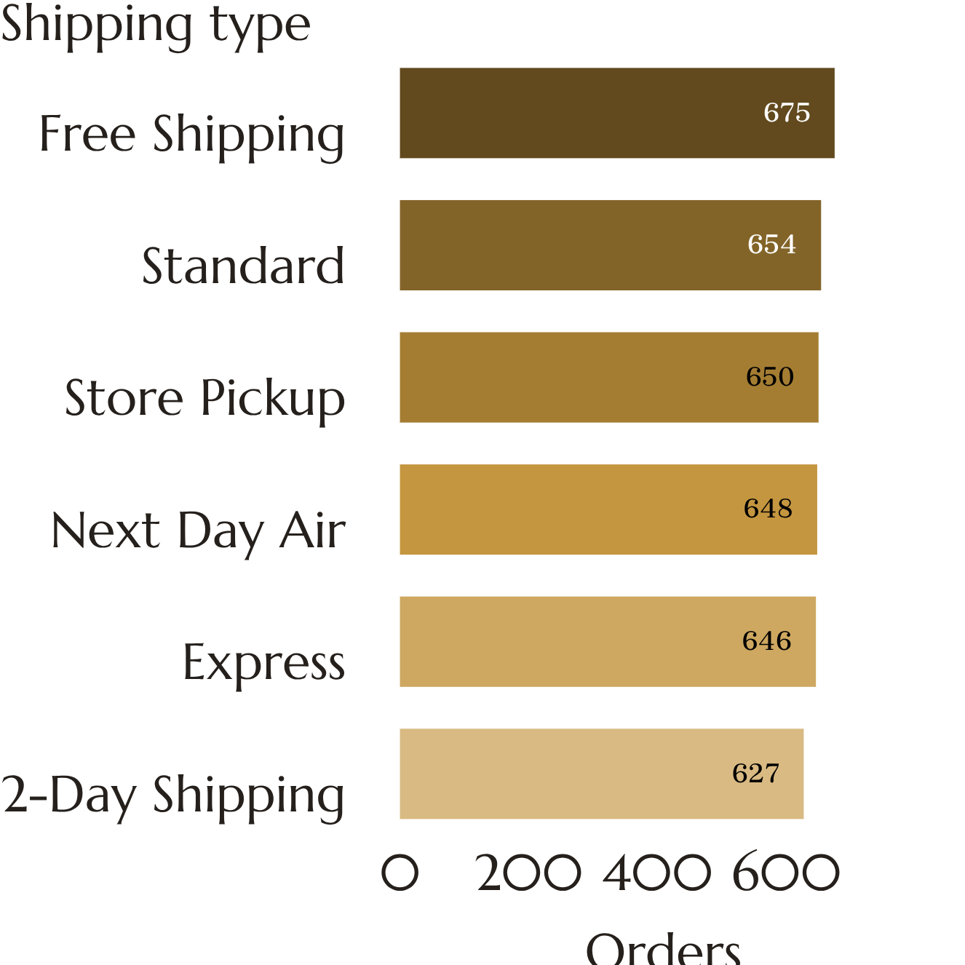
Shipping: Free Shipping leads volume and revenue at a $60.41 AOV
SHIPPING TYPE | AOV ($) | REVENUE ($) | ORDERS
Free Shipping | 60.41 | 40,777 | 675
Standard | 58.46 | 38,233 | 654
Store Pickup | 59.89 | 38,931 | 650
Next Day Air | 58.63 | 37,993 | 648
Express | 60.48 | 39,067 | 646
2-Day Shipping | 60.73 | 38,080 | 627
Observed: AOV range across methods is narrow ($58.46 to $60.73).

