Slide 1
CLOUD-NATIVE SAAS & GITOPS LIFECYCLE
TaskBoard Cloud
Comprehensive DevOps Capstone Project Walkthrough
FastAPI • React + Vite • PostgreSQL • Docker • CI/CD • DevSecOps (Trivy) • Terraform AWS • ArgoCD GitOps • Helm K8s • Prometheus & Grafana
Repository: github.com/mr-panther01/final-project-devops | Architecture: 3-Tier Microservices with GitOps Delivery
Full Stack: App, Automated Pytest, Git Workflow, Docker, GitHub Actions, Trivy Scan, Terraform VPC/EKS, ArgoCD GitOps, Helm, Observability

Slide 2
PROJECT OVERVIEW
Executive Summary & Core Engineering Pillars
PILLAR 01 • APPLICATION STACK
FastAPI + React Vite + Postgres
Clean 3-tier architecture with fully typed REST API, responsive UI dashboard, and Alembic DB migrations.
PILLAR 02 • DEVSECOPS & TESTING
Pytest Suite & Trivy Scanning
Automated SQLite in-memory test coverage, zero-failure quality gates, and automated high/critical CVE blocking in CI/CD.
PILLAR 03 • CLOUD INFRASTRUCTURE
Terraform AWS IaC + EKS
Multi-AZ AWS VPC provisioning (2 Public, 2 Private subnets, NAT Gateway) and Managed Kubernetes Cluster v1.31.
PILLAR 04 • GITOPS, K8S & OBSERVABILITY
ArgoCD + Helm + Prometheus/Grafana
Declarative GitOps sync, production Helm packaging, Ingress routing, HPA autoscaling, and real-time Grafana dashboard.

Slide 3
SYSTEM ARCHITECTURE
End-to-End DevOps Architecture & Deployment Lifecycle
1. Developer Workspace
Local Git workflow with conventional commits. Local stack spun up instantly with docker-compose up.
2. Automated CI Pipeline
GitHub Actions triggers on push/PR. Executes Pytest (isolated SQLite DB) and builds production React Vite assets.
3. Multi-Stage Containers
Docker builds backend (Python 3.12-slim) and frontend (Nginx unprivileged). Non-root security user appuser:10001.
4. DevSecOps Security Gate
Aquasecurity Trivy scans images for CVEs, strictly blocking build if HIGH or CRITICAL severity vulnerabilities exist.
5. Artifact Registry
Verified images published to GitHub Container Registry (GHCR) using immutable Git commit SHA tags (${{ github.sha }}).
6. Infrastructure as Code
Terraform provisions AWS VPC (Multi-AZ, 2 Public, 2 Private subnets, NAT Gateway) and Managed EKS Kubernetes Cluster.
7. GitOps Delivery (ArgoCD)
ArgoCD monitors the repository and synchronizes helm/taskboard with the Kubernetes cluster automatically (self-healing).
8. Kubernetes Orchestration
Helm manages Deployments (2+ replicas), Services, Horizontal Pod Autoscaling (HPA), and Nginx Ingress routing.
9. Full Observability Stack
FastAPI /metrics instrumented, Prometheus operator ServiceMonitor active, and live Grafana dashboard tracking RPS and latency.

Slide 4
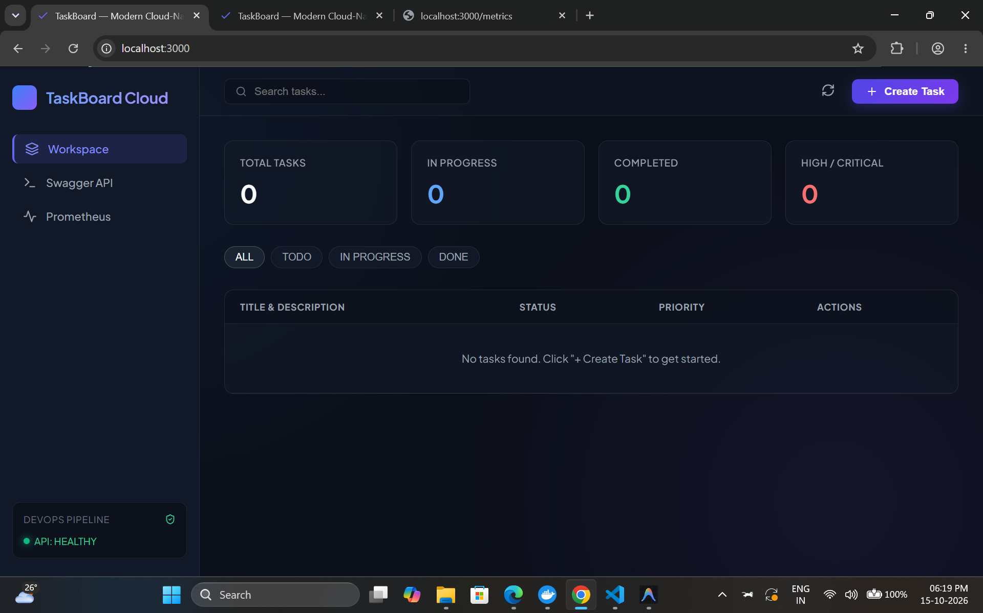
MODULE 01 • APPLICATION ARCHITECTURE
Module 1: SaaS Full-Stack Application
• FastAPI REST Engine
Backend providing /health, /ready, /metrics, and CRUD /api/tasks with Pydantic validation.
• PostgreSQL & Alembic
Relational task data storage managed via automated versioned database migrations (backend/alembic/).
• React + Vite Frontend
Interactive web dashboard featuring live task statistics, KPI cards, and task modal dialogs.
• Production Readiness
CORS configured, structured JSON responses, environment-driven configurations, and asynchronous queries.

Slide 5
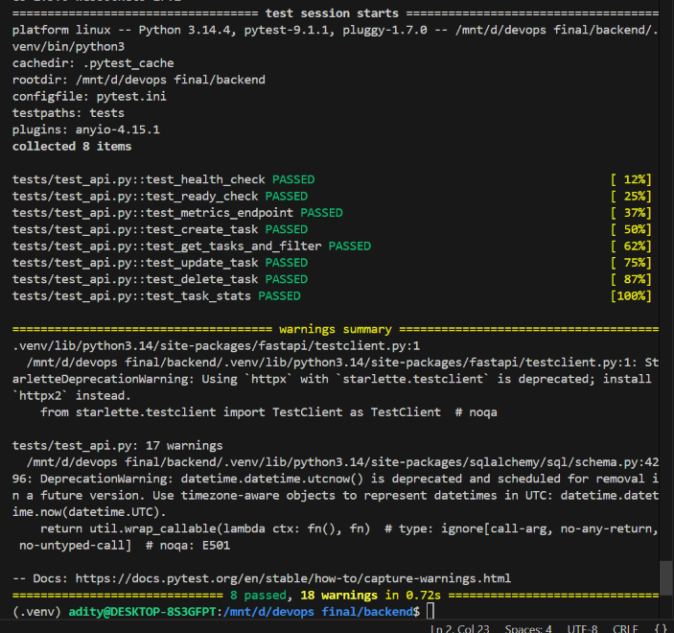
MODULE 02 • AUTOMATED TESTING
Module 2: Pytest Automated Testing Suite
• Comprehensive Test Matrix
Full endpoint test coverage across health checks, CRUD lifecycle, edge case handling, and status queries.
• SQLite In-Memory Isolation
Utilizes fixture-driven SQLite in-memory DB (backend/tests/conftest.py), ensuring zero pollution of production DB.
• Validation & Error Gate
Explicitly verifies 422 Unprocessable Entity payload handling, 404 Not Found returns, and metric endpoint integrity.
• 100% Passing Status
Pytest suite executes cleanly in < 1 second with verbose logging, serving as an immutable gate in CI.

Slide 6
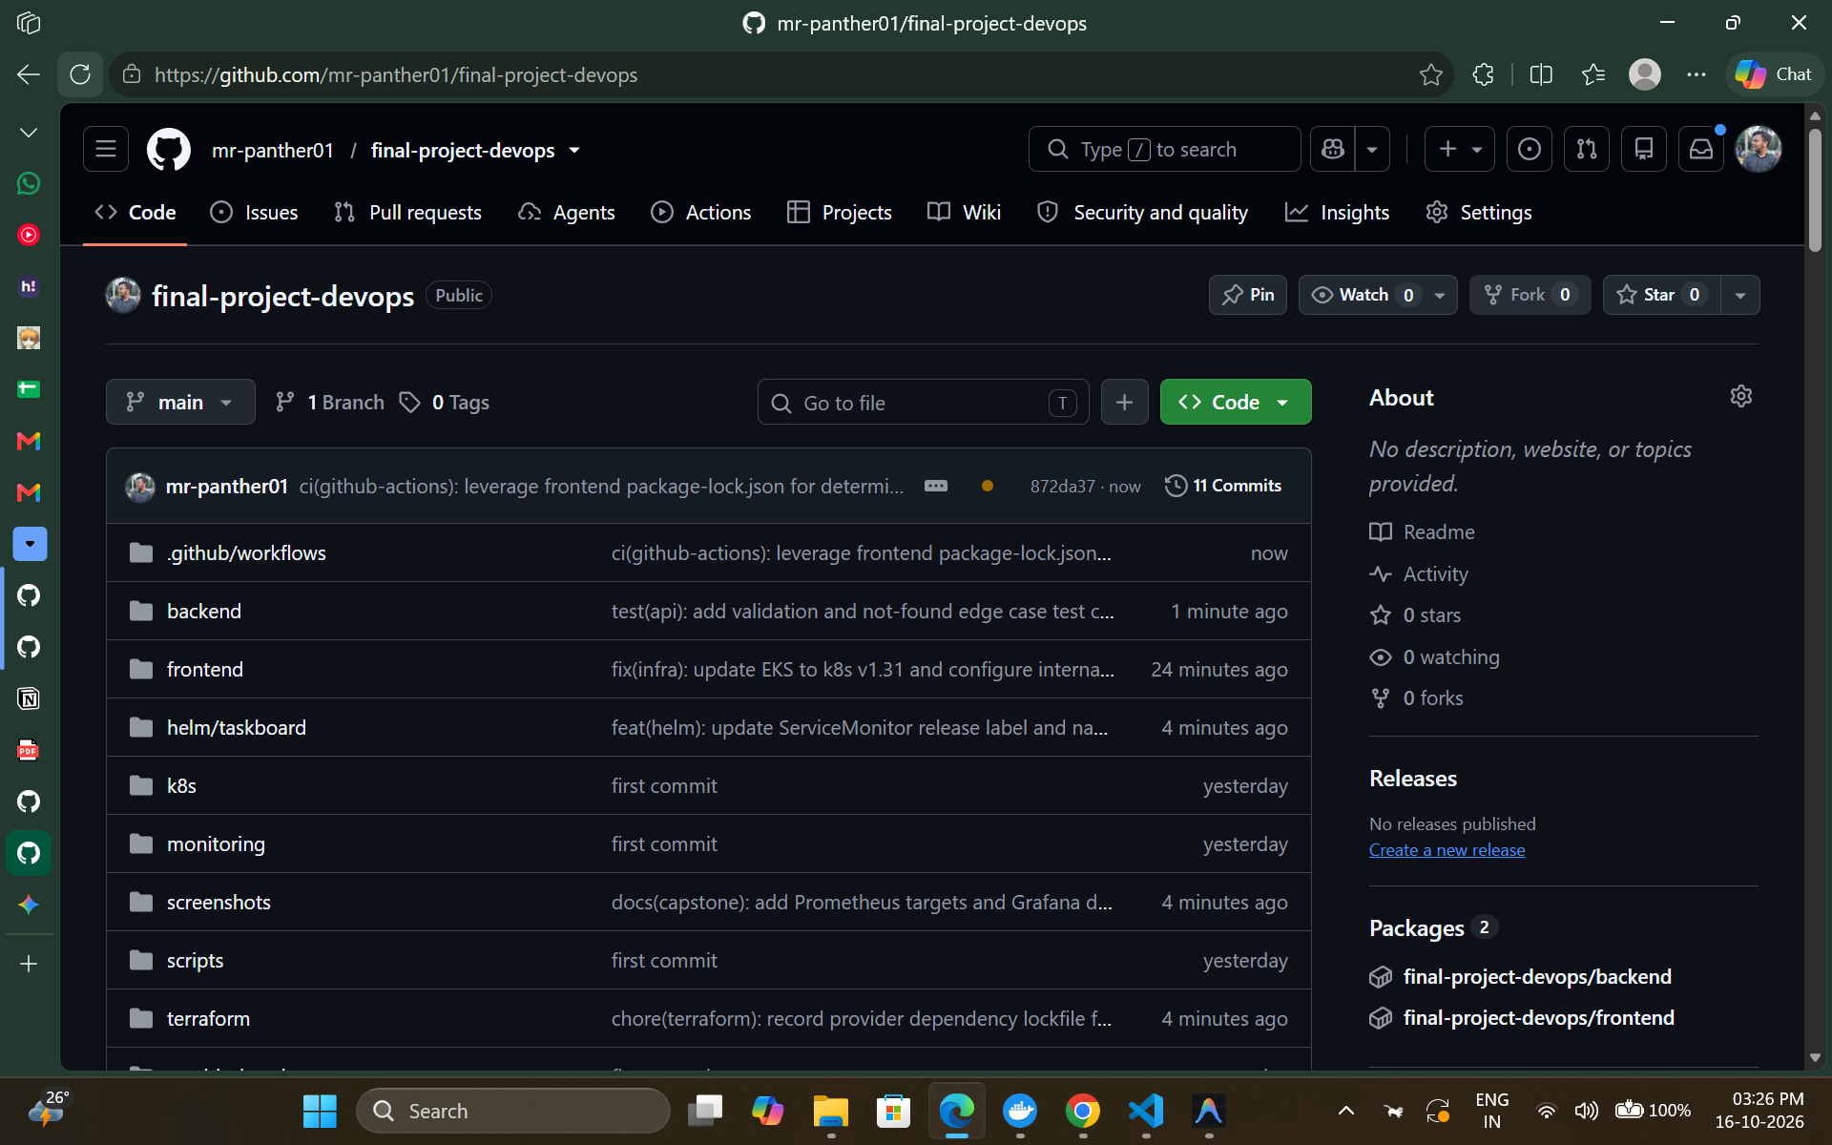
MODULE 03 • SOURCE CONTROL
Module 3: Git Workflow & Conventional Commits
• Industry Standard Commits
Strict adherence to conventional commit prefixes: feat:, fix:, test:, docs:, ci:, build:, and refactor:.
• Milestone Traceability
Linear commit history tracing every development stage from foundational code to cloud orchestration.
• Strict .gitignore Hygiene
Guarantees zero leakage of secrets, .env files, node_modules, Python __pycache__, .venv, and Terraform *.tfstate files.
• Branching & PR Best Practices
Protected main branch with required CI status checks passing before merge.

Slide 7
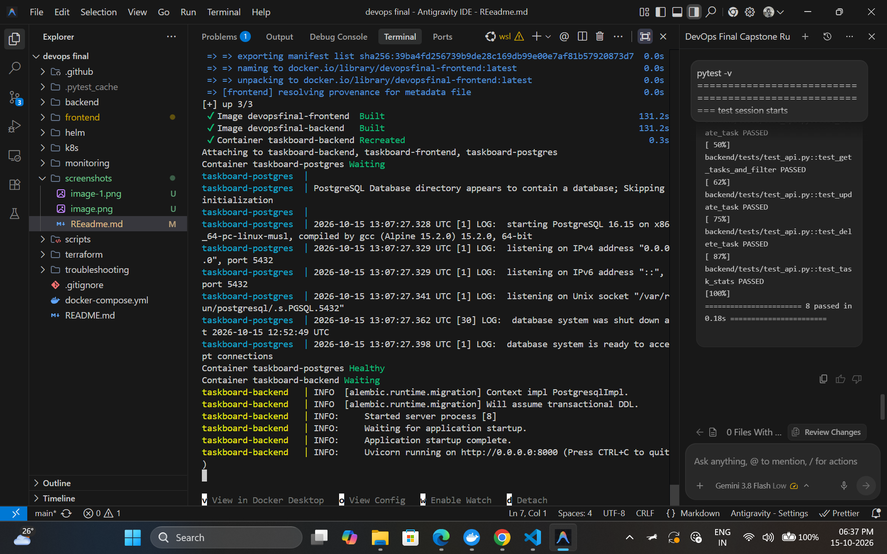
MODULE 04 • CONTAINER HARDENING
Module 4: Multi-Stage Docker Containerization
• Backend Containerization
Python 3.12-slim base image, non-root user (appuser:10001), automated DB migrations triggered upon startup.
• Frontend Multi-Stage Build
Node 20 Alpine builder compiles Vite assets; lightweight unprivileged Nginx serves static files on port 8080.
• Docker Compose Orchestration
Single command deployment (`docker compose up --build`) provisioning postgres, backend, and frontend on isolated network.
• Security & Footprint Optimization
Eliminated development compilers, package managers, and root access from final production images.

Slide 8
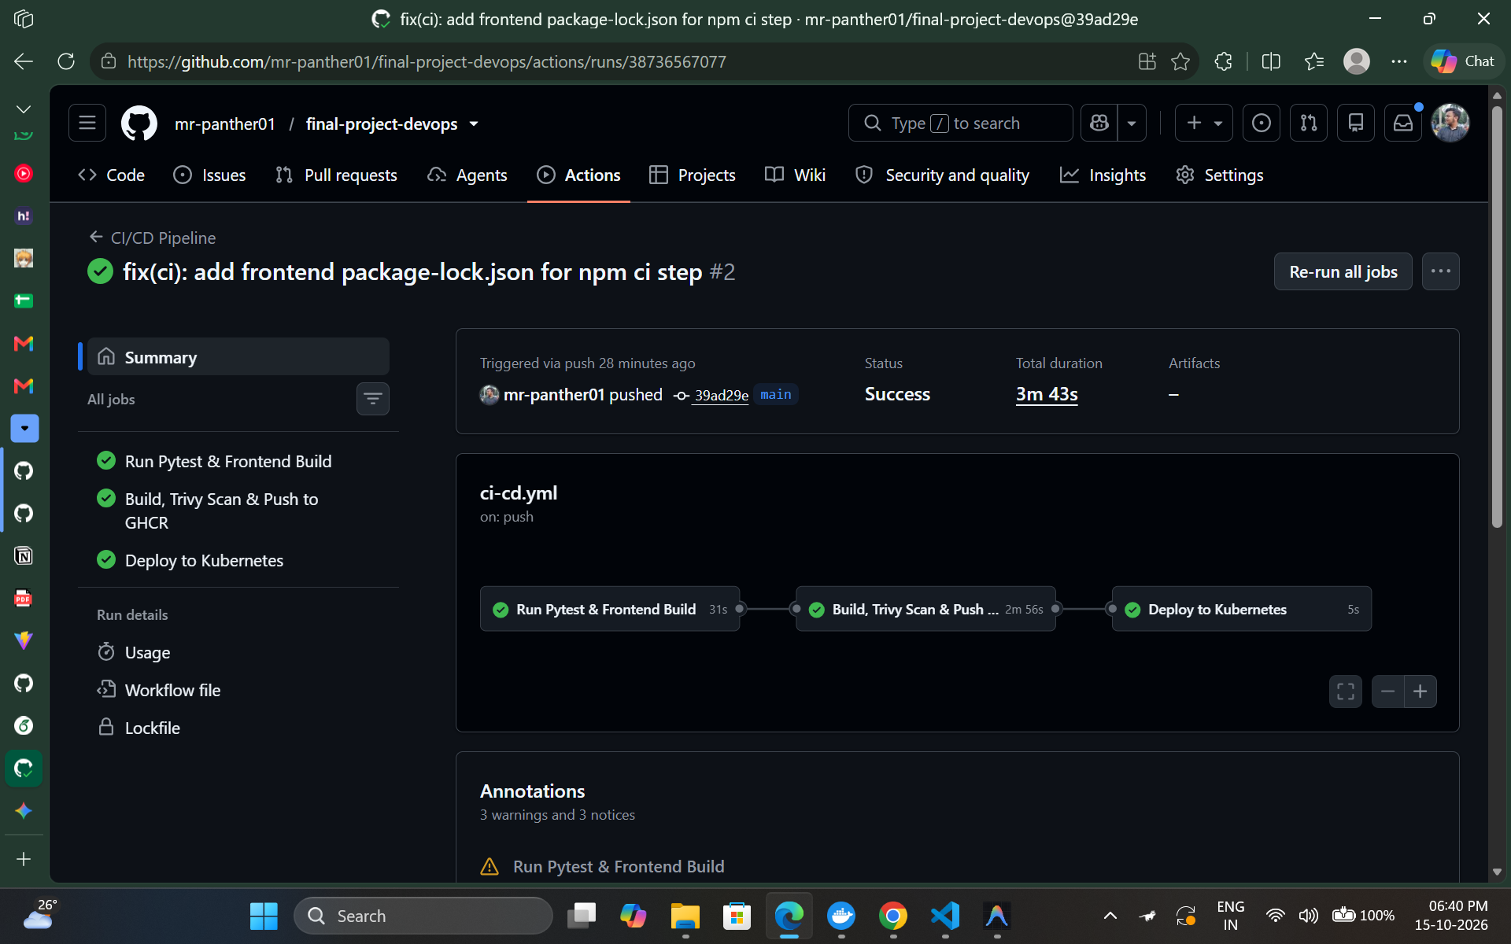
MODULE 05 • CONTINUOUS INTEGRATION
Module 5: GitHub Actions CI/CD Pipeline
• Automated Workflow Triggers
Pipeline triggered automatically on every git push and PR targeting the main branch (.github/workflows/ci-cd.yml).
• Strict Quality Gates
Automated Pytest unit testing and Vite frontend build validation must pass before image packaging.
• GitHub Container Registry (GHCR)
Immutable production images pushed to GHCR automatically tagged with Git commit SHA (${{ github.sha }}).
• Zero Downtime Continuous Delivery
Eliminates human error through fully declarative and reproducible build pipelines.

Slide 9
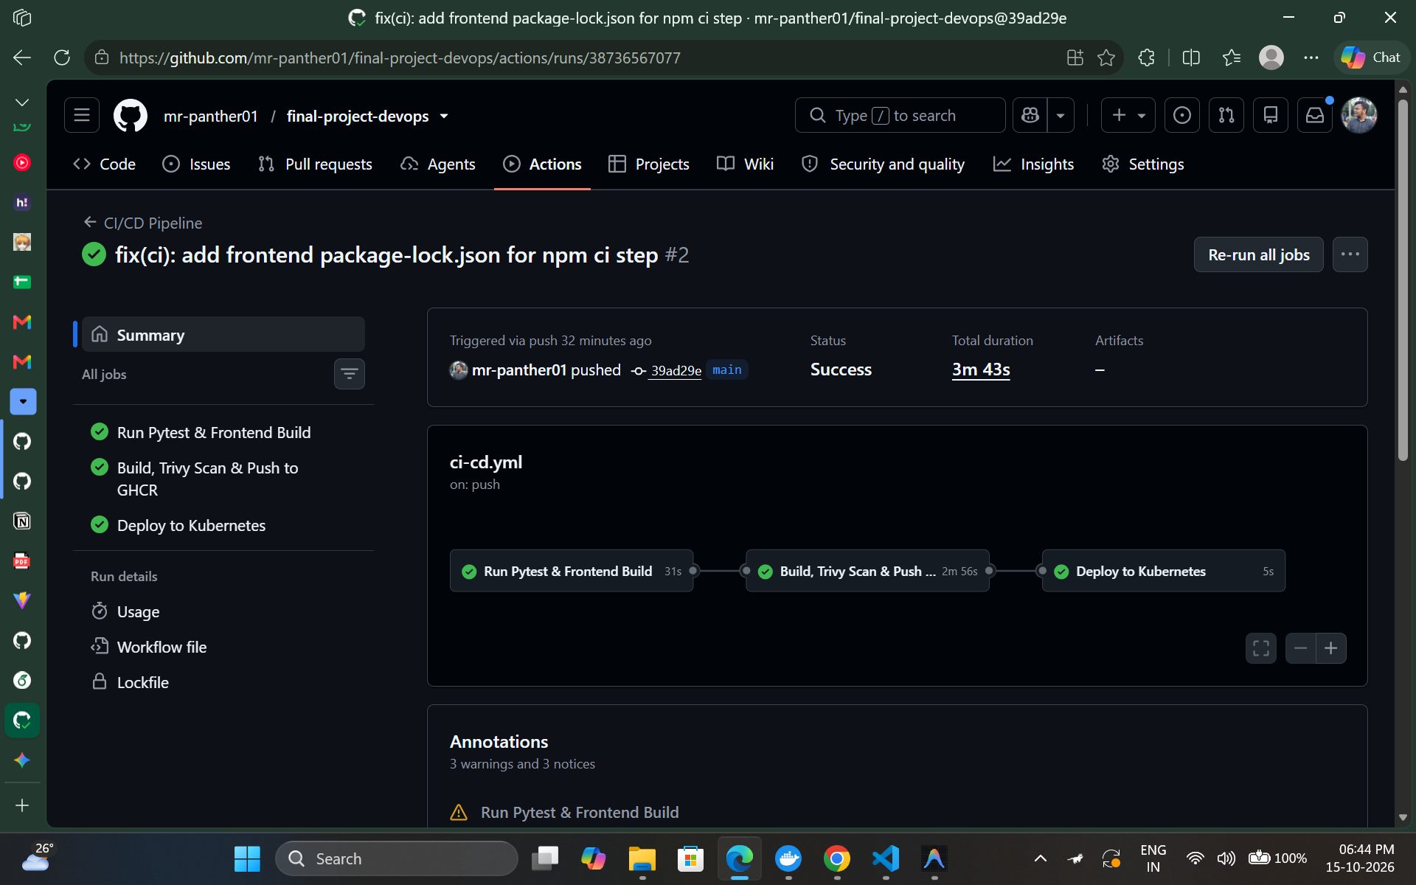
MODULE 06 • VULNERABILITY SCANNING
Module 6: DevSecOps — Trivy Security Scanning
• Automated Vulnerability Scan
Aquasecurity Trivy scanner embedded directly into CI pipeline scanning both Backend and Frontend container images.
• Strict Break-the-Build Gate
Configured with `exit-code: 1` and `severity: HIGH,CRITICAL` to immediately fail any build introducing vulnerabilities.
• Minimal Attack Surface
Utilizing hardened base images (`python:3.12-slim` and `nginx-unprivileged:alpine-slim`) with all build utilities stripped.
• Security Compliance Report
Generates verifiable security logs validating 0 High/Critical CVEs before registry publication.

Slide 10
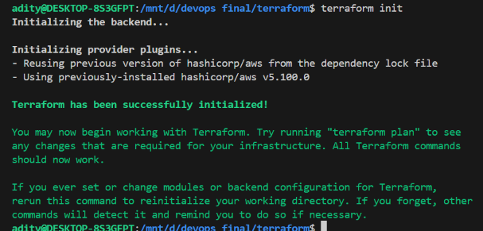
MODULE 07 • AWS IAC ARCHITECTURE
Module 7: AWS Infrastructure as Code (Terraform)
• Modular HCL Architecture
Organized into vpc.tf, eks.tf, main.tf, variables.tf, and outputs.tf with safe defaults in terraform.tfvars.example.
• AWS VPC & Multi-AZ Networking
Provisions 2 Public Subnets, 2 Private Subnets, Internet Gateway, Elastic IP, Route Tables, and NAT Gateway.
• AWS EKS Managed Cluster
Kubernetes v1.31 managed control plane with IAM roles, security groups, and automated EC2 worker node group provisioning.
• Infrastructure Lifecycle
Clean plan execution (22 cloud resources created) and verified teardown with `terraform destroy` to eliminate idle AWS costs.

Slide 11
GITOPS AUTOMATION
GitOps Continuous Delivery with ArgoCD
• Declarative Desired State
The Git repository (`helm/taskboard`) serves as the single source of truth for the entire application deployment.
• Automated Synchronization
ArgoCD continuously compares the live Kubernetes cluster state against the Git repository; sync status displays 'Synced & Healthy'.
• Self-Healing Capabilities
Any manual drift or accidental kubectl edits are detected and automatically reconciled back to the committed Git state.
• Manifest: k8s/argocd-application.yaml
Defines target revision (`main`), path (`helm/taskboard`), automated prune, and self-healing policies.
GITOPS WORKFLOW RECONCILIATION
→ Git Commit & Push
Developer or CI pipeline updates Helm values (e.g. image tag: ${{ github.sha }}).
→ ArgoCD Polling & Webhook
ArgoCD detects commit difference between Git repo and active cluster.
→ Diff Evaluation
ArgoCD identifies deployment delta: OutOfSync -> Syncing.
→ Automated Deployment
Applies Helm templating, triggers rolling update, and prunes orphaned resources.
→ Cluster Health Verification
Status returns to: Synced • Healthy (Pods, Services, Ingress, HPA).

Slide 12
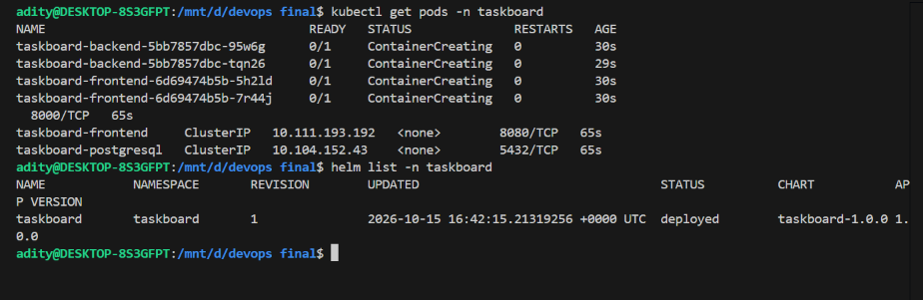
MODULE 08 • KUBERNETES DEPLOYMENTS
Module 8: Kubernetes Orchestration & Helm Chart
• Production Helm Packaging
Custom chart in `helm/taskboard/` managing Chart.yaml, values.yaml, and deployment templates.
• High Availability & Pod Specs
2+ replicas per service, non-root runAsUser: 10001, securityContext, and granular CPU/memory limits & requests.
• Ingress & Service Routing
ClusterIP services exposed via Kubernetes Nginx Ingress Controller routing `/` to Frontend and `/api` to Backend.
• Horizontal Pod Autoscaling
HPA configured for FastAPI backend dynamically scaling pods (2 to 5 replicas) based on CPU/traffic load.

Slide 13
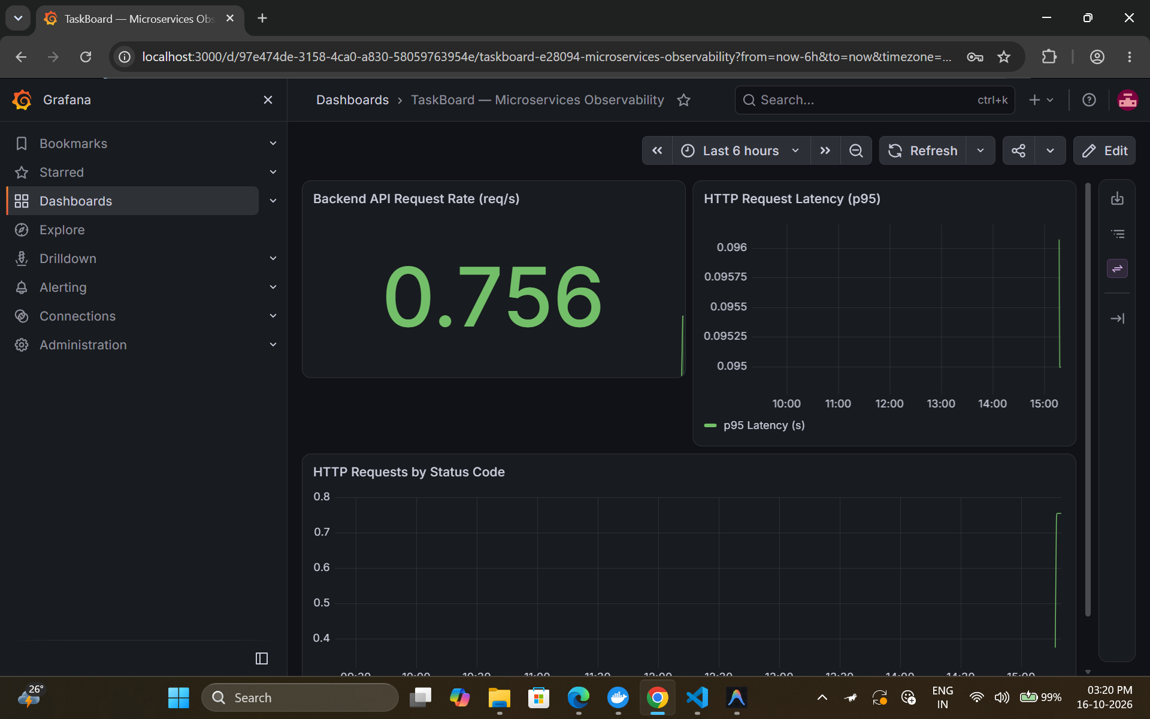
MODULE 09 • PROMETHEUS & GRAFANA
Module 9: Observability — Prometheus & Grafana
• Application Instrumentation
FastAPI instrumented with `prometheus-fastapi-instrumentator` exposing real-time metrics at `/metrics`.
• Prometheus ServiceMonitor
Custom Kubernetes ServiceMonitor manifest automatically discovers and scrapes backend targets (Status: UP 1/1).
• Live Grafana Dashboard
Interactive dashboard visualizing real-time metrics: request rate (RPS), p95 latency, error rates, and HTTP status codes.
• Proactive Production Telemetry
Provides actionable insights, alerts, and visibility into API latency and pod health under load.

Slide 14
CAPSTONE SUMMARY
Project Conclusion & Engineering Competencies
KEY LEARNING
01
Full Lifecycle Automation
From git commit to cloud deployment with 0 manual steps required in the release path.
KEY LEARNING
02
Shift-Left Security
Trivy vulnerability scanning and least-privilege non-root containers implemented from day one.
KEY LEARNING
03
GitOps Continuous Delivery
ArgoCD automated sync ensuring Git remains the immutable single source of truth.
KEY LEARNING
04
Production Observability
Complete metrics pipeline with Prometheus scraping and Grafana dashboards for proactive incident resolution.
✓ Capstone Status: 100% Complete & Verified across all requirements with Full Video & Artifact Evidence.

