Slide 1
Automated Insight Engine

Slide 2
Executive Summary
  Okay, here's a summary of the provided data, focusing on actionable insights:
  Executive Summary:**
  This report analyzes campaign performance data across 5000 rows, revealing a solid click-through rate (CTR) of 7.61% on 16.2 million impressions, resulting in 1.23 million clicks. Traffic is primarily concentrated in the top five cities, with Bangalore leading the way. However, a significant number of traffic anomalies, particularly in Bangalore, require immediate investigation to understand their cause and impact.
  Key Takeaways:**
  Strong CTR:** The 7.61% CTR indicates effective ad creative and targeting strategies overall.
  City Concentration:** Top 5 cities contribute significantly to overall traffic, indicating potential for focused regional campaigns.
  Bangalore Anomaly Cluster:** The large number of traffic anomalies specifically in Bangalore suggests potential data issues, campaign malfunctions, or external factors affecting traffic in this region.
  Action Recommendations:**
  Investigate Bangalore Anomalies:** Prioritize a deep dive into the Bangalore traffic data around 2025-01-01 to identify the root cause of the numerous anomalies. This includes checking for data integrity issues, campaign configuration errors, and external events affecting Bangalore traffic.
  Segment & Analyze City Performance:** Further analyze performance metrics by city (beyond just impressions) to identify opportunities for optimization. This includes comparing CTRs, conversion rates (if available), and cost per click (CPC) across different cities.

Slide 3
Key Metrics
Metric | Value
Row Count | 5000
Total Impressions | 16221520
Total Clicks | 1234819
CTR | 0.0761
Top Cities | {'Bangalore': 273546, 'Chennai': 269173, 'Mumbai': 260675, 'Delhi': 259930, 'Hyderabad': 251324}

Slide 4
Detected Anomalies
  Traffic dropped 35.1% in Bangalore on 2025-01-01
  Traffic dropped 68.7% in Bangalore on 2025-01-01
  Traffic spiked 275.0% in Bangalore on 2025-01-01
  Traffic dropped 51.0% in Bangalore on 2025-01-01
  Traffic spiked 135.3% in Bangalore on 2025-01-01
  ... plus 6413 more anomalies (summarized).

Slide 5
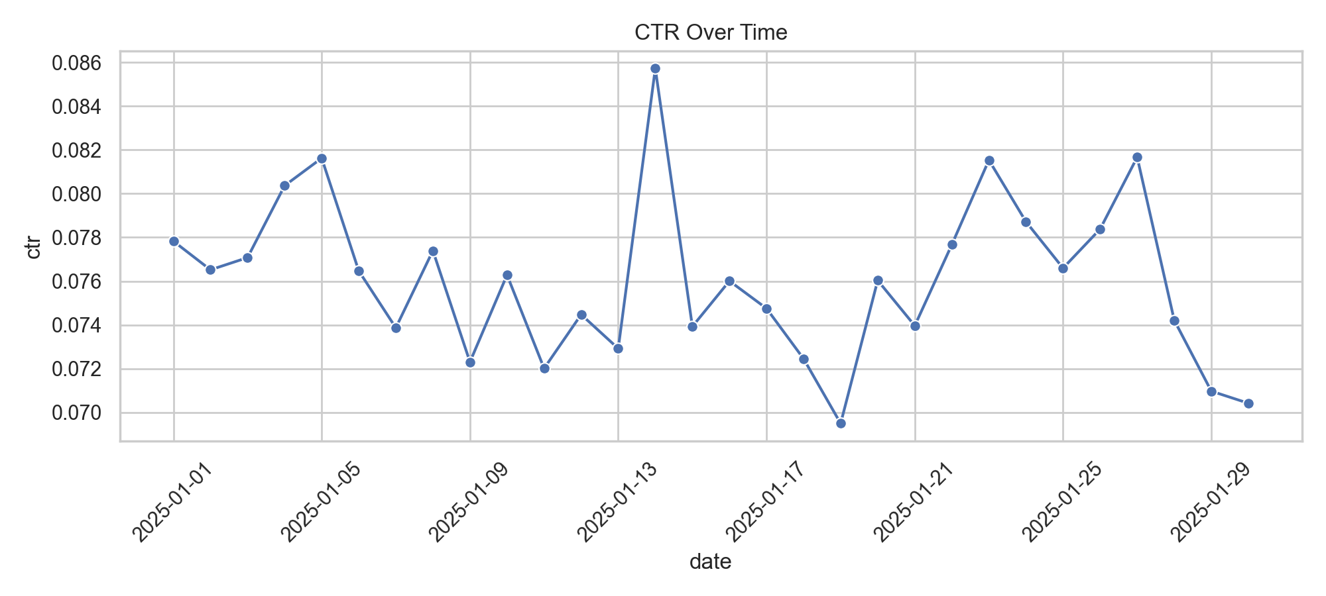
Large Ad Dataset Ctr 1764749897.Png

Slide 6
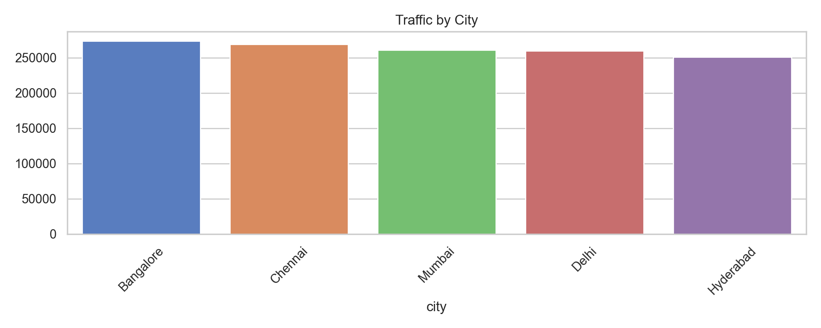
Large Ad Dataset City 1764749897.Png

Slide 7
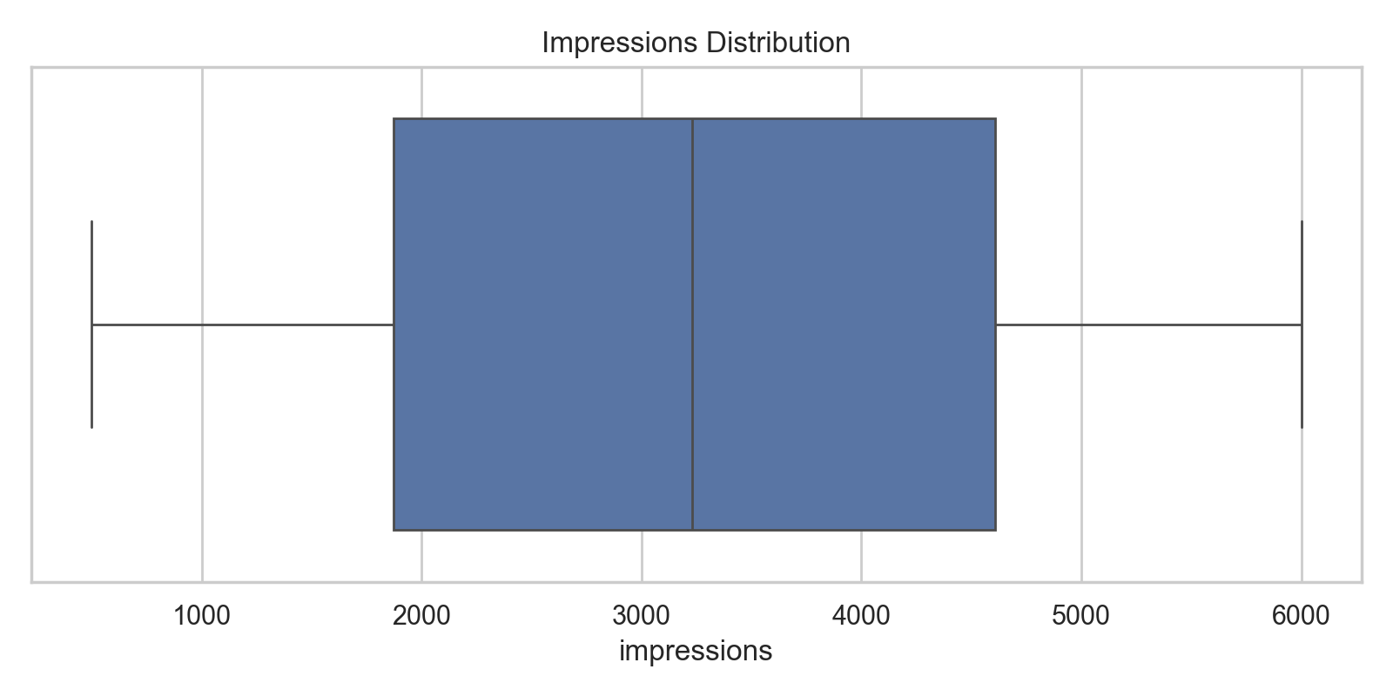
Large Ad Dataset Impr Box 1764749897.Png

