Slide 1
Weekly Performance Report
Automated Insight Engine
Generated using AI

Slide 2
Executive Summary
Okay, here's an executive summary, key insights, and recommended actions based on the provided data:
**Executive Summary:**
The recent advertising campaign, comprised of 9 ad variations, generated 16,800 impressions and 935 clicks, resulting in a click-through rate (CTR) of 5.57%. This CTR indicates a moderate level of engagement with the ads. Geographically, the majority of clicks originated from the top three cities: Delhi, Mumbai, and Bangalore, highlighting their significance as key markets for our campaign. Optimizing the creative messaging for specific cities may increase engagement.
**Key Insights:**
* **Moderate CTR:** The 5.57% CTR suggests there's room for improvement in ad relevance or targeting. A deeper analysis may be required to determine areas of optimization.
* **Delhi Dominance:** Delhi is the leading city for clicks, suggesting stronger resonance with the ads in that region compared to Mumbai and Bangalore, by at least 20%.
* **Concentrated Engagement:** The concentration of clicks in the top three cities emphasizes the importance of a location-based targeting strategy.
**Recommended Actions:**
* **A/B Test Ad Creatives:** Develop and implement A/B tests for ad creatives, particularly targeting Delhi, Mumbai, and Bangalore, to improve CTR. Consider tailoring messaging to resonate with each city's unique demographics and interests.
* **Refine Targeting:** Analyze user demographics and behavior in the top three cities to refine targeting parameters and reach a more relevant audience. Explore targeting options such as interests, demographics, and online behavior within these specific locations.

Slide 3
Key Metrics Summary
total_rows: 9
impressions: 16800
clicks: 935
ctr: 0.0557
top_cities: {'Delhi': 580, 'Mumbai': 485, 'Bangalore': 455}

Slide 4
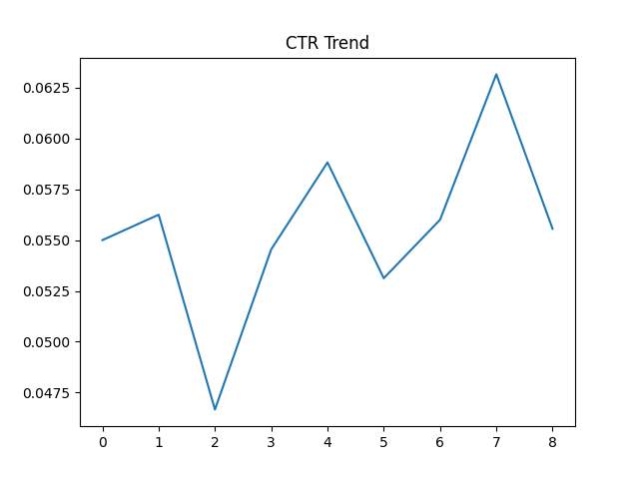
Generated Chart

