Slide 1
Microsoft Engage Project
2022
Face Recognition

Slide 2
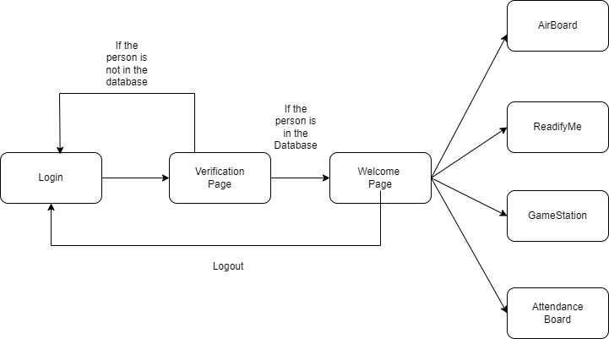
Flowchart
Features

Slide 3






Technologies Used

Slide 4
TechStack
Front End : HTML,CSS, JAVASCRIPT
Backend- Flask
Database – SQLAlchemy
Technologies/libraries used – Numpy, OpeCV, Face_Recognition, Mediapipe, CVZONE, Pyautogui

Slide 5
KeyFeatures
Login:
Login in to your Home page using face recognition.
You will be directed to login page if your image is not present in database
Welcome Page:
In the Welcome Page you will be shown your name in the title
You will be provided 4 features which will be helpful in your daily activities
Feature 1 (Airboard) : In airboard it helps you draw anything on the screen using your hand gestures, various color features are provided with it and also a feature to clean your screen
Feature 2 (ReadifyMe) : Using Readify me you can scroll up and down your document file using hand recognition gestures.
Feature 3 (GameStation) : In Gamestation you come across an interactive game with which you can play snake game using hand gestures.
Feature 4 (Attendance Database) : Here you can see the person who logged in and when with date and time.

Slide 6
Thank You

