Slide 1

Basic Details of the Team and Problem Statement
Ministry/Organization Name/Student Innovation: AICTE , MIC-Student Innovation
PS Code: SIH1486
Problem Statement Title: Develop a comprehensive online platform to streamline and enhance the travel and tourism experience for users.
Team Name: BYTE SYSTEM
Team Leader Name: Harshita Patnaik
Institute Code (AISHE): U-1071
Institute Name: Gandhi Institute of Engineering And Technology University
Theme Name: Travel and Tourism

Slide 2
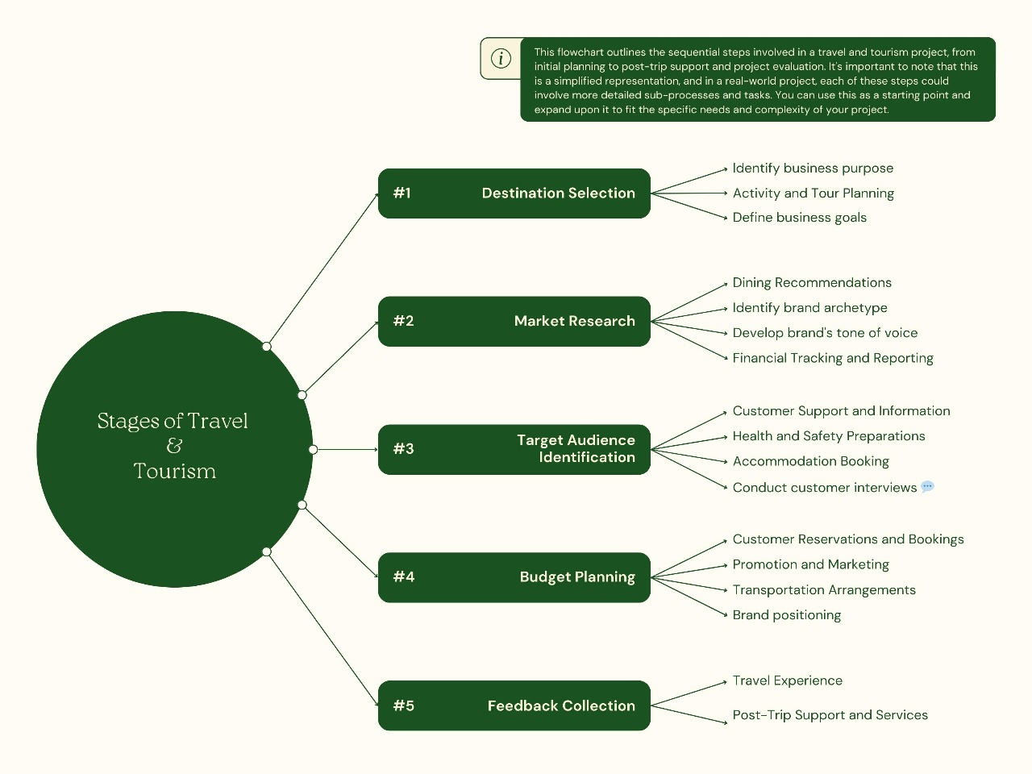








Idea/Approach Details
Describe your idea/Solution/Prototype here:
Creating a tourist-friendly and budget-conscious travel project requires careful planning and consideration of various factors. Here are some key points to define for such a project:
Destination Selection: Select destinations with a range of attractions and experiences.
Accommodation Variety: Provide options for all budgets from average hotels to luxury hotels.
Transport Access: Facilitate easy transportation access.
Local Information: Offer detailed destination guides and local insights.
Budget Planning: Provide tools to help travelers stay within their budget.
Affordable Activities: Curate low-cost or free activities.
Safety Measures: Ensure safety and health precautions are in place.
Language Support: Offer translation services and multilingual resources.
Budget-Friendly Packages: Design cost-effective travel packages.
Sustainability Focus: Encourage eco-friendly and sustainable practices.
Traveler Education: Provide resources for smart budgeting.
Digital Tools: Develop a user-friendly travel app or website.
Describe your Technology stack here:

Slide 3
Idea/Approach Details
Describe your Use Cases here
Describe your Dependencies / Show stopper here
Travel Booking Website:
Develop a responsive website to allow users to book flights, hotels, and activities using HTML, CSS, Bootstrap, and JavaScript with a backend technology like Node.js or Python.
Interactive Destination Guides:
Create interactive guides with maps, images, and descriptions of tourist destinations using HTML, CSS, and JavaScript.
Customizable Travel Itinerary Builder:
Build an itinerary builder that lets users plan their trips by selecting destinations, activities, and accommodations with dynamic updates using JavaScript and a server-side language like PHP or Python.
Real-time Weather Dashboard:
Display real-time weather data using APIs like OpenWeatherMap with JavaScript and update the UI dynamically using HTML and CSS.
User Reviews and Ratings:
. Allow users to rate and review destinations, hotels, and restaurants with dynamic, user-friendly interfaces built using HTML, CSS, and JavaScript, and store data using a backend database system
Multi-language Support:
Implement language selection and translation features using JavaScript and libraries like i18next, combined with HTML and CSS for language-specific style
Responsive Booking Forms:
Create responsive booking forms for accommodations, tours, and transportation with client-side validation using JavaScript, and handle form submissions with a server-side language.
Payment Gateway Integration:
Integrate payment gateways like PayPal or Stripe for secure online payments in travel booking services using JavaScript for frontend interactivity and server-side scripting for payment processing.
Social Media Integration:
Allow users to share their travel experiences and connect their social media profiles using JavaScript SDKs and HTML/CSS for styling
Tour and Activity Search Engine:
Create a dynamic search engine that filters and displays tours and activities based on user preferences using JavaScript and server-side scripting.

Slide 4
Team Member Details
Team Leader Name: Harshita Patnaik
Branch : Btech Stream : CSE Year: ||
ear : II Team Member 1 Name: Laxmi Narayan Panigrahy
Branch : Btech Stream : CSE Year :II
Team Member 2 Name: Himanshu Kumar Parida
Branch : Btech Stream : CSE Year :II
Team Member 3 Name: Rajesh Kumar Panda
Branch : Btech Stream : CSE Year :II
Team Member 4 Name: Soubhagya Jena
Branch : Btech Stream : CSE Year :II
Team Member 5 Name: Subrat Sahu
Branch : Btech Stream : CSE Year :II
Team Mentor 1 Name: Sontosh Kumar Panda
Category :Academic
:

