Slide 1

LEARNATHON 4.0
UNLOCKING THE FUTURE: LEARN, BUILD, INNOVATE
LEARN TO HACK -HACK TO LEARN
Team Name: Syntax Squad
Rajesh Kumar Panda
BTech in CSE
22UG010981
GIET UNIVERSITY, Gunupur
Debasish Senapati
BTech in CSE
22UG010460
GIET UNIVERSITY, Gunupur
Rakesh Senapati
BTech in CSE
22UG010461
GIET UNIVERSITY, Gunupur
M Bharat
BTech in CSE
22UG010917
GIET UNIVERSITY, Gunupur

Slide 2

AI-Powered Fraud Detection in Auto Insurance: Predictive Modeling for Smarter Claims Management.
Revolutionizing Finance Through Technology and Design………………

Slide 3

CONTENTS
Introduction
Stakeholders & Benefits
ANALYSIS
Proposed SOLUTION (Phases of Pipeline)
EDA INSIGHTS & ACTION
FEATURE SELECTION
RESULT(BEST MODEL)
Deployment

Slide 4
INTRODUCTION
Insurance fraud, especially in auto claims, leads to massive financial losses and operational inefficiencies. Traditional methods struggle to detect complex fraud patterns effectively.
We propose an AI-powered predictive system that uses Machine Learning and Deep Learning models to accurately identify fraudulent claims. This solution enhances claim processing, minimizes manual effort, and supports smarter, faster decision-making for insurers.

Slide 5
Stakeholders & Benefits
👥 Stakeholders:
Insurance Companies – reduce fraud-related losses
Claims Investigators – faster, AI-assisted decision-making
Policyholders – quicker claim resolution, fair premiums
Regulatory Bodies – ensure fraud compliance & reporting
AI Developers – innovate intelligent detection systems
🎯 Key Benefits:
Faster claim approvals via automation
Reduced financial losses from fraud
Higher accuracy than manual/rule-based methods
Transparent AI decisions
Scalable to future data and fraud trends

Slide 6
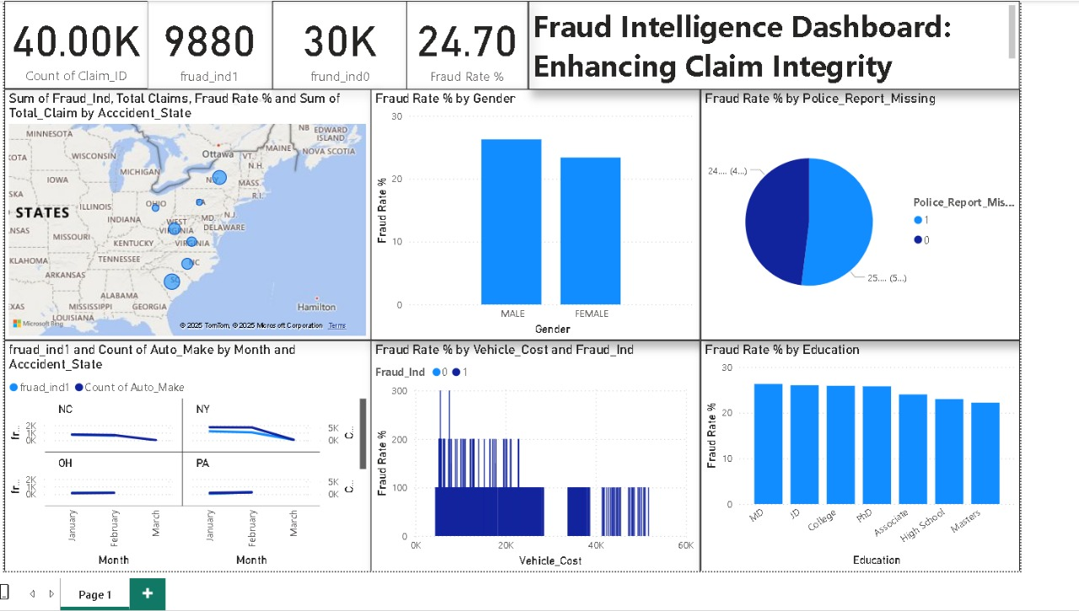
ANALYSIS

Slide 7
Proposed SOLUTION (Phases of pipeline)
Phase 1 (Data Loading & Cleaning):
Loaded Train, Test, and Validation files separately
Cleaned column names, removed extra spaces and symbols
Normalized binary categorical values (Y/N, YES/NO → 1/0)
Parsed date fields and handled missing values
Removed duplicate records
Phase 2 (Exploratory Data Analysis (EDA)):
Visualized class imbalance in fraud labels
Plotted feature distributions, outliers, correlations
Explored categorical value frequencies
Phase 3 (Outlier Treatment):
Applied IQR capping on high-skew numeric fields like Policy_Premium, Claims, Mileage
Verified improvements with before-after boxplots
Phase 4 (Feature Engineering):
Extracted new features: Policy Duration, Accident to Claim Lag, DL Expiry before Accident
Dropped original date columns to reduce noise

Slide 8
Proposed SOLUTION (Phases of pipeline)
Phase 5 (Dataset Alignment & Class Balancing):
Ensured consistent columns across Train, Test, and Val
Retained all columns including IDs and targets
No merging was done; alignment preserved dataset independence
Applied SMOTE to balance fraud vs. non-fraud cases in training data
Phase 6 (Feature Selection):
Compared Mutual Info, F-Test, Chi², and Boruta
Identified top-5 features using best-performing method
Phase 6 (Model Training & Evaluation):
Trained 10 models: LR, DT, RF, GB, AB, NB, SVM, XGB, LGBM, CatBoost
Evaluated using Accuracy, Precision, Recall, F1, AUC, MCC, and Log Loss
Normalized metrics to compute a single overall score per model
Phase 6 (Overfitting Detection & Validation on Unseen Data):
Compared training vs. testing accuracy to detect overfitting gaps
Predicted on 10,000 real-world records using the top model (Decision Tree)
Saved outputs as “Validation_Predictions_By_DecisionTree.csv

Slide 9
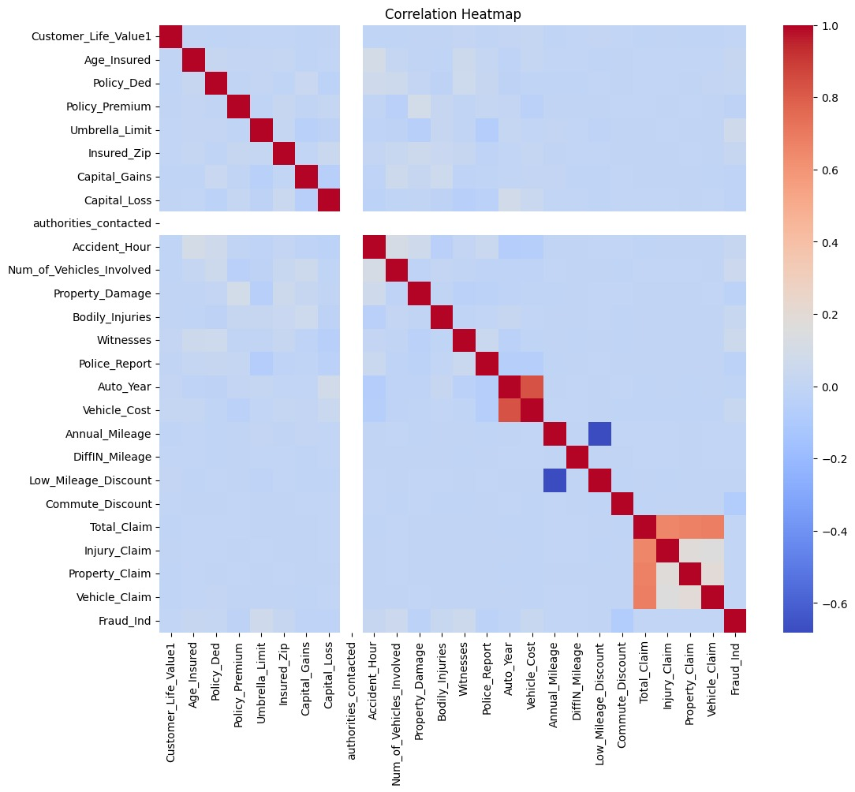
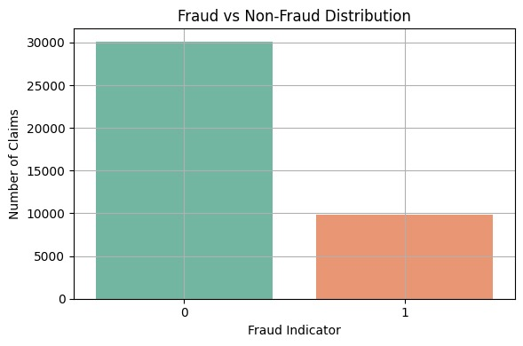
EDA INSIGHTS & ACTION
EDA Results:

Slide 10
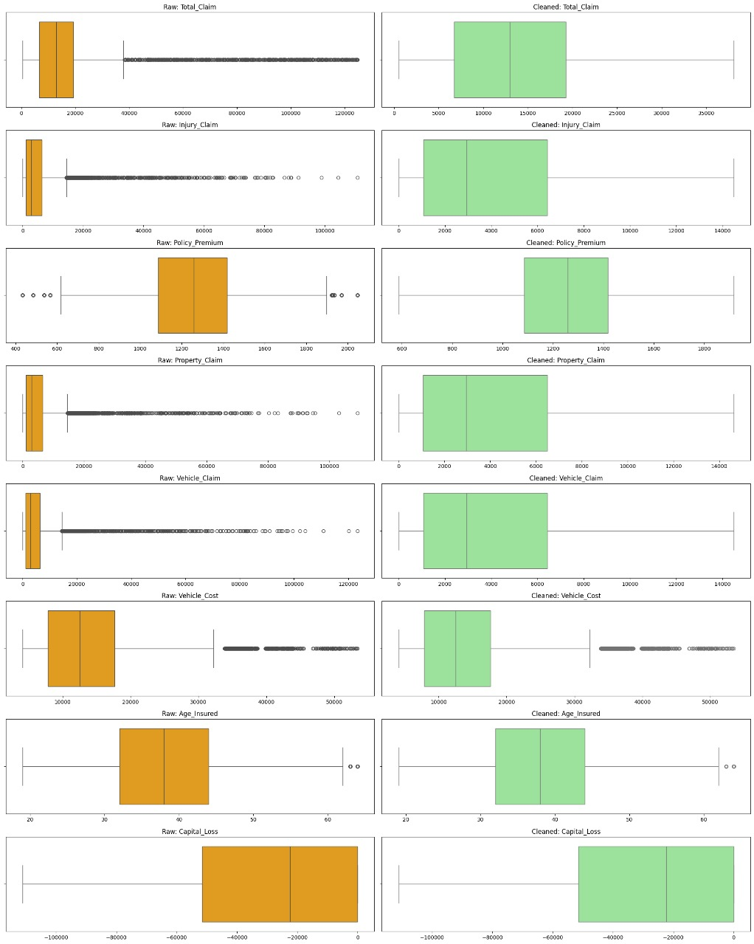
EDA INSIGHTS & ACTION
EDA Results:
⚠ Class Imbalance Observed ▸ Fraud cases were significantly fewer than non-fraud ▸ Triggered the use of SMOTE to balance classes
🔍 Numerical Feature Insights ▸ Features like Policy_Premium, Claim Amounts, and Annual Mileage
showed high skewness and extreme values ▸ Detected strong outliers via boxplots
📈 Correlation Analysis ▸ Weak-to-moderate correlations with target variable ▸ Some related claim fields were correlated with each other
📦 Categorical Feature Patterns ▸ Many high-cardinality categories (e.g., Insured_Zip, Vehicle_Make) ▸ Top few categories dominated frequency distributions
✅ Action Taken
▸ Applied IQR capping for outlier treatment
▸ Selected robust features using MI, F-Test, Chi², Boruta
▸ Encoded categorical variables for model compatibility

Slide 11
FEATURE SELECTION
Top 5 Features by Mutual Information:
['Policy_Num', 'Accident_Location', 'Insured_Zip', 'Policy_Premium', 'DL_Expiry_Before_Accident_Days’]
Top 5 Features by F-test (ANOVA):
['Accident_Severity', 'Collision_Type', 'Low_Mileage_Discount', 'Commute_Discount', 'Garage_Location’]
Top 5 Features by Chi-square Test:
['Accident_Severity', 'Low_Mileage_Discount', 'Commute_Discount', 'Garage_Location', 'Collision_Type’]
Top 5 Features by Boruta:
['Accident_Severity', 'Hobbies', 'Policy_Num', 'Insured_Zip', 'DL_Expiry_Before_Accident_Days’]
The code trains a Random Forest classifier using the top 5 features from each selection method (Mutual Info, F-test, Chi2, Boruta) and evaluates them using metrics like Accuracy, Precision, Recall, F1-Score, and ROC-AUC.It selects the best feature selection method based on the highest F1-Score and saves its top 5 features to a CSV file named Best_Top5_Features.csv.

Slide 12
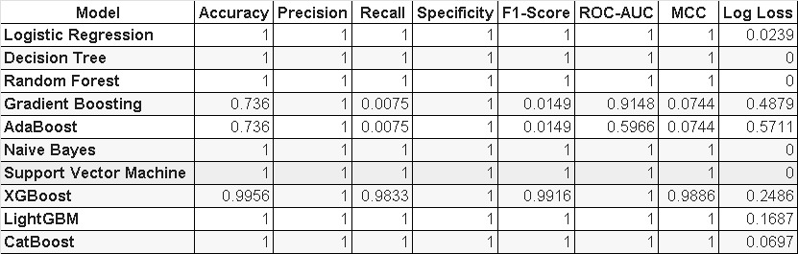
result(BEST MODEL):
Models Analysis:
🔄 All performance metrics were normalized (0–1 scale), and Log Loss was inverted to ensure consistent evaluation.
🏆 Decision Tree achieved the highest Overall Score, making it the best-performing model across all metrics.

Slide 13
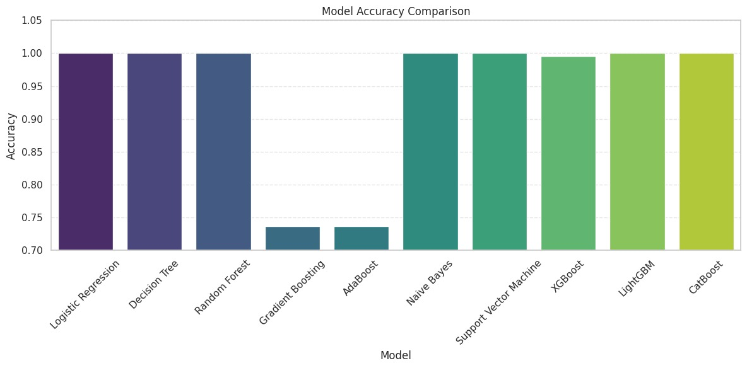
result(BEST MODEL):
Models Analysis:

Slide 14
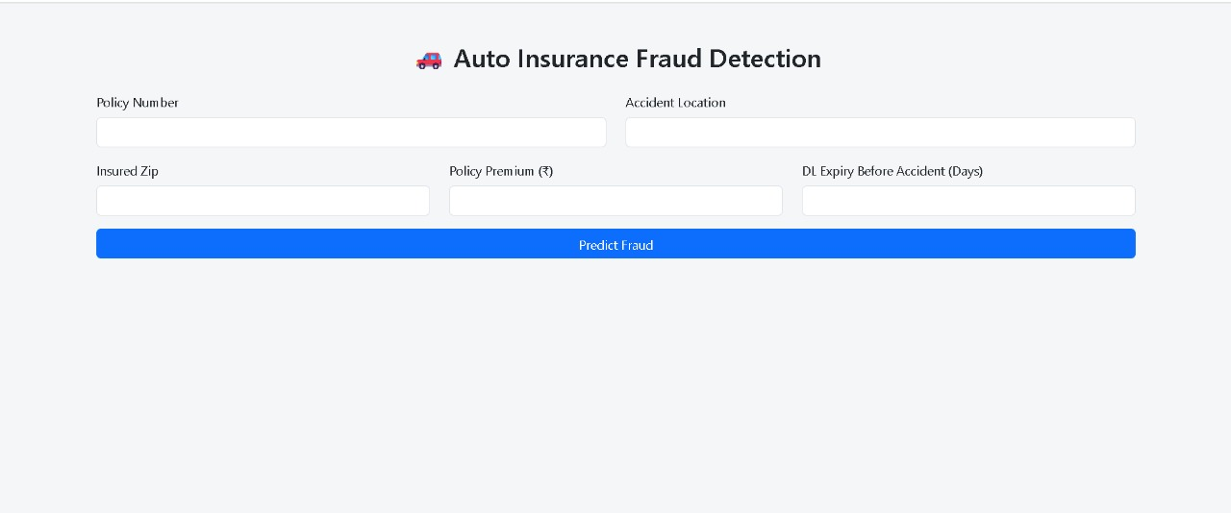
Deployment:
Deployment Process🛠 The trained and validated Decision Tree model is deployed using Flask (or any web framework), which acts as a bridge between the ML model and a user interface (UI).
User Interaction:
📥 Input:The user provides the required values for the top 5 selected features, such as:Policy_Num, Accident_Location, Insured_Zip, Policy_Premium, DL_Expiry_Before_Accident_Days.
📤 Output:The system returns whether the claim is "Fraudulent" or "Legitimate" based on the model's prediction.

