Slide 1
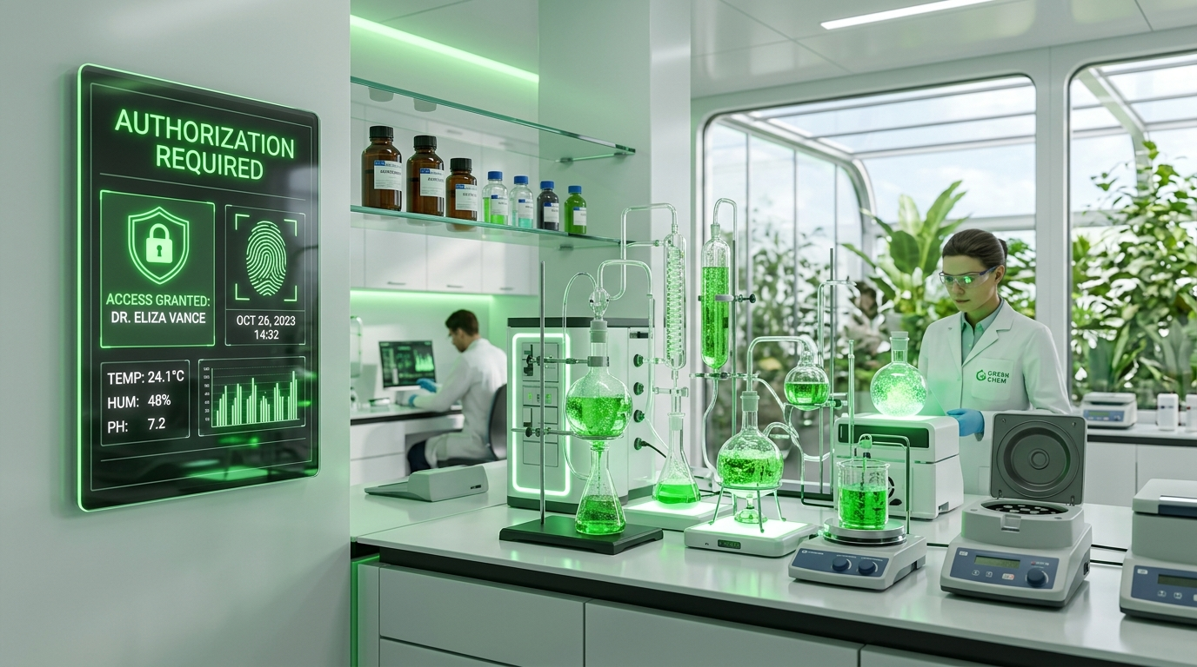
CHEMICAL PURCHASE SYSTEM
PRODUCT
TECH STACK
WORKFLOW
SCHEDULE
BENEFITS
CONCLUSION
ACADEMIC PROJECT PRESENTATION | FINAL EVALUATION
Chemical Purchase System
A Centralized Regulatory Web Platform for Digital Safety Authorization
CORE ARCHITECTURAL PILLARS
• Mandatory Proof Verification • 15 Units/Month Limit • 6-Digit Pickup Code • Online & Offline Fulfillment
Chemical Purchase System | Final Project Presentation | Slide 1 of 13

Slide 2
CHEMICAL PURCHASE SYSTEM
PRODUCT
TECH STACK
WORKFLOW
SCHEDULE
BENEFITS
CONCLUSION
1. Project Introduction & Problem Context
THE PROPOSED SOLUTION (CENTRALIZED CPS PLATFORM)
• Centralized Digital Governance: A unified multi-role web platform connecting Researchers, Certified Laboratories, and Statutory Regulatory Administrators in real time.
• Mandatory Safety Authorization: Every chemical order requires prior submission of verified research justification and government/institutional proof documentation.
• Strict 15-Unit Monthly Limit: Automated system-enforced ceiling capping every user at 15 chemical units per calendar month, eradicating hoarding risks.
• Tamper-Proof Dual Fulfillment: Supports both in-person verification via cryptographically generated 6-digit pickup codes and secure online payment clearance.
• Real-Time Inventory Locking: Atomic inventory reservation guarantees that stock is instantly committed upon approval, preventing double-booking.
Chemical Purchase System | Final Project Presentation | Slide 2 of 13

Slide 3
CHEMICAL PURCHASE SYSTEM
PRODUCT
TECH STACK
WORKFLOW
SCHEDULE
BENEFITS
CONCLUSION
3. System Technology Stack & Architecture
FRONTEND PRESENTATION TIER
• HTML5 & Modern CSS3: Semantic structure with custom Eco-Emerald design tokens, responsive Flexbox, and CSS Grid.
• JavaScript (ES6+): Client-side state management, async RESTful API consumption, and dynamic modal rendering.
• Bootstrap 5 Framework: Mobile-first responsive interface, interactive data tables, progress bars, and modal dialogues.
• FontAwesome 6 Iconography: Visual iconography providing intuitive visual cues across all three portal dashboards.
BACKEND APPLICATION TIER
• Node.js Runtime: High-performance, event-driven, non-blocking asynchronous JavaScript runtime environment.
• Express.js v5 REST API: Scalable routing architecture handling cross-origin requests, controllers, and middleware.
• MVC Architecture: Clean separation of Models (SQL data models), Views (Client interfaces), and Controllers.
• Multer File Middleware: Secure document uploading enforcing PDF/JPG filetype validation and 5 MB size ceilings.
DATABASE & STORAGE TIER
• MySQL 8.0 Relational RDBMS: Normalized relational database ensuring ACID-compliant transactional consistency.
• mysql2 Connection Pooling: High-throughput asynchronous connection pool for fast concurrent query execution.
• Dynamic Quota Calculations: SQL windowing and date aggregation computing real-time monthly usage per user.
• Relational Foreign Keys: Cascading integrity linking users, laboratories, chemicals, permits, and purchase records.
SECURITY & AUTHENTICATION FRAMEWORK
• JSON Web Tokens (JWT): Stateless, cryptographic bearer tokens securely carrying user identity and role claims.
• Bcrypt Cryptographic Hashing: One-way salted password hashing protecting user, laboratory, and admin credentials.
• Role-Based Access Control (RBAC): Custom authorization middleware restricting endpoints to specific verified user roles.
• SQL Injection Protection: Strict parameterized SQL prepared statements eliminating injection vulnerabilities.
Chemical Purchase System | Final Project Presentation | Slide 4 of 13

Slide 4
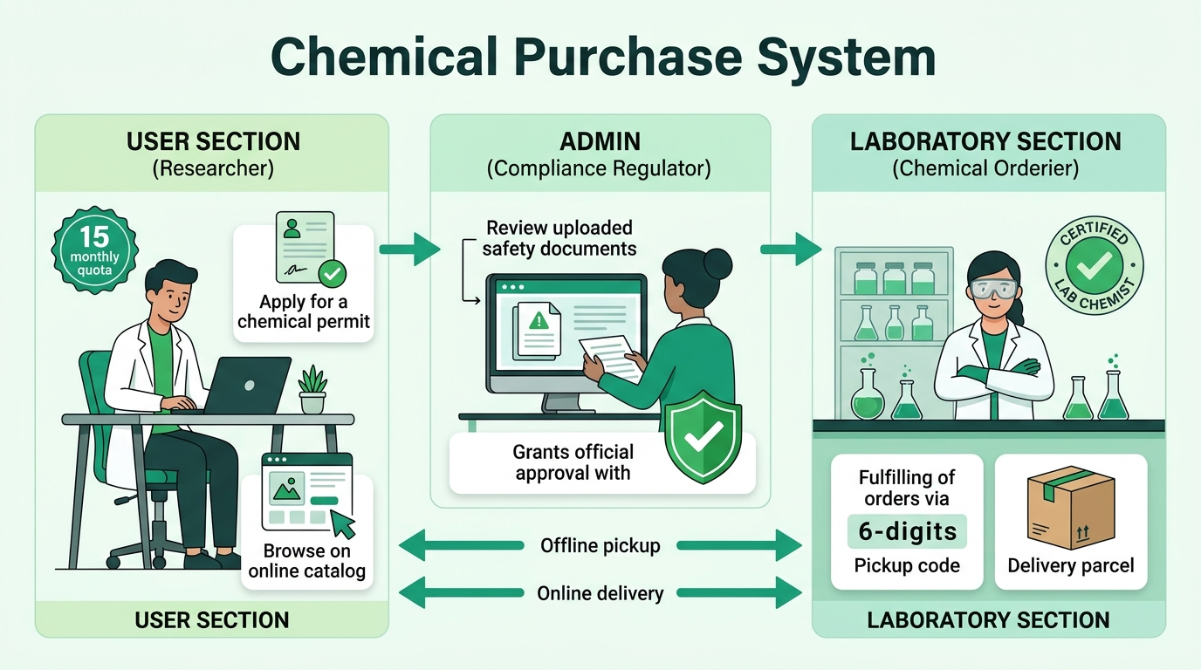
CHEMICAL PURCHASE SYSTEM
PRODUCT
TECH STACK
WORKFLOW
SCHEDULE
BENEFITS
CONCLUSION
4. Project Workflow: Multi-Role Collaboration
COLLABORATIVE ROLE INTERACTION
• 1. User (Researcher): Signs in, verifies current monthly quota (15 units), submits permit request with institutional proof, and browses verified lab catalogs.
• 2. Admin (Regulator): Acts as compliance authority; inspects uploaded safety docs, evaluates legal purpose, and issues digital authorization permits (AUTH-XXXXXX).
• 3. Laboratory (Supplier): Maintains live inventory stock, reviews incoming purchase requests, reserves units, and completes fulfillment.
• Offline Mode Fulfillment: User presents secure 6-digit pickup code at the lab counter; chemist validates code on the portal and dispenses chemicals.
• Online Mode Fulfillment: User clears payment online; chemical package is prepared and shipped directly to user's registered delivery address.
Chemical Purchase System | Final Project Presentation | Slide 5 of 13

Slide 5
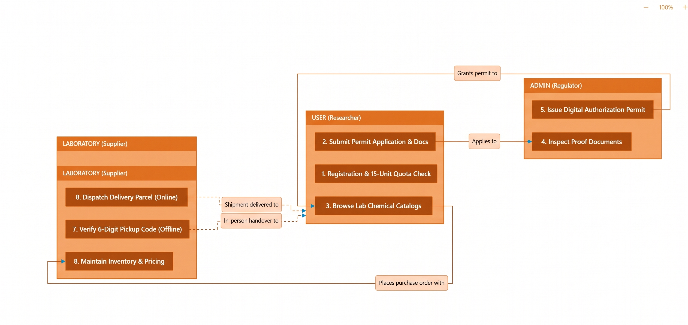
CHEMICAL PURCHASE SYSTEM
PRODUCT
TECH STACK
WORKFLOW
SCHEDULE
BENEFITS
CONCLUSION
5. End-to-End Operational Work Flow
Chemical Purchase System | Final Project Presentation | Slide 6 of 13

Slide 6
CHEMICAL PURCHASE SYSTEM
PRODUCT
TECH STACK
WORKFLOW
SCHEDULE
BENEFITS
CONCLUSION
6. 3-Month Project Schedule & Timeline Table
Phase & Month | Target Module | Key Deliverables & Architectural Milestones | Duration | Status
Month 1 (Weeks 1 - 4) | User Module & Quota Engine | • User Registration, Authentication (JWT, Bcrypt) & Profile Management • 15-Unit Monthly Purchase Allowance engine with dynamic limit calculations • Chemical Authorization request portal with Multer proof document upload • Chemical Storefront browsing, purchase order forms & order tracking | 4 Weeks | 100% Completed
Month 2 (Weeks 5 - 8) | Laboratory Module & Stock Management | • Certified Laboratory registration, licensing & profile management • Chemical catalog inventory control (Total Stock, Reserved Stock, Price/Unit) • Order review workflow with instant chemical stock reservation locks • 6-digit offline pickup code verification terminal & online dispatch tracking | 4 Weeks | 100% Completed
Month 3 (Weeks 9 - 11) | Admin Governance & Regulatory Oversight | • Centralized Administrative master dashboard & real-time KPI metrics • Laboratory license verification, approval, rejection & audit controls • User chemical authorization permit audit with proof document preview • System-wide compliance audit logging & role-based route security | 3 Weeks | 100% Completed
Post-Dev (Week 12) | System Integration, Testing & Deployment | • End-to-end integration testing across User, Laboratory & Admin portals • Edge-case testing (e.g., 10 + 10 = 20 > 15 quota boundary violations) • Responsive UI verification (Dark/Light themes) & SQL transaction stress testing • Comprehensive documentation, user guides, and evaluation walkthroughs | 1 Week | 100% Completed
TOTAL | Overall Project | Complete End-to-End Chemical Purchase System (3 Distinct Roles + Full Database) | 3 Months | 100% DONE
Chemical Purchase System | Final Project Presentation | Slide 7 of 13

Slide 7
CHEMICAL PURCHASE SYSTEM
PRODUCT
TECH STACK
WORKFLOW
SCHEDULE
BENEFITS
CONCLUSION
7. Detailed Module-by-Module Breakdown
USER MODULE
• Researcher Authentication: Secure sign-up, JWT token login, and profile address management.
• 15-Unit Quota Enforcement: Live monthly allowance tracker capping procurement to 15 units per month.
• Permit Applications: Upload institutional proof documents (PDF/JPG) with research purpose description.
• Storefront Browsing: Search chemicals across certified laboratories with live stock availability.
• Order Placement: Order placement via Offline Pickup (code generation) or Online Delivery.
• Purchase History: Complete transaction ledger with real-time status and payment records.
LABORATORY MODULE
• Licensing & Profile: Submit institutional lab license credentials for regulatory approval.
• Chemical Inventory: Add, edit, and categorize chemicals (unit, formula, price, total stock).
• Stock Reservation: Automatic locking of requested chemicals to prevent overselling.
• Pickup Code Verifier: Verify the buyer's 6-digit pickup code before physical handover.
• Order Dispatch: Mark online orders as 'Paid' and 'Delivered' with courier logging.
• Transaction Analytics: Track lab revenue, pending requests, and low-stock alerts.
ADMIN MODULE
• Master Dashboard: Real-time metrics: active users, certified labs, permits, and total sales.
• Lab Certification: Review laboratory license documents, approve or reject applications.
• Permit Auditing: Inspect user research purpose, verify uploaded proof, and grant permits.
• Regulatory Oversight: Inspect system-wide orders, track hazardous chemical distributions.
• Audit Logging: Immutable timestamps for regulatory investigations and compliance.
• Security & RBAC: Strict middleware guarding administrative endpoints against intrusion.
Chemical Purchase System | Final Project Presentation | Slide 8 of 13

Slide 8
CHEMICAL PURCHASE SYSTEM
PRODUCT
TECH STACK
WORKFLOW
SCHEDULE
BENEFITS
CONCLUSION
8. Key features added: 15-Unit Quota & 6-Digit Pickup
15-UNIT MONTHLY QUOTA ENGINE
• Hard Regulatory Ceiling: Every user is strictly limited to purchasing a cumulative maximum of 15 chemical units per calendar month.
• Dynamic SQL Aggregation: Calculates usage dynamically: SUM(quantity) WHERE user_id = ? AND YEAR(CURDATE()) AND MONTH(CURDATE()) AND request_status NOT IN ('Rejected', 'Expired').
• Intelligent Boundary Enforcement: Prevents multi-stage overages: If a user buys 10 units in Week 1 and requests 10 units in Week 2 (10 + 10 = 20 > 15), the request is rejected with exact remaining allowance (5 units).
• Permit Locking Safeguard: Once the 15-unit threshold is reached, both new purchase orders AND new authorization requests are automatically locked.
• Profile Quota Card: Real-time visual progress bar in User Profile transitioning from Green (Normal) to Yellow (Moderate) to Red (Quota Exhausted).
SECURE DUAL FULFILLMENT ARCHITECTURE
• 6-Digit Cryptographic Code: For Offline Pickup orders, the backend generates a random 6-digit verification code stored securely in the database.
• Zero Discrepancy Handover: Lab technicians must enter and validate the buyer's 6-digit code in the lab terminal before physical chemical release.
• Real-Time Inventory Locking: Requested chemicals transition from Total Stock to Reserved Stock the instant an order is placed, preventing phantom sales.
• Online Tracked Delivery: Online orders support digital payment clearance, automated order dispatch, and 2-day delivery completion windows.
• Automatic Expiration Policy: Unclaimed reservations automatically expire, releasing locked inventory back into public lab stock safely.
Chemical Purchase System | Final Project Presentation | Slide 9 of 13

Slide 9
CHEMICAL PURCHASE SYSTEM
PRODUCT
TECH STACK
WORKFLOW
SCHEDULE
BENEFITS
CONCLUSION
9. Key Benefits & Strategic Value
REGULATORY COMPLIANCE & LEGAL SAFETY
• Total Elimination of Paper Exploits: Substitutes falsifiable paper paperwork with digitally authenticated permits.
• Institutional Proof Auditing: Enforces rigorous documentary justification before any hazardous chemical is dispensed.
• Statutory Oversight: Empowers government or institutional regulators with continuous monitoring capabilities.
ANTI-HOARDING & EQUITABLE DISTRIBUTION
• 15-Unit Quota Enforcement: Guarantees that sensitive precursor chemicals cannot be stockpiled by unauthorized entities.
• Dynamic Balance Calculation: Transparently informs researchers of remaining monthly allowance.
• Equitable Resource Allocation: Prevents single laboratories or research teams from exhausting regional supply.
OPERATIONAL EFFICIENCY & SPEED
• 70% Reduction in Approval Time: Digital permit review cuts processing time from weeks of physical transit to minutes.
• Instant Stock Verification: Researchers can view certified chemical availability without visiting physical laboratories.
• Dual Mode Flexibility: Supports immediate local counter pickup via 6-digit code or direct courier delivery.
TRANSPARENT INVENTORY & AUDITABILITY
• Zero Discrepancy Stock Records: Atomic reservation ensures digital catalog exactly matches physical shelf counts.
• Comprehensive Audit Trail: Every action, rejection note, payment, and handover is permanently recorded.
• Tamper-Resistant Security: Protected by JWT tokens, Bcrypt password hashing, and parameterized database queries.
Chemical Purchase System | Final Project Presentation | Slide 10 of 13

Slide 10
CHEMICAL PURCHASE SYSTEM
PRODUCT
TECH STACK
WORKFLOW
SCHEDULE
BENEFITS
CONCLUSION
11. Conclusion
PROJECT EXECUTION & OUTCOMES
• Successful 3-Month Implementation: The Chemical Purchase System was systematically designed, developed, and verified over a disciplined 3-month schedule (User → Lab → Admin).
• 100% Milestone Completion: All planned deliverables across all three functional roles are fully functional, integrated, and validated against edge cases.
• Strict Quota Integrity: The 15-unit monthly limit engine successfully prevents hazardous stockpiling, with boundary protection (e.g., 10 + 10 = 20 > 15) and live profile progress tracking.
• Robust Security Architecture: Stateless JWT authentication, Bcrypt password encryption, parameterized SQL queries, and Multer document validation provide institutional-grade protection.
• Proven Real-World Utility: Transforms an insecure, error-prone paper process into an automated, transparent, and auditable digital ecosystem.
Chemical Purchase System | Final Project Presentation | Slide 12 of 13

Slide 11
CHEMICAL PURCHASE SYSTEM
PRODUCT
TECH STACK
WORKFLOW
SCHEDULE
BENEFITS
CONCLUSION
CHEMICAL PURCHASE SYSTEM
Thank You!
Questions, Demonstrations & Evaluation Discussion
A Final Year Academic Project | Node.js • Express.js • MySQL 8.0 • Bootstrap 5 | Total 3-Month Development
Chemical Purchase System | Final Project Presentation | Slide 13 of 13

