Slide 1


Customer Shopping Behavior Analysis
Uncovering spending patterns, segments, and preferences from 3,900 transactions to guide strategic decisions.

Slide 2
Data at a Glance
3,900
Transactions
Across all product categories
18
Features
Demographics, purchases & behavior
Gender
Male : 2,652
Females : 1,248
37
Missing Values
Review Rating column only

Slide 3


Python: Data Preparation
Load & Explore
pandas: df.info(), df.describe()
Clean
Imputed Review Rating via median per category; snake_case columns
Engineer
Created age_group & purchase_frequency_days; dropped redundant promo_code_used
Integrate
Loaded cleaned DataFrame into MySQL for SQL analysis

Slide 4
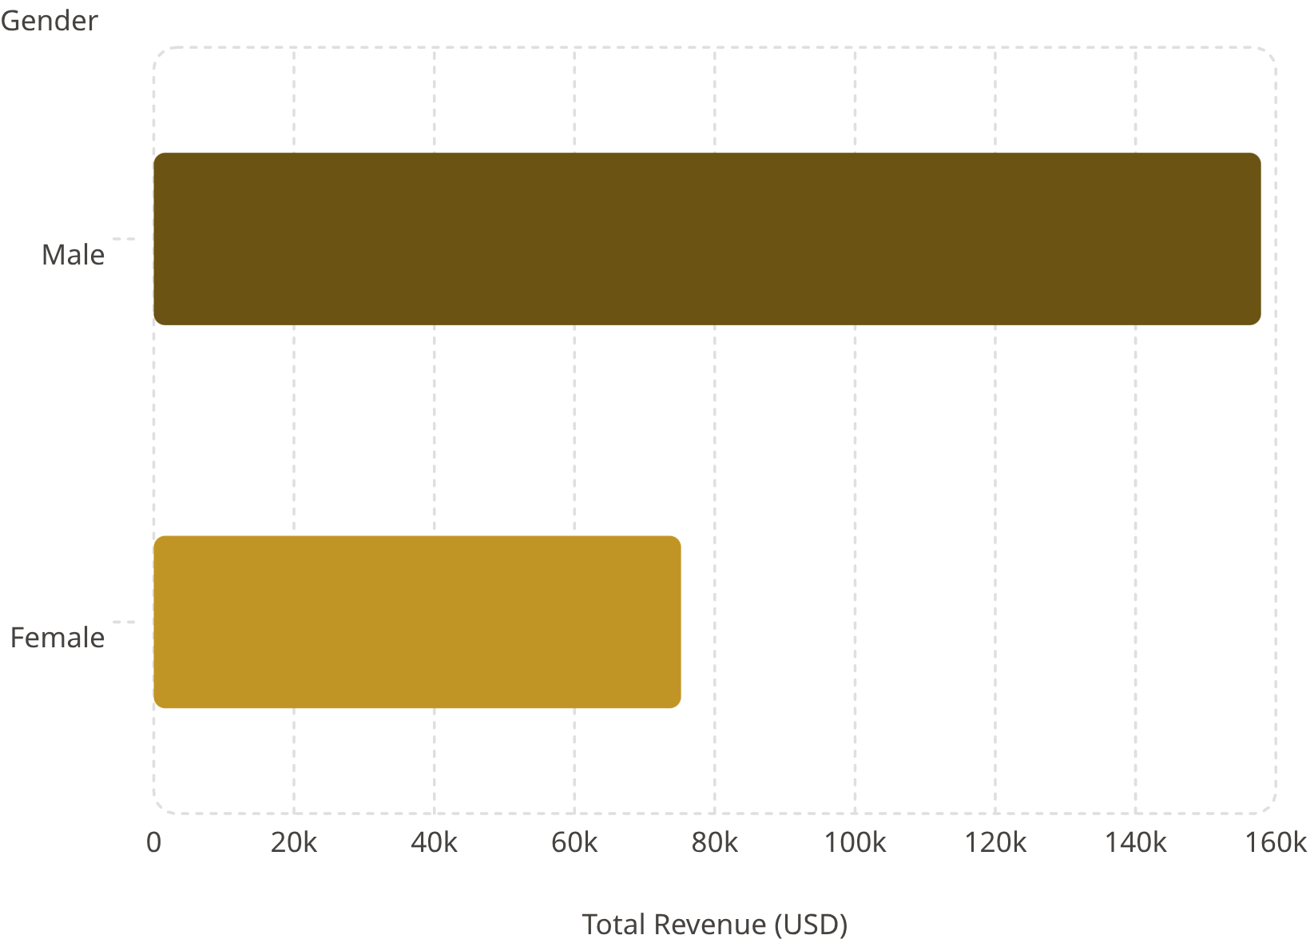
SQL Insights: Revenue & Ratings
Top 5 Products by Avg Rating
Product
Avg Rating
Gloves
3.86
Sandals
3.84
Boots
3.82
Hat
3.80
Handbag
3.78

Slide 5
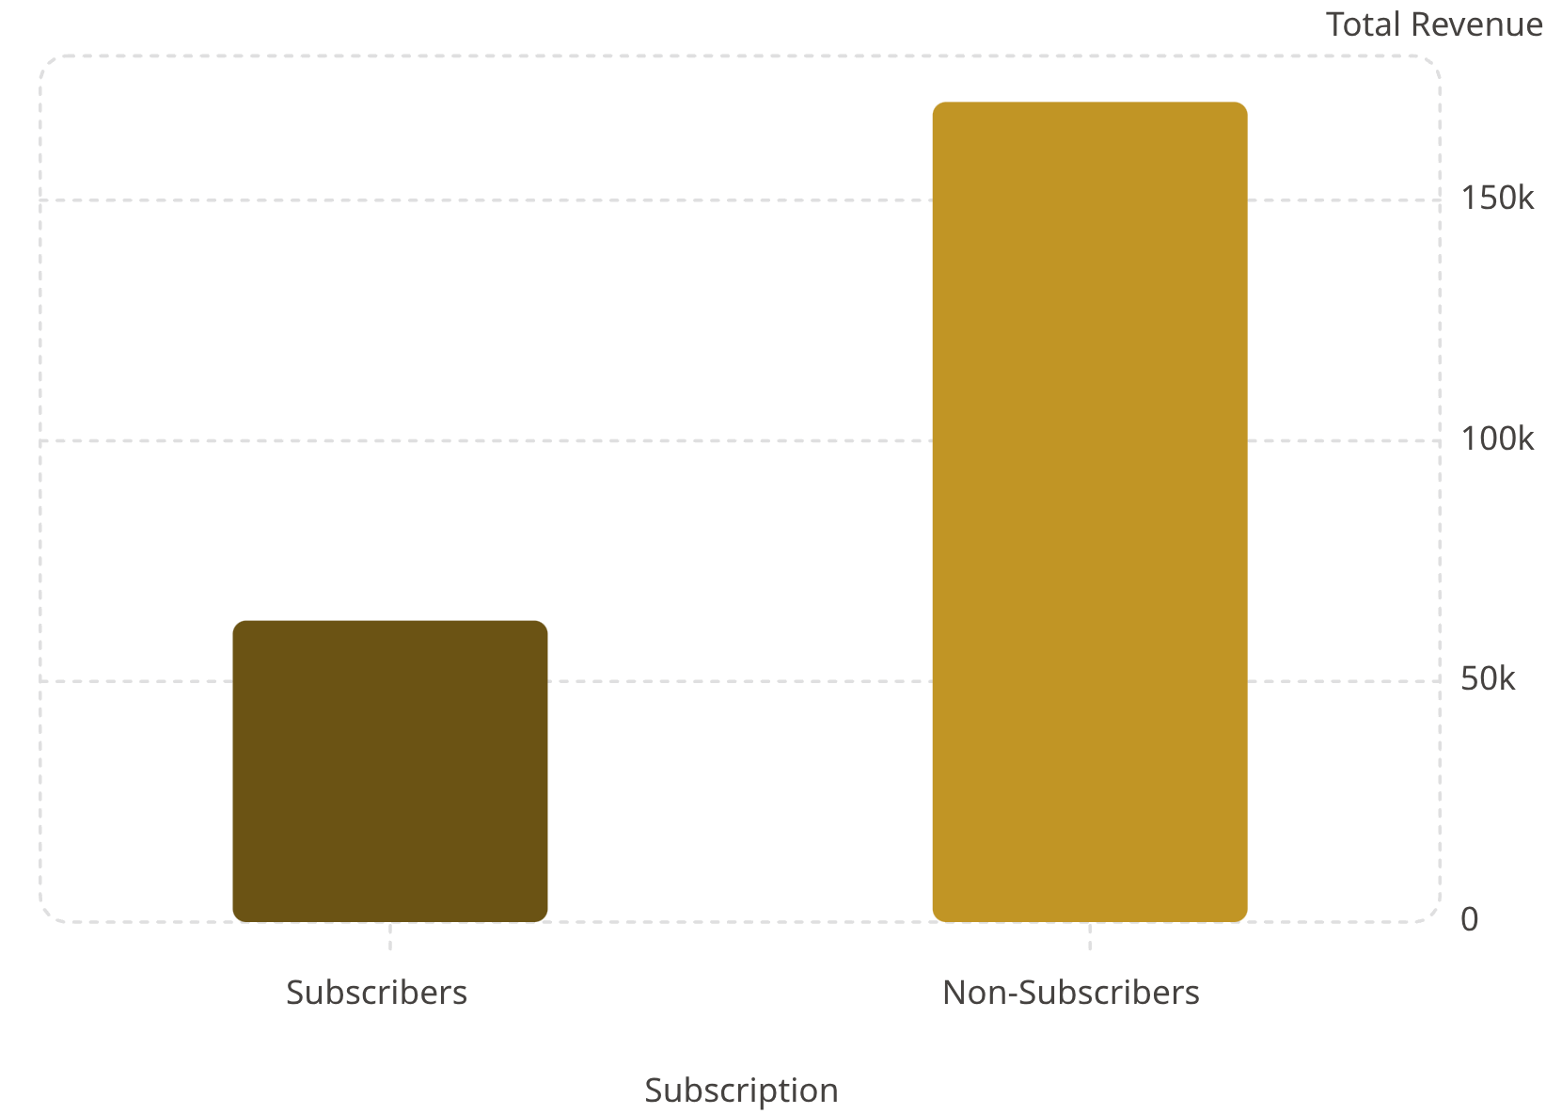


SQL Insights: Subscribers & Shipping
Key Findings
Express vs Standard
Express avg: $60.48 · Standard: $58.46
Discount-Heavy Products
Sneakers & Hat: 50% discounted purchases
Repeat Buyers
958 subscribers vs 2,518 non-subscribers with >5 purchases

Slide 6



Customer Segmentation
1
Loyal — 3,116
2
Returning — 701
3
New — 83
Over 80% of customers are in the Loyal segment — a strong retention base to leverage.

Slide 7
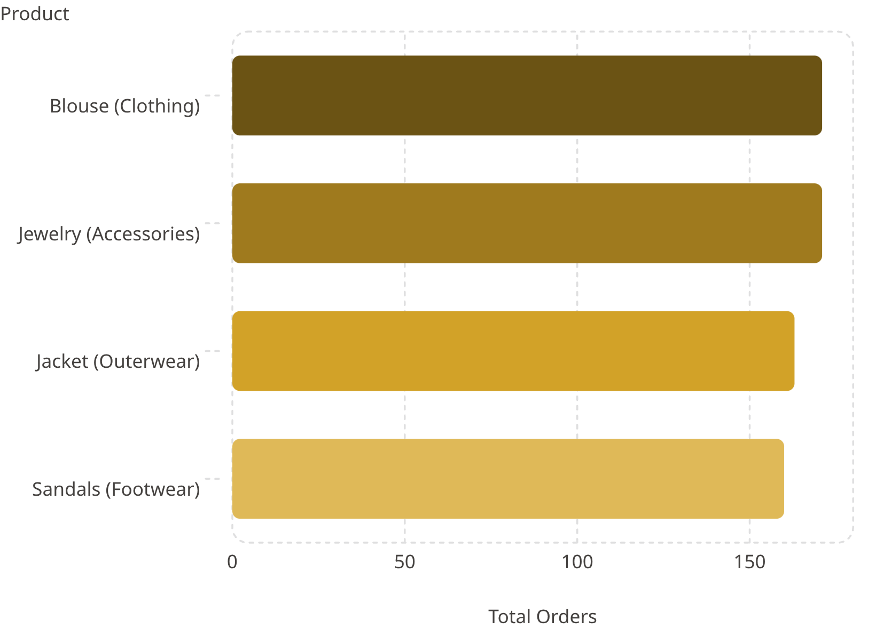
Top Products by Category
Category Leaders
Clothing
Accessories
Blouse, Pants, Shirt
Jewelry, Sunglasses, Belt
Footwear
Outerwear
Sandals, Shoes, Sneakers
Jacket, Coat

Slide 8
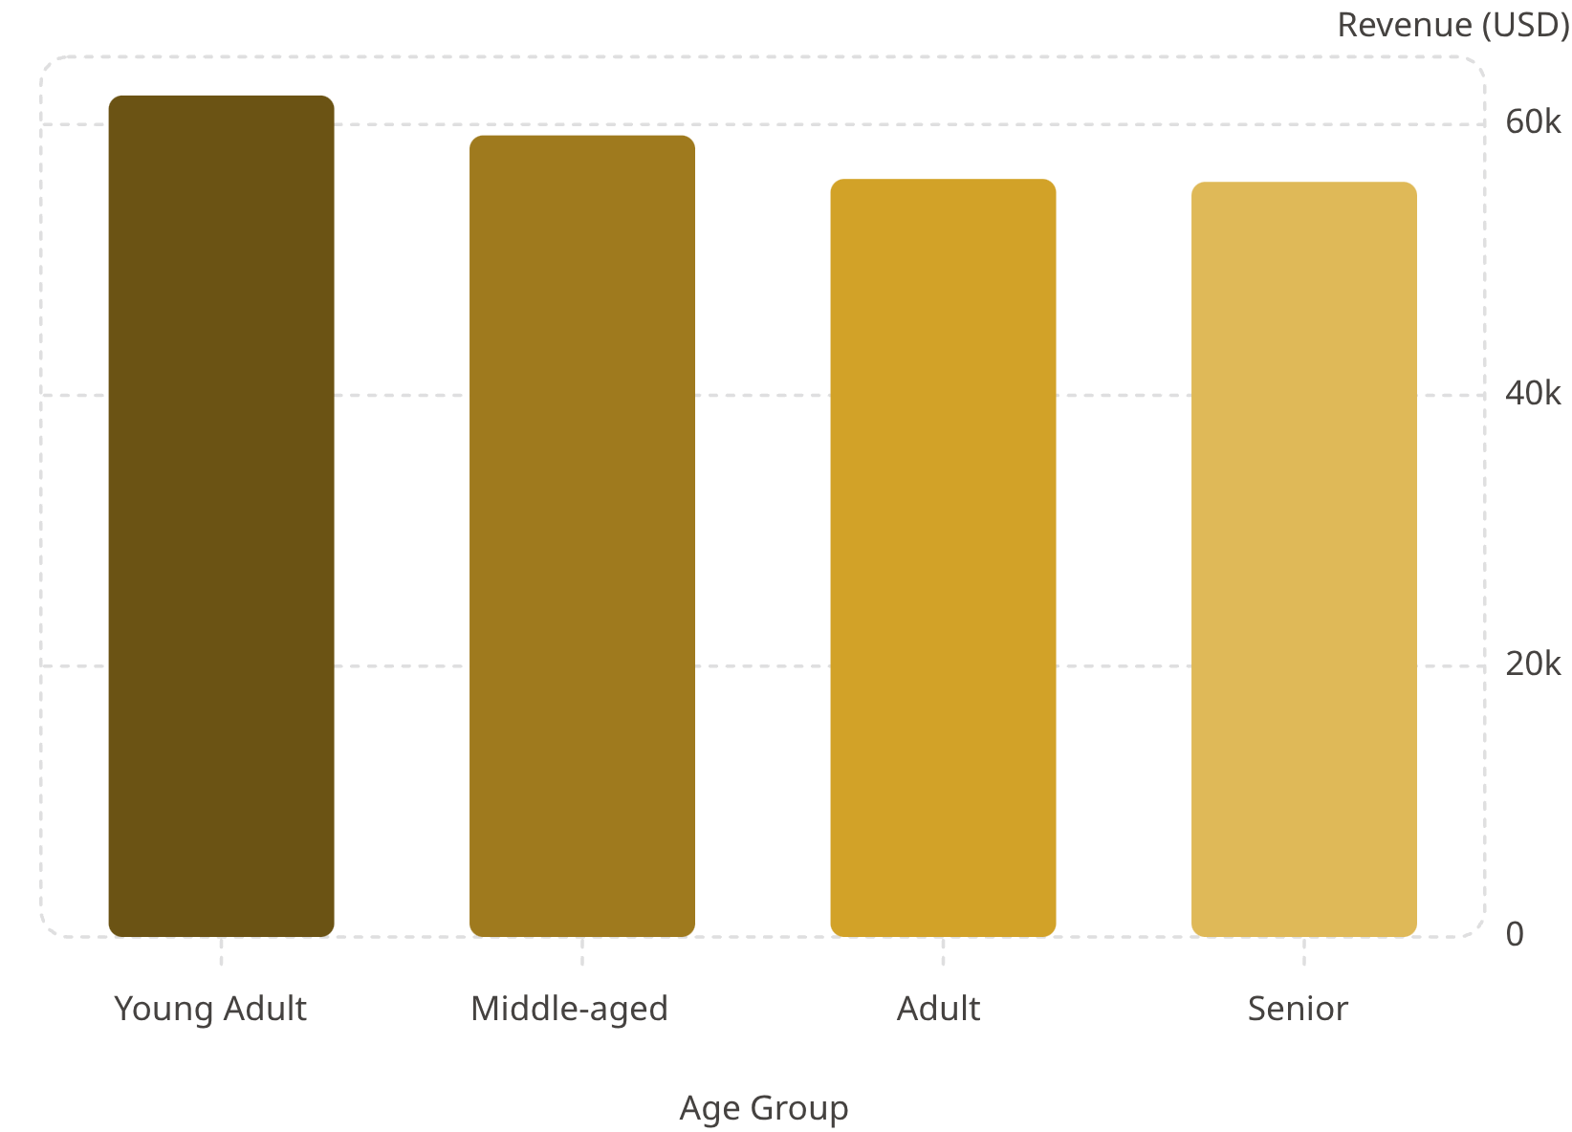

Revenue by Age Group
Age Group Insights
Young Adults lead revenue at $62K. Revenue is relatively balanced across all four age groups — each contributes between $55K–$62K.
Young Adult
Middle-aged
Adult
Senior
$62,143 · 1,028 sales
$59,197 · 986 sales
$55,978 · 942 sales
$55,763 · 944 sales

Slide 9
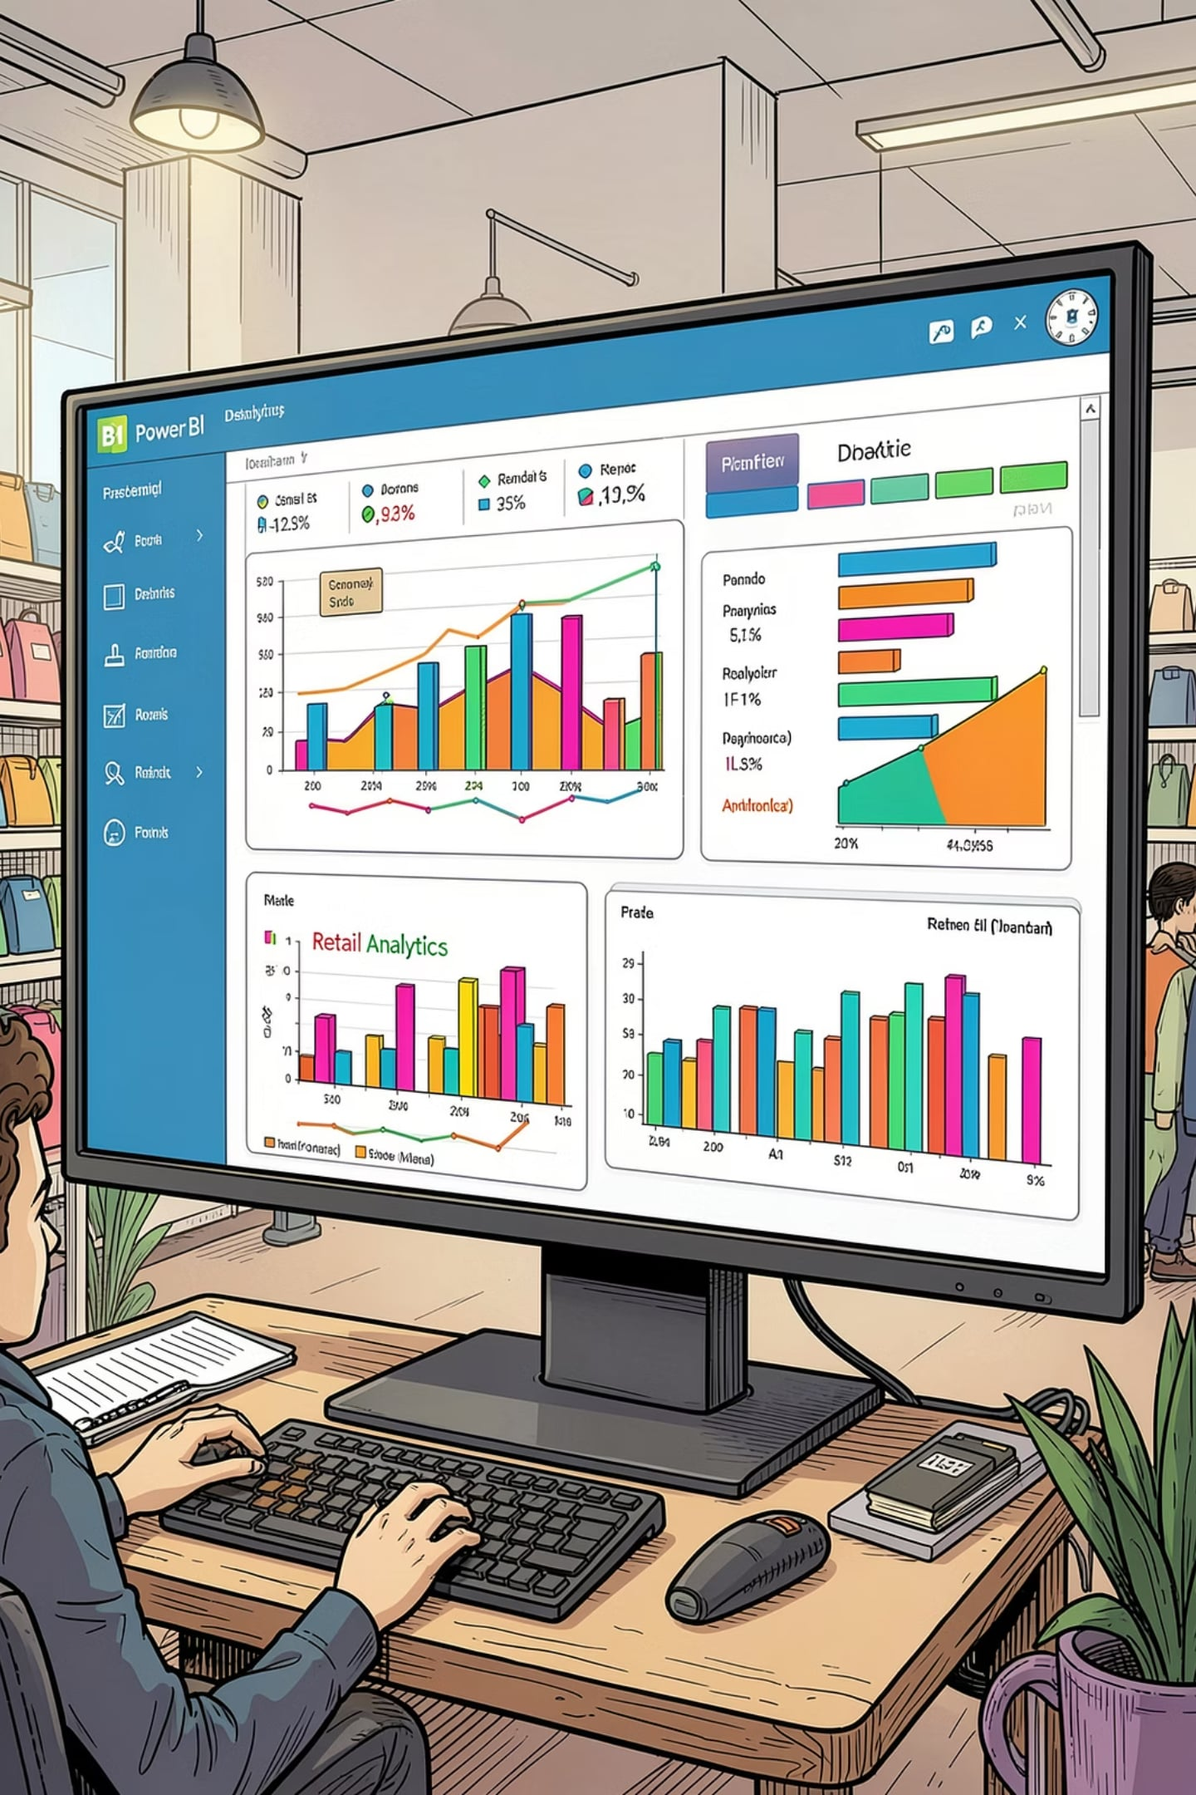
Power BI Dashboard
3.9K Customers
Total transaction records
$59.76 Avg Spend
Per purchase
3.75 Avg Rating
Customer review score
27% Subscribers
73% non-subscribers
Filters: Subscription Status · Gender · Category · Shipping Type. Visuals include Revenue & Sales by Category and Age Group.

Slide 10
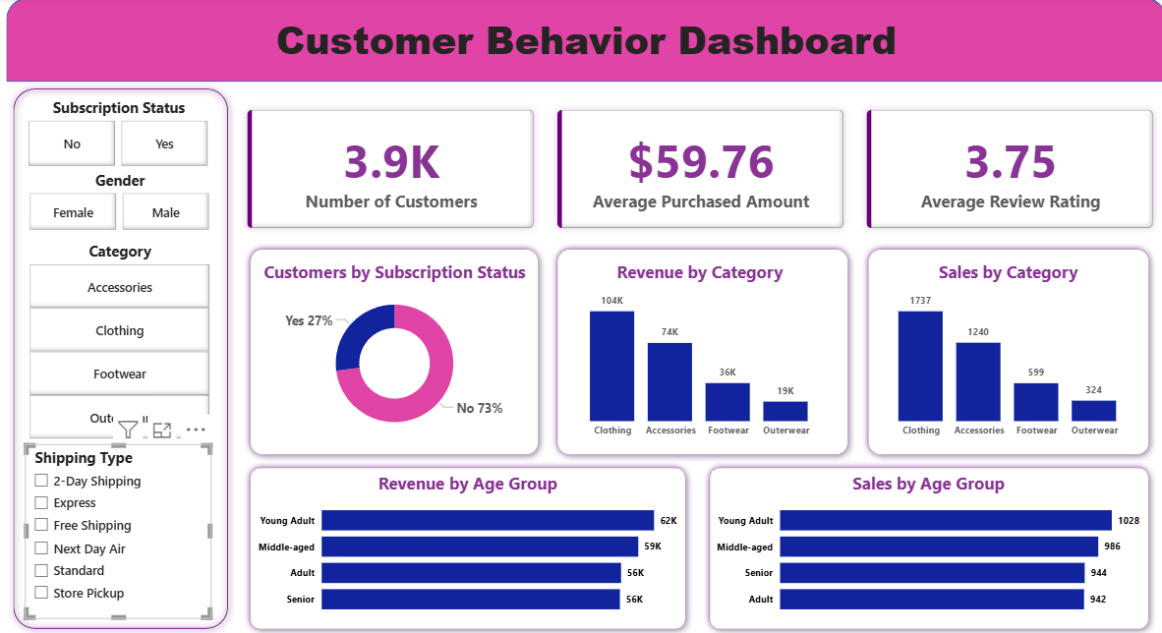

Slide 11





Business Recommendations
Boost Subscriptions
Loyalty Programs
Review Discount Policy
Promote exclusive subscriber benefits
Reward repeat buyers → Loyal segment
Balance sales lift with margin control
Targeted Marketing
Product Positioning
Focus on high-revenue age groups & express-shipping users
Highlight top-rated & best-selling products in campaigns

