Slide 1
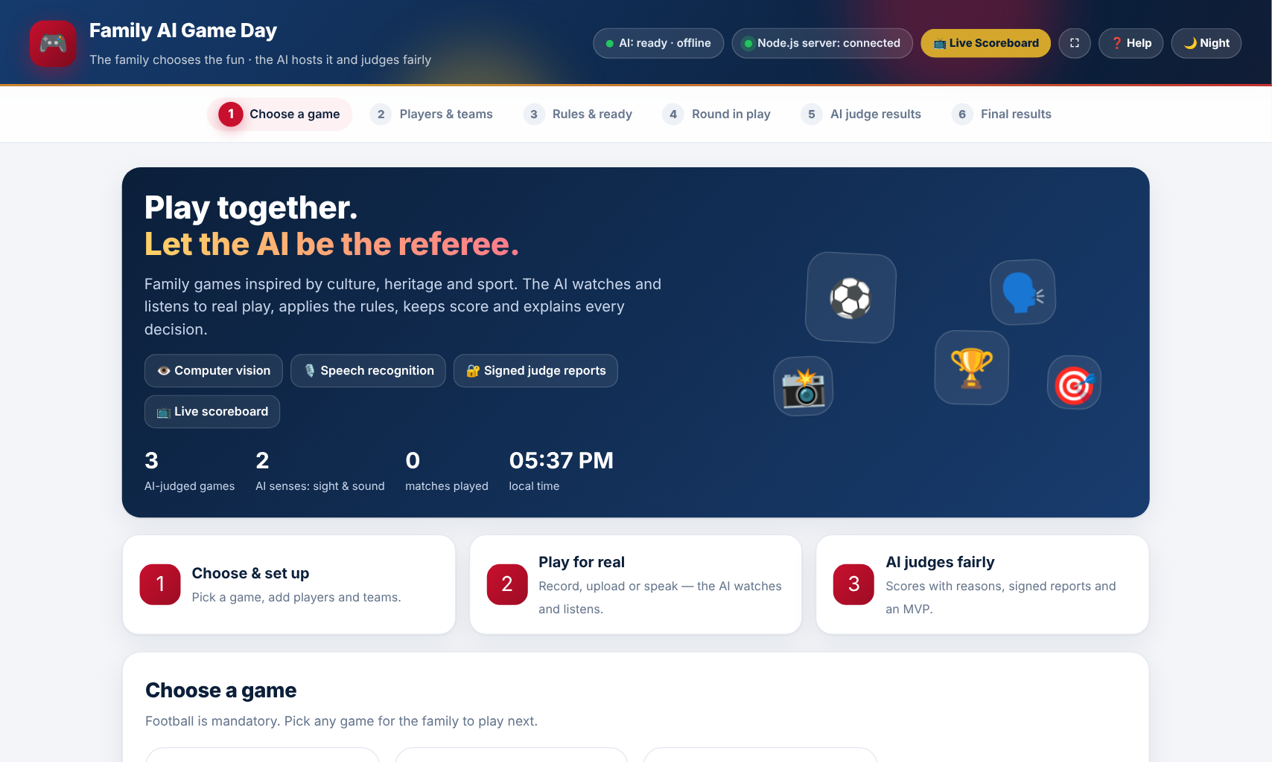
FAMILY AI GAME DAY
AI-judged family games inspired by culture, heritage and sport
ABU DHABI UNIVERSITY | CYCLE 3 | GRADES 9-12
Karen Makar · Ahmed Mitwalli
Saeed Alkaabi · Falah Alzeyoudi
Our working app, judged by AI
[Team name] | [School name]

Slide 2
MEET THE TEAM
Four students, one AI judge
Add photo
Add photo
Add photo
Add photo
Karen Makar
Ahmed Mitwalli
Saeed Alkaabi
Falah Alzeyoudi
[Role]
[Role]
[Role]
[Role]

Slide 3
AGENDA
Three parts: the idea, how we solved it, and the results
OUR IDEA
1
Slides 5-12
Why it matters, the problem, the gap and our idea
HOW WE SOLVED IT
2
Slides 13-20
Research, design, technology, build and testing
OUR RESULTS
3
Slides 21-27
Data, analysis, feedback, impact and next steps

Slide 4
EXECUTIVE SUMMARY
The whole project on one slide
THE IDEA
THE SOLUTION
THE RESULTS
A web app where AI is the fair judge for family games, so nobody judges a game they are playing.
The AI watches video and photos, listens to speech, applies the rules and signs every report.
Three working games, a live scoreboard and scores that cannot be changed, tested on a real laptop.
FOOTBALL + WORD CHAIN + PHOTO SCAVENGER HUNT, ALL JUDGED BY AI

Slide 5
BACKGROUND
IDEA
Games carry culture from one generation to the next
CULTURE
HERITAGE
SPORT
Family games are where language, sayings and values are shared.
Playing together keeps family stories and traditions alive.
Football brings every age group onto the same team.
STRIKING STATISTIC
[Add one statistic about family time or screen time, with its source]

Slide 6
PROBLEM STATEMENT
IDEA
When the judge is also a player, family games feel unfair and often end in arguments.
OUR QUESTION: CAN AI BE A FAIR, EXPLAINED JUDGE FOR REAL FAMILY PLAY?

Slide 7
WHO IS AFFECTED
IDEA
The people who play together every week
FAMILIES
1
Mixed ages playing together at home, where every result matters.
TEENS AND KIDS
2
Want games that feel fair and want to see how AI works.
SCHOOLS AND COMMUNITIES
3
Run game days and events that need quick, trusted scoring.

Slide 8
LOCAL RELEVANCE
IDEA
Made for families in the UAE
ARABIC AND ENGLISH
NATIONAL AI GOALS
Word Chain understands both languages.
Supports the UAE National Strategy for Artificial Intelligence 2031.
FAMILY FIRST
SPORT FOR ALL
One laptop and one screen bring the whole family together.
Football is the game every family already knows.

Slide 9
EXISTING SOLUTIONS AND THE GAP
IDEA
What families use today, and what is missing
TODAY
FAMILY AI GAME DAY
✕ A human judge who is also playing
✓ An AI judge that explains every decision
✕ Screen-only video games, no real play
✓ Real play: video, photos and voice
✕ No record of why a point was given
✓ Saved matches and a family leaderboard
✕ Scores are easy to change
✓ Signed reports that cannot be changed

Slide 10
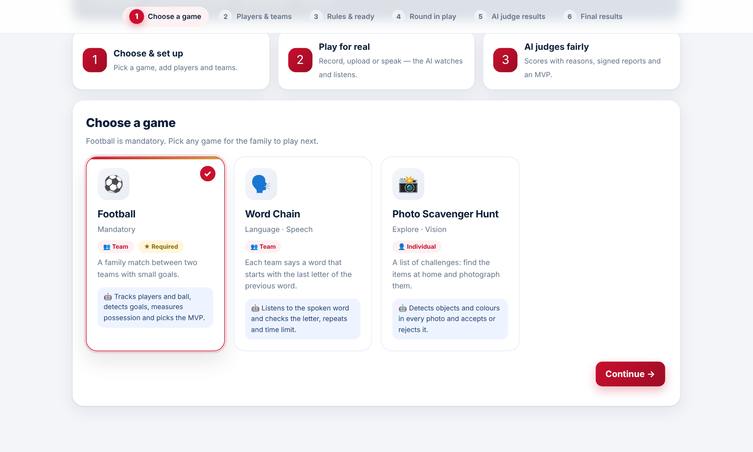
OUR IDEA
IDEA
A web app where the AI is the referee
THE AI WATCHES, LISTENS, APPLIES THE RULES AND EXPLAINS EVERY POINT.
SEES
Video and photos
HEARS
English and Arabic speech
DECIDES
Score with a reason

Slide 11
GOALS AND OBJECTIVES
IDEA
Four measurable targets we set at the start
3 working games
100% explained
Football plus two original games, each judged by AI
Every AI decision shows a reason and evidence
100% verified
6 of 6 steps
Every report is signed and checked before points
All six steps from the competition brief

Slide 12
WHAT MAKES IT UNIQUE
IDEA
A judge you can trust, not just a game
1
AI THAT SEES AND HEARS
Vision and speech models run inside the browser
2
EXPLAINS EVERY DECISION
A reason and a snapshot of the moment
3
TAMPER-PROOF REPORTS
HMAC-SHA256 signature checked before points
4
LIVE SCOREBOARD
On a TV or phone, updated instantly
5
WORKS OFFLINE
AI models run on the laptop, no internet needed

Slide 13
RESEARCH APPROACH
SOLUTION
How we learned what to build
BRIEF ANALYSIS
AI EXPERIMENTS
We broke the Abu Dhabi University brief into required features and the 6-step flow.
We tested object, pose and speech models on real photos and videos.
FAMILY SURVEY
INTERVIEWS
[Add: how many families you asked and what you asked]
[Add: who you interviewed, e.g. parents or teachers]

Slide 14
KEY RESEARCH FINDINGS
SOLUTION
Our top three discoveries from testing
95%
Chrome
Filming
The AI recognised a person in a real photo with 95% confidence, running in the browser.
Camera and speech recognition work best in Chrome; some browsers block them.
The ball is found best with a big, bright ball filmed from a fixed side angle.

Slide 15
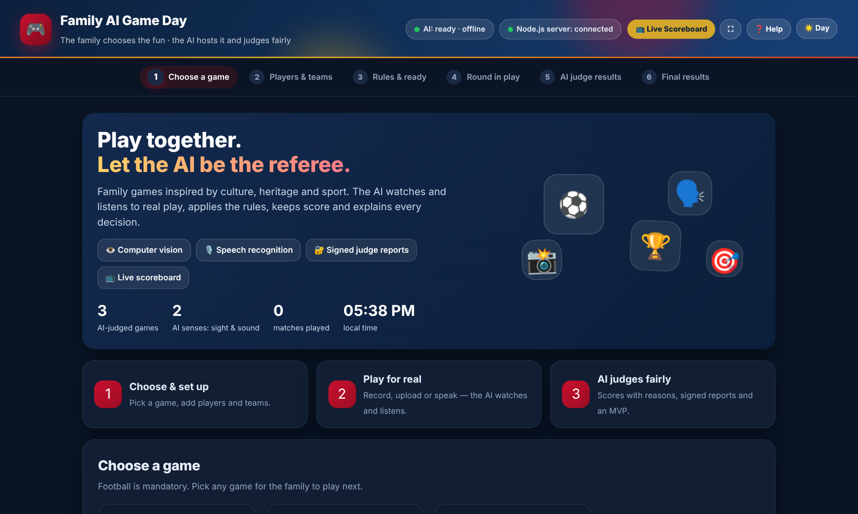
DESIGN PROCESS
SOLUTION
From the first draft to the final app
1
BRAINSTORM
2
FIRST DRAFT
3
FEEDBACK
4
FINAL DESIGN
Picked games that AI can judge fairly
Arabic site with five games
Cut two games, moved to English
New look, animations and host controls
[Add a photo of your sketches or brainstorm]

Slide 16
HOW IT WORKS
SOLUTION
Six simple steps, from choosing a game to the winner
1
CHOOSE A GAME
2
PLAYERS & TEAMS
3
RULES & READY
Pick a card
Names, Team A and B
Points, time, penalties
4
ROUND IN PLAY
5
AI JUDGE RESULTS
6
FINAL RESULTS
Turn, timer, score
Reason and signed report
Winner, MVP, leaderboard

Slide 17
MATERIALS, TOOLS AND TECHNOLOGY
SOLUTION
What we used and why
MEDIAPIPE OBJECT DETECTOR
MEDIAPIPE POSE LANDMARKER
Finds players, the ball and objects in video and photos
Reads 33 points on the body
WEB SPEECH API
NODE.JS SERVER
Hears words in English and Arabic
Signs reports, saves matches, runs the live scoreboard
HTML, CSS, JAVASCRIPT
A LAPTOP AND CHROME
The app and its design, no extra libraries
All the hardware a family needs

Slide 18
BUILD STEPS AND TIMELINE
SOLUTION
How the project came together on build day
4:00 PM
4:20
4:30
4:40
5:00
5:20
1
2
3
4
5
6
Read the brief
First AI judge in the browser
Node.js server and signed reports
English site and animations
Three games and host controls
Offline AI and online hosting
ONE AFTERNOON, FROM AN EMPTY FOLDER TO A TESTED, HOSTED APP

Slide 19
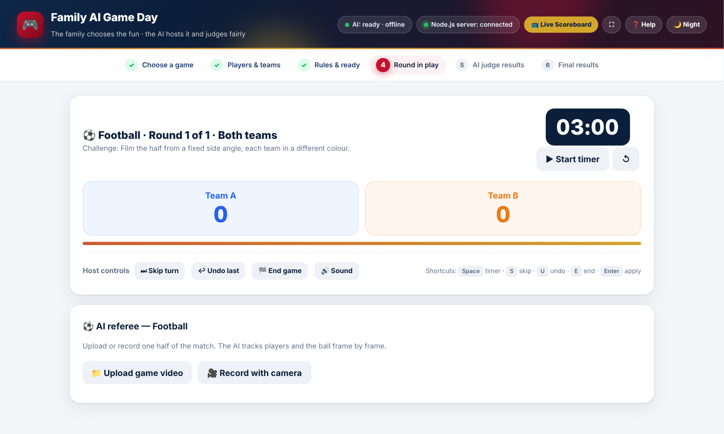
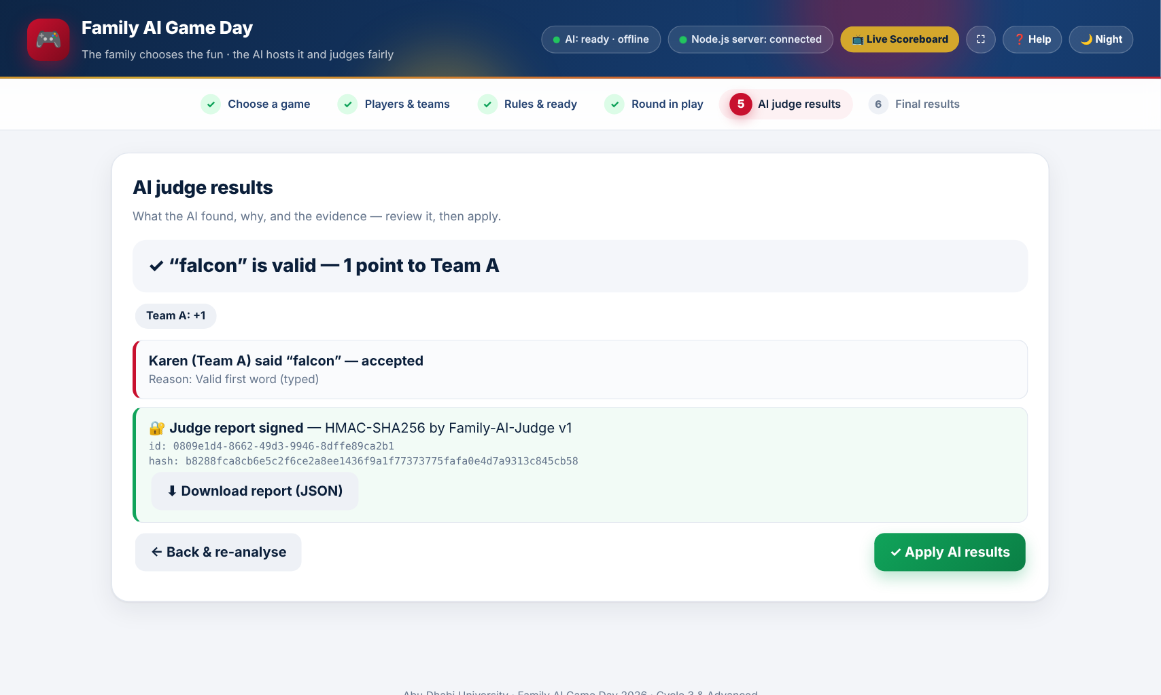
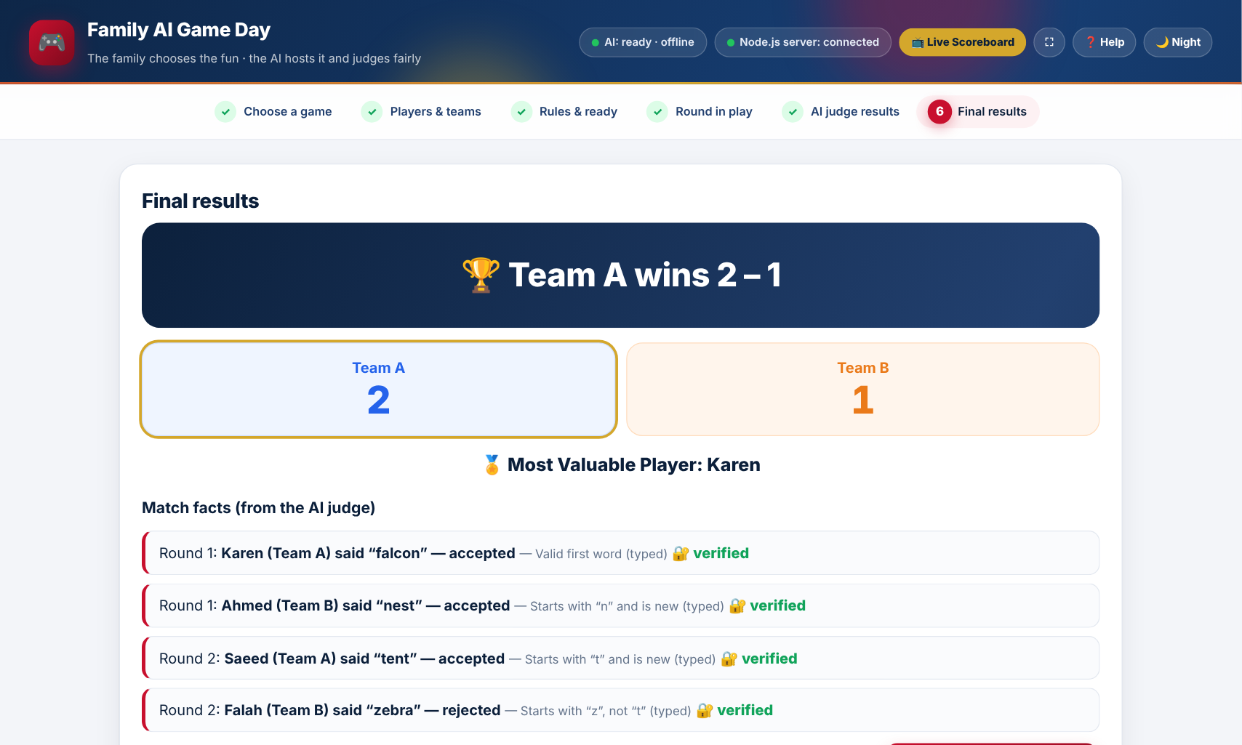
PROTOTYPE AND DEMO
SOLUTION
Real screenshots from the working app
ROUND IN PLAY
AI JUDGE RESULTS
FINAL RESULTS
LIVE DEMO: [ADD YOUR LINK OR QR CODE]
Runs on a laptop at localhost:3000, with a live scoreboard at localhost:3000/scoreboard.

Slide 20
TESTING AND IMPROVEMENTS
SOLUTION
What failed, and how we fixed it
WHAT FAILED
HOW WE FIXED IT
Camera blocked in some browsers
The app now tells you to open it in Chrome
Ball not found in a test video
The app now gives filming tips instead of a wrong score
Old version stuck in the browser
The server now always sends the newest version
Popups blocked on the hosted site
Confirmations moved into the page itself
AI needed internet
The AI models now run offline on the laptop

Slide 21
DATA AND RESULTS
RESULTS
What our tests measured
TEST RESULTS
AI person detection
95%
Features tested and working
7 of 9
Games built and judged by AI
3 of 3
Brief steps covered
6 of 6
Camera and mic tested
0 of 2
Camera and microphone still need a test in Chrome; the in-app test browser blocks them.

Slide 22
ANALYSIS
RESULTS
What the results mean
THE AI JUDGE IS RELIABLE
1
It found people with high confidence and judged photos and words correctly, every time we tested.
FAIR PLAY IS PROVABLE
2
Every point comes from a signed report, and a changed report is rejected before it counts.
REAL-WORLD FILMING MATTERS
3
Lighting, camera angle and ball size decide how well football is judged.

Slide 23
GOALS VS. OUTCOMES
RESULTS
Each goal and whether we met it
GOAL | OUTCOME | STATUS
3 working games | Football, Word Chain, Photo Hunt | Met
100% explained | A reason and evidence with every decision | Met
100% verified | Signature checked before points are added | Met
6 of 6 steps | All six steps in the app | Met
Real-world play | Video, photo and speech judging | Camera and mic in testing

Slide 24
FEEDBACK
RESULTS
What users, teachers and experts said
[Name], parent
“[Add a quote from a family member who played]”
[Name], teacher
“[Add a quote from a teacher or mentor]”
[Name], student
“[Add a quote from a student who tested the app]”

Slide 25
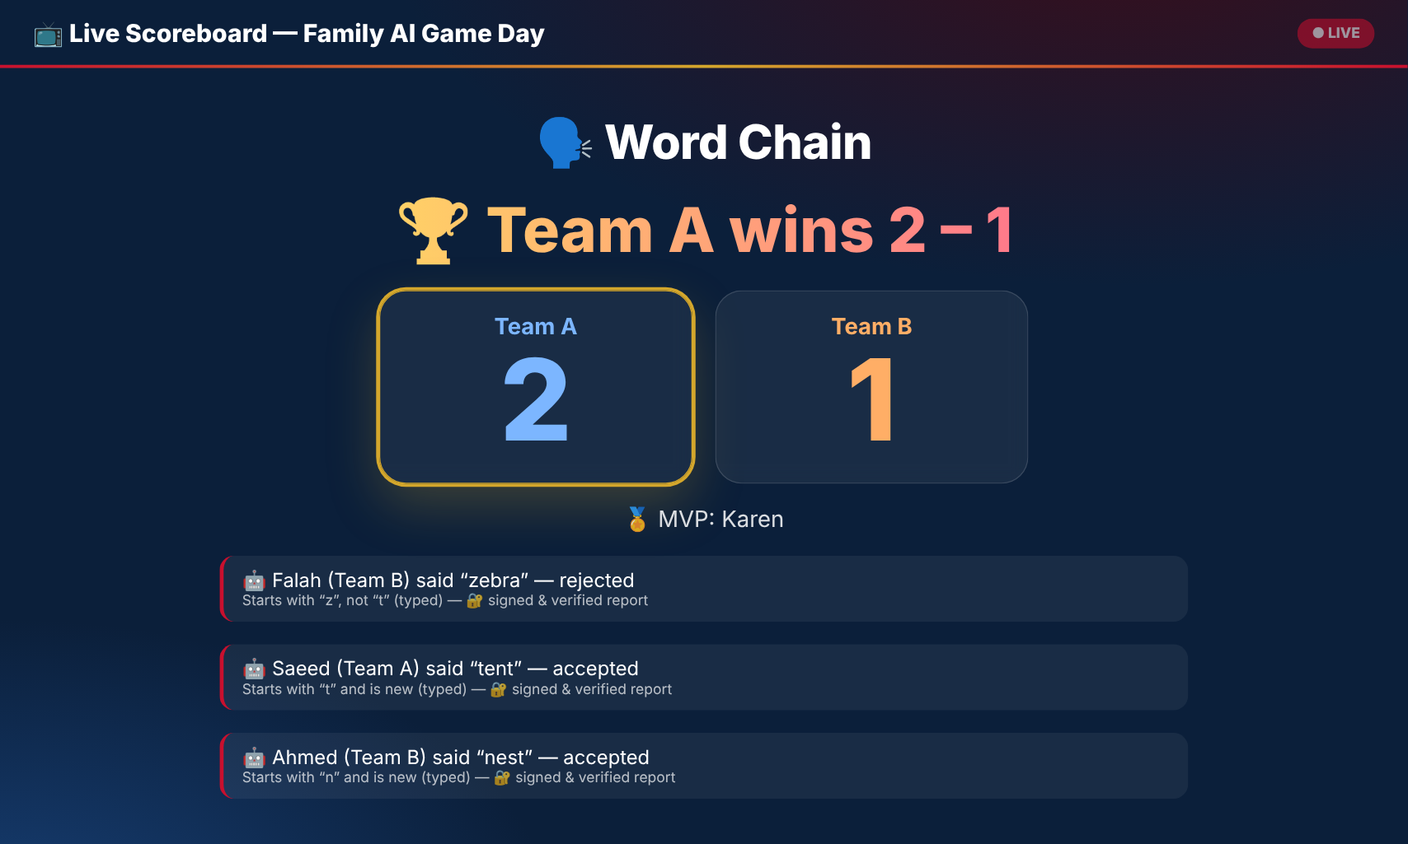
IMPACT
RESULTS
Benefits for families and communities
SOCIAL
EDUCATIONAL
ECONOMIC
Families play together and trust the result, with fewer arguments.
Teens see how AI sees, hears and makes decisions.
Free to use. One laptop, no extra hardware or subscriptions.
The live scoreboard lets the whole family follow the game on a TV or phone.

Slide 26
CHALLENGES AND LESSONS LEARNED
RESULTS
What we would do differently
CHALLENGE | LESSON / WHAT WE WOULD DO DIFFERENTLY
Little time on build day | Plan the features first, then build the most important ones
Browsers block the camera and mic | Test in Chrome early, on the real device
The ball is hard to detect | Film real matches early to test the AI
Too many games at first | Fewer games, done well, beat more games done badly

Slide 27
SUSTAINABILITY AND NEXT STEPS
RESULTS
How it lasts and how it could grow
HOW IT LASTS
NEXT STEPS
Runs offline on any laptop
Test camera and microphone in Chrome
1
No paid services or subscriptions
Add more UAE heritage games
2
Easy to add new games
Share the hosted version with schools
3

Slide 28
CONCLUSION
Three takeaways: the idea, the solution and the results
THE IDEA
THE SOLUTION
THE RESULTS
Family games need a fair judge that never takes sides.
AI that sees, hears, applies the rules and signs every report.
Three tested games with explained, verified and live results.
FAIR PLAY, EXPLAINED BY AI

Slide 29
REFERENCES AND ACKNOWLEDGMENTS
REFERENCES
THANKS TO
Google MediaPipe Tasks for Web (Object Detector, Pose Landmarker)
[Teacher / mentor name]
Web Speech API (MDN Web Docs)
[School name]
Node.js
Abu Dhabi University
Abu Dhabi University competition brief: Family AI Game Day
Our families, who tested the games
[Add any other sources]

Slide 30
THANK YOU
Questions and live demo
KAREN · AHMED · SAEED · FALAH
Contact: [team email]
Live demo: [add link or QR code]

