Slide 1
GIT
Presented by
Samarjit Adhikari (samarjit.adhikari@hp.com)
Tapan Karecha (tapan@hp.com)

Slide 2
GIT
[Agenda]
Introduction of GIT/History
How GIT is different from other VCS
GIT commands
How GIT works
GIT Configuration (Command Line)
GIT Configuration with GUI
GIT and GITHUB
GIT and SVN integration
An example with open source project setup.

Slide 3
GIT
IS …
Directory content management system
Tree history storage system
Stupid content tracker
A toolkit
[History]
In 2005, the relationship between the open community that developed the Linux kernel and the commercial company that developed BitKeeper broke down → Results git

Slide 4
GIT
[git and other VCS]
git is not subversion!
A distributed SCM/VCS
Snapshots, Not Differences
Nearly every operation is local
Git has integrity

Slide 5
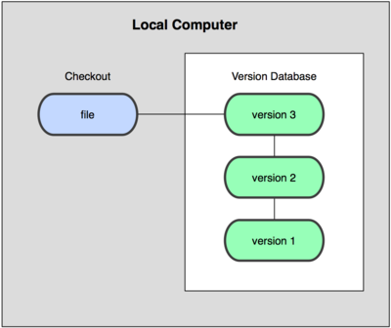
GIT
Local Version Control Systems

Slide 6
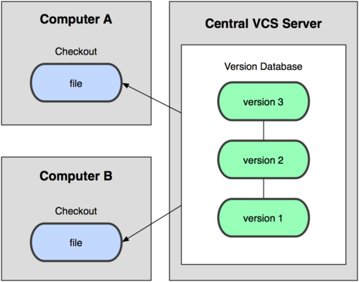
GIT
Centralized Version Control System

Slide 7
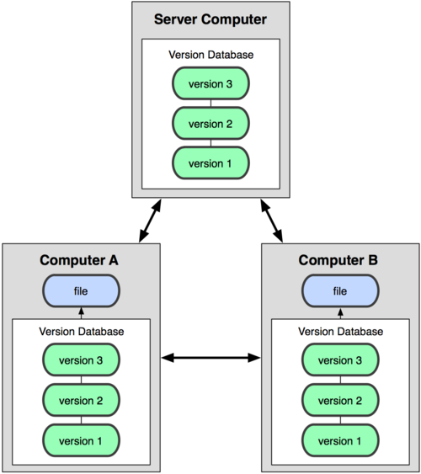
GIT
Distributed Version Control System

Slide 8
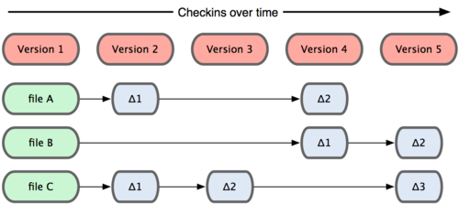
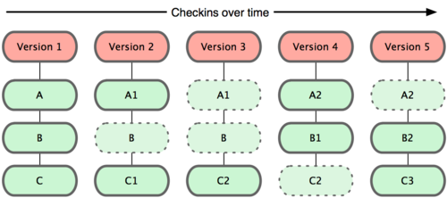
GIT

Slide 9
GIT
Nearly Every operation is local
Browse the history of the project
Work offline
Subversion provides local repositoy but History not being maintained.
Git has integrity
It doesn’t store filename rather stores file content.
Git uses for this checksumming, called a SHA-1 hash. This is a 40-character string composed of hexadecimal characters (0–9 and a–f) and calculated based on the contents of a file or directory structure in Git.
A SHA-1 hash looks something like this:
24b9da6552252987aa493b52f8696cd6d3b00373

Slide 10
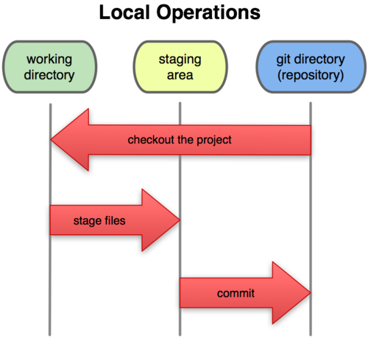
GIT

Slide 11
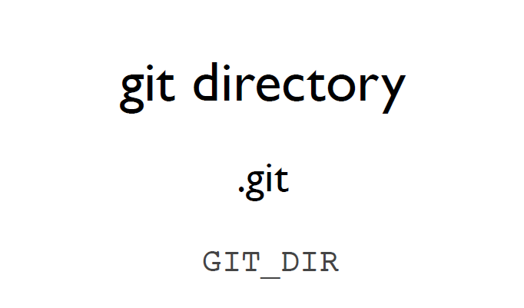
GIT

Slide 12
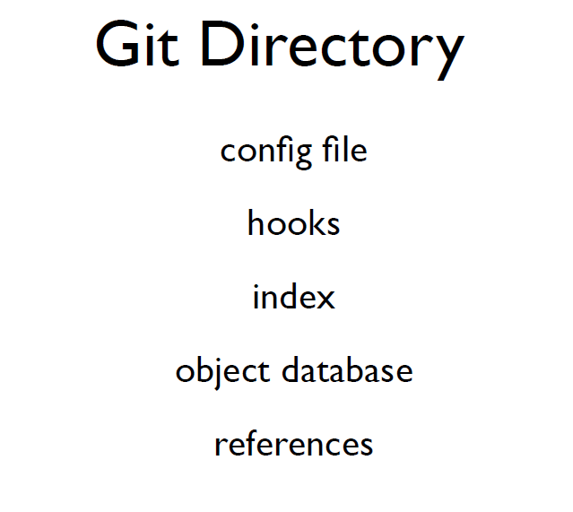
GIT

Slide 13
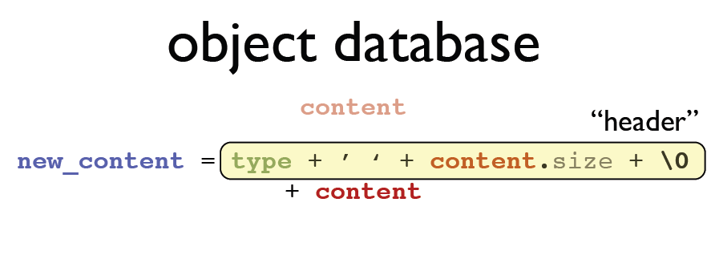
GIT

Slide 14
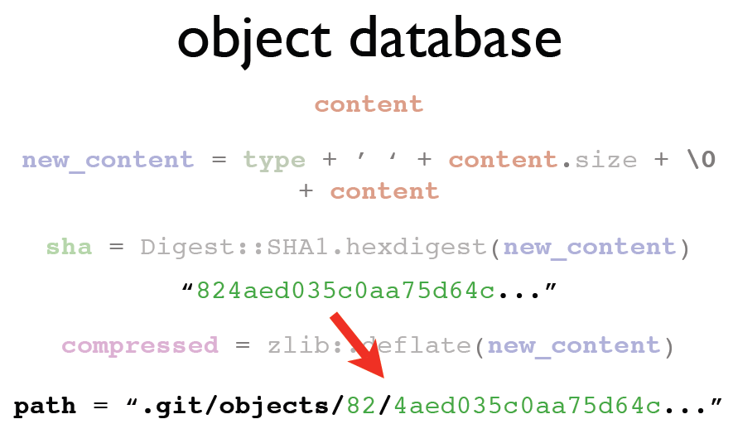
GIT

Slide 15
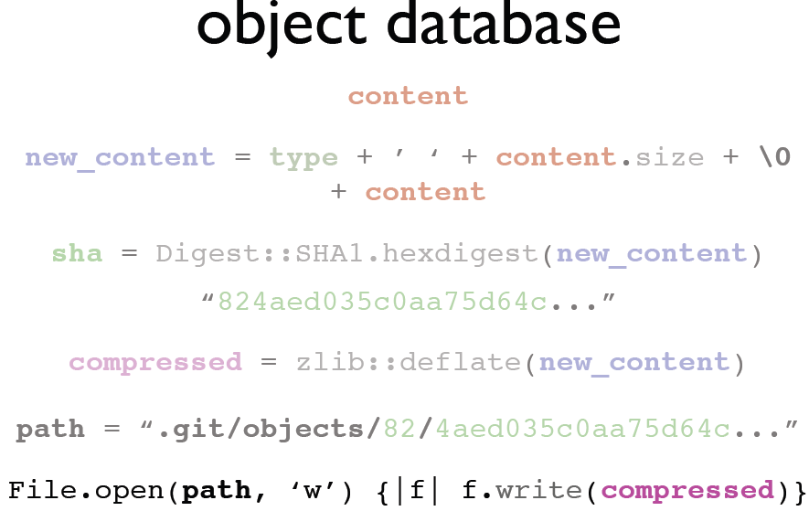
GIT

Slide 16
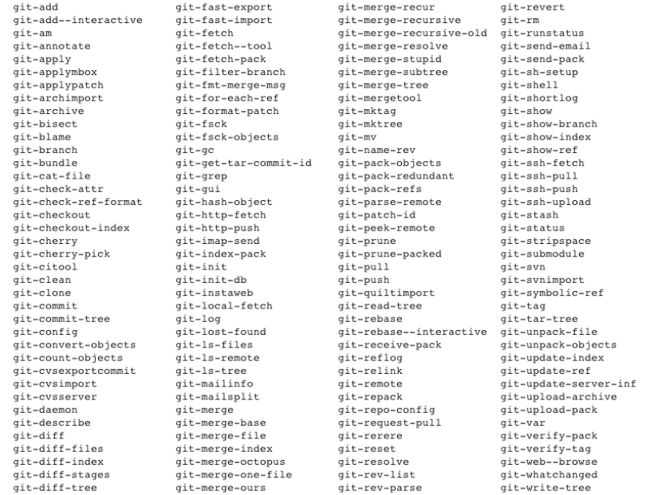
GIT

Slide 17
GIT
Git example…..
Q&A

