Slide 1
Sample Presentation
This is a test

Slide 2

This has a BIG title!
Sample 2020

Slide 3
A Busy One
Bear with me.
Author’s note: Basically, this is due tomorrow, so instead of making a slide for this I’m pasting a chunk of some source textbook/wiki article right here and if anyone asks I’ll say ‘well, it really is a complex topic so I felt it’s appropriate to go into it in some detail…’
“It was the best of times, it was the worst of times, it was the age of wisdom, it was the age of foolishness, it was the epoch of belief, it was the epoch of incredulity, it was the season of Light, it was the season of Darkness, it was the spring of hope, it was the winter of despair, we had everything before us, we had nothing before us, we were all going direct to
in short, the period was so far like the present period, that some of its noisiest authorities insisted on its being received, for good or for evil, in the superlative degree of comparison only.
There were a king with a large jaw and a queen with a plain face, on the throne of England; there were a king with a large jaw and a queen with a fair face, on the throne of France. In both countries it was clearer than crystal to the lords of the State preserves of loaves and fishes, that things in general were settled for ever.
It was the year of Our Lord one thousand seven hundred and seventy-five. Spiritual revelations were conceded to England at that favoured period, as at this. Mrs. Southcott had recently attained her five-and-twentieth blessed birthday, of whom a prophetic private in the Life Guards had heralded the sublime appearance by announcing that arrangements were made for the swallowing up of London and Westminster. Even the Cock-lane ghost had been laid only a round dozen of years, after rapping out its messages, as the spirits of this very year last past (supernaturally deficient in originality) rapped out theirs. Mere messages in the earthly order of events had lately come to the English Crown and People, from a congress of British subjects in America: which, strange to relate, have proved more important to the human race than any communications yet received through any of the chickens of the Cock-lane brood.”
A Tale of Two Cities by Charles Dickens - text from Project Gutenberg (gutenberg.org)

Slide 4
There are questions
…
There are words
And more words…
Enough words?

Slide 5

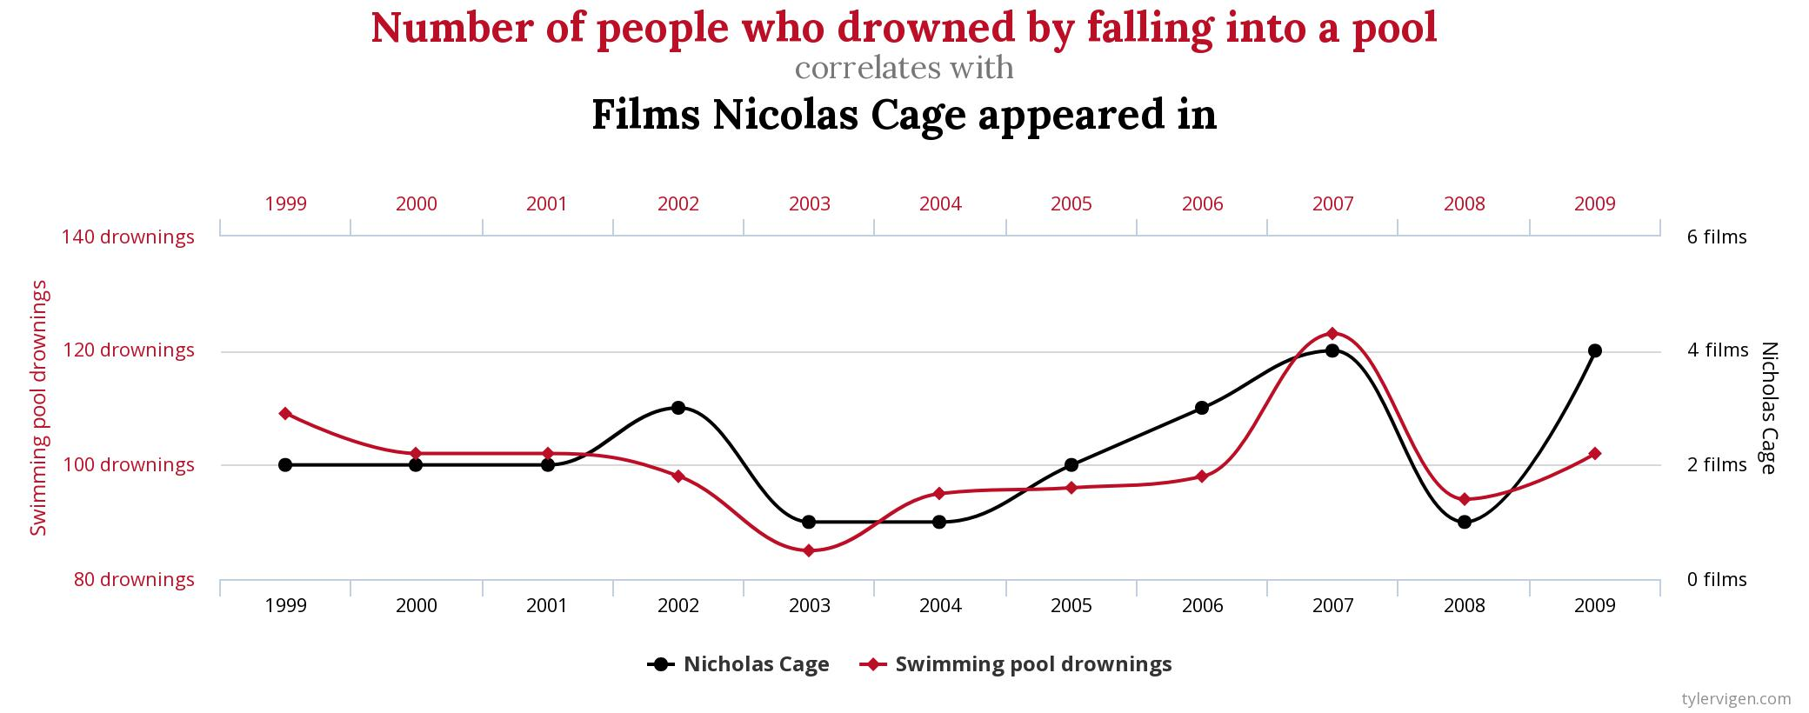
A common format
Plenty of info
Not so cluttered
Let’s add a chart

Slide 6
66.6%
Correlation

Slide 7
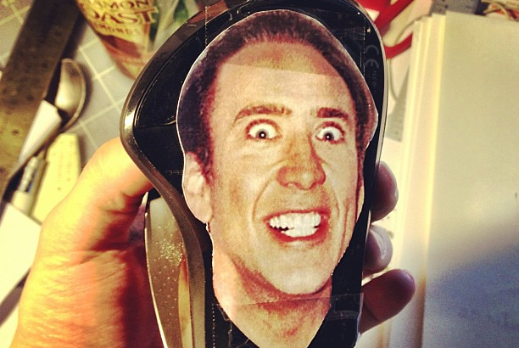
Josh Temper
(CC BY-ND 2.0)
https://www.flickr.com/photos/likespinningplates/8622520954

Slide 8
Oh no!
One of those slides.
Basically, right, I was commissioned to write this and the people who commissioned it either:
Are paying me by the word, or
Have set me a word/slide count I have to hit (probably based on however big the content is in some book), or
Have given this task to someone perhaps well-meaning, but who will never actually need to teach it.
So probably for one of the reasons above I am writing slides with WAAAY too much information.
I mean, have you seen this font size? Can the people at the back even read this?
I doubt it - but who care? They chose to sit at the back and slack so…
screw them!
Oops, I wrote that in a bigger font didn’t I? - doesn’t matter, they’re probably asleep already
Along with the people at the front!
So what were we talking about again?
Oh who cares? No one is reading this far in a real presentation.
And the author has clearly been incentivised to be as verbose, explicit and - one might even be tempted to say - loquacious as humanly possible.
Does this look familiar? Have you payed for courseware that has this many words on a slide…
And who uses full sentences in a presentation? Seriously?

Slide 9
Encryption
For keeping secrets
Ancient — since dawn of writing
Used everywhere today

Slide 10
Now you are just adding stuff for the sake of it.
This is:
True
Isn’t wrong
For creating data

